Slide 1

Enter in
SILENCE
Wait with
REVERENCE
Worship from
JOY

Slide 2
PRELUDE
WELCOME & ANNOUNCEMENTS
AFFIRMATION OF OUR MISSION STATEMENT
Our Mission Statement
As disciples of Jesus Christ,
led by the Holy Spirit,
we experience God’s unconditional love,
and we witness to others
by discovering and sharing our gifts.

Slide 3


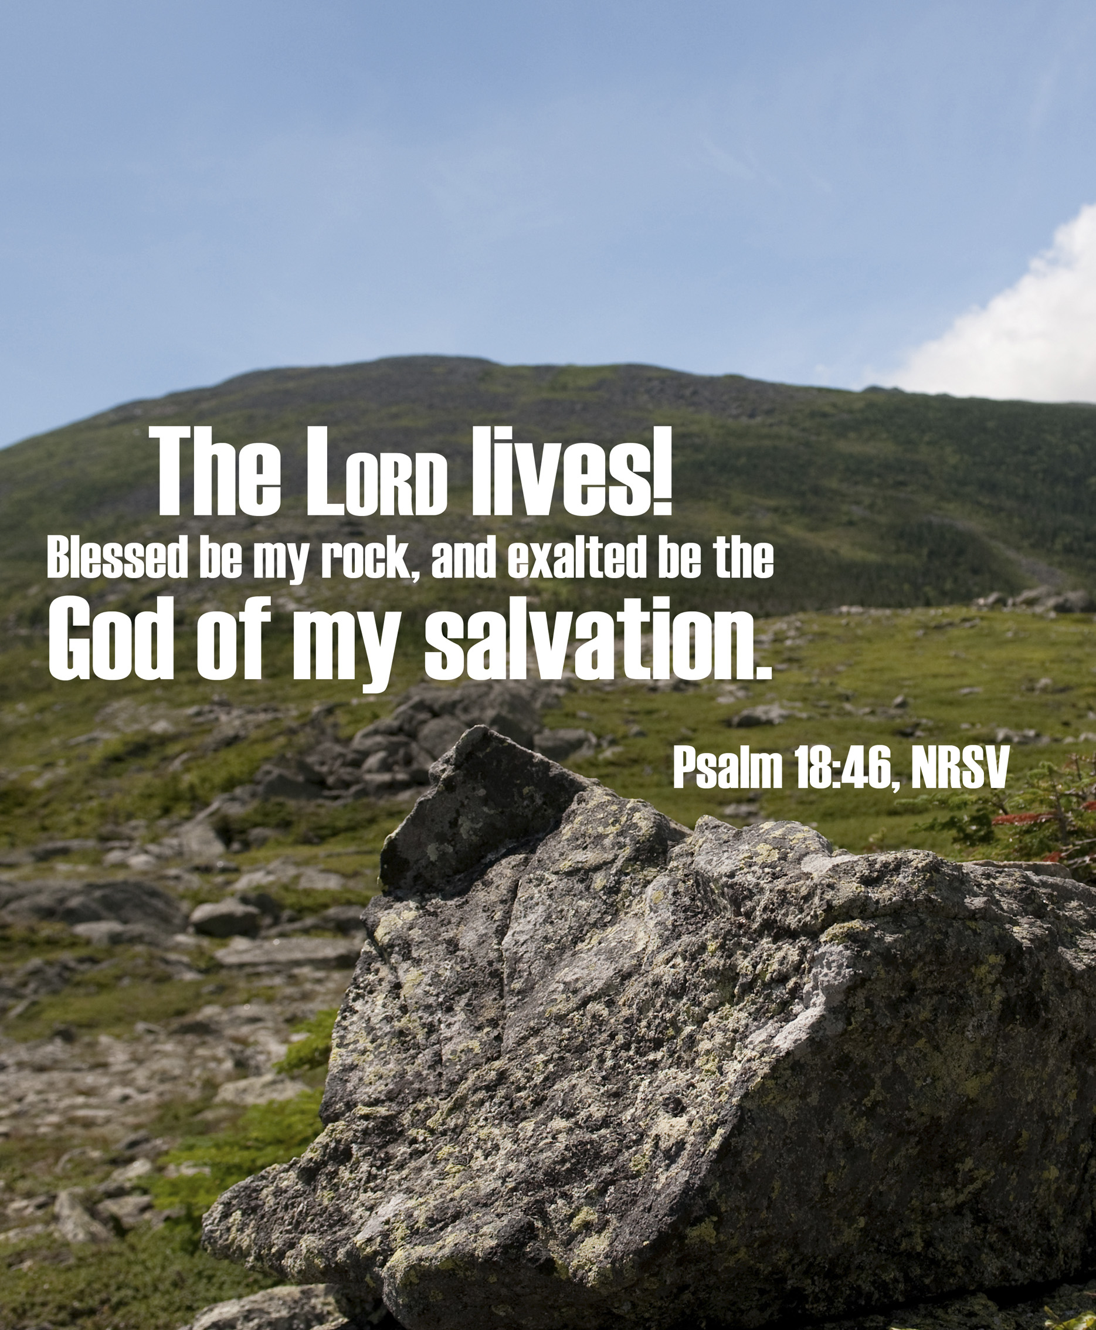
MOMENT FOR STEWARDSHIP:
Bill Olivier

Slide 4

CHORAL INTROIT

Slide 5
* CALL TO WORSHIP:
Lord, you have been our refuge from age to age.
  Before the mountains were born, and the earth and the world came to birth;
From eternity to eternity, thou art God. Teach us to
count up the days that are ours.
. . .

Slide 6
  And we shall come to the heart of wisdom.
Show your servants the deeds you do, let your children enjoy your splendor!
May the sweetness of the Lord be upon us to confirm the work we have done!
With joy in our hearts and praise on our lips, let us worship God.

Slide 7
* HYMN: No. 210 Our God, Our Help in Ages Past vv. 1–3, 5
Our God, our help in ages past,
Our hope for years to come,
Our shelter from the stormy blast,
And our eternal home:
. . .

Slide 8
2
Before the hills in order stood,
Or earth received its frame,
From everlasting Thou art God,
To endless years the same.
. . .

Slide 9
3
A thousand ages in Thy sight
Are like an evening gone;
Short as the watch that ends the night
Before the rising sun.
. . .

Slide 10
5
Our God, our help in ages past,
Our hope for years to come,
Be Thou our guard while life shall last,
And our eternal home.

Slide 11
PRAYER OF CONFESSION: (in silence then in unison)
Holy and merciful God, whose Son Jesus is the light and Savior of the world, we thank you for Jesus’ abiding presence that has led us one hundred and eighty-six years.
. . .

Slide 12
We confess we have not always lived alive to Christ nor loved you or our neighbor with the breadth and depth that we could and should.
Forgive us of our sins, especially when we wander off. . . .

Slide 13
Inspire us to live faithful, impactful, and joyful lives on our journey of faith that we may glorify you in all things; in Jesus’ name. Amen.

Slide 14
ASSURANCE OF CHRIST’S FORGIVENESS:
Forgiveness refreshes us and opens us to life with a new and different future. Our brokenness is mended, our friendships become tended; and grace and hospitality are demonstrated. All in the name of Jesus Christ.
In Jesus Christ, we are forgiven! Let us forgive one another.

Slide 15
* CELEBRATING CHRIST’S FORGIVENESS: Give Thanks (No. 647 GTG)
Give thanks with a grateful heart,
give thanks to the Holy One;
Give thanks, because we’re given
Jesus Christ the Son.
And now let the weak say,
“we are strong”; let the poor say,
“We are rich, because of what the
Lord has done for us!”
Give thanks.

Slide 16

* EXCHANGE OF CHRIST’S PEACE:
L: The peace of Christ be with you.
P: And also with you.
Welcome one another
with the peace of Christ.
~ Children may go downstairs for Sunday School ~

Slide 17

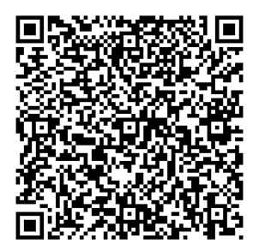
GIVING OF OUR GIFTS & OFFERTORY:
Our God has blessed us, so let us extend
God’s Blessing as we present our Tithes and Offerings.
Thank you for being faithful stewards of your
church family with your prayers, your time,
talent, and your financial resources.
Contributions may also be made:
Electronically on the church website
at fpcb-nj.org;
By reoccurring electronic withdrawal; or
By mailing your offering to the church:
P.O. Box 385, Blairstown, NJ.

Slide 18
* DOXOLOGY: No. 592 Praise God
Praise God, from whom
all blessings flow;
Praise Him, all creatures here below;
Praise Him above, ye heavenly host;
Praise Father, Son, and Holy Ghost. Amen.
* PRAYER OF DEDICATION

Slide 19
PRAYER OF ILLUMINATION: (In unison)
Gracious God, as we turn to your Word, may your Holy Spirit rest upon us. Help us to listen attentively and live faithfully to the good news of Jesus’ gospel, that in our hearing, believing, and behaving, the world may see and know we are Christians by Christ’s love. Amen.

Slide 20

DECLARING
GOD‘S WORD

Slide 21
HEBREW BIBLE LESSON: Leviticus 19: 1–2, 15–19a, 32–34
A few important commandments of Moses.
19 The Lord spoke to Moses, saying:
² “Speak to all the congregation of the Israelites and say to them: You shall be holy, for I the Lord your God am holy.
¹⁵ “You shall not render an unjust judgment; you shall not be partial to the poor or defer to the great: with justice you shall judge your neighbor. . . .

Slide 22
¹⁶ You shall not go around as a slanderer among your people, and you shall not stand idly by when the blood of your neighbor is at stake: I am the Lord.
¹⁷ “You shall not hate in your heart anyone of your kin; you shall reprove your neighbor, or you will incur guilt yourself. . . .

Slide 23
¹⁸ You shall not take vengeance or bear a grudge against any of your people, but you shall love your neighbor as yourself: I am the Lord.
¹⁹ “You shall keep my statutes.
³² “You shall rise before the aged and defer to the old, and you shall fear your God: I am the Lord.
. . .

Slide 24
³³ “When an alien resides with you in your land, you shall not oppress the alien. ³⁴ The alien who resides with you shall be to you as the native-born among you; you shall love the alien as yourself, for you were aliens in the land of Egypt: I am the Lord your God.

Slide 25
GOSPEL READING: Matthew 22: 34–46
Jesus delivers the Greatest Commandment.
³⁴ When the Pharisees heard that he had silenced the Sadducees, they gathered together, ³⁵ and one of them, an expert in the law, asked him a question to test him. ³⁶ “Teacher, which commandment in the law is the greatest?” ³⁷ He said to him, “ ‘You shall love the Lord your God with all your heart and with all your soul and with all your mind.’ . . .

Slide 26
³⁸ This is the greatest and first commandment. ³⁹ And a second is like it: ‘You shall love your neighbor as yourself.’ ⁴⁰ On these two commandments hang all the Law and the Prophets.”
⁴¹ Now while the Pharisees were gathered together, Jesus asked them this question: ⁴² “What do you think of the Messiah? Whose son is he?” . . .

Slide 27
They said to him, “The son of David.” ⁴³ He said to them, “How is it then that David by the Spirit calls him Lord, saying,
⁴⁴ ‘The Lord said to my Lord, “Sit at my right hand, until I put your enemies under your feet” ’?
⁴⁵ “If David thus calls him Lord, how can he be his son?” ⁴⁶ No one was able to give him an answer, nor from that day did anyone dare to ask him any more questions.

Slide 28
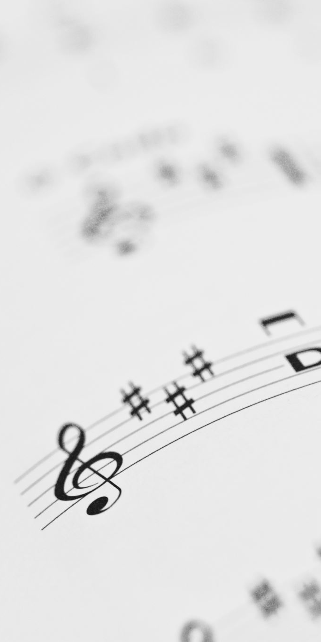
CHANCEL CHOIR ANTHEM:
“Come, Bless the Lord”
by Robert Lau

Slide 29

Pastor David’s Sermon:
Living the Questions

Slide 30
RESPONDING TO GOD’S WORD

Slide 31
* AFFIRMATION OF FAITH: (A Brief Statement of Faith, 1990)
We trust in God the Holy Spirit, everywhere the giver and renewer of life. The Spirit justifies us by grace through faith, sets us free to accept ourselves and to love God and neighbor, and binds us together with all believers in one body of Christ, the Church. . . .

Slide 32
The same Spirit who inspired the prophets and apostles rules our faith and life in Christ through Scripture, engages us through the Word proclaimed, claims us in the waters of baptism, feeds us with the bread of life and the cup of salvation, . . .

Slide 33
and calls women and men to all ministries of the Church.
In gratitude to God, empowered by the Spirit, we strive to serve Christ in our daily tasks and to live holy and joyful lives, even as we watch for God’s new heaven and new earth praying, “Come, Lord Jesus!” Amen.

Slide 34
* HYMN: A Lawyer Came Near Tune 554, vv. 1 & 3
© 2023 by Carolyn Winfrey Gillette
A lawyer came near,
asking Jesus a question;
he did it to test him,
to find Jesus' flaws:
O Teacher, we've listened
and heard what you're saying.
Now which is the greatest
of all of God's laws? . . .

Slide 35
With six hundred thirteen commandments to choose from,
now tell us your views!
Tell us: What do you say? —
The lawyer was searching
for ways to accuse him
by tripping up Jesus,
that long-ago day.
. . .

Slide 36
3
Lord Jesus, you teach us to
love God and neighbor,
for love adds the flavor
to all that we do.
At home or away,
in our leisure or labor,
there's nothing that's greater
than love — it is true! . . .

Slide 37
And Lord, in this world
that is filled with great suffering —
may we know that love
is not just some ideal;
Your practical teaching
is really far-reaching;
God's love is a gift
that will help the world heal.

Slide 38
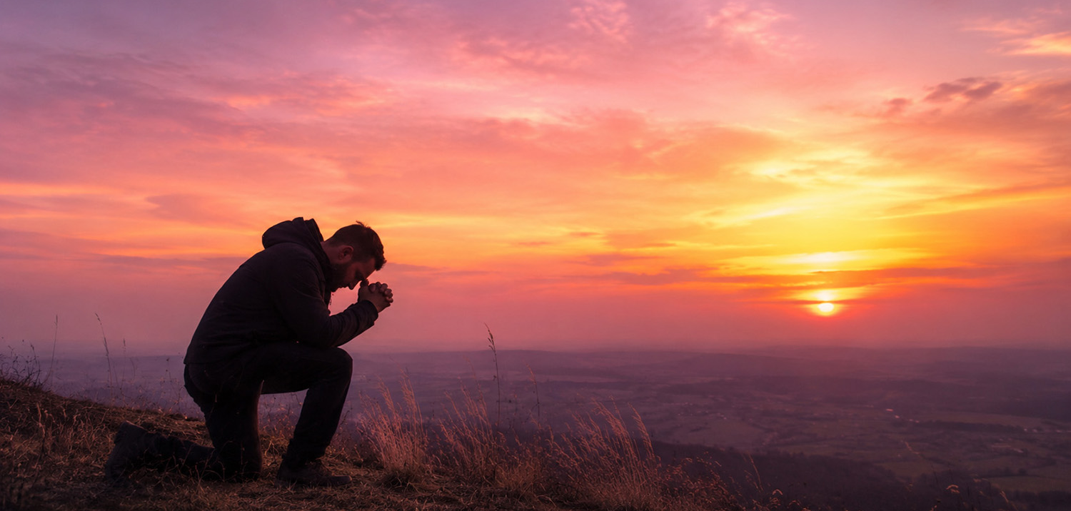
Joys & Concerns
to lift up in prayer

Slide 39
Our Father who art in heaven,
Hallowed be thy name.
Thy kingdom come, thy will be done;
On earth as it is in heaven.
Give us this day our daily bread;
And forgive us our debts,
As we forgive our debtors;
And lead us not into temptation,
But deliver us from evil,
For Thine is the kingdom
And the power and the glory, forever. Amen.

Slide 40
DEPARTING IN GOD’S NAME

Slide 41
* HYMN: We Are One in the Spirit (No. 300, GTG)
(They’ll Know We Are Christians by Our Love)
We are one in the Spirit,
we are one in the Lord,
we are one in the Spirit,
we are one in the Lord,
and we pray that
all unity may one day be restored:
. . .

Slide 42
And they’ll know we are Christians by our love,
by our love;
Yes, they’ll know
we are Christians by our love.
. . .

Slide 43
2
We will walk with each other;
we will walk hand in hand;
We will walk with each other;
we will walk hand in hand,
and together we’ll spread the news
that God is in our land:

Slide 44
And they’ll know we are
Christians by our love,
by our love;
Yes, they’ll know
we are Christians by our love.
. . .

Slide 45
3
We will work with each other,
we will work side by side,
we will work with each other,
we will work side by side,
and we‘ll guard human dignity
and save human pride:

Slide 46
And they’ll know we are
Christians by our love,
by our love;
Yes, they’ll know
we are Christians by our love.
. . .

Slide 47
4
All praise to the Father
whom all things come
and all praise to Christ Jesus,
God’s only Son,
and all praise to the Spirit,
who makes us one:
. . .

Slide 48
And they’ll know we are
Christians by our love,
by our love;
Yes, they’ll know
we are Christians by our love.
. . .

Slide 49


* CHARGE TO THE PEOPLE & BENEDICTION
* CHORAL BENEDICTION
POSTLUDE
Our worship has ended—our Christian Witness begins!

