Slide 1

Enter in
SILENCE
Wait with
REVERENCE
Worship from
JOY

Slide 2
PRELUDE
WELCOME & ANNOUNCEMENTS
AFFIRMATION OF MISSION STATEMENT
Our Mission Statement
As disciples of Jesus Christ,
led by the Holy Spirit,
we experience God’s unconditional love,
and we witness to others
by discovering and sharing our gifts.

Slide 3

MOMENT FOR STEWARDSHIP
with Elder Gail Weber
CHORAL INTROIT

Slide 4


Slide 5

CHORAL INTROIT

Slide 6
* CALL TO WORSHIP:
Great and good God, give us pure hearts that we may see you;
Give us humble hearts that we may hear you;
Give us hearts of love that we may serve you;
Give us hearts of faith that we may live in you; . . .

Slide 7
Give us reverent hearts that we may worship you;
Give us joyful hearts that we may take refuge and trust in you.
With joy in our hearts and praise on our lips,
let us worship God

Slide 8
* HYMN: No. 144 Alleluia! Sing to Jesus! vv. 1 & 4
Alleluia! Sing to Jesus!
His the scepter, His the throne.
Alleluia! His the triumph,
His the victory alone!
. . .

Slide 9
Hark! the songs of peaceful Zion
Thunder like a mighty flood;
Jesus out of every nation
Hath redeemed us by His blood.
. . .

Slide 10
4
Alleluia! King eternal,
Thee the Lord of lords we own;
Alleluia! born of Mary,
Earth Thy footstool,
heaven Thy throne.
. . .

Slide 11
Thou within the veil hast entered,
Robed in flesh our great High Priest;
Thou on earth both priest and victim
In the Eucharistic feast.

Slide 12
PRAYER OF CONFESSION: (in silence then in unison)
Merciful God, you pardon all who truly repent and turn to you. We humbly confess our sins and seek your mercy. We have not loved you with a pure heart, nor have we loved our neighbor as ourselves. We have not done justice, loved kindness, or walked humbly with you, our God. . . .

Slide 13
Have mercy on us, O God, in your loving-kindness. In your great compassion, cleanse us from our sins. Create in us a clean heart and renew a right spirit within us. Do not cast us from your presence or take your Holy Spirit from us. . . .

Slide 14
Restore to us the joy of your salvation and sustain us with a bountiful Spirit. This we ask in the strong name of Jesus, our Lord. Amen.

Slide 15
ASSURANCE OF CHRIST’S FORGIVENESS:
Who is in a position to condemn? Only Christ, and Christ died for us, was buried for us, and was raised from the dead for us. In our hour of need, Christ prays for us and forgives us of our sins.
In Jesus Christ, we are forgiven. Let us forgive one another.

Slide 16
* CELEBRATING CHRIST’S FORGIVENESS: No. 466 v. 1
O For a Thousand Tongues to Sing
O for a thousand tongues to sing
My dear Redeemer’s praise,
The glories of my God and King,
The triumphs of God's grace!

Slide 17

* EXCHANGE OF CHRIST’S PEACE:
Pastor: The peace of Christ be with you.
People: And also with you.
Welcome one another
with the peace of Christ.
~ Children may go downstairs for Sunday School ~

Slide 18

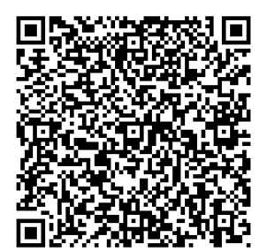
GIVING OF OUR GIFTS & OFFERTORY:
Our God has blessed us, so let us extend God’s Blessing as we present our Tithes and Offerings.
Thank you for being faithful stewards of your church family with your prayers, your time, talent, and your financial resources.
Contributions may also be made:
Electronically on the church website at fpcb-nj.org;
By reoccurring electronic withdrawal; or
By mailing your offering to the church:
P.O. Box 385, Blairstown, NJ.

Slide 19
* DOXOLOGY: No. 592 Praise God
Praise God, from whom
all blessings flow;
Praise Him, all creatures here below;
Praise Him above, ye heavenly host;
Praise Father, Son, and Holy Ghost. Amen.
* PRAYER OF DEDICATION

Slide 20
PRAYER OF ILLUMINATION: (In unison)
God, Source of life, the One in whom we live, move and have our very being, by your Holy Spirit, open our minds that as the Scriptures are read and your Word is proclaimed, we may be led into your truth, equipped to do your work, . . .

Slide 21
and empowered to live your will, for the glory and the gospel of your Son, Jesus the Christ. Amen.

Slide 22
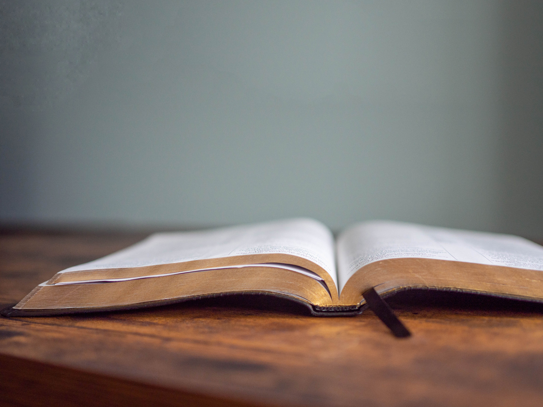
DECLARING GOD‘S WORD

Slide 23
EPISTLE LESSON: Philippians 1: 1–14, 21–30
Paul commends the faith of the Philippians.
1 Paul and Timothy, servants of Christ Jesus,
To all the saints in Christ Jesus who are in Philippi, with the bishops and deacons:
² Grace to you and peace from God our Father and the Lord Jesus Christ.
³ I thank my God for every remembrance of you, ⁴ always in every one of my prayers for all of you, praying with joy ⁵ for your partnership . . .

Slide 24
in the gospel from the first day until now. ⁶ I am confident of this, that the one who began a good work in you will continue to complete it until the day of Jesus Christ. ⁷ It is right for me to think this way about all of you, because I hold you in my heart, for all of you are my partners in God’s grace, both in my imprisonment and in the defense and confirmation of the gospel. ⁸ For God is my witness, how I long for all of you with the tender affection of Christ Jesus. . . .

Slide 25
⁹ And this is my prayer, that your love may overflow more and more with knowledge and full insight ¹⁰ to help you to determine what really matters, so that in the day of Christ you may be pure and blameless, ¹¹ having produced the harvest of righteousness that comes through Jesus Christ for the glory and praise of God. ¹² I want you to know, brothers and sisters, . . .

Slide 26
that what has happened to me has actually resulted in the progress of the gospel, ¹³ so that it has become known throughout the whole imperial guard and to everyone else that my imprisonment is for Christ, ¹⁴ and most of the brothers and sisters, having been made confident in the Lord by my imprisonment, dare to speak the word with greater boldness and without fear. . . .

Slide 27
Philippians 1:21-30
²¹ For to me, living is Christ and dying is gain. ²² If I am to live in the flesh, that means fruitful labor for me, yet I cannot say which I will choose. ²³ I am hard pressed between the two: my desire is to depart and be with Christ, for that is far better, ²⁴ but to remain in the flesh is more necessary for you. ²⁵ Since I am convinced of this, . . .

Slide 28
I know that I will remain and continue with all of you for your progress and joy in faith, ²⁶ so that, by my presence again with you, your boast might abound in Christ Jesus because of me.
²⁷ Only, live your life in a manner worthy of the gospel of Christ, so that, whether I come and see you or am absent and hear about you, I will know that you are standing firm in one spirit, . . .

Slide 29
striving side by side with one mind for the faith of the gospel ²⁸ and in no way frightened by those opposing you. For them, this is evidence of their destruction but of your salvation. And this is God’s doing. ²⁹ For he has graciously granted you the privilege not only of believing in Christ but of suffering for him as well, ³⁰ since you are having the same struggle that you saw I had and now hear that I still have.

Slide 30
GOSPEL LESSON: Matthew 20: 1–16
Jesus demonstrates the nature of God’s justice.
20 “For the kingdom of heaven is like a landowner who went out early in the morning to hire laborers for his vineyard. ² After agreeing with the laborers for a denarius for the day, he sent them into his vineyard. ³ When he went out about nine o’clock, he saw others standing idle in the marketplace, ⁴ and he said to them, ‘You also go into the vineyard, . . .

Slide 31
and I will pay you whatever is right.’ So they went. ⁵ When he went out again about noon and about three o’clock, he did the same. ⁶ And about five o’clock he went out and found others standing around, and he said to them, ‘Why are you standing here idle all day?’ ⁷ They said to him, ‘Because no one has hired us.’ He said to them, ‘You also go into the vineyard.’ ⁸ When evening came, . . .

Slide 32
the owner of the vineyard said to his manager, ‘Call the laborers and give them their pay, beginning with the last and then going to the first.’ ⁹ When those hired about five o’clock came, each of them received a denarius. ¹⁰ Now when the first came, they thought they would receive more; but each of them also received a denarius. ¹¹ And when they received it, they grumbled against the landowner, . . .

Slide 33
¹² saying, ‘These last worked only one hour, and you have made them equal to us who have borne the burden of the day and the scorching heat.’ ¹³ But he replied to one of them, ‘Friend, I am doing you no wrong; did you not agree with me for a denarius? ¹⁴ Take what belongs to you and go; I choose to give to this last the same as I give to you. . . .

Slide 34
¹⁵ Am I not allowed to do what I choose with what belongs to me? Or are you envious because I am generous?’ ¹⁶ So the last will be first, and the first will be last.”

Slide 35
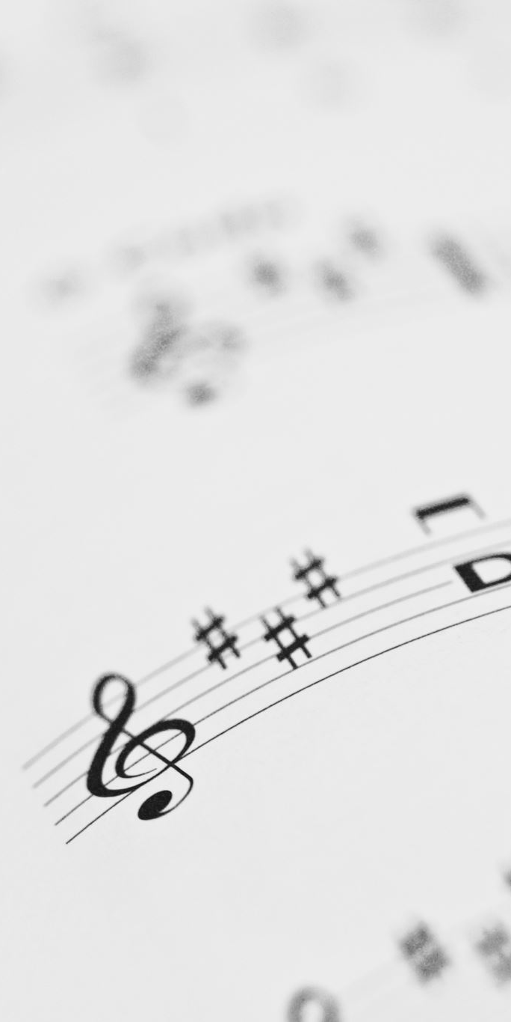
CHANCEL CHOIR ANTHEM:
“A Jubilant Song”
by Mary Lynn Lightfood

Slide 36

PASTOR DAVID’S SERMON SERIES:
Faith of the Philippians
I. Servant-Bees
for Jesus

Slide 37
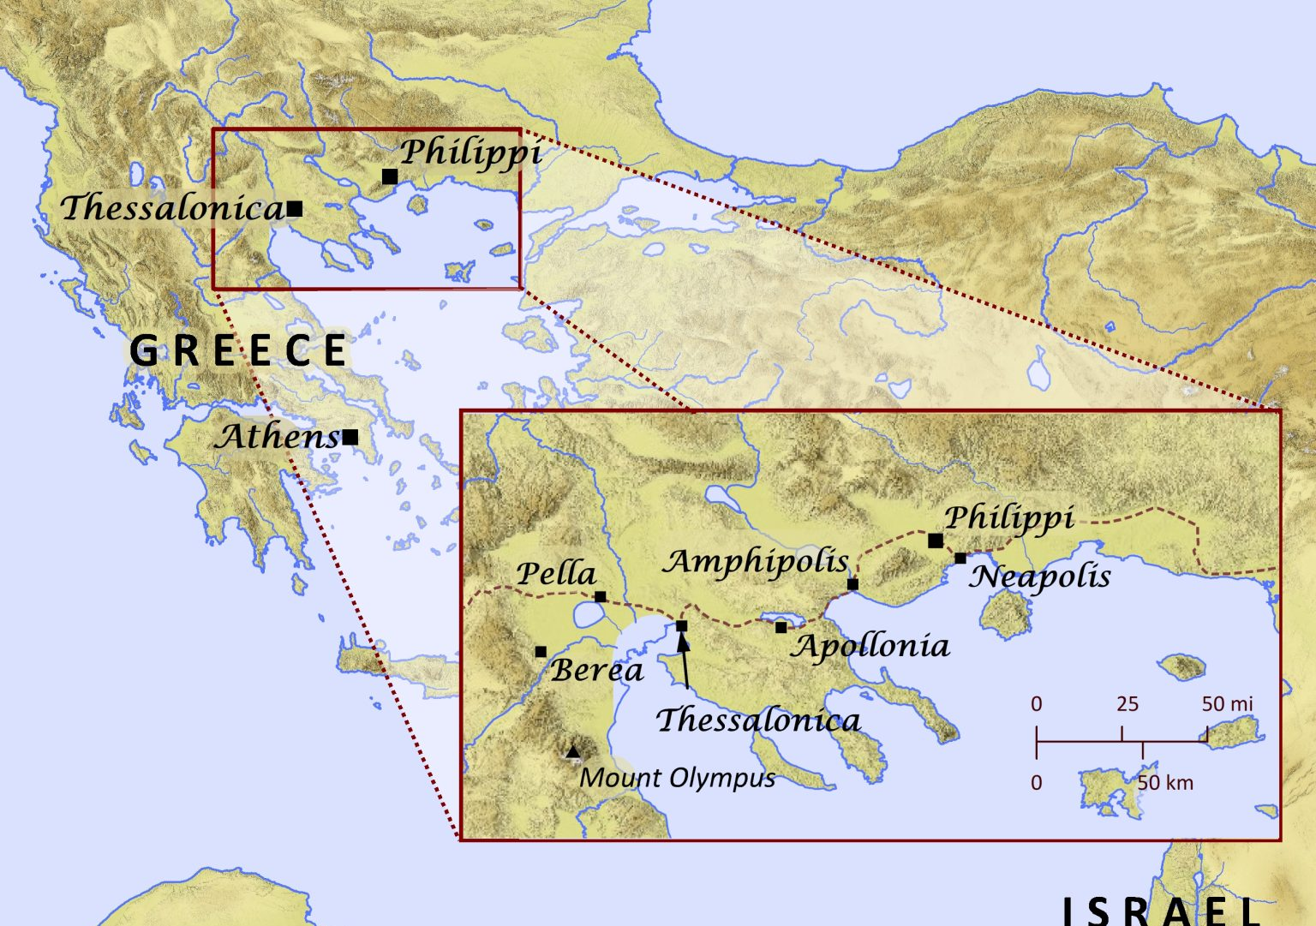

Slide 38
RESPONDING TO GOD’S WORD

Slide 39
* AFFIRMATION OF FAITH: (Romans 8: 1, 28, 38-39)
We affirm there is no condemnation for those who are in Christ Jesus; for we know that all things work together for good for those who love God, who are called according to God’s purpose. . . .

Slide 40
We are convinced that neither death, nor life, nor angels, nor rulers, nor things present, nor things to come, nor powers, nor height, nor depth, nor anything else in all creation will be able to separate us from the love of God in Christ Jesus our Lord.

Slide 41
* HYMN: No. 392 tune 375, vv. 1, 2, 4
Take Thou Our Minds, Dear Lord
Take Thou our minds, dear Lord,
we humbly pray;
Give us the mind of Christ
each passing day;
Teach us to know the truth
that sets us free;
Grant us in all our thoughts to honor Thee.
. . .

Slide 42
2
Take Thou our hearts,
O Christ, they are Thine own;
Come Thou within our souls
and claim Thy throne;
Help us to shed abroad
Thy deathless love;
Use us to make the earth
like heaven above.
. . .

Slide 43
4
Take Thou ourselves, O Lord,
heart, mind, and will;
Through our surrendered souls
Thy plans fulfill.
We yield ourselves to Thee—
time, talents, all;
We hear, and henceforth heed,
Thy sovereign call.

Slide 44
PRAYER OF THANKSGIVING, OF THE PEOPLE,
& THE LORD’S PRAYER
Our Father who art in heaven,
Hallowed be thy name.
Thy kingdom come, thy will be done;
On earth as it is in heaven.
Give us this day our daily bread;
And forgive us our debts,
As we forgive our debtors;
And lead us not into temptation,
But deliver us from evil,
For Thine is the kingdom
And the power and the glory, forever. Amen.

Slide 45
DEPARTING IN GOD’S NAME

Slide 46
* HYMN: No. 403 What A Friend We Have in Jesus
What a friend we have in Jesus,
All our sins and griefs to bear!
What a privilege to carry
Everything to God in prayer!
O what peace we often forfeit,
O what needless pain we bear,
All because we do not carry
Everything to God in prayer!
. . .

Slide 47
2
Have we trials and temptations?
Is there trouble anywhere?
We should never be discouraged:
Take it to the Lord in prayer!
Can we find a friend so faithful,
Who will all our sorrows share?
Jesus knows our every weakness;
Take it to the Lord in prayer. . . .

Slide 48
3
Are we weak and heavy-laden,
cumbered with a load of care?
Precious Savior, still our refuge—
take it to the Lord in prayer!
Do thy friends despise, forsake thee?
Take it to the Lord in prayer!
In His arms He’ll take and shield thee,
thou wilt find a solace there.

Slide 49

* CHARGE TO THE PEOPLE & BENEDICTION
* CHORAL BENEDICTION
POSTLUDE
Our worship has ended—our Christian Witness begins!

