Slide 1

Enter in
SILENCE
Wait with
REVERENCE
Worship from
JOY

Slide 2
PRELUDE
WELCOME & ANNOUNCEMENTS
AFFIRMATION OF MISSION STATEMENT
Our Mission Statement
As disciples of Jesus Christ,
led by the Holy Spirit,
we experience God’s unconditional love,
and we witness to others
by discovering and sharing our gifts.

Slide 3
* SONG OF PRAISE: No. 333 Seek Ye First
Seek ye first the kingdom of God
and His righteousness,
And all these things
shall be added unto you.
Al-le-lu, al-le-lu-ia!
. . .

Slide 4
2
Ask and it shall be given unto you,
Seek and ye shall find,
Knock and the door
Shall be opened unto you
Al-le-lu, al-le-lu-ia!

Slide 5
* CALL TO WORSHIP:
Almighty God, may your blessings permeate this space and place.
Let the faithful be renewed in our salvation and the careless awakened.
Let the doubting find faith, and the anxious be encouraged.
Let the weary find rest, and the weak be renewed. . . .

Slide 6
Let the aged find invigoration and the young experience invigoration.
With grateful hearts and with lips of praise, let us worship God.

Slide 7
* HYMN OF PRAISE: No. 255 Now Praise the Lord vv. 1–4
Now praise the Lord, all living saints,
Sing praises that endure.
Our children God does surely bless,
Our future is secure.
. . .

Slide 8
2
God brings us peace in midst of strife,
Our borders to protect.
All those who trust the Lord for strength
Need never fear neglect.
. . .

Slide 9
3
God’s Word runs swiftly o’er the earth,
The seasons to command.
Spring, summer, winter, autumn, all
Display that wondrous hand.
. . .

Slide 10
4
Your life-filled Word brings order to
The chaos of our days.
In love You claim us as Your own;
What better cause for praise?

Slide 11
PRAYER OF CONFESSION: (in silence then in unison)
Forgiving and merciful God, you who are steadfast in love, are more ready to forgive than we want to be forgiven. We also confess the grudges and resentments that we carry which diminishes our humanity.
Forgive us, Lord Jesus, of our attitudes and actions . . .

Slide 12
which separate us from your love and prevent us from loving one another. Mold us by your mercy. Grant us a hospitable and an honorable spirit that we may live daily as a people who forgive one another as you have first loved and forgiven us. In your name, we pray. Amen.

Slide 13
ASSURANCE OF CHRIST’S FORGIVENESS:
As God’s own children, be merciful in action, kind in heart, humble in mind. Be ready to forgive as freely as God has forgiven you. And above everything else, be loving and grateful, for what Christ has done for us, in us, and among us.
In Jesus Christ, we are forgiven! Let us forgive one another.

Slide 14
* CELEBRATING CHRIST’S FORGIVENESS: No. 304 Jesus Loves Me v. 1
Jesus loves me! This I know,
For the Bible tells me so;
Little ones to Him belong;
They are weak, but He is strong.
Yes, Jesus loves me!
Yes, Jesus loves me!
Yes, Jesus loves me!
The Bible tells me so.

Slide 15

* EXCHANGE OF CHRIST’S PEACE:
Pastor: The peace of Christ be with you.
People: And also with you.
Welcome one another
with the peace of Christ.

Slide 16

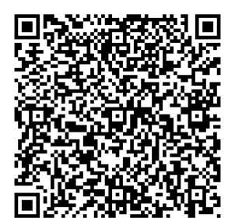
GIVING OF OUR GIFTS & OFFERTORY:
Our God has blessed us, so let us extend God’s Blessing as we present our Tithes and Offerings.
Thank you for being faithful stewards of your church family with your prayers, your time, talent, and your financial resources.
Contributions may also be made:
Electronically on the church website at fpcb-nj.org;
By reoccurring electronic withdrawal; or
By mailing your offering to the church:
P.O. Box 385, Blairstown, NJ.

Slide 17
* DOXOLOGY: No. 592 Praise God
Praise God, from whom
all blessings flow;
Praise Him, all creatures here below;
Praise Him above, ye heavenly host;
Praise Father, Son, and Holy Ghost. Amen.
* PRAYER OF DEDICATION

Slide 18

COMMISSIONING OF 2026–27 SUNDAY SCHOOL
TEACHERS & Youth workers:

Slide 19
Hear the words of our Lord Jesus Christ:
Jesus came to them and said: “All authority in heaven and on earth has been given to me. Therefore go and make disciples of all nations, baptizing them in the name of the Father and of the Son and of the Holy Spirit, and teaching them to obey everything I have commanded you. And surely I am with you always, to the very end of the age.”
(Matthew 28: 18–20)

Slide 20
Here also these words from St. Paul: “Continue in what you have learned and firmly believed, knowing from whom you learned it and how from childhood you have known sacred writings that are able to instruct you for salvation through faith in Christ Jesus. All scripture is inspired by God and is useful for teaching, for reproof, for correction, and for training in righteousness, so that the person of God may be proficient, equipped for every good work.”
(2 Timothy 3: 14–17)

Slide 21
The opportunity to teach our children and youth . . . As God has called you to this particular teaching ministry of our church family, please respond by affirming the following questions:
AFFIRMATION OF THE SUNDAY SCHOOL TEACHERS
& YOUTH WORKERS:
We are grateful for your willingness to teach the faith to our children and ask:
Do you accept the opportunity to serve Jesus in our Sunday school program this year, and will you be faithful in your instruction of the faith to our children?
I do and I will with Christ’s help.

Slide 22
Will you serve Christ with energy, intelligence, imagination and love, relying on God’s mercy and trusting the power of the Holy Spirit in your teaching ministry?
I will with Christ’s help.

Slide 23
AFFIRMATION OF THE MEMBERS OF FIRST PRESBYTERIAN CHURCH, BLAIRSTOWN, NJ:
Do you, the members of this church family, promise to pray for and support our Sunday school teachers and youth workers as they labor in love, teaching the way of Christ to our young people?
We will with Christ’s help.
COMMISSIONING PRAYER & BLESSING

Slide 24
* COMMISSIONING HYMN: No. 495
We Know That Christ Is Raised
We know that Christ is raised
and dies no more.
Embraced by death
He broke its fearful hold;
And our despair He turned to
blazing joy. Alleluia!
. . .

Slide 25
2
We share by water
in His saving death.
Reborn we share with Him
an Easter life
As living members of a living Christ.
Alleluia!
. . .

Slide 26
3
The Father’s splendor
clothes the Son with life.
The Spirit’s power
shakes the church of God.
Baptized we live with God
the Three in One.
Alleluia!
. . .

Slide 27
4
A new creation comes to life and grows As Christ’s new body
takes on flesh and blood.
The universe, restored and whole,
will sing: Alleluia!
Alleluia! Amen.

Slide 28
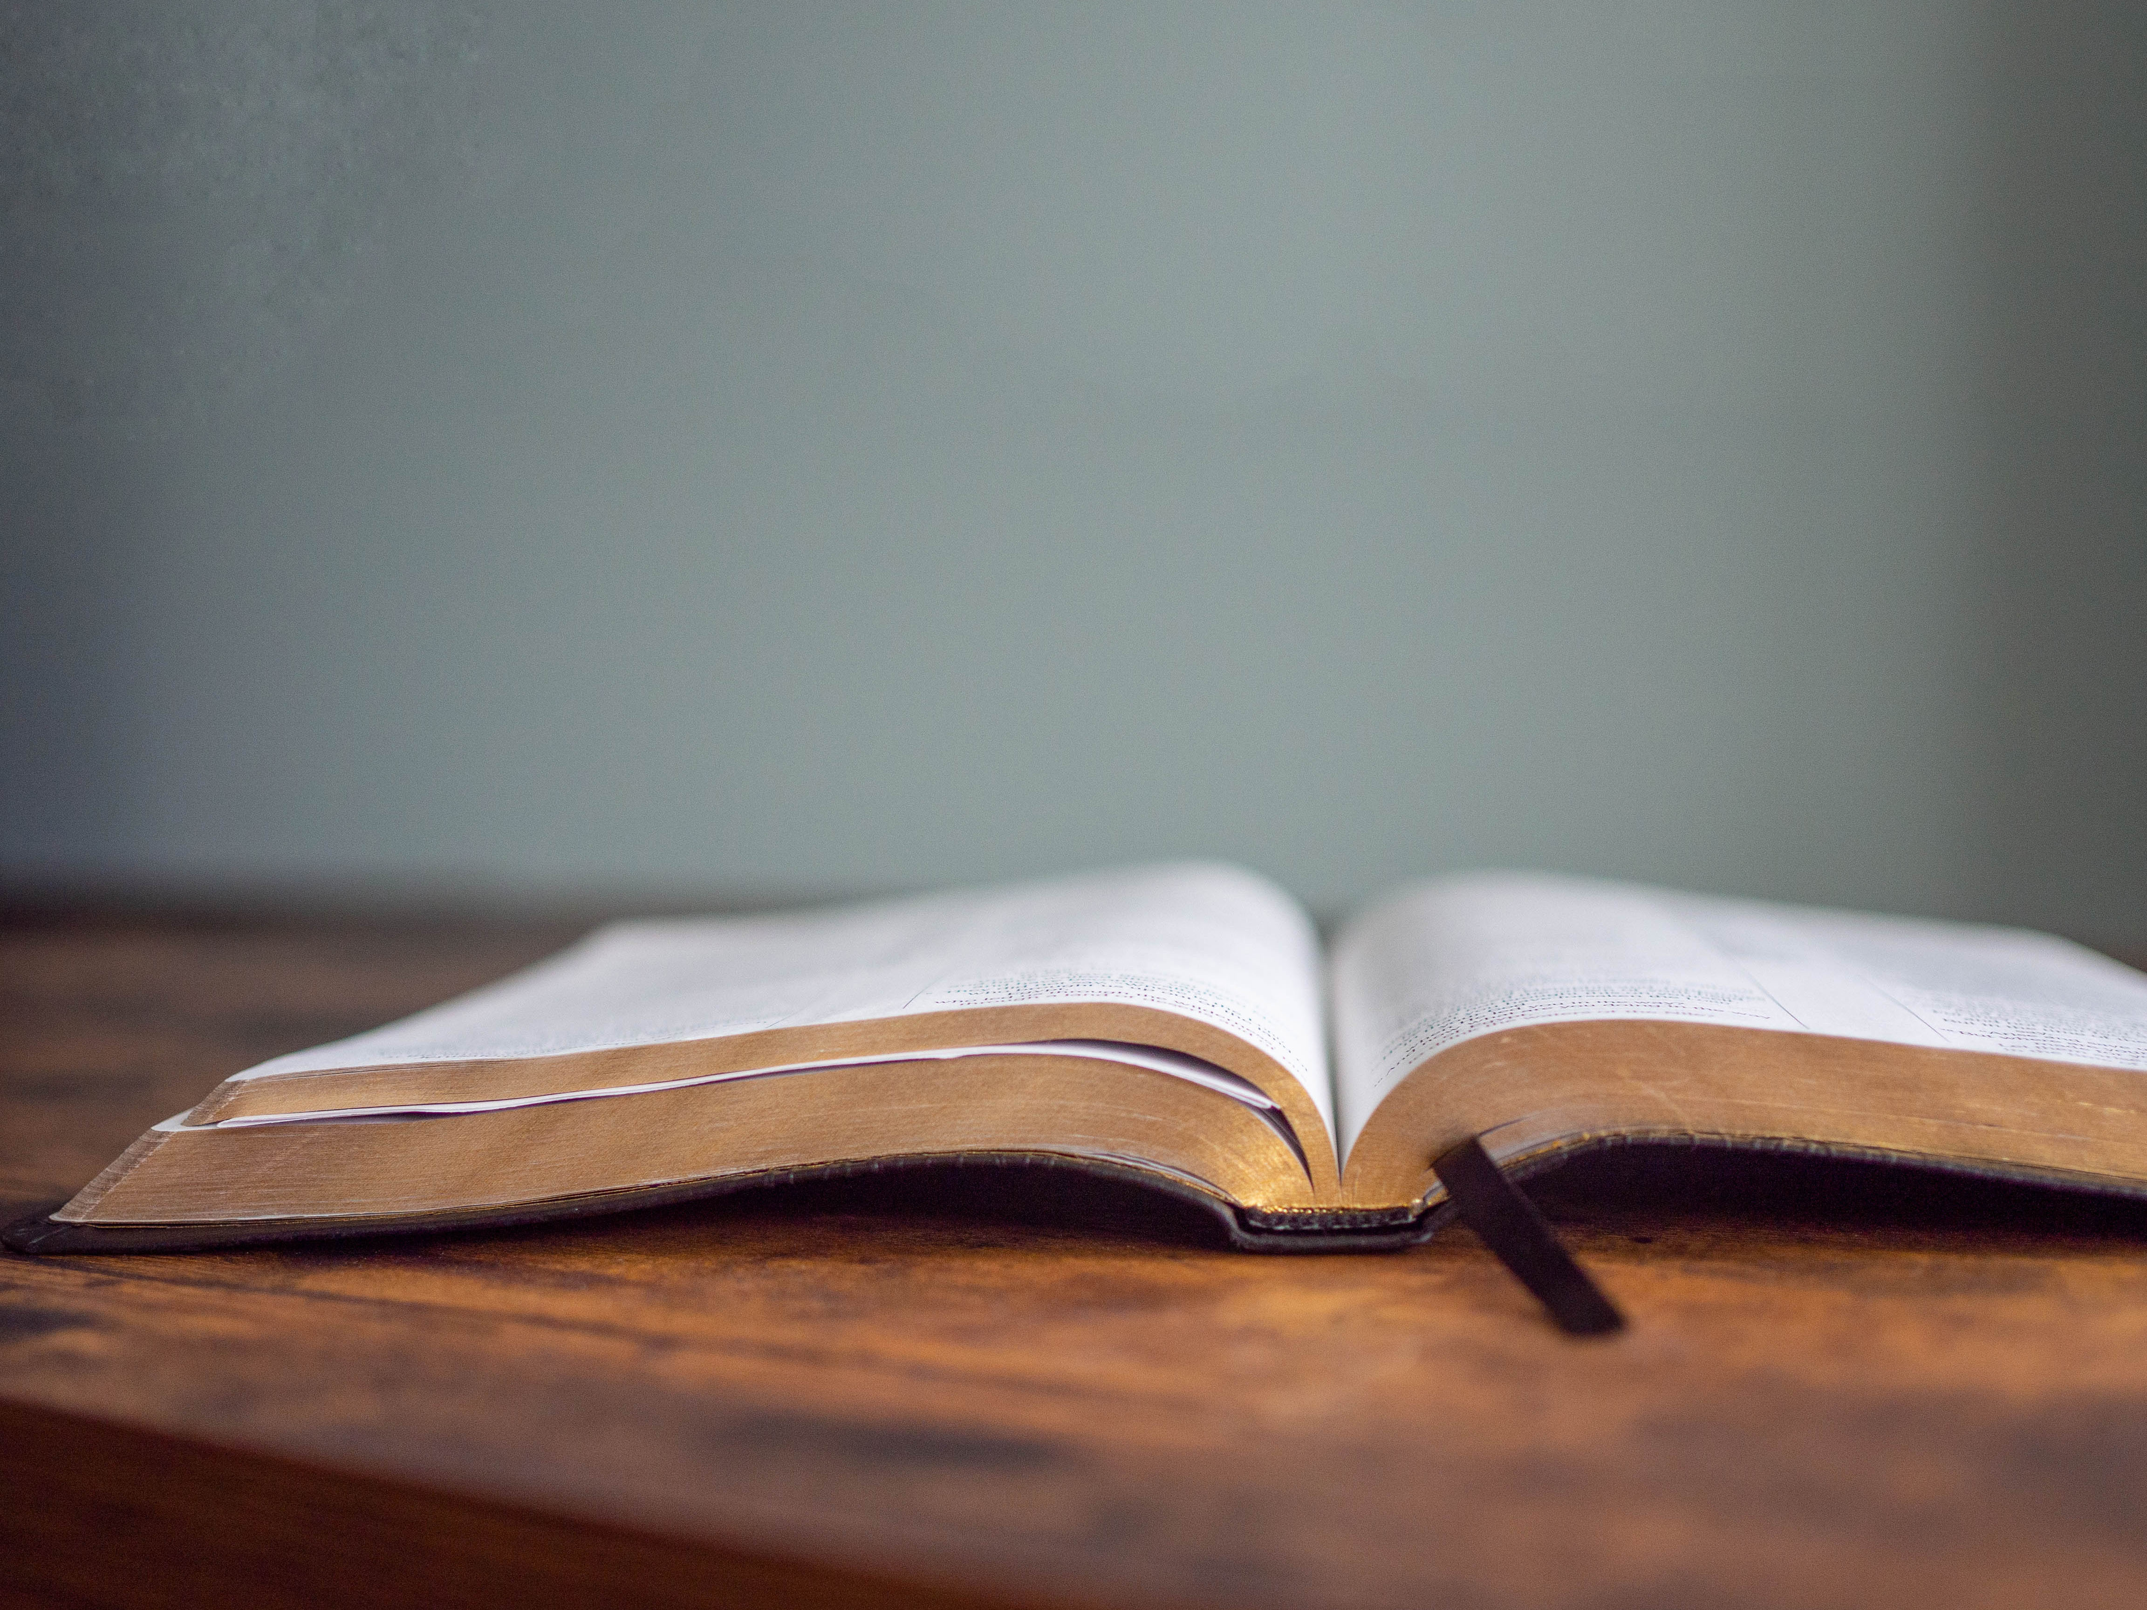
DECLARING GOD‘S WORD

Slide 29
OLD TESTAMENT LESSON: Genesis 45:1–8, 50: 14–21
By offering his brothers forgiveness, Joseph demonstrates the steadfast love, the hospitality, and the mercy of God.
45 Then Joseph could no longer control himself before all those who stood by him, and he cried out, “Send everyone away from me.” So no one stayed with him when Joseph made himself known to his brothers. ² And he wept so loudly that the Egyptians heard it, and the household of Pharaoh heard it. . . .

Slide 30
³ Joseph said to his brothers, “I am Joseph. Is my father still alive?” But his brothers could not answer him, so dismayed were they at his presence.
⁴ Then Joseph said to his brothers, “Come closer to me.” And they came closer. He said, “I am your brother, Joseph, whom you sold into Egypt. ⁵ And now do not be distressed or angry with yourselves because you sold me here, for God sent me before you to preserve life. . . .

Slide 31
⁶ For the famine has been in the land these two years, and there are five more years in which there will be neither plowing nor harvest. ⁷ God sent me before you to preserve for you a remnant on earth and to keep alive for you many survivors. ⁸ So it was not you who sent me here but God; he has made me a father to Pharaoh and lord of all his house and ruler over all the land of Egypt. . . .

Slide 32
Genesis 50:14-21
¹⁴ After he had buried his father, Joseph returned to Egypt with his brothers and all who had gone up with him to bury his father.
¹⁵ Realizing that their father was dead, Joseph’s brothers said, “What if Joseph still bears a grudge against us and pays us back in full for all the wrong that we did to him?” ¹⁶ So they approached Joseph, saying, . . .

Slide 33
“Your father gave this instruction before he died, ¹⁷ ‘Say to Joseph: I beg you, forgive the crime of your brothers and the wrong they did in harming you.’ Now therefore please forgive the crime of the servants of the God of your father.” Joseph wept when they spoke to him. ¹⁸ Then his brothers also wept, fell down before him, and said, “We are here as your slaves.” ¹⁹ But Joseph said to them, “Do not be afraid! Am I in the place of God? . . .

Slide 34
²⁰ Even though you intended to do harm to me, God intended it for good, in order to preserve a numerous people, as he is doing today. ²¹ So have no fear; I myself will provide for you and your little ones.” In this way he reassured them, speaking kindly to them.

Slide 35
GOSPEL LESSON: Matthew 18: 21–35
Jesus illustrates danger of forgiveness refusal.
²¹ Then Peter came and said to him, “Lord, if my brother or sister sins against me, how often should I forgive? As many as seven times?” ²² Jesus said to him, “Not seven times, but, I tell you, seventy-seven times.
²³ “For this reason the kingdom of heaven may be compared to a king who wished to settle accounts with his slaves. . . .

Slide 36
²⁴ When he began the reckoning, one who owed him ten thousand talents was brought to him, ²⁵ and, as he could not pay, the lord ordered him to be sold, together with his wife and children and all his possessions and payment to be made. ²⁶ So the slave fell on his knees before him, saying, ‘Have patience with me, and I will pay you everything.’ . . .

Slide 37
²⁷ And out of pity for him, the lord of that slave released him and forgave him the debt. ²⁸ But that same slave, as he went out, came upon one of his fellow slaves who owed him a hundred denarii, and seizing him by the throat he said, ‘Pay what you owe.’ ²⁹ Then his fellow slave fell down and pleaded with him, ‘Have patience with me, and I will pay you.’ ³⁰ But he refused; then he went and threw him into prison until he would pay the debt. . . .

Slide 38
³¹ When his fellow slaves saw what had happened, they were greatly distressed, and they went and reported to their lord all that had taken place. ³² Then his lord summoned him and said to him, ‘You wicked slave! I forgave you all that debt because you pleaded with me. ³³ Should you not have had mercy on your fellow slave, as I had mercy on you?’ . . .

Slide 39
³⁴ And in anger his lord handed him over to be tortured until he would pay his entire debt. ³⁵ So my heavenly Father will also do to every one of you, if you do not forgive your brother or sister from your heart.”

Slide 40
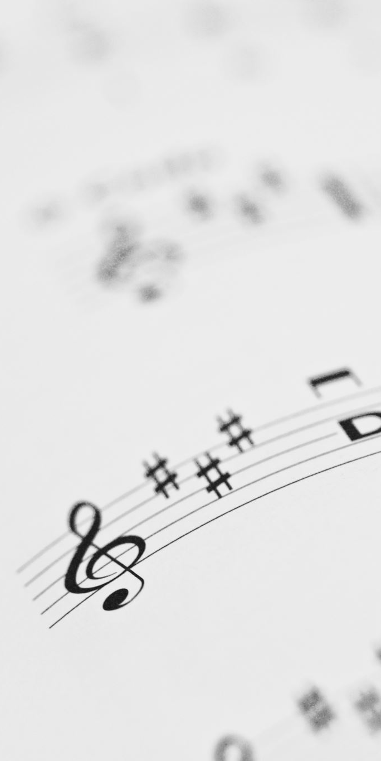
“You Raise Me Up”
Maggie Morokutti, Soloist

Slide 41
PASTOR DAVID’S SERMON:
Forgiven Anyone Recently?

Slide 42
RESPONDING TO GOD’S WORD

Slide 43
* AFFIRMATION OF FAITH: (responsive) Psalm 103: 1–12, 21–22)
Praise the Lord, my soul; all my inmost being, praise his holy name.
Praise the Lord, my soul, and forget not all God’s benefits—
God forgives all your sins and heals all your diseases,
God redeems your life from the pit and crowns you with love and compassion. . . .

Slide 44
God satisfies your desires with good, so that youth are renewed like the eagle’s.
The Lord works righteousness and justice for all the oppressed.
God made known his ways to Moses, his deeds to the people of Israel:
The Lord is compassionate and gracious, slow to anger, abounding in love. . . .

Slide 45
He will not always accuse, nor will he harbor his anger forever; he does not treat us as our sins deserve or repay us according to our iniquities.
For as high as the heavens are above the earth, so great is his love for those who fear him; as far as the east is from the west, so far has he removed our transgressions from us.
. . .

Slide 46
Praise the Lord, all his heavenly hosts, you his servants who do his will. Praise the Lord, all his works everywhere in his dominion. Praise the Lord, my soul. Amen.

Slide 47
PRAYER OF THANKSGIVING, OF THE PEOPLE,
& THE LORD’S PRAYER
Our Father who art in heaven,
Hallowed be thy name.
Thy kingdom come, thy will be done;
On earth as it is in heaven.
Give us this day our daily bread;
And forgive us our debts,
As we forgive our debtors;
And lead us not into temptation,
But deliver us from evil,
For Thine is the kingdom
And the power and the glory, forever. Amen.

Slide 48
DEPARTING IN GOD’S NAME

Slide 49
* HYMN: No. 302 I Danced in the Morning vv. 1, 3–5
I danced in the morning
when the world was begun,
And I danced in the moon
and the stars and the sun,
And I came down from heaven
and I danced on the earth;
At Bethlehem I had My birth.
. . .

Slide 50
Dance, then, wherever you may be:
I am the Lord of the Dance, said He,
And I’ll lead you all,
wherever you may be,
And I’ll lead you all
in the dance said He.
. . .

Slide 51
I danced on the Sabbath
and I cured the lame;
The holy people said it was a shame.
They whipped and they stripped
and they hung Me high,
And left Me there on a cross to die.
. . .

Slide 52
Dance, then, wherever you may be:
I am the Lord of the Dance, said He,
And I’ll lead you all,
wherever you may be,
And I’ll lead you all
in the dance said He.
. . .

Slide 53
I danced on a Friday when
the sky turned black;
It's hard to dance with the devil
on your back; They buried my body
and they thought I'd gone,
But I am the dance, and I still go on.
. . .

Slide 54
Dance, then, wherever you may be:
I am the Lord of the Dance, said He,
And I’ll lead you all,
wherever you may be,
And I’ll lead you all
in the dance said He.
. . .

Slide 55
They cut me down and I leap up high
I am the life that will never,
never die;
I’ll live in you if you’ll live in Me:
I am the Lord of the Dance said He.
. . .

Slide 56
Dance, then, wherever you may be:
I am the Lord of the Dance, said He,
And I’ll lead you all,
wherever you may be,
And I’ll lead you all
in the dance said He.

Slide 57
* CHARGE TO THE PEOPLE & BENEDICTION
* CONGREGATIONAL BENEDICTION: “May the Lord, Mighty God”
(sung to the tune of Edelweiss”) No. 596
May the Lord, mighty God,
bless and keep you forever.
Grant you peace, perfect peace,
courage in every endeavor.
Lift up your eyes and see God’s face,
full of grace forever;
May the Lord, mighty God,
bless and keep you forever.

Slide 58

POSTLUDE
Our worship has ended—our Christian Witness begins!

