Slide 1

Enter in SILENCE
Wait with REVERENCE
Worship from JOY

Slide 2
PRELUDE
WELCOME & ANNOUNCEMENTS
AFFIRMATION OF MISSION STATEMENT
Our Mission Statement
As disciples of Jesus Christ,
led by the Holy Spirit,
we experience God’s unconditional love,
and we witness to others
by discovering and sharing our gifts.

Slide 3
* SONG OF PRAISE: Lord, Prepare Me (Sanctuary) No. 701 GTG
Lord, prepare me to be a sanctuary,
pure and holy, tried and true.
With thanksgiving, I’ll be a living sanctuary for you.

Slide 4
* CALL TO WORSHIP:
The earth belongs to God, for the Lord made it.
Come, let us adore our Creator.
Worship the Lord in the beauty of holiness;
Come, let us give thanks to our Redeemer.
The steadfast love and mercy of the Lord is everlasting.
With open hearts and minds, with joy and thanksgiving, let us worship God.

Slide 5
* HYMN OF PRAISE: No. 464 Joyful, Joyful, We Adore Thee
Joyful, joyful, we adore Thee,
God of glory, Lord of love;
Hearts unfold like flowers before Thee,
Opening to the sun above.
Melt the clouds of sin and sadness;
Drive the gloom of doubt away;
Giver of immortal gladness,
Fill us with the light of day.
. . .

Slide 6
All Thy works with joy surround Thee,
Earth and heaven reflect Thy rays,
Stars and angels sing around Thee,
Center of unbroken praise.
Field and forest, vale and mountain,
Flowery meadow, flashing sea,
Chanting bird and flowing fountain,
Call us to rejoice in Thee.
. . .

Slide 7
Mortals, join the happy chorus
Which the morning stars began;
Love divine is reigning o’er us,
Joining all in heaven's plan.
Ever singing, march we onward,
Victors in the midst of strife,
Joyful music leads us sunward
In the triumph song of life.

Slide 8
PRAYER OF CONFESSION: (in silence then in unison)
Almighty and merciful God, you created us to be the church, the Body of Christ, to continue the mission of Jesus in the world today. Yet, we can be more apathetic than active, more isolated than involved, more callous than compassionate, more obstinate than obedient, more legalistic than loving. . . .

Slide 9
Gracious Lord, have mercy upon us and forgive our sin, remove the obstacles that prevent us from representing Jesus in the world and to the world. May your Spirit awaken within us the joy of living for Jesus and serving him today; in Jesus’ name. Amen.

Slide 10
ASSURANCE OF CHRIST’S FORGIVENESS:
Hear the good news! There is now no condemnation for those who are in Christ Jesus! Know you are forgiven and be at peace.
In Jesus Christ, we are forgiven! Let us forgive one another.

Slide 11
* CELEBRATING CHRIST’S FORGIVENESS: No. 466 v. 1
O For a Thousand Tongues to Sing
O for a thousand tongues to sing
My dear Redeemer’s praise,
The glories of my God and King,
The triumphs of God's grace!

Slide 12

* EXCHANGE OF CHRIST’S PEACE:
Pastor: The peace of Christ be with you.
People: And also with you.
Welcome one another
with the peace of Christ.

Slide 13

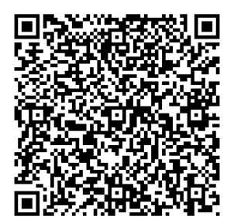
GIVING OF OUR GIFTS & OFFERTORY:
Our God has blessed us, so let us extend
God’s Blessing as we present our Tithes and Offerings.
Thank you for being faithful stewards of your
church family with your prayers, your time,
talent, and your financial resources.
Contributions may also be made:
Electronically on the church website
at fpcb-nj.org;
By reoccurring electronic withdrawal; or
By mailing your offering to the church:
P.O. Box 385, Blairstown, NJ.

Slide 14
* DOXOLOGY: No. 428 We Give Thee but Thine Own v. 1
We give Thee but Thine own,
Whate’er the gift may be;
All that we have is Thine alone,
A trust, O Lord, from Thee.

Slide 15
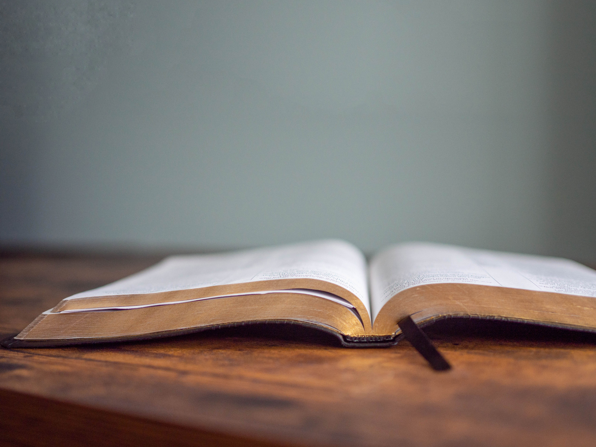
DECLARING
GOD‘S WORD

Slide 16
EPISTLE LESSON: Genesis 2: 15–23
God creates and instills value on the first human beings.
¹⁵ The Lord God took the man and put him in the garden of Eden to till it and keep it. ¹⁶ And the Lord God commanded the man, “You may freely eat of every tree of the garden, ¹⁷ but of the tree of the knowledge of good and evil you shall not eat, for in the day that you eat of it you shall die.”
¹⁸ Then the Lord God said, “It is not good that the man should be alone; I will make him a helper as his partner.” . . .

Slide 17
¹⁹ So out of the ground the Lord God formed every animal of the field and every bird of the air and brought them to the man to see what he would call them, and whatever the man called every living creature, that was its name. ²⁰ The man gave names to all cattle and to the birds of the air and to every animal of the field, but for the man there was not found a helper as his partner. ²¹ So the Lord God caused a deep sleep to fall upon the man, and he slept; . . .

Slide 18
then he took one of his ribs and closed up its place with flesh. ²² And the rib that the Lord God had taken from the man he made into a woman and brought her to the man. ²³ Then the man said,
“This at last is bone of my bones
and flesh of my flesh;
this one shall be called Woman,
for out of Man this one was taken.”

Slide 19
GOSPEL LESSON: Matthew 5: 1–16
Jesus instills value on those who suffer.
5 When Jesus saw the crowds, he went up the mountain, and after he sat down, his disciples came to him. ² And he began to speak and taught them, saying:
³ “Blessed are the poor in spirit, for theirs is the kingdom of heaven.
⁴ “Blessed are those who mourn, for they will be comforted. . . .

Slide 20
⁵ “Blessed are the meek, for they will inherit the earth.
⁶ “Blessed are those who hunger and thirst for righteousness, for they will be filled.
⁷ “Blessed are the merciful, for they will receive mercy.
⁸ “Blessed are the pure in heart, for they will see God.
⁹ “Blessed are the peacemakers, for they will be called children of God.
¹⁰ “Blessed are those who are persecuted for the sake of righteousness, for theirs is the kingdom of heaven.
. . .

Slide 21
¹¹ “Blessed are you when people revile you and persecute you and utter all kinds of evil against you falsely on my account. ¹² Rejoice and be glad, for your reward is great in heaven, for in the same way they persecuted the prophets who were before you.
¹³ “You are the salt of the earth, but if salt has lost its taste, how can its saltiness be restored? It is no longer good for anything but is thrown out and trampled under foot. . . .

Slide 22
¹⁴ “You are the light of the world. A city built on a hill cannot be hid. ¹⁵ People do not light a lamp and put it under the bushel basket; rather, they put it on the lampstand, and it gives light to all in the house. ¹⁶ In the same way, let your light shine before others, so that they may see your good works and give glory to your Father in heaven.

Slide 23


PASTOR DAVID’S SERMON SERIES:
1. Reclaiming the Gold in the Rule

Slide 24
RESPONDING TO GOD’S WORD

Slide 25
* AFFIRMATION OF FAITH: The Contemporary Apostles’ Creed
I believe in God who places joy in our souls, dancing in our toes and songs in our hearts. I believe God wanted gladness to flow like a river, so the Good Lord created a bountiful earth with plenty for all to share.
I believe in Jesus, who turned water into wine, . . .

Slide 26
partied with outcasts and sinners, and touched the broken so they could leap and dance. I believe Jesus opened the doors and set an extra place so we could feast.
I believe in the Holy Spirit, who prompts us to smile, who sends us invitations to come and dine, who nudges us to openness and tenderness. . . .

Slide 27
I believe the Spirit is present every time we gather to break bread and stirs within us the desire to live joyfully, to walk hopefully, and to enact justice boldly.
Forever, I will live in the embrace of God and be a witness to Christ’s resurrection joy. Amen.

Slide 28
* HYMN: Lord, the Light of Your Love Is Shining! (No. 192 GTG)
Lord, the light of your love is shining,
in the midst of the darkness, shining;
Jesus, Light of the World, shine upon us;
set us free by the truth you now bring us.
Shine on me; shine on me.
. . .

Slide 29
Shine, Jesus, shine;
fill this land with the Father’s glory.
Blaze, Spirit, blaze; set our hearts on fire.
Flow, river, flow;
flood the nations with grace and mercy.
Send forth your word, Lord,
and let there be light.
. . .

Slide 30
2
Lord, I come to your awesome presence,
from the shadows into your radiance;
by the blood I may enter your brightness.
Search me; try me;
consume all my darkness;
Shine on me; shine on me.
. . .

Slide 31
Shine, Jesus, shine;
fill this land with the Father’s glory.
Blaze, Spirit, blaze; set our hearts on fire.
Flow, river, flow;
flood the nations with grace and mercy.
Send forth your word, Lord,
and let there be light.
. . .

Slide 32
3
As we gaze on your kingly brightness,
so our faces display your likeness;
ever changing from glory to glory,
mirrored here may our lives tell your story.
Shine on me; shine on me.
. . .

Slide 33
Shine, Jesus, shine;
fill this land with the Father’s glory.
Blaze, Spirit, blaze; set our hearts on fire.
Flow, river, flow;
flood the nations with grace and mercy.
Send forth your word, Lord,
and let there be light.

Slide 34
PRAYER OF THANKSGIVING, OF THE PEOPLE,
& THE LORD’S PRAYER
Our Father who art in heaven,
Hallowed be thy name.
Thy kingdom come, thy will be done;
On earth as it is in heaven.
Give us this day our daily bread;
And forgive us our debts,
As we forgive our debtors;
And lead us not into temptation,
But deliver us from evil,
For Thine is the kingdom
And the power and the glory, forever. Amen.

Slide 35
DEPARTING IN GOD’S NAME

Slide 36
* HYMN: No. 425 Lord of Light, Your Name Outshining (vv. 1,3,4)
Lord of light, Your name outshining
all the stars and suns of space,
Use our talents in Your kingdom
as the servants of Your grace;
Use us to fulfill Your purpose
in the gift of Christ Your Son:
Abba, as in highest heaven,
so on earth Your will be done.
. . .

Slide 37
3
Grant that knowledge, still increasing,
at your feet may lowly kneel;
With your grace our triumphs hallow,
with Your charity our zeal;
Lift the nations from the shadows
to the gladness of the sun:
Abba, as in highest heaven,
so on earth your will be done. . . .

Slide 38
4
By the prayers of faithful watchers,
never silent day or night;
By the cross of Jesus bringing peace
to all and healing light;
By the love that passes knowledge,
making all your children one:
Abba, as in highest heaven,
so on earth your will be done.
. . .

Slide 39
* CHARGE TO THE PEOPLE & BENEDICTION
* CONGREGATIONAL BENEDICTION: “May the Lord, Mighty God”
(sung to the tune of Edelweiss”) No. 596
May the Lord, mighty God,
bless and keep you forever.
Grant you peace, perfect peace,
courage in every endeavor.
Lift up your eyes and see God’s face,
full of grace forever;
May the Lord, mighty God,
bless and keep you forever.

Slide 40

POSTLUDE
Our worship has ended—our Christian Witness begins!

Slide 41
* CHARGE TO THE PEOPLE & BENEDICTION
* CONGREGATIONAL BENEDICTION: “Let There be Peace on Earth”
Let there be peace on earth
and let it begin with me;
let there be peace on earth,
the peace that was meant to be.
With God as our Father, we are family.
Let us walk with each other
in perfect harmony.
. . .

Slide 42
Let peace begin with me,
let this be the moment now.
With every step I take,
may this be my solemn vow:
To take each moment
and live each moment in peace eternally.
Let there be peace on earth,
and let it begin with me.

