Slide 1
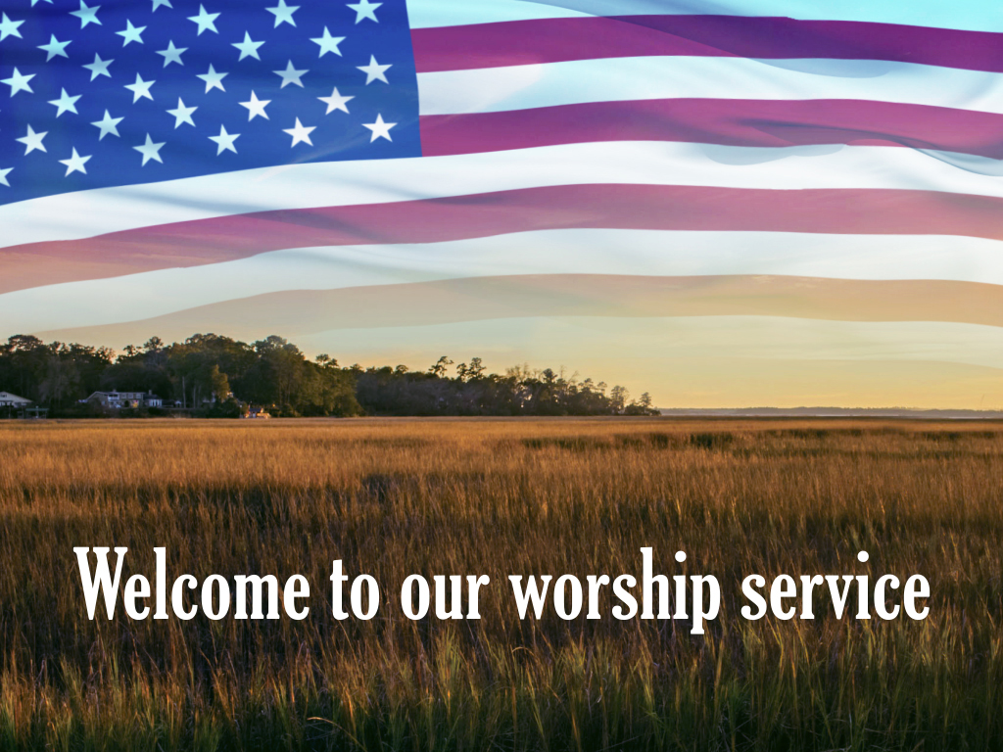
Enter in SILENCE Wait with REVERENCE
Worship from JOY

Slide 2
PRELUDE
WELCOME & ANNOUNCEMENTS
AFFIRMATION OF MISSION STATEMENT
Our Mission Statement
As disciples of Jesus Christ,
led by the Holy Spirit,
we experience God’s unconditional love,
and we witness to others
by discovering and sharing our gifts.

Slide 3
* SONG OF PRAISE: Lord, Prepare Me (Sanctuary) No. 701 GTG
Lord, prepare me to be a sanctuary,
pure and holy, tried and true.
With thanksgiving, I’ll be a living sanctuary for you.

Slide 4
* CALL TO WORSHIP:
The Lord is gracious and merciful, slow to anger and abounding in steadfast love.
God is good to all, and God’s compassion is over all creation.
Christ says: “Come to me, all you that are weary and carrying heavy burdens, and I will give rest.”
Jesus says: “Keep company with me and we’ll learn to live freely and lightly;”
Jesus says, “Come to him, and find rest for our souls.”
With joyful and grateful hearts, let us worship God.

Slide 5
* HYMN OF PRAISE: No. 564 O Beautiful for Spacious Skies
O beautiful for spacious skies,
For amber waves of grain,
For purple mountain majesties
Above the fruited plain!
America! America!
God shed His grace on thee,
And crown thy good with servanthood
From sea to shining sea!
. . .

Slide 6
O beautiful for pilgrim feet,
Whose stern, impassioned stress
A thoroughfare for freedom beat
Across the wilderness!
America! America!
God mend thine every flaw,
Confirm thy soul in self-control,
Thy liberty in law!
. . .

Slide 7
O beautiful for heroes proved
In liberating strife,
Who more than self their country loved,
And mercy more than life!
America! America!
May God thy gold refine
Till all success be nobleness
And every gain divine.
. . .

Slide 8
O beautiful for patriot dream
That sees beyond the years
Thine alabaster cities gleam,
Undimmed by human tears!
America! America!
God shed His grace on thee
And crown thy good with servanthood
From sea to shining sea!

Slide 9
PRAYER OF CONFESSION: (in silence then in unison)
Merciful God, we confess that we are captive to sin and are unable to free ourselves. Like the Apostle Paul, we do the very things we hate, failing to live out the good we desire. We carry heavy burdens of our own making—anxiety, pride, and the exhausting pace of a world that demands we prove our worth. . . .

Slide 10
Forgive us, form us, and fashion us into your image, Lord Jesus. Meet us in our weariness. Help us to trade our heavy yokes that we may learn the humble rhythms of your generous and abundant grace. We pray this in your precious name. Amen.

Slide 11
ASSURANCE OF CHRIST’S FORGIVENESS:
In Christ, barriers are demolished, strangers become friends, the huddled masses yearning to be free experience liberty and a new community. In Christ a new life and a new way of living has begun.
In Jesus Christ, we are forgiven! Let us forgive one another.

Slide 12
* CELEBRATING CHRIST’S FORGIVENESS: No. 582 (GTG)
Glory to God, whose goodness
shines on me; and to the Son,
whose grace has pardoned me;
and to the Spirit,
whose love has set me free.
As it was in the beginning,
is now, and ever shall be. Amen.

Slide 13

* EXCHANGE OF CHRIST’S PEACE:
Pastor: The peace of Christ be with you.
People: And also with you.
Welcome one another
with the peace of Christ.

Slide 14

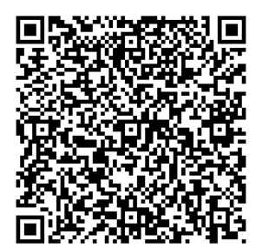
GIVING OF OUR GIFTS & OFFERTORY:
Our God has blessed us, so let us extend
God’s Blessing as we present our Tithes and Offerings.
Thank you for being faithful stewards of your
church family with your prayers, your time,
talent, and your financial resources.
Contributions may also be made:
Electronically on the church website
at fpcb-nj.org;
By reoccurring electronic withdrawal; or
By mailing your offering to the church:
P.O. Box 385, Blairstown, NJ.

Slide 15
* DOXOLOGY: No. 577 Glory Be to the Father
Glory be to the Father, and the Son,
and the Holy Ghost;
As it was in the beginning, is now, and ever shall be, world without end. Amen.
As it was in the beginning, is now, and ever shall be, world without end. Amen.
Amen. Amen. Amen. Amen.
Amen. Amen. Amen.
* PRAYER OF DEDICATION

Slide 16
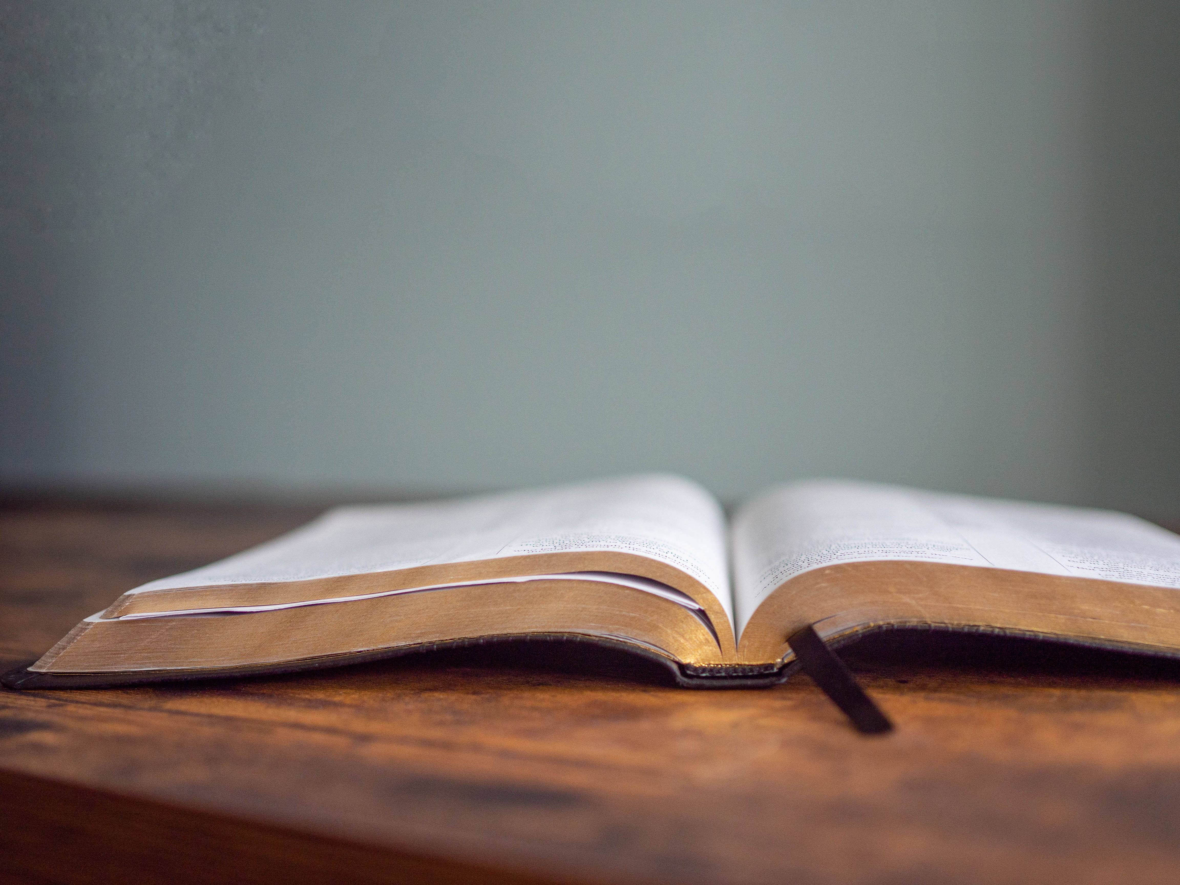
DECLARING
GOD‘S WORD

Slide 17
EPISTLE LESSON: 1 John 4: 7–8, 16–21 NRSVUE God’s love is seen through our indiscriminate and impartial love.
⁷ Beloved, let us love one another, because love is from God; everyone who loves is born of God and knows God. ⁸ Whoever does not love does not know God, for God is love.
¹⁶ So we have known and believe the love that God has for us.
God is love, and those who abide in love abide in God, and God abides in them. . . .

Slide 18
¹⁷ Love has been perfected among us in this: that we may have boldness on the day of judgment, because as he is, so are we in this world. ¹⁸ There is no fear in love, but perfect love casts out fear; for fear has to do with punishment, and whoever fears has not reached perfection in love. ¹⁹ We love because he first loved us. ²⁰ Those who say, “I love God,” and hate a brother or sister are liars, for those who do not love a brother or sister, whom they have seen, cannot love God, whom they have not seen. . . .

Slide 19
²¹ The commandment we have from him is this: those who love God must love their brothers and sisters also.

Slide 20
GOSPEL LESSON: John 13: 34–35
Jesus commands us to love one another.
³⁴ I give you a new commandment, that you love one another. Just as I have loved you, you also should love one another. ³⁵ By this everyone will know that you are my disciples, if you have love for one another.”

Slide 21
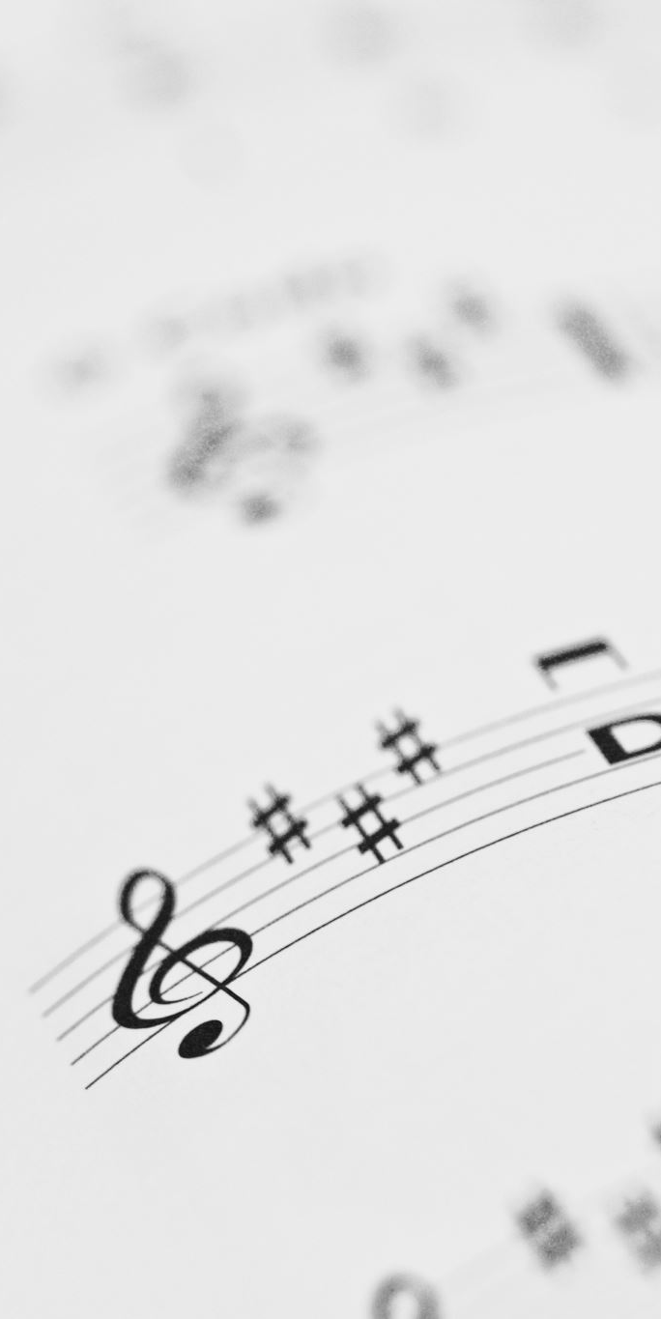
SOLO:
“This is My Song”
Lyrics - Lloyd Stone;
Music - “Finlandia”
by Jean Sibelius
Maggie Morokutti, Piano/Vocals

Slide 22


PASTOR DAVID’S
SERMON:
“Love One Another”

Slide 23
RESPONDING TO GOD’S WORD

Slide 24
* AFFIRMATION OF FAITH: Romans 8: 28, 31–35, 37–39
We know that all things work together for good for those who love God, who are called according to his purpose. If God is for us, who is against us? So who will separate us from the love of Christ? Will hardship, or distress, or persecution, or famine, or nakedness, or peril, or sword?
. . .

Slide 25
In all these things we are more than conquerors through him who loved us. For I am convinced that neither death, nor life, nor angels, nor rulers, nor things present, nor things to come, nor powers, nor height, nor depth, nor anything else in all creation, will be able to separate us from the love of God in Christ Jesus our Lord. Amen.

Slide 26
* COMMUNION HYMN: For Everyone Born, vv. 1, 3–5 No. 769, GTG
For everyone born, a place at the table,
for everyone born, clean water and bread,
a shelter, a space, a safe place for growing,
for everyone born, a star overhead,
and God will delight when we are creators of justice and joy, compassion and peace:
yes, God will delight when we are creators of justice, . . . justice and joy!
. . .

Slide 27
For young and for old, a place at the table,
a voice to be heard, a part in the song,
the hands of a child in hands that are wrinkled, for young and for old, the right to belong, and God will delight when we are creators of justice and joy, compassion and peace: yes, God will delight when we are creators of justice, . . . justice and joy!
. . .

Slide 28
For just and unjust, a place at the table,
abuser, abused, with need to forgive,
in anger, in hurt, a mindset of mercy,
for just and unjust, a new way to live,
and God will delight when we are creators of justice and joy, compassion and peace:
yes, God will delight when we are creators of justice, . . . justice and joy!
. . .

Slide 29
For everyone born, a place at the table,
to live without fear, and simply to be,
to work, to speak out,
to witness and worship,
for everyone born, the right to be free,
and God will delight when we are creators of justice and joy, compassion and peace:
yes, God will delight when we are creators of justice, . . . justice and joy!

Slide 30


Slide 31
SACRAMENT OF HOLY COMMUNION
INVITATION TO THE LORD’S TABLE:
L: Friends, this is the joyful feast of the people of God!
P: People will come from east and west, and from north and south, and sit at the table in the kingdom of God.

Slide 32
L: Behold, how good and pleasant it is when brothers and sisters dwell in unity.
P: God sent the whole world God’s only Son. Since God loved us so much, we too, should love one another.
L: This is the Lord’s Table. Our Savior invites all who are truly sorry for their sins and would humbly put their trust in him to come to the feast which he has prepared. Listen to the gracious words of our Savior Jesus Christ:

Slide 33
“Come to me, all you that are weary and are carrying heavy burdens, and I will give you rest. Take my yoke upon you, and learn from me; for I am gentle and humble in heart, and you will find rest for your souls. For my yoke is easy, and my burden is light.“ Matthew 11: 28–30
”This is indeed the will of my Father, that all who see the Son and believe in him may have eternal life, and I will raise them up on the last day.” John 6: 40
“Behold, I stand at the door and knock; if those who hear my voice open the door, I will come in to them and eat with them, and they with me.” Revelation 3: 20

Slide 34
L: The Lord be with you.
P: And with your spirit.
L: Lift up your hearts.
P: We lift them to the Lord.
L: Let us give thanks to the Lord our God.
P: It is right to give God our thanks and praise.

Slide 35
PRAYER OF THANKSGIVING, PRAYERS OF THE PEOPLE,
& THE LORD’S PRAYER:
L: Holy Lord . . . as we pray together:
Nourished at this table, O God, may we know the impartial, the indiscriminate, and unconditional way of Christ’s redemptive love. Recreate Christ’s image within us and invigorate us in our daily walk with Jesus . . .

Slide 36
that we may present and represent Jesus to a broken and fearful world. This we pray in Jesus’ precious name, saying . . .

Slide 37
Our Father who art in heaven,
Hallowed be thy name.
Thy kingdom come, thy will be done;
On earth as it is in heaven.
Give us this day our daily bread;
And forgive us our debts,
As we forgive our debtors;
And lead us not into temptation,
But deliver us from evil,
For Thine is the kingdom
And the power and the glory, forever. Amen.

Slide 38


Slide 39

OFFERING OF THE ELEMENTS:
Approach the Table,
receive the bread,
take the cup,
and return to your pew.

Slide 40
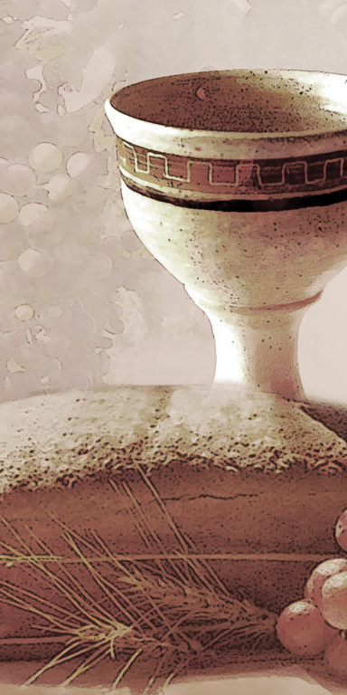
SHARING THE BREAD:
Jesus said, “I am the bread of life. Whoever comes to me will never be hungry...” (Jn. 6:35a)
Let us eat this bread in remembrance of Christ and may the spirit that is in him be in us also.
DRINKING THE CUP:
Jesus said, “I am the vine, you are the branches, apart from him, we can do nothing.”
Drink this cup in remembrance of Christ and may the spirit in which he died be our Spirit.

Slide 41
COMMUNION BLESSING: Let us give thanks to the Lord our God.
By the power of your Spirit, O God, make us useful instruments of Christ’s kingdom. Use us, Holy Spirit, that our misery may become our ministry, our pain become our purpose, our mess become our message, and our trials become our testimony of you at work within us and through us . . .

Slide 42
all for your gain and your glory; in Jesus’ name, we pray this in Jesus’ name. Amen.

Slide 43
DEPARTING IN GOD’S NAME

Slide 44
* HYMN: No. 561 My Country, 'Tis of Thee
My country, ’tis of thee,
Sweet land of liberty,
Of thee I sing;
Land where my fathers died,
Land of the pilgrims’ pride,
From every mountainside,
Let freedom ring!
. . .

Slide 45
My native country, thee,
Land of the noble free,
Thy name I love;
I love thy rocks and rills,
Thy woods and templed hills;
My heart with rapture thrills,
Like that above.
. . .

Slide 46
Let music swell the breeze,
And ring from all the trees,
Sweet freedom’s song;
Let mortal tongues awake;
Let all that breathe partake;
Let rocks their silence break,
The sound prolong.
. . .

Slide 47
Our fathers’ God, to Thee,
Author of liberty,
To Thee we sing;
Long may our land be bright
With freedom’s holy light;
Protect us by Thy might,
Great God, our King.
* CHARGE TO THE PEOPLE & BENEDICTION

Slide 48
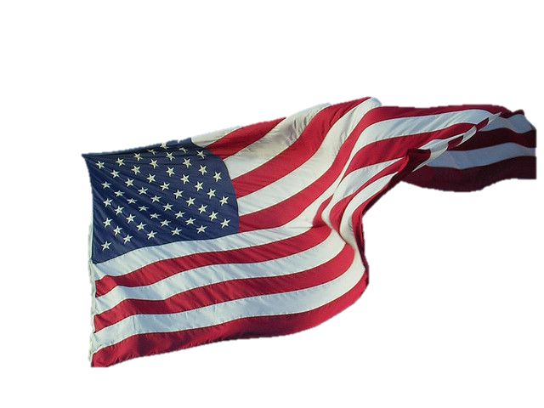

* CONGREGATIONAL BENEDICTION: God Bless America!
God Bless America! Land that I love.
Stand beside her; and guide her;
Through the night of the light from above!
From the ocean, to the prairie;
from mountains white with snow.
God bless America! My home sweet, home.
POSTLUDE
Our Worship has ended —
our Christian Witness begins!

