Slide 1

Enter in SILENCE
Wait with REVERENCE
Worship from JOY

Slide 2
PRELUDE
WELCOME & ANNOUNCEMENTS
AFFIRMATION OF MISSION STATEMENT
Our Mission Statement
As disciples of Jesus Christ,
led by the Holy Spirit,
we experience God’s unconditional love,
and we witness to others
by discovering and sharing our gifts.

Slide 3
* SONG OF PRAISE: No. 333 Seek Ye First v. 1
Seek ye first the kingdom of God
and His righteousness,
and all these things
shall be added unto you.
Al-le-lu, al-le-lu-ia!

Slide 4
* CALL TO WORSHIP: 1 Chronicles 29: 10–13
Blessed are you, Lord God of our father Israel, from everlasting to everlasting.
Yours, O Lord, is the greatness and the power, the glory, the splendor, and the majesty.
Everything in Heaven and on earth is yours.
Yours, Lord, is the sovereignty.
. . .

Slide 5
You are exalted as head over all. Wealth and honor come from you. You rule over all; might and power are of your disposing.
Now, our God, we give you thanks. Now, we praise your glorious name!
With minds open and hearts filled with praise,
let us worship God.

Slide 6
* HYMN: No. 446 Glorious Things of Thee are Spoken
Glorious things of thee are spoken,
Zion, city of our God;
God, whose word cannot be broken,
Formed thee for a blest abode.
On the rock of ages founded,
What can shake thy sure repose?
With salvation’s walls surrounded,
Thou may’st smile at all thy foes.
. . .

Slide 7
2
See, the streams of living waters,
Springing from eternal love,
Well supply thy sons and daughters
And all fear of want remove.
Who can faint while such a river
Ever flows their thirst to assuage?
Grace, which like the Lord, the Giver,
Never fails from age to age.
. . .

Slide 8
3
Round each habitation hovering,
See the cloud and fire appear
For a glory and a covering,
Showing that the Lord is near.
Thus deriving from their banner
Light by night and shade by day,
Safe they feed upon the manna
Which God gives them when they pray.

Slide 9
PRAYER OF CONFESSION: (in silence then in unison)
Dear God, our Heavenly Father, by the gift of your Holy Spirit, you are at work in our lives in ways unknown. We confess we do not discern the reality of your presence very well. We often confuse your will with our ways. We frequently find our lives conflicted and confused at knowing you. . . .

Slide 10
We ask and pray for your forgiveness. Cleanse us and create within us pure hearts that we may return to you, perfectly love you, and mightily magnify your name; in the precious name of Jesus, we pray. Amen.

Slide 11
ASSURANCE OF CHRIST’S FORGIVENESS:
The mercy of the Lord is from everlasting to everlasting. I declare to you, in the name of Jesus Christ, you are forgiven. May the God of mercy forgive our sins and keep us in the way of eternal life.
In Jesus Christ, we are forgiven! Let us forgive one another.

Slide 12
* HYMN: No. 293 This Is My Father's World v. 1/2
This is my Father’s world,
And to my listening ears
All nature sings, and round me rings
The music of the spheres.
This is my Father’s world:
The battle is not done:
Jesus who died shall be satisfied,
And earth and heaven be one.

Slide 13

* EXCHANGE OF CHRIST’S PEACE:
Pastor: The peace of Christ be with you.
People: And also with you.
Welcome one another
with the peace of Christ.

Slide 14

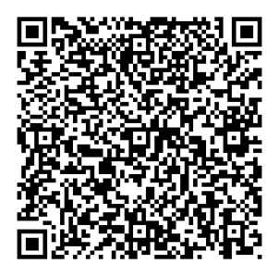
GIVING OF OUR GIFTS & OFFERTORY:
Our God has blessed us, so let us extend
God’s Blessing as we present our Tithes and Offerings.
Thank you for being faithful stewards of your
church family with your prayers, your time,
talent, and your financial resources.
Contributions may also be made:
Electronically on the church website
at fpcb-nj.org;
By reoccurring electronic withdrawal; or
By mailing your offering to the church:
P.O. Box 385, Blairstown, NJ.

Slide 15
* DOXOLOGY: No. 592 Praise God, from Whom All Blessings Flow
Praise God, from whom all blessings flow;
Praise Him, all creatures here below;
Praise Him above, ye heavenly host;
Praise Father, Son, and Holy Ghost. Amen.
* PRAYER OF DEDICATION

Slide 16
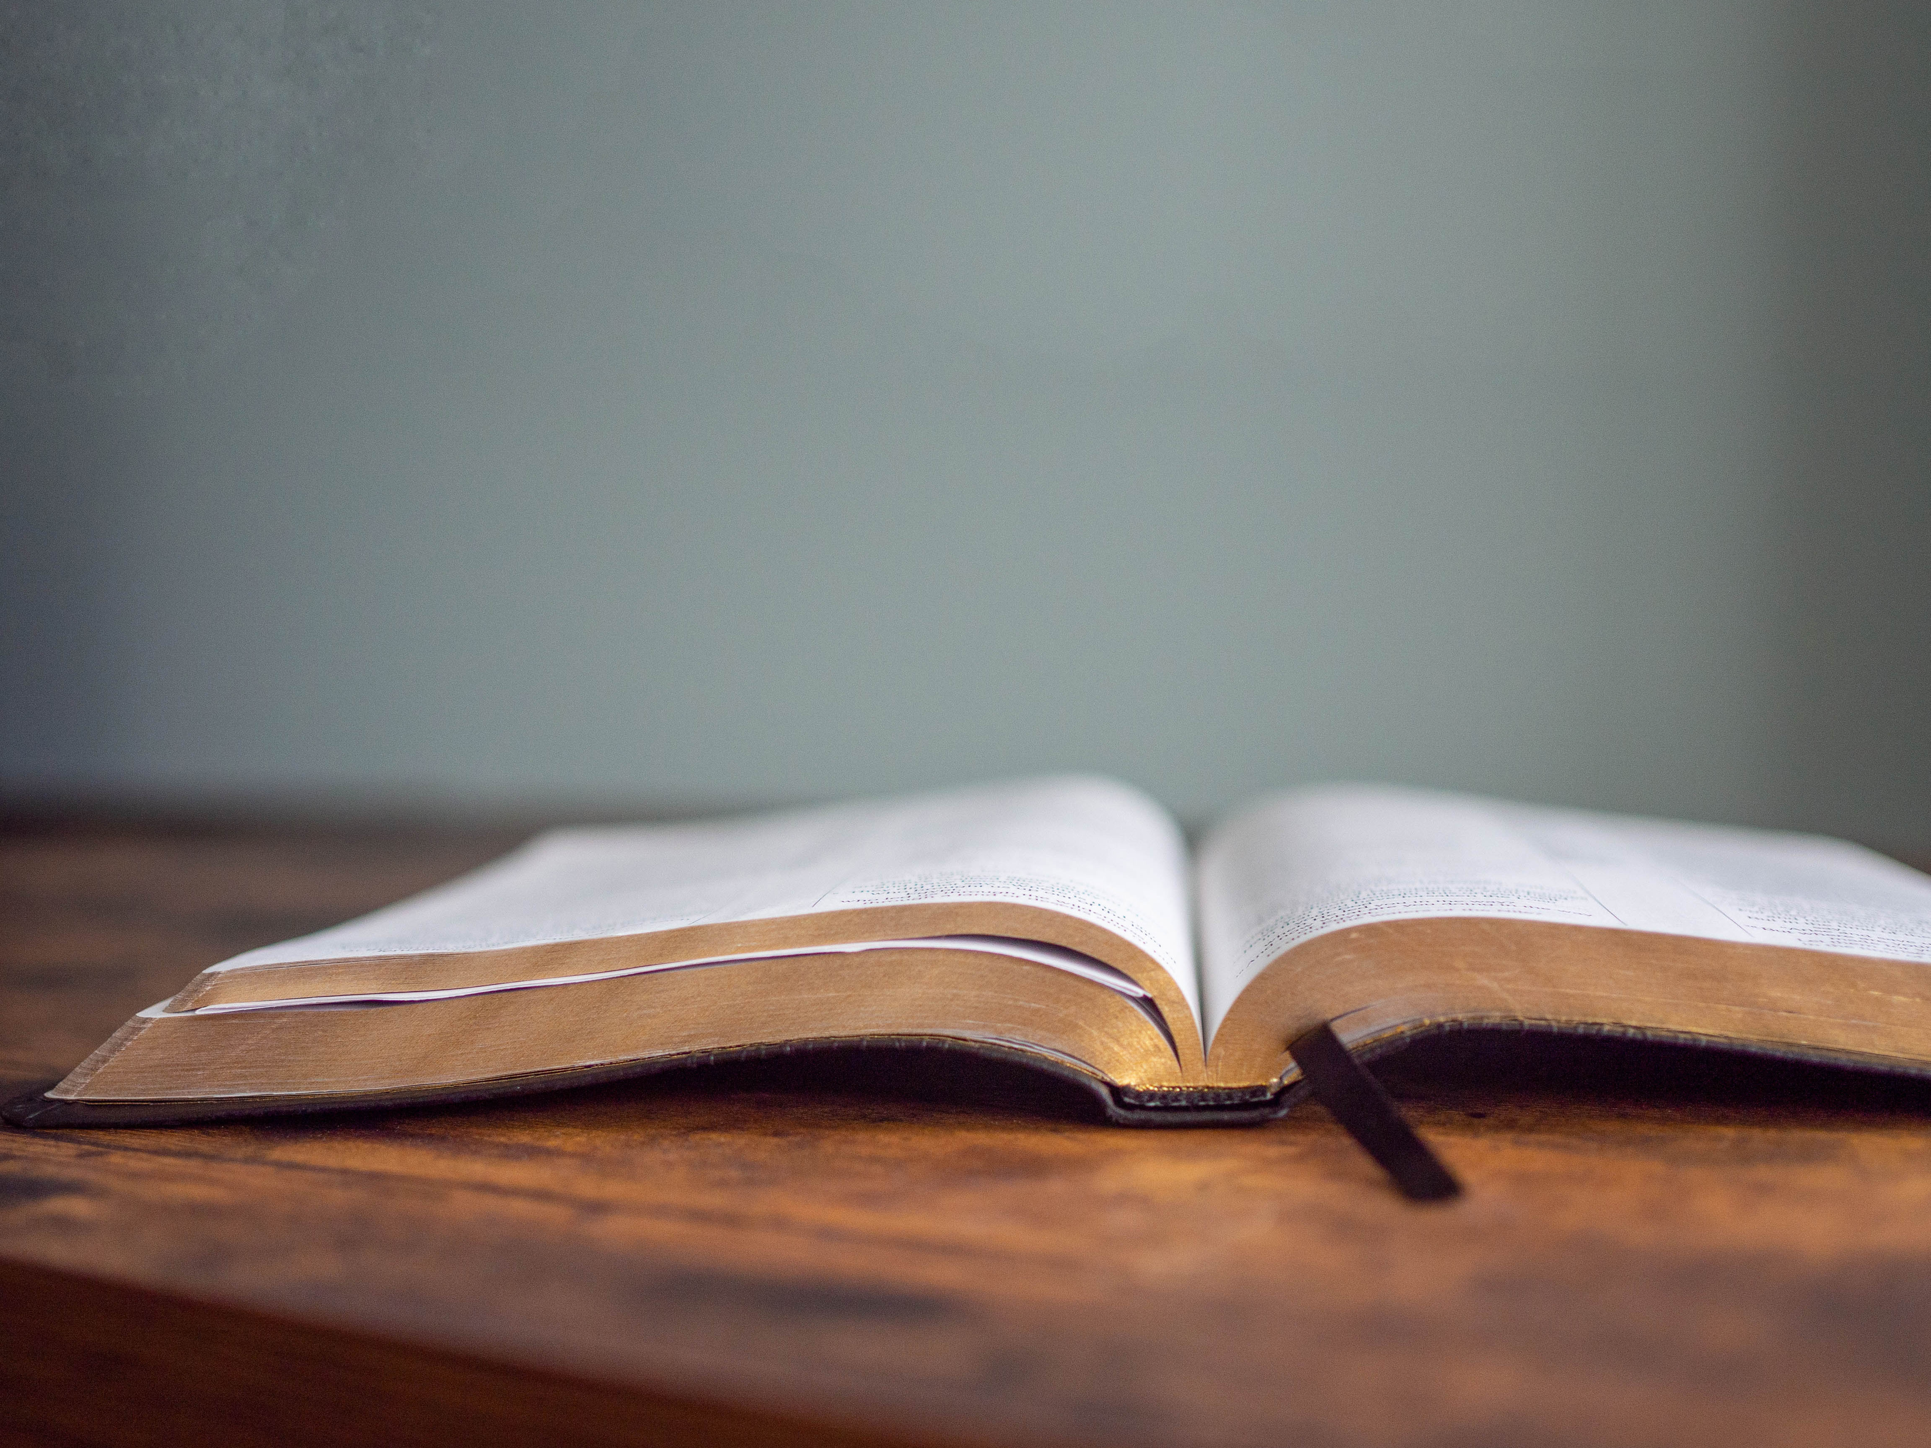
DECLARING
GOD‘S WORD

Slide 17
HEBREW BIBLE LESSON: Isaiah 64: 3–8; 65: 17–25 NRSVUE
Isaiah realizes the future is the work of God.
³ When you did awesome deeds that we did not expect, you came down; the mountains quaked at your presence.
⁴ From ages past no one has heard,
no ear has perceived,
no eye has seen any God besides you,
who works for those who wait for him.
⁵ You meet those who gladly do right,
those who remember you in your ways. . . .

Slide 18
But you were angry, and we sinned;
because you hid yourself we transgressed.
⁶ We have all become like one who is unclean,
and all our righteous deeds are like a filthy cloth.
We all fade like a leaf, and our iniquities, like the wind, take us away.
⁷ There is no one who calls on your name
or attempts to take hold of you,
for you have hidden your face from us and have delivered us into the hand of our iniquity. . . .

Slide 19
⁸ Yet, O Lord, you are our Father;
we are the clay, and you are our potter;
we are all the work of your hand.
¹⁷ For I am about to create new heavens
and a new earth;
the former things shall not be remembered
or come to mind.
¹⁸ But be glad and rejoice forever
in what I am creating, . . .

Slide 20
for I am about to create Jerusalem as a joy
and its people as a delight.
¹⁹ I will rejoice in Jerusalem
and delight in my people;
no more shall the sound of weeping be heard in it
or the cry of distress.
²⁰ No more shall there be in it
an infant who lives but a few days
or an old person who does not live out a lifetime,
. . .

Slide 21
for one who dies at a hundred years will be considered a youth,
and one who falls short of a hundred will be considered accursed.
²¹ They shall build houses and inhabit them;
they shall plant vineyards and eat their fruit.
²² They shall not build and another inhabit;
they shall not plant and another eat,
for like the days of a tree shall the days of my people be, . . .

Slide 22
and my chosen shall long enjoy the work of their hands.
²³ They shall not labor in vain
or bear children for calamity,
for they shall be offspring blessed by the Lord—
and their descendants as well.
²⁴ Before they call I will answer,
while they are yet speaking I will hear.
²⁵ The wolf and the lamb shall feed together;
the lion shall eat straw like the ox, . . .

Slide 23
but the serpent—its food shall be dust!
They shall not hurt or destroy
on all my holy mountain,
says the Lord.

Slide 24
NEW TESTAMENT LESSON: Revelation 21: 1–7
God is making all things new.
21 Then I saw a new heaven and a new earth, for the first heaven and the first earth had passed away, and the sea was no more. ² And I saw the holy city, the new Jerusalem, coming down out of heaven from God, prepared as a bride adorned for her husband. ³ And I heard a loud voice from the throne saying,
“See, the home of God is among mortals.
He will dwell with them; they will be his peoples, . . .

Slide 25
and God himself will be with them and be their God;
⁴ he will wipe every tear from their eyes.
Death will be no more;
mourning and crying and pain will be no more,
for the first things have passed away.”
⁵ And the one who was seated on the throne said, “See, I am making all things new.” Also he said, “Write this, for these words are trustworthy and true.” ⁶ Then he said to me, . . .

Slide 26
“It is done! I am the Alpha and the Omega, the Beginning and the End. To the thirsty I will give water as a gift from the spring of the water of life. ⁷ Those who conquer will inherit these things, and I will be their God, and they will be my children.

Slide 27
GOSPEL LESSON: Matthew 10: 28–33
Jesus illustrates qualities of God the Father.
²⁸ Do not fear those who kill the body but cannot kill the soul; rather, fear the one who can destroy both soul and body in hell. ²⁹ Are not two sparrows sold for a penny? Yet not one of them will fall to the ground apart from your Father. ³⁰ And even the hairs of your head are all counted. ³¹ So do not be afraid; you are of more value than many sparrows. . . .

Slide 28
³² “Everyone, therefore, who acknowledges me before others, I also will acknowledge before my Father in heaven, ³³ but whoever denies me before others, I also will deny before my Father in heaven.

Slide 29



PASTOR DAVID’S
SERMON SERIES:
“I am”
Sayings of Jesus:
IX. “I am Doing
a New Thing”

Slide 30


Slide 31
RESPONDING TO GOD’S WORD

Slide 32
* AFFIRMATION OF FAITH: A Brief Statement of Faith
We trust in God, whom Jesus called Abba, Father. In sovereign love God created the world good and makes everyone equally in God’s image, male and female, of every race and people, to live as one community.
. . .

Slide 33
In everlasting love, the God of Abraham and Sarah chose a covenant people to bless all families of the earth. Loving us still, God makes us heirs with Christ of the covenant like a mother will not forsake her nursing child, like a father who runs to welcome the prodigal home, God is faithful still. . . .

Slide 34
With believers in every time and place, we rejoice that nothing in life or in death can separate us from the love of God in Christ Jesus our Lord. Amen.

Slide 35
* HYMN: No. 309 Of the Father's Love Begotten vv. 1, 3
Of the Father’s love begotten,
Ere the worlds began to be,
He is Alpha and Omega,
He the source, the ending He,
Of the things that are, that have been,
And that future years shall see,
Evermore and evermore!
. . .

Slide 36
3
Christ, to Thee with God the Father,
And, O Holy Ghost, to Thee,
Hymn and chant with high thanksgiving,
And unwearied praises be:
Honor, glory, and dominion,
And eternal victory,
Evermore and evermore!
Amen.

Slide 37
PRAYER OF THANKSGIVING, OF THE PEOPLE,
& THE LORD’S PRAYER
Our Father who art in heaven,
Hallowed be thy name.
Thy kingdom come, thy will be done;
On earth as it is in heaven.
Give us this day our daily bread;
And forgive us our debts,
As we forgive our debtors;
And lead us not into temptation,
But deliver us from evil,
For Thine is the kingdom
And the power and the glory, forever. Amen.

Slide 38
DEPARTING IN GOD’S NAME

Slide 39
* HYMN OF PRAISE: No. 339 Be Thou My Vision vv. 1 & 3
Be Thou my vision, O Lord of my heart;
Naught be all else to me,
save that Thou art--
Thou my best thought,
by day or by night,
Waking or sleeping,
Thy presence my light.
. . .

Slide 40
3
Be Thou my wisdom,
and Thou my true word;
I ever with Thee and Thou with me, Lord;
Heart of my own heart, whatever befall,
Still be my vision, O Ruler of all.

Slide 41

* CHARGE TO THE PEOPLE & BENEDICTION
* CHORAL BENEDICTION
POSTLUDE
Our worship has ended—our Christian Witness begins!

