Slide 1

Enter in
SILENCE
Wait with
REVERENCE
Worship from
JOY

Slide 2
PRELUDE
WELCOME & ANNOUNCEMENTS
AFFIRMATION OF MISSION STATEMENT
CHORAL INTROIT
Our Mission Statement
As disciples of Jesus Christ,
led by the Holy Spirit,
we experience God’s unconditional love,
and we witness to others
by discovering and sharing our gifts.

Slide 3
* CALL TO WORSHIP:
O God, Creator, Redeemer, and Sanctifier of all life, come and visit us this morning.
Refresh our faith, rekindle with us deep hope, mold us by your love.
O Lord, Jesus Christ, who redeemed the world in love,
Reclaim our hearts in our worship of you.
  . . .

Slide 4
O Holy Spirit, who moves this world toward the new creation,
Move within us and help us to live in relationship with you and one another.
With joyful and grateful hearts, let us worship God.

Slide 5
* HYMN: No. 460 Holy God, We Praise Your Name vv. 1, 2, 4
Holy God, we praise Your Name;
Lord of all, we bow before You;
All on earth Your scepter claim,
All in heaven above adore You.
Infinite Your vast domain,
Everlasting is Your reign.
. . .

Slide 6
2
Hark, the loud celestial hymn
Angel choirs above are raising;
Cherubim and seraphim,
In unceasing chorus praising,
Fill the heavens with sweet accord:
Holy, holy, holy Lord.
. . .

Slide 7
4
Holy Father, Holy Son,
Holy Spirit, Three we name You,
While in essence only One;
Undivided God we claim You,
And adoring bend the knee
While we own the mystery.

Slide 8
PRAYER OF CONFESSION: (in silence then responsively)
Triune God, we praise you that you claim us and are the God of life, love, and laughter. Though Jesus prayed that we might be one, …
We confess that we fail to live in unity and community with you and one another. We can be an othering people, and we break our communion with you through hostile words and . . .

Slide 9
unkind actions. We long for your Spirit to heal us and to correct us, we long, too, for you to reconnect with us that we may experience deep and intimate communion with you and all humankind. In Jesus’ name, we pray, Amen.

Slide 10
ASSURANCE OF CHRIST’S FORGIVENESS:
Friends — live into the joyful freedom of Christ’s forgiveness. Hear, believe, and claim the good news of the gospel!
In Jesus Christ, we are forgiven! Let us forgive one another.

Slide 11
* HYMN: No. 293 This Is My Father's World v. 1
This is my Father’s world,
And to my listening ears
All nature sings, and round me rings
The music of the spheres.
This is my Father’s world:
I rest me in the thought
Of rocks and trees, of skies and seas;
His hand the wonders wrought.

Slide 12

* EXCHANGE OF CHRIST’S PEACE:
Pastor: The peace of Christ be with you.
People: And also with you.
Welcome one another
with the peace of Christ.
~ Children may go downstairs for Sunday School ~

Slide 13

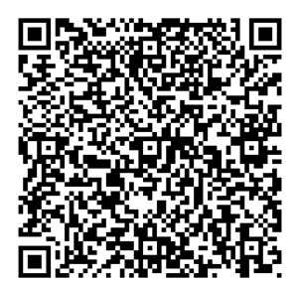
GIVING OF OUR GIFTS & OFFERTORY:
Our God has blessed us, so let us extend
God’s Blessing as we present our Tithes and Offerings.
Thank you for being faithful stewards of your
church family with your prayers, your time,
talent, and your financial resources.
Contributions may also be made:
Electronically on the church website
at fpcb-nj.org;
By reoccurring electronic withdrawal; or
By mailing your offering to the church:
P.O. Box 385, Blairstown, NJ.

Slide 14
* DOXOLOGY: No. 592 Praise God
Praise God, from whom all blessings flow;
Praise Him, all creatures here below;
Praise Him above, ye heavenly host;
Praise Father, Son, and Holy Ghost. Amen.
* PRAYER OF DEDICATION

Slide 15
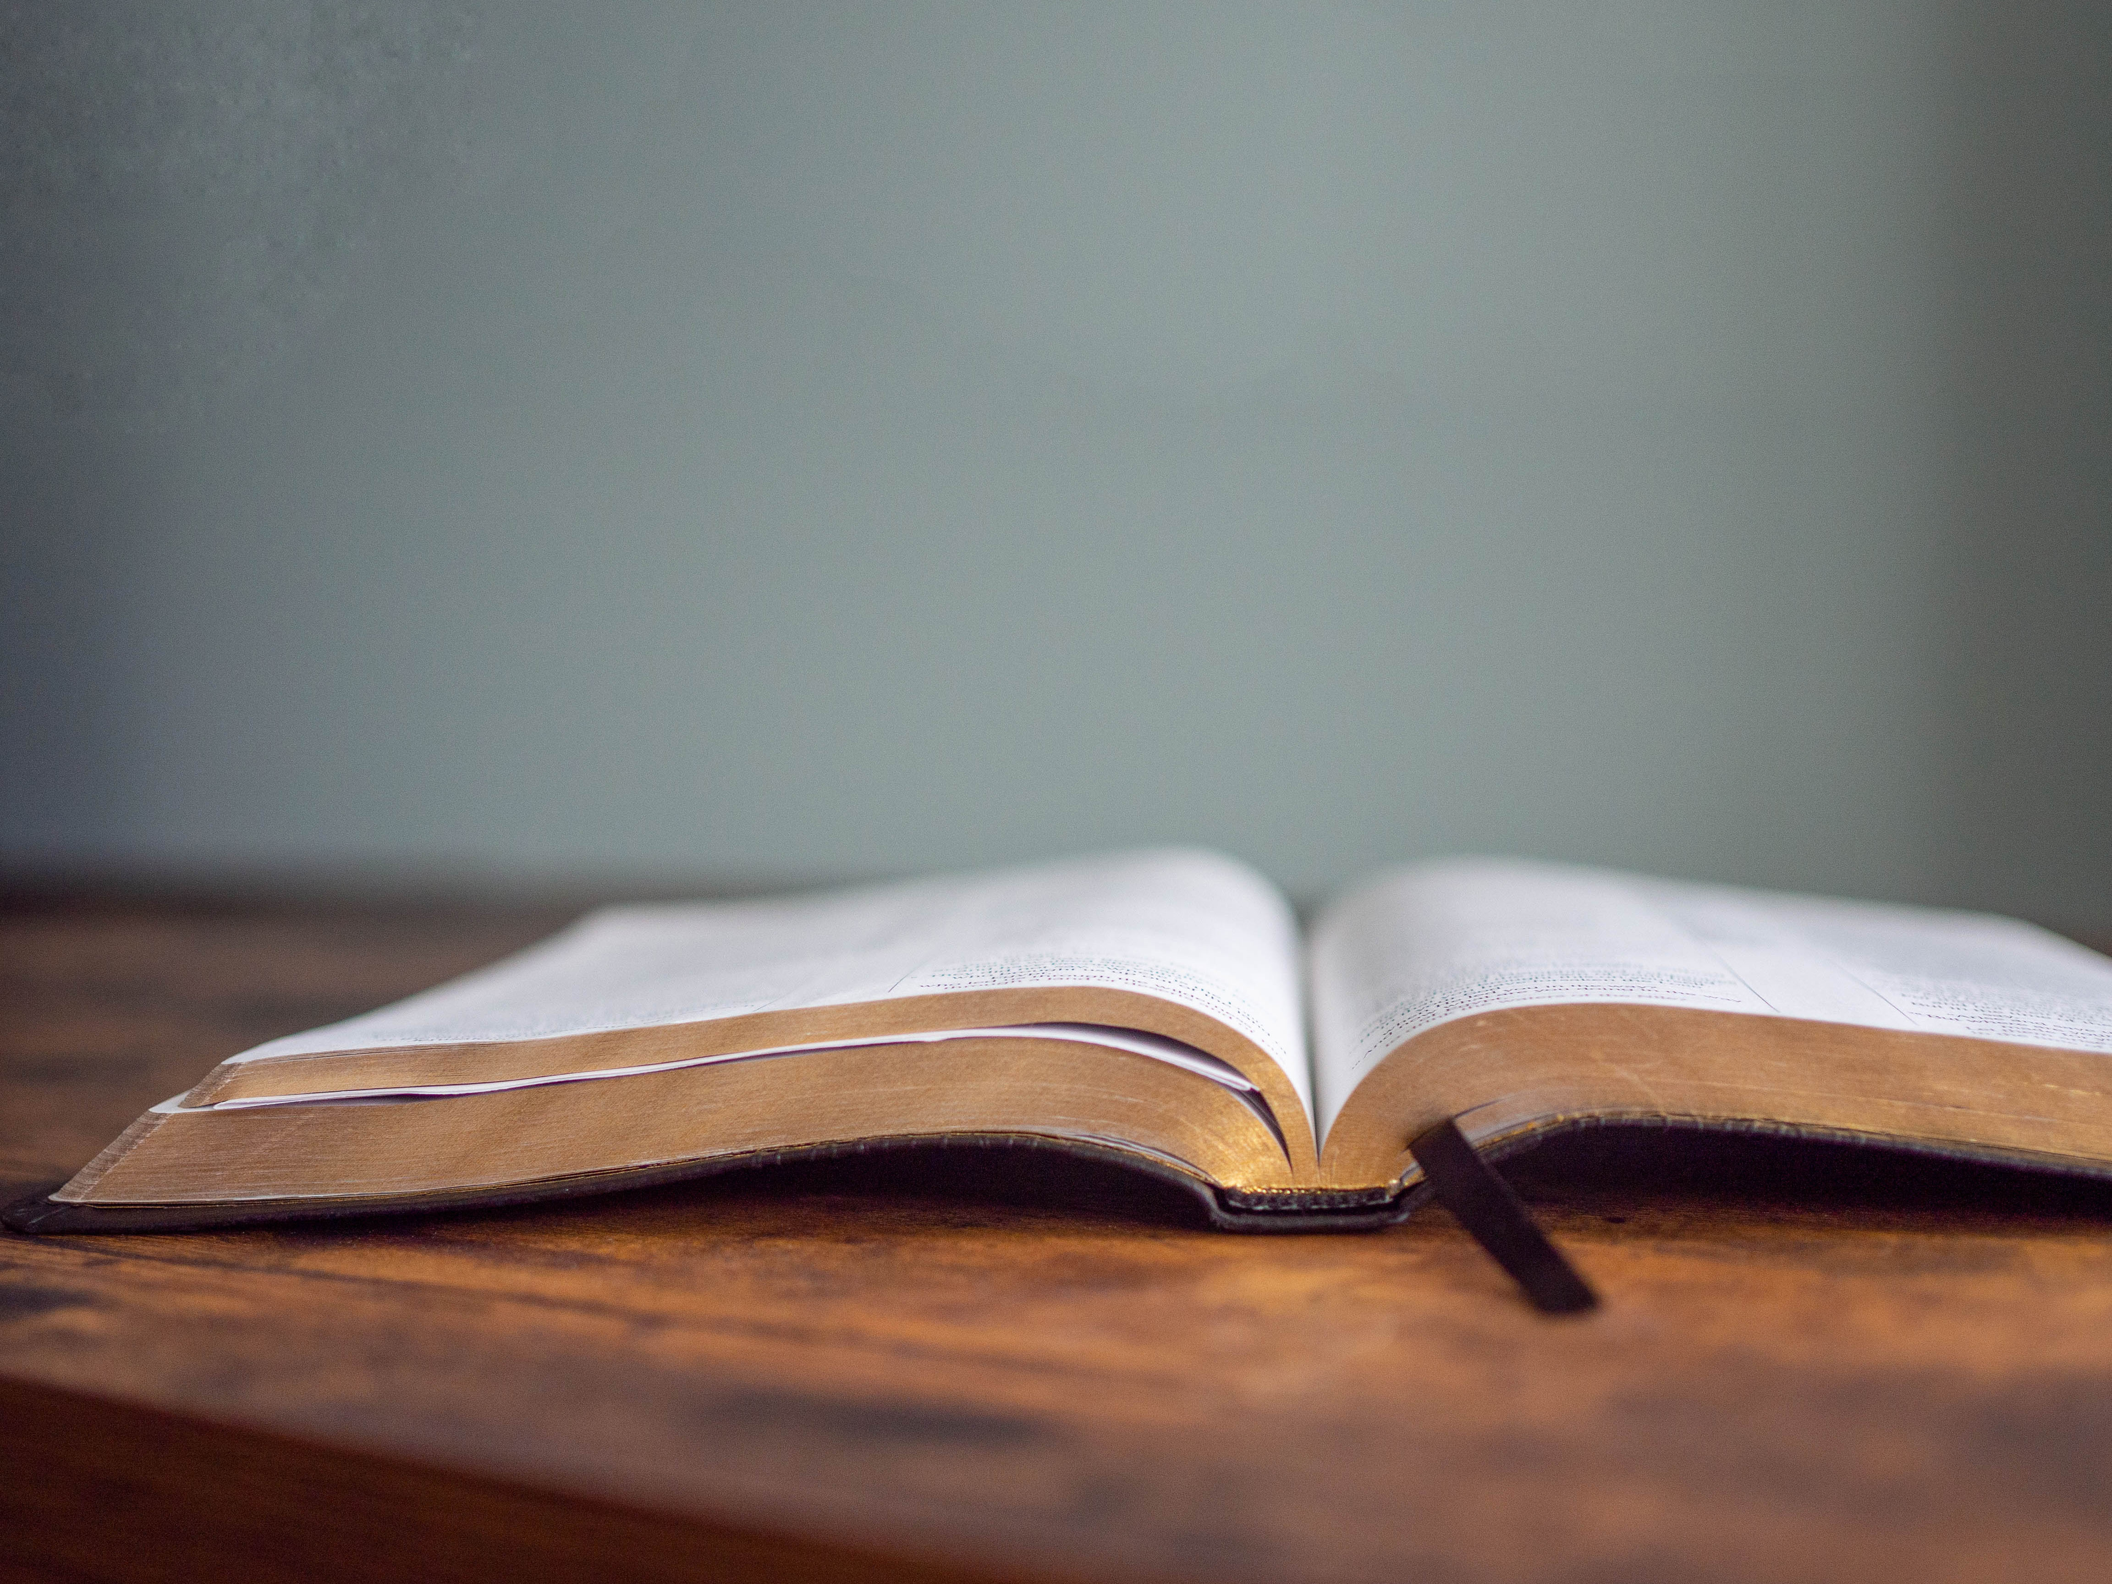
DECLARING
GOD‘S WORD

Slide 16
PSALTER LESSON: Psalm 80: 7–19
As the vine of God, Israel lives in need of restoration with God.
⁷ Restore us, O God of hosts;
let your face shine, that we may be saved.
⁸ You brought a vine out of Egypt;
you drove out the nations and planted it.
⁹ You cleared the ground for it;
it took deep root and filled the land.
¹⁰ The mountains were covered with its shade,
the mighty cedars with its branches;
. . .

Slide 17
¹¹ it sent out its branches to the sea
and its shoots to the River.
¹² Why then have you broken down its walls,
so that all who pass along the way pluck its fruit?
¹³ The boar from the forest ravages it,
and all that move in the field feed on it.
¹⁴ Turn again, O God of hosts;
look down from heaven and see;
have regard for this vine,
¹⁵ the stock that your right hand planted. . . .

Slide 18
¹⁶ It has been burned with fire; it has been cut down;
may they perish at the rebuke of your countenance.
¹⁷ But let your hand be upon the one at your right hand, the one whom you made strong for yourself.
¹⁸ Then we will never turn back from you;
give us life, and we will call on your name.
¹⁹ Restore us, O Lord God of hosts;
let your face shine, that we may be saved.

Slide 19
GOSPEL LESSON: John 15: 1–16, 26
15 “I am the true vine, and my Father is the vinegrower. ² He removes every branch in me that bears no fruit. Every branch that bears fruit he prunes to make it bear more fruit. ³ You have already been cleansed by the word that I have spoken to you. ⁴ Abide in me as I abide in you. Just as the branch cannot bear fruit by itself unless it abides in the vine, neither can you unless you abide in me. ⁵ I am the vine; you are the branches. . . .

Slide 20
Those who abide in me and I in them bear much fruit, because apart from me you can do nothing. ⁶ Whoever does not abide in me is thrown away like a branch and withers; such branches are gathered, thrown into the fire, and burned. ⁷ If you abide in me and my words abide in you, ask for whatever you wish, and it will be done for you. ⁸ My Father is glorified by this, that you bear much fruit and become my disciples. ⁹ As the Father has loved me, so I have loved you; abide in my love. . . .

Slide 21
¹⁰ If you keep my commandments, you will abide in my love, just as I have kept my Father’s commandments and abide in his love. ¹¹ I have said these things to you so that my joy may be in you and that your joy may be complete.
¹² “This is my commandment, that you love one another as I have loved you. ¹³ No one has greater love than this, to lay down one’s life for one’s friends. ¹⁴ You are my friends if you do what I command you. . . .

Slide 22
¹⁵ I do not call you servants any longer, because the servant does not know what the master is doing, but I have called you friends, because I have made known to you everything that I have heard from my Father. ¹⁶ You did not choose me, but I chose you. And I appointed you to go and bear fruit, fruit that will last, so that the Father will give you whatever you ask him in my name.
²⁶ “When the Advocate comes, whom I will send to you from the Father, the Spirit of truth who comes from the Father, he will testify on my behalf.

Slide 23
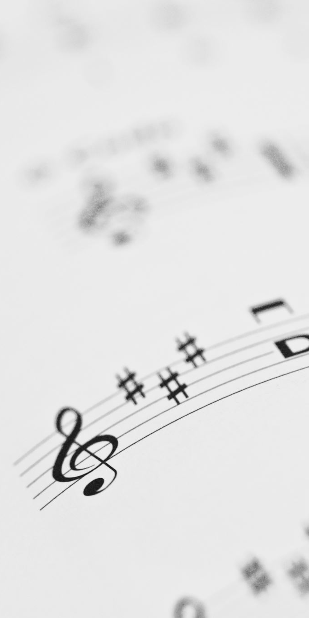
CHANCEL CHOIR ANTHEM
“We Come Together Here”
by J. Stevens

Slide 24



PASTOR DAVID’S
SERMON SERIES:
“I Am”
Sayings of Jesus:
VII. “I am the true vine and my Father is the true vine grower.
I am the vine and You are the branches, those who abide in me, I will abide in them.”

Slide 25
RESPONDING TO GOD’S WORD

Slide 26
* AFFIRMATION OF FAITH: A Brief Statement of Faith, 1990
We trust in Jesus Christ, fully human, fully God. In everlasting love, the God of Abraham and Sarah chose a covenant people to bless all families of the earth. Loving us still, God makes us heirs with Christ of the covenant. Like a mother who will not forsake her nursing child, . . .

Slide 27
like a father who runs to welcome the prodigal home, God is faithful still.
With believers in every time and place, we rejoice that nothing in life and in death can separate us from the love of God in Christ Jesus our Lord. Amen.

Slide 28
* HYMN: No. 508 For the Bread Which You Have Broken
For the bread which You have broken,
For the wine which You have poured,
For the words which You have spoken,
Now we give You thanks, O Lord.
By this promise that You love us,
By Your gift of peace restored,
By Your call to heaven above us,
Hallow all our lives, O Lord. . . .

Slide 29
With the saints who now adore You
Seated at the heavenly board,
May the Church still waiting for You
Keep love’s tie unbroken, Lord.
In Your service, Lord, defend us;
In our hearts keep watch and ward;
In the world to which You send us
Let Your kingdom come, O Lord.

Slide 30


Slide 31
SACRAMENT OF HOLY COMMUNION
INVITATION TO THE LORD’S TABLE:
L: Friends, this is the joyful feast of the people of God!
P: People will come from east and west, and from north and south, and sit at the table in the kingdom of God.

Slide 32
L: Behold, how good and pleasant it is when brothers and sisters dwell in unity.
P: God sent the whole world God’s only Son. Since God loved us so much, we too, should love one another.
L: This is the Lord’s Table. Our Savior invites all who are truly sorry for their sins and would humbly put their trust in him to come to the feast which he has prepared. Listen to the gracious words of our Savior Jesus Christ:

Slide 33
“Come to me, all you that are weary and are carrying heavy burdens, and I will give you rest. Take my yoke upon you, and learn from me; for I am gentle and humble in heart, and you will find rest for your souls. For my yoke is easy, and my burden is light.“ Matthew 11: 28–30
”This is indeed the will of my Father, that all who see the Son and believe in him may have eternal life, and I will raise them up on the last day.” John 6: 40
“Behold, I stand at the door and knock; if those who hear my voice open the door, I will come in to them and eat with them, and they with me.” Revelation 3: 20

Slide 34
L: The Lord be with you.
P: And with your spirit.
L: Lift up your hearts.
P: We lift them to the Lord.
L: Let us give thanks to the Lord our God.
P: It is right to give God our thanks and praise.

Slide 35
PRAYER OF THANKSGIVING, PRAYERS OF THE PEOPLE,
& THE LORD’S PRAYER:
L: Holy Lord . . . as we pray together:
Nourished at this table, O God, may we know the power of Christ’s redemptive love and may we desire to lean into and live in the power of your grace and truth. Give us courage to dismantle and break down the barriers that separate us from your love and . . .

Slide 36
from living lovingly on this planet, within this nation and in this community. In Jesus’ name, we pray saying, . . .

Slide 37
Our Father who art in heaven,
Hallowed be thy name.
Thy kingdom come, thy will be done;
On earth as it is in heaven.
Give us this day our daily bread;
And forgive us our debts,
As we forgive our debtors;
And lead us not into temptation,
But deliver us from evil,
For Thine is the kingdom
And the power and the glory, forever. Amen.

Slide 38


Slide 39

OFFERING OF THE ELEMENTS:
Approach the Table,
receive the bread,
take the cup,
and return to your pew.

Slide 40
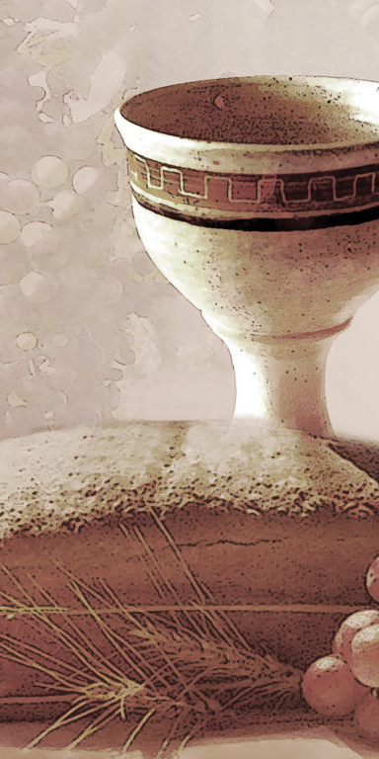
SHARING THE BREAD:
Jesus said, “I am the bread of life. Whoever comes to me will never be hungry...” (Jn. 6:35a)
Let us eat this bread in remembrance of Christ and may the spirit that is in him be in us also.
DRINKING THE CUP:
Jesus said, “I am the vine, you are the branches, apart from him, we can do nothing.”
Drink this cup in remembrance of Christ and may the spirit in which he died be our Spirit.

Slide 41
COMMUNION BLESSING: Let us give thanks to the Lord our God.
Awesome God, we give you thanks for the hope we have in Jesus, who died, is risen and reigns over all. Rekindle within us hope for a better tomorrow. Enable us to live in the present with confidence, courage, and the full conviction that nothing within all of your creation shall ever separate us . . .

Slide 42
from your mysterious and miraculous love revealed in Jesus Christ, your Son, our Savior and our Lord. Amen.

Slide 43
DEPARTING IN GOD’S NAME

Slide 44
* HYMN: No. 276 Great Is Thy Faithfulness
Great is Thy faithfulness, O God my Father,
There is no shadow of turning with Thee;
Thou changest not,
Thy compassions they fail not;
As Thou hast been Thou forever wilt be.
. . .

Slide 45
Great is Thy faithfulness!
Great is Thy faithfulness!
Morning by morning new mercies I see;
All I have needed Thy hand hath provided;
Great is Thy faithfulness, Lord, unto me!
. . .

Slide 46
2
Summer and winter and springtime
and harvest,
Sun, moon, and stars in their courses above
Join with all nature in manifold witness
To Thy great faithfulness, mercy and love.
. . .

Slide 47
Great is Thy faithfulness!
Great is Thy faithfulness!
Morning by morning new mercies I see;
All I have needed Thy hand hath provided;
Great is Thy faithfulness, Lord, unto me!
. . .

Slide 48
3
Pardon for sin and a peace that endureth,
Thine own dear presence to cheer
and to guide;
Strength for today and bright hope
for tomorrow,
Blessings all mine,
with ten thousand beside!
. . .

Slide 49
Great is Thy faithfulness!
Great is Thy faithfulness!
Morning by morning new mercies I see;
All I have needed Thy hand hath provided;
Great is Thy faithfulness, Lord, unto me!

Slide 50


* CHARGE TO THE PEOPLE &
BENEDICTION
* CHORAL BENEDICTION
POSTLUDE
Our worship has ended —
our Christian Witness begins!
for refreshments & fellowship.

