Slide 1

Enter in
SILENCE
Wait with
REVERENCE
Worship from
JOY

Slide 2
PRELUDE
WELCOME & ANNOUNCEMENTS
AFFIRMATION OF MISSION STATEMENT
CHORAL INTROIT
Our Mission Statement
As disciples of Jesus Christ,
led by the Holy Spirit,
we experience God’s unconditional love,
and we witness to others
by discovering and sharing our gifts.

Slide 3
* CALL TO WORSHIP:
Gracious and Holy God, give us diligence to seek you.
Give us wisdom to perceive you.
Give us patience to wait for you and on you.
Give us a mind, O God, to
meditate on you.
Give us eyes to behold you; and ears to listen for your word.
Give us grateful hearts, O God, and lips of praise that we may worship you.
Let us worship God.

Slide 4
* HYMN OF PRAISE: No. 138 Holy, Holy, Holy! Lord God Almighty
Holy, holy, holy! Lord God Almighty!
Early in the morning
our song shall rise to Thee;
Holy, holy, holy! merciful and mighty!
God in three Persons, blessèd Trinity!
. . .

Slide 5
2
Holy, holy, holy! all the saints adore Thee,
Casting down their golden crowns
around the glassy sea;
Cherubim and seraphim
falling down before Thee,
Who wert, and art, and evermore shalt be.
. . .

Slide 6
3
Holy, holy, holy!
though the darkness hide Thee,
Though the eye of sinfulness
Thy glory may not see,
Only Thou art holy;
there is none beside Thee
Perfect in power, in love, and purity.
. . .

Slide 7
4
Holy, holy, holy! Lord God Almighty!
All Thy works shall praise Thy Name,
in earth, and sky, and sea;
Holy, holy, holy! merciful and mighty!
God in three Persons, blessèd Trinity!

Slide 8
PRAYER OF CONFESSION: (in silence then in unison)
Eternal God, King of the Universe, in whom we live, move, and have our being, whose mercy we forget in the blindness of our hearts: Forgive and cleanse us from our offenses, and deliver us from proud thoughts and vain desires, that with reverent and humble hearts, . . .

Slide 9
we may draw near to you, confessing our faults, confiding in your grace, and finding in you our refuge and strength; through King Jesus, your Son, our Savior. Amen.

Slide 10
ASSURANCE OF CHRIST’S FORGIVENESS:
Friends — we did not receive a spirit of slavery to fall back into fear; but we have received a spirit of adoption, that we are children of God most high; and if children, then heirs, heirs of God and joint heirs with Christ.
Imperfect people though we are, in Christ, by the power of the Spirit, we are forgiven. Thanks be to God, who claims and calls us by name. Amen.

Slide 11
* GLORIA PATRI: No. 579 Glory Be to the Father
Glory be to the father, and to the Son
and to the Holy Ghost.
As it was in the beginning,
is now and ever shall be,
world without end.
Amen. Amen.

Slide 12

* EXCHANGE OF CHRIST’S PEACE:
Pastor: The peace of Christ be with you.
People: And also with you.
Welcome one another
with the peace of Christ.
~ Children may go downstairs for Sunday School ~

Slide 13

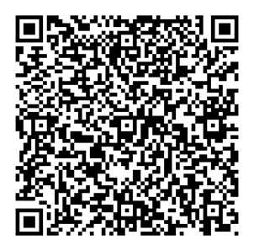
GIVING OF OUR GIFTS & OFFERTORY:
Our God has blessed us, so let us extend
God’s Blessing as we present our Tithes and Offerings.
Thank you for being faithful stewards of your
church family with your prayers, your time,
talent, and your financial resources.
Contributions may also be made:
Electronically on the church website
at fpcb-nj.org;
By reoccurring electronic withdrawal; or
By mailing your offering to the church:
P.O. Box 385, Blairstown, NJ.

Slide 14
* DOXOLOGY: No. 592 Praise God
Praise God, from whom all blessings flow;
Praise Him, all creatures here below;
Praise Him above, ye heavenly host;
Praise Father, Son, and Holy Ghost. Amen.
* PRAYER OF DEDICATION

Slide 15

DECLARING
GOD‘S WORD

Slide 16
EPISTLE LESSON: 2 Corinthians 13: 11–13
Paul signs off in the name of the Triune God.
¹¹ Finally, brothers and sisters, farewell. Be restored; listen to my appeal; agree with one another; live in peace; and the God of love and peace will be with you. ¹² Greet one another with a holy kiss. All the saints greet you.
¹³ The grace of the Lord Jesus Christ, the love of God, and the communion of the Holy Spirit be with all of you.

Slide 17
GOSPEL LESSON: John 8: 21–30; John 18: 33–39
Pilate and Jesus discuss Jesus’ kingship.
²¹ Again he said to them, “I am going away, and you will search for me, but you will die in your sin. Where I am going, you cannot come.” ²² Then the Jews said, “Is he going to kill himself? Is that what he means by saying, ‘Where I am going, you cannot come’?” ²³ He said to them, “You are from below, I am from above; you are from this world, I am not from this world. . . .

Slide 18
²⁴ I told you that you would die in your sins, for you will die in your sins unless you believe that I am he.” ²⁵ They said to him, “Who are you?” Jesus said to them, “Why do I speak to you at all? ²⁶ I have much to say about you and much to condemn, but the one who sent me is true, and I declare to the world what I have heard from him.” ²⁷ They did not understand that he was speaking to them about the Father. ²⁸ So Jesus said, . . .

Slide 19
“When you have lifted up the Son of Man, then you will realize that I am he and that I do nothing on my own, but I speak these things as the Father instructed me. ²⁹ And the one who sent me is with me; he has not left me alone, for I always do what is pleasing to him.” ³⁰ As he was saying these things, many believed in him.
³³ Then Pilate entered the headquarters again, summoned Jesus, and asked him, “Are you the King of the Jews?” . . .

Slide 20
³⁴ Jesus answered, “Do you ask this on your own, or did others tell you about me?” ³⁵ Pilate replied, “I am not a Jew, am I? Your own nation and the chief priests have handed you over to me. What have you done?” ³⁶ Jesus answered, “My kingdom does not belong to this world. If my kingdom belonged to this world, my followers would be fighting to keep me from being handed over to the Jews. But as it is, my kingdom is not from here.” ³⁷ Pilate asked him, “So you are a king?”. . .

Slide 21
Jesus answered, “You say that I am a king. For this I was born, and for this I came into the world, to testify to the truth. Everyone who belongs to the truth listens to my voice.” ³⁸ Pilate asked him, “What is truth?”
After he had said this, he went out to the Jews again and told them, “I find no case against him. ³⁹ But you have a custom that I release someone for you at the Passover. Do you want me to release for you the King of the Jews?”

Slide 22
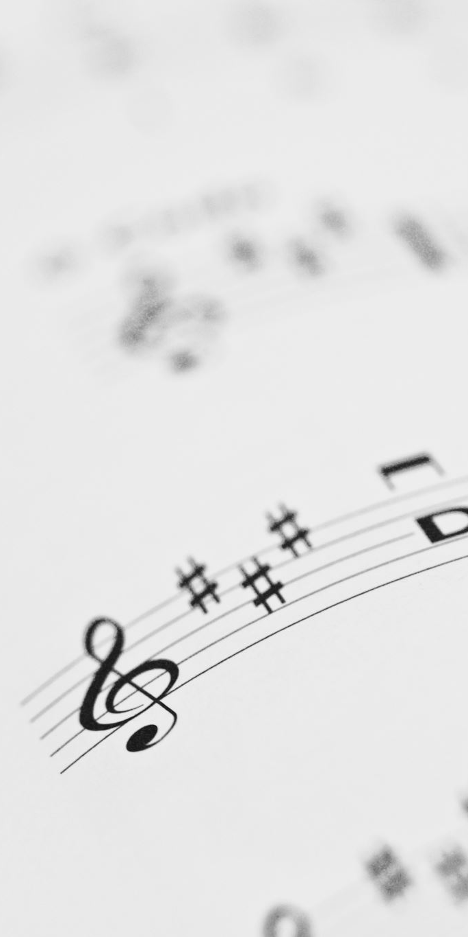
DUET:
“O Lovely Peace”
by G.F. Handel from Judas Maccabeus
Elizabeth Toploski, Alto &
Maggie Morokutti, Soprano

Slide 23


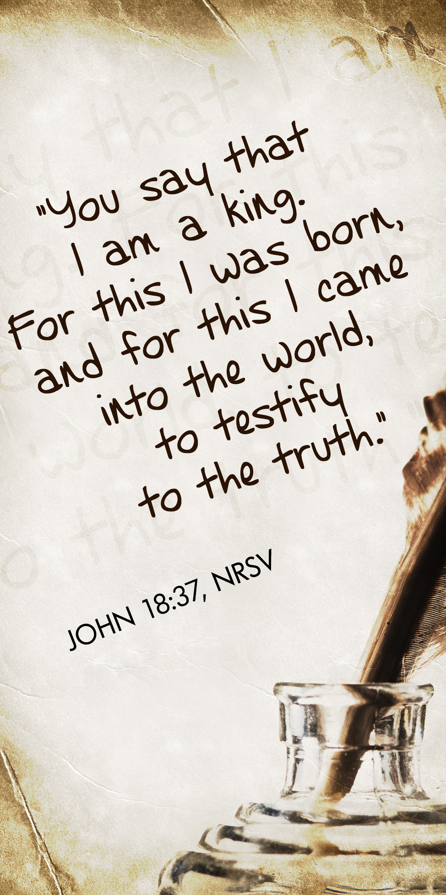
PASTOR DAVID’S
SERMON SERIES:
“I am”
Sayings of Jesus:
VI. “I Am a King”

Slide 24
RESPONDING TO GOD’S WORD

Slide 25
* AFFIRMATION OF FAITH: A Brief Statement of Faith
In life and in death we belong to God. Through the grace of our Lord Jesus Christ, the love of God and the communion of the Holy Spirit, we trust in the one triune God, the Holy One of Israel, whom alone we worship and serve. We trust in Jesus Christ, fully human, fully God...and we trust in God, . . .

Slide 26
whom Jesus called Abba, Father. In sovereign love God created the world good and makes everyone equally in God’s image, male and female, of every race and people, to live as one community. But we rebel against God; we hide from our Creator. Ignoring God’s commandments, we violate the image of God in others and ourselves, . . .

Slide 27
accept lies as truth, exploit neighbor and nature, and threaten death to the planet entrusted to our care. We deserve God’s condemnation.
Yet, God acts with justice and mercy to redeem creation. In everlasting love, the God of Abraham and Sarah chose a covenant people to bless all families of the earth. . . .

Slide 28
In a broken and fearful world, the Spirit gives us courage to pray without ceasing, to witness among all peoples to Christ as Lord and Savior, to unmask idolatries in Church and culture, to hear the voices of peoples long silenced, and to work with others for justice, freedom, and people. Amen.

Slide 29

INSTALLATION
OF A CHURCH OFFICER
Being installed as a deacon is Kelly McElroy

Slide 30
SENTENCES OF SCRIPTURE: 1 Corinthians 12: 4–7, 27
There are varieties of gifts, but it is the same
Spirit who gives them.
There are different ways of serving God, but it is the same Lord who is served. . . .

Slide 31
God works through each person in a unique way, but it is God’s purpose that is accomplished.
To each is given a gift of the Spirit to be used for the common good.
Together we are the body of Christ, and
individually members of it.
By the power and might of your Spirit, O Christ, may we too, seek not to be served but to serve, in your name. Amen.

Slide 32
STATEMENT ON THE GIFT
OF INSTALLATION: Pastor David Harvey
PRESENTATION OF DEACON TO BE INSTALLED:
Elder: Mr. Moderator, Deacon Kelly McElroy, having been elected again to active service by the vote of this congregation, may now be installed to office.

Slide 33
QUESTIONS OF AFFIRMATION FOR OFFICER
ALREADY ORDAINED
Kelly, you have been called again to the position of servant leadership in and for this church. Do you welcome the work for which you have been chosen, and will you serve the people with energy, intelligence, imagination, and love, relying on God’s mercy and rejoicing in God’s promises through and in the name of Jesus, our Lord?
Officer: I do and I will.

Slide 34
QUESTIONS OF AFFIRMATION TO THE CONGREGATION:
Do we, the members of the Church, accept this young woman as a deacon, chosen by God through the voice of the congregation to lead us in the ways of Jesus Christ?
We do.
Do we agree to encourage her, to respect her decisions, and to follow as she guides us serving Jesus Christ, who alone is Head of the Church?
We do.
INSTALLATION BLESSING

Slide 35
* HYMN: No. 155 Rejoice, the Lord Is King
Rejoice, the Lord is King!
Your Lord and King adore!
Rejoice, give thanks, and sing,
And triumph evermore:
Lift up your heart, lift up your voice!
Rejoice, again I say, rejoice!
. . .

Slide 36
God's kingdom cannot fail,
Christ rules o’er earth and heaven;
The keys of death and hell
Are to our Jesus given:
Lift up your heart, lift up your voice!
Rejoice, again I say, rejoice!
. . .

Slide 37
Rejoice in glorious hope!
For Christ the Judge shall come
To glorify the saints
For their eternal home:
Lift up your heart, lift up your voice!
Rejoice, again I say, rejoice!

Slide 38
PRAYER OF THANKSGIVING, OF THE PEOPLE,
& THE LORD’S PRAYER
Our Father who art in heaven,
Hallowed be thy name.
Thy kingdom come, thy will be done;
On earth as it is in heaven.
Give us this day our daily bread;
And forgive us our debts,
As we forgive our debtors;
And lead us not into temptation,
But deliver us from evil,
For Thine is the kingdom
And the power and the glory, forever. Amen.

Slide 39
DEPARTING IN GOD’S NAME

Slide 40
* HYMN: No. 139 Come, Thou Almighty King
Come, Thou Almighty King,
Help us Thy name to sing,
Help us to praise:
Father, all-glorious,
O’er all victorious,
Come, and reign over us,
Ancient of Days.
. . .

Slide 41
2
Come, Thou Incarnate Word,
Gird on Thy mighty sword,
Our prayer attend:
Come, and Thy people bless,
And give Thy word success;
Spirit of holiness,
On us descend.
. . .

Slide 42
3
Come, Holy Comforter,
Thy sacred witness bear
In this glad hour:
Thou who almighty art,
Now rule in every heart,
And ne’er from us depart,
Spirit of power.
. . .

Slide 43
4
To Thee, great One in Three,
The highest praises be,
Hence evermore!
Thy sovereign majesty
May we in glory see,
And to eternity
Love and adore.

Slide 44

* CHARGE TO THE PEOPLE & BENEDICTION
* CHORAL BENEDICTION
POSTLUDE
Our worship has ended—our Christian Witness begins!

