Slide 1
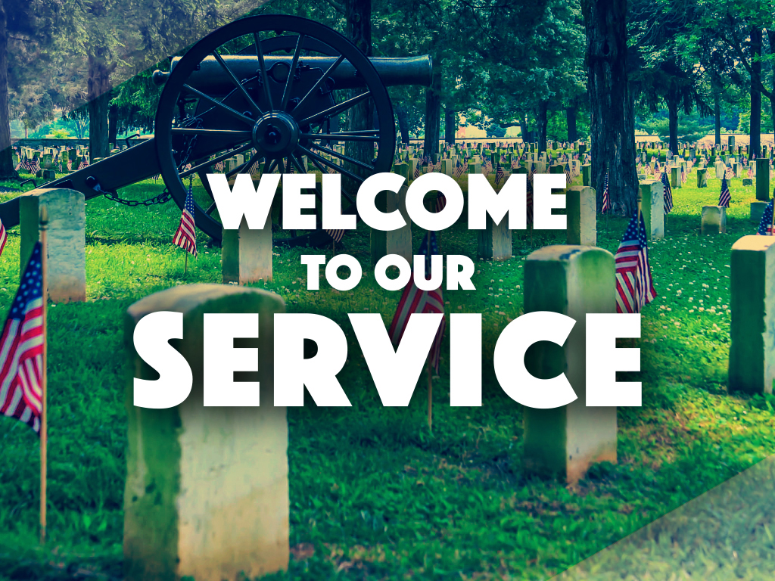
Enter in SILENCE Wait with REVERENCE
Worship from JOY

Slide 2
PRELUDE
WELCOME & ANNOUNCEMENTS
AFFIRMATION OF MISSION STATEMENT
Our Mission Statement
As disciples of Jesus Christ, led by the Holy Spirit, we experience God’s unconditional love, and we witness to others by discovering and sharing our gifts.

Slide 3

MOMENT FOR MEMORIAL DAY: Gail Weber

Slide 4

CHORAL INTROIT

Slide 5
* CALL TO WORSHIP:
From the prophet, Joel, the Lord declares:
I will pour out my Spirit on all flesh;
Sons and daughters shall prophesy: your old shall dream dreams;
Your young shall see visions.
You shall know the Lord, your God dwells in Zion, on God’s holy hill.
With grateful hearts and with lips of praise, let us worship God.

Slide 6
* HYMN: No. 210 Our God, Our Help in Ages Past vv. 1–4
Our God, our help in ages past,
Our hope for years to come,
Our shelter from the stormy blast,
And our eternal home:
. . .

Slide 7
Before the hills in order stood,
Or earth received its frame,
From everlasting Thou art God,
To endless years the same.
. . .

Slide 8
A thousand ages in Thy sight
Are like an evening gone;
Short as the watch that ends the night
Before the rising sun.
. . .

Slide 9
Time, like an ever rolling stream,
Soon bears us all away;
We fly forgotten, as a dream
Dies at the opening day.

Slide 10
PRAYER OF CONFESSION: In silence then in unison
Almighty God, as you poured your Spirit upon gathered disciples creating bold tongues, open ears, dazzled listeners, and a new community, we confess we hold back the force of your Spirit among us. We do not listen for your word of truth, speak the good news of your love, or live as a people made one in Christ. . . .

Slide 11
Have mercy on us, Lord, Jesus. Transform our rigid minds and timid faith by the power of your Holy Spirit. Empower us to live as wisely and responsibly as stewards of your good news, that we may do your will, walk in your grace, and show your goodness to this broken and at times faithless world; in Jesus’ name and for his sake we pray these things. Amen.

Slide 12
ASSURANCE OF CHRIST’S FORGIVENESS:
Friends — hear, believe, and accept the good news of the gospel of Christ’s love.
In Jesus Christ, we are forgiven! Let us forgive one another.

Slide 13
* CELEBRATING CHRIST’S FORGIVENESS: No. 582 (GTG)
Glory to God, whose goodness
shines on me; and to the Son,
whose grace has pardoned me;
and to the Spirit,
whose love has set me free.
As it was in the beginning,
is now, and ever shall be. Amen.

Slide 14

* EXCHANGE OF CHRIST’S PEACE:
L: The peace of Christ be with you.
P: And also with you.
Welcome one another with Christ’s peace.

Slide 15

GIVING OF OUR GIFTS & OFFERTORY:
Our God has blessed us, so let us extend God’s Blessing as we present our Tithes and Offerings.
Thank you for being faithful stewards of your church family with your prayers, your time, talent, and your financial resources.
Contributions may also be made:
Electronically on the church website at fpcb-nj.org;
By reoccurring electronic withdrawal; or by
By mailing your offering to the church: P.O. Box 385, Blairstown, NJ.

Slide 16
* DOXOLOGY: No. 592 Praise God
Praise God, from whom all blessings flow;
Praise Him, all creatures here below;
Praise Him above, ye heavenly host;
Praise Father, Son, and Holy Ghost. Amen.
* PRAYER OF DEDICATION

Slide 17
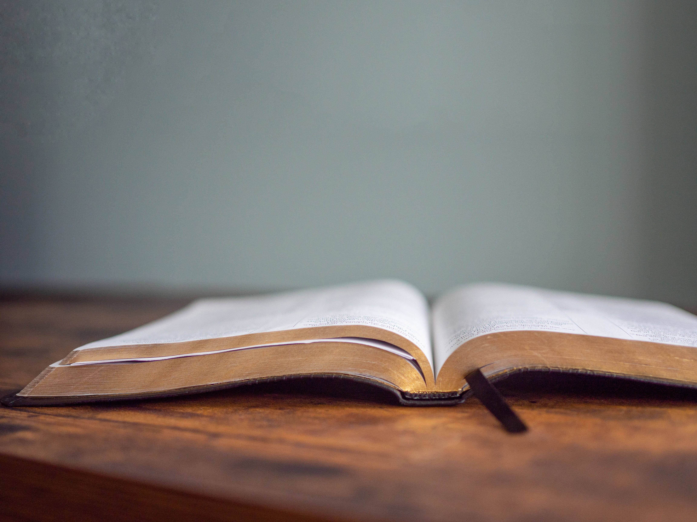
DECLARING GOD‘S WORD

Slide 18
NEW TESTAMENT: Acts 2: 1–21
2 When the day of Pentecost had come, they were all together in one place. ² And suddenly from heaven there came a sound like the rush of a violent wind, and it filled the entire house where they were sitting. ³ Divided tongues, as of fire, appeared among them, and a tongue rested on each of them. ⁴ All of them were filled with the Holy Spirit and began to speak in other languages, as the Spirit gave them ability. . . .

Slide 19
⁵ Now there were devout Jews from every people under heaven living in Jerusalem. ⁶ And at this sound the crowd gathered and was bewildered, because each one heard them speaking in the native language of each. ⁷ Amazed and astonished, they asked, “Are not all these who are speaking Galileans? ⁸ And how is it that we hear, each of us, in our own native language? ⁹ Parthians, Medes, Elamites, and residents of Mesopotamia, Judea and Cappadocia, Pontus and Asia, . . .

Slide 20
¹⁰ Phrygia and Pamphylia, Egypt and the parts of Libya belonging to Cyrene, and visitors from Rome, both Jews and proselytes, ¹¹ Cretans and Arabs—in our own languages we hear them speaking about God’s deeds of power.” ¹² All were amazed and perplexed, saying to one another, “What does this mean?” ¹³ But others sneered and said, “They are filled with new wine.” . . .

Slide 21
¹⁴ But Peter, standing with the eleven, raised his voice and addressed them, “Fellow Jews and all who live in Jerusalem, let this be known to you, and listen to what I say. ¹⁵ Indeed, these are not drunk, as you suppose, for it is only nine o’clock in the morning. ¹⁶ No, this is what was spoken through the prophet Joel:
¹⁷ ‘In the last days it will be, God declares, that I will pour out my Spirit upon all flesh, . . .

Slide 22
and your sons and your daughters shall prophesy, and your young men shall see visions, and your old men shall dream dreams. ¹⁸ Even upon my slaves, both men and women, in those days I will pour out my Spirit, and they shall prophesy. ¹⁹ And I will show portents in the heaven above and signs on the earth below, blood, and fire, and smoky mist.
. . .

Slide 23
²⁰ The sun shall be turned to darkness and the moon to blood, before the coming of the Lord’s great and glorious day. ²¹ Then everyone who calls on the name of the Lord shall be saved.’

Slide 24
GOSPEL LESSON: John 14: 1–6
14 “Do not let your hearts be troubled. Believe in God; believe also in me. ² In my Father’s house there are many dwelling places. If it were not so, would I have told you that I go to prepare a place for you? ³ And if I go and prepare a place for you, I will come again and will take you to myself, so that where I am, there you may be also. ⁴ And you know the way to the place where I am going.” . . .

Slide 25
⁵ Thomas said to him, “Lord, we do not know where you are going. How can we know the way?” ⁶ Jesus said to him, “I am the way and the truth and the life. No one comes to the Father except through me.

Slide 26


CHANCEL CHOIR ANTHEM:
“Spirit Come Down”
by Mark Hayes

Slide 27

PASTOR DAVID’S SERMON SERIES:
“I am” Sayings of Jesus:

Slide 28
RESPONDING TO GOD’S WORD

Slide 29
* A LITANY FOR MEMORIAL DAY
L: Let us give thanks to God for the beauty, the bounty, and the blessing of this land with all its chartered liberties and opportunities given to us; for the awesome wonder of America.
P: We offer our thanks and praise, O God.
L: For elected leaders who serve us at the federal, the state and the local levels, for their aspirations and inspiration of upholding the ideals that perpetuate our nation’s story,
P: We offer our hearts in thankful praise, O God.
. . .

Slide 30
L: For men and women, young and old, who bravely and boldly enlist in our nation’s armed services, placing their lives on the line in our country’s finest hour, and especially those who gave even their lives in service, defending freedom and faith.
P: We declare our thankful praise, O God.
L: Almighty God and merciful Father, as we remember these your servants, remembering with gratitude their courage and compassion, their heroic strength and valor, we also hold before you those who mourn them.
. . .

Slide 31
Look upon your bereaved servants with divine and tender mercy. As we enjoy the freedoms that we do, may we remember with appreciation and gratitude the men and women who have fought and who have died, and who in their dying allow us to live freely and enjoy life abundantly. In Jesus’ name, we pray. Amen.

Slide 32
* HYMN: Battle Hymn of the Republic No. 804 Celebration Hymnal
vv. 1, 3–5
Mine eyes have seen the glory of the coming of the Lord:
He is trampling out the vintage
where the grapes of wrath are stored;
He hath loosed the fateful lightning
of His terrible, swift sword:
His truth is marching on.
. . .

Slide 33
Glory, glory, hallelujah!
Glory, glory, hallelujah!
Glory, glory, hallelujah!
His truth is marching on.
. . .

Slide 34
3
He has sounded forth the trumpet
that shall never call retreat;
he is sifting out the hearts of men
before his judgment seat;
O be swift, my soul, to answer him;
be jubilant, my feet!
Our God is marching on.
. . .

Slide 35
Glory, glory, hallelujah!
Glory, glory, hallelujah!
Glory, glory, hallelujah!
His truth is marching on.
. . .

Slide 36
4
In the beauty of the lilies
Christ was born across the sea,
with a glory in his bosom that
transfigures you and me;
as he died to make men holy,
let us die to make men free,
while God is marching on.
. . .

Slide 37
Glory, glory, hallelujah!
Glory, glory, hallelujah!
Glory, glory, hallelujah!
His truth is marching on.
. . .

Slide 38
5
We can almost hear the trumpet sound,
the Lord’s return is near;
There are still so many people lost,
His message they must hear;
Father, given us one more moment,
one more day, just one more year—
With God we’re marching on.
. . .

Slide 39
Glory, glory, hallelujah!
Glory, glory, hallelujah!
Glory, glory, hallelujah!
His truth is marching on.

Slide 40
PRAYER OF THANKSGIVING, OF THE PEOPLE, & THE LORD’S PRAYER
Our Father who art in heaven,
Hallowed be thy name.
Thy kingdom come, thy will be done;
On earth as it is in heaven.
Give us this day our daily bread;
And forgive us our debts,
As we forgive our debtors;
And lead us not into temptation,
But deliver us from evil,
For Thine is the kingdom
And the power and the glory, forever. Amen.

Slide 41
DEPARTING IN GOD’S NAME

Slide 42

DEPARTING IN GOD’S NAME
* HYMN: No. 564 O Beautiful for Spacious Skies
O beautiful for spacious skies,
For amber waves of grain,
For purple mountain majesties
Above the fruited plain! America! America!
God shed His grace on thee,
And crown thy good with servanthood
From sea to shining sea!
. . .

Slide 43
O beautiful for pilgrim feet,
Whose stern, impassioned stress
A thoroughfare for freedom beat
Across the wilderness! America! America!
God mend thine every flaw,
Confirm thy soul in self-control,
Thy liberty in law!
. . .

Slide 44
O beautiful for heroes proved
In liberating strife,
Who more than self their country loved,
And mercy more than life!
America! America!
May God thy gold refine
Till all success be nobleness
And every gain divine.
. . .

Slide 45
O beautiful for patriot dream
That sees beyond the years
Thine alabaster cities gleam,
Undimmed by human tears!
America! America!
God shed His grace on thee
And crown thy good with servanthood
From sea to shining sea!

Slide 46


* CHARGE TO THE PEOPLE & BENEDICTION
* CHORAL BENEDICTION
POSTLUDE
Our worship has ended—our Christian Witness begins!

