Slide 1

Enter in SILENCE
Wait with REVERENCE
Worship from JOY

Slide 2
PRELUDE
WELCOME & ANNOUNCEMENTS
AFFIRMATION OF MISSION STATEMENT
CHORAL INTROIT
Our Mission Statement
As disciples of Jesus Christ, led by the Holy Spirit, we experience God’s unconditional love, and we witness to others by discovering and sharing our gifts.

Slide 3
* CALL TO WORSHIP:
Those who wait upon the Lord shall renew their strength.
They shall mount upon wings as eagles.
They shall run and not be weary;
They shall walk and faint.
With grateful hearts and with lips of praise, let us worship God.

Slide 4
* HYMN OF PRAISE: No. 267 All Things Bright and Beautiful
All things bright and beautiful,
all creatures great and small, All things wise and wonderful:
The Lord God made them all.
Each little flower that opens,
each little bird that sings:
God made their glowing colors,
God made their tiny wings. Cont’d.

Slide 5
The purple-headed mountain,
the river running by, The sunset, and the morning
that brightens up the sky.
The cold wind in the winter,
the pleasant summer sun, The ripe fruits in the garden:
God made them every one.
Cont’d.

Slide 6
God gave us eyes to see them,
and lips that we might tell How great is God Almighty,
who has made all things well.
All things bright and beautiful,
all creatures great and small, All things wise and wonderful:
The Lord God made them all.

Slide 7
PRAYER OF CONFESSION: (in silence then in unison)
Merciful and loving God, you pardon all who truly repent and turn to you. We humbly confess our sins and seek your mercy. We have neither loved you with a pure heart, nor loved our neighbor as ourselves. We have viewed our neighbor as the ‘other’, thus neglecting to do justice, failing to love kindness, . . .

Slide 8
and denying your call to walk humbly with you, our God.
Forgive our sin, O God. Create within us a clean heart and renew a right spirit within us. Do not cast us from your presence, or take your Holy Spirit from us, only restore us to the joy of your salvation; through Jesus Christ, our Lord, we pray. Amen.

Slide 9
ASSURANCE OF CHRIST’S FORGIVENESS:
Friends — hear, believe, and accept the good news of the gospel of Christ’s love.
In Jesus Christ, we are forgiven! Let us forgive one another.

Slide 10
* CELEBRATING CHRIST’S FORGIVENESS: No. 466 v. 1
O For a Thousand Tongues to Sing
O for a thousand tongues to sing
My dear Redeemer’s praise,
The glories of my God and King,
The triumphs of God's grace!

Slide 11

* EXCHANGE OF CHRIST’S PEACE:
Pastor: The peace of Christ be with you.
People: And also with you.
Welcome one another with the peace of Christ.

Slide 12

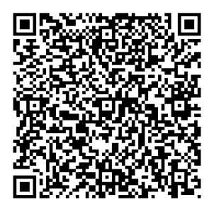
GIVING OF OUR GIFTS & OFFERTORY:
Our God has blessed us, so let us extend God’s Blessing as we present our Tithes and Offerings.
Thank you for being faithful stewards of your church family with your prayers, your time, talent, and your financial resources.
Contributions may also be made:
Electronically on the church website at fpcb-nj.org;
By reoccurring electronic withdrawal; or
By mailing your offering to the church: P.O. Box 385, Blairstown, NJ.

Slide 13
* DOXOLOGY: No. 577 Glory Be to the Father
Glory be to the Father, and the Son,
and the Holy Ghost; As it was in the beginning, is now, and ever shall be,
world without end. Amen.
As it was in the beginning, is now,
and ever shall be, world without end. Amen. Amen. Amen.
Amen. Amen. Amen. Amen. Amen.
* PRAYER OF DEDICATION

Slide 14
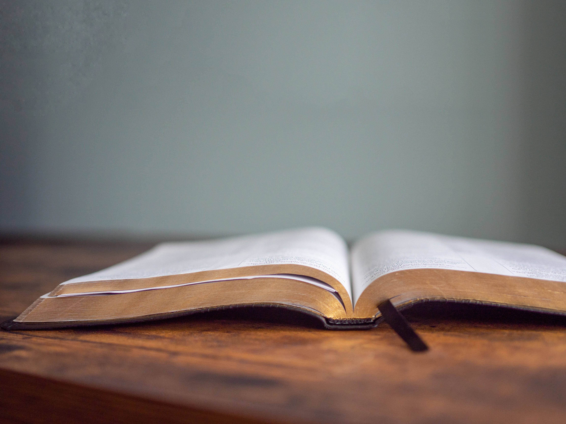
DECLARING GOD‘S WORD

Slide 15
EPISTLE LESSON: 1 Corinthians 15: 50–58
St. Paul commends the power of Christ’s resurrection.
⁵⁰ What I am saying, brothers and sisters, is this: flesh and blood cannot inherit the kingdom of God, nor does the perishable inherit the imperishable. ⁵¹ Look, I will tell you a mystery! We will not all die, but we will all be changed, ⁵² in a moment, in the twinkling of an eye, at the last trumpet. For the trumpet will sound, and the dead will be raised imperishable, and we will be changed. . . .

Slide 16
⁵³ For this perishable body must put on imperishability, and this mortal body must put on immortality. ⁵⁴ When this perishable body puts on imperishability and this mortal body puts on immortality, then the saying that is written will be fulfilled:
“Death has been swallowed up in victory.” ⁵⁵ “Where, O death, is your victory? Where, O death, is your sting?”
. . .

Slide 17
⁵⁶ The sting of death is sin, and the power of sin is the law. ⁵⁷ But thanks be to God, who gives us the victory through our Lord Jesus Christ.
⁵⁸ Therefore, my beloved brothers and sisters, be steadfast, immovable, always excelling in the work of the Lord because you know that in the Lord your labor is not in vain.

Slide 18
GOSPEL LESSON: John 11: 21–27
Jesus declares himself the resurrection and the life.
²¹ Martha said to Jesus, “Lord, if you had been here, my brother would not have died. ²² But even now I know that God will give you whatever you ask of him.” ²³ Jesus said to her, “Your brother will rise again.” ²⁴ Martha said to him, “I know that he will rise again in the resurrection on the last day.” ²⁵ Jesus said to her, “I am the resurrection and the life. . . .

Slide 19
Those who believe in me, even though they die, will live, ²⁶ and everyone who lives and believes in me will never die. Do you believe this?” ²⁷ She said to him, “Yes, Lord, I believe that you are the Messiah, the Son of God, the one coming into the world.”

Slide 20
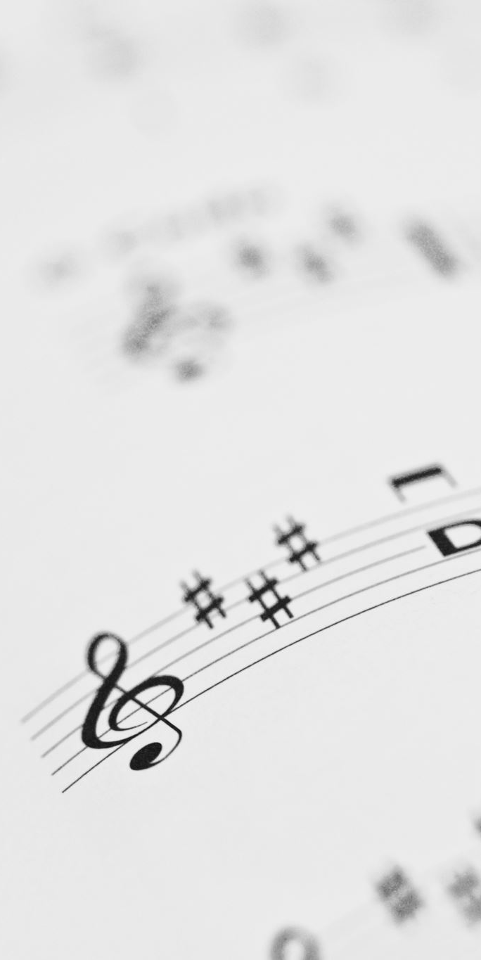
CHANCEL CHOIR ANTHEM/DUET:
“My Prayer”
by Penny Rodriguez
(revised selection)
“O Lovely Peace”
by G.F. Handel from Judas Maccabeus

Slide 21



PASTOR DAVID’S SERMON SERIES:
“I am” Sayings of Jesus:
IV. “I am the Resurrection and the Life”

Slide 22
RESPONDING TO GOD’S WORD

Slide 23
* AFFIRMATION OF FAITH: Contemporary Apostles’ Creed
I believe in God who places joy in our souls, dancing in our toes and songs in our hearts. I believe God wanted gladness to flow like a river, so the Good Lord created a bountiful earth with plenty for all to share.
I believe in Jesus, who turned water into wine, . . .

Slide 24
partied with outcasts and sinners, and touched the broken so they could leap and dance. I believe Jesus opened the doors and set an extra place so we could feast.
I believe in the Holy Spirit, who prompts us to smile, who sends us invitations to come and dine, . . .

Slide 25
who nudges us to openness and tenderness. I believe the Spirit is present every time we gather to break bread and stirs within us the desire to live joyfully, to walk hopefully, and to enact justice boldly. Forever, I will live in the embrace of God and be a witness to Christ’s resurrection joy. Amen.

Slide 26

INSTALLATION OF CHURCH OFFICERS
Being installed as deacons are Kelly McElroy & Judy Trigg

Slide 27
SENTENCES OF SCRIPTURE: 1 Corinthians 12: 4–7, 27
There are varieties of gifts, but it is the same Spirit who gives them.
There are different ways of serving God, but it is the same Lord who is served. . . .

Slide 28
God works through each person in a unique way, but it is God’s purpose that is accomplished.
To each is given a gift of the Spirit to be used for the common good.
Together we are the body of Christ, and individually members of it.
By the power and might of your Spirit, O Christ, may we too, seek not to be served but to serve, in your name. Amen.

Slide 29
STATEMENT ON THE GIFT OF ORDINATION & INSTALLATION: Pastor David Harvey
PRESENTATION OF DEACONS TO BE INSTALLED:
Elder: Mr. Moderator, Deacons Kelly McElroy and Judy Trigg, having been elected again to active service by the vote of this congregation, may now be installed to office.

Slide 30
QUESTIONS OF AFFIRMATION FOR OFFICERS ALREADY ORDAINED
Kelly and Judy, you have been called again to the position of servant leadership in and for this church. Do you welcome the work for which you have been chosen, and will you serve the people with energy, intelligence, imagination, and love, relying on God’s mercy and rejoicing in God’s promises through and in the name of Jesus, our Lord?
Officers: I do and I will.

Slide 31
QUESTIONS OF AFFIRMATION TO THE CONGREGATION:
Do we, the members of the Church, accept these women as deacons, chosen by God through the voice of the congregation to lead us in the ways of Jesus Christ?
We do.
Do we agree to encourage them, to respect their decisions, and to follow as they guide us serving Jesus Christ, who alone is Head of the Church?
We do.
INSTALLATION BLESSING

Slide 32
* HYMN: No. 525 Here I Am, Lord vv. 1 & 3
I, the Lord of sea and sky,
I have heard My people cry.
All who dwell in deepest sin
my hand will save.
. . .

Slide 33
I who made the stars of night,
I will make their darkness bright.
Who will bear My light to them?
Whom shall I send?
. . .

Slide 34
Here I am, Lord. Is it I, Lord?
I have heard You calling in the night.
I will go, Lord, if you lead me.
I will hold Your people in my heart.
. . .

Slide 35
3
I, the Lord of wind and flame,
I will tend the poor and lame.
I will set a feast for them,
My hand will save.
. . .

Slide 36
Finest bread I will provide
Till their hearts be satisfied.
I will give My life to them.
Whom shall I send?
. . .

Slide 37
Here I am, Lord. Is it I, Lord?
I have heard You calling in the night
I will go, Lord, if you lead me.
I will hold Your people in my heart.

Slide 38
PRAYER OF THANKSGIVING, OF THE PEOPLE, & THE LORD’S PRAYER
Our Father who art in heaven,
Hallowed be thy name.
Thy kingdom come, thy will be done;
On earth as it is in heaven.
Give us this day our daily bread;
And forgive us our debts,
As we forgive our debtors;
And lead us not into temptation,
But deliver us from evil,
For Thine is the kingdom
And the power and the glory, forever. Amen.

Slide 39
DEPARTING IN GOD’S NAME

Slide 40
* HYMN: No. 343 Called as Partners in Christ’s Service vv. 1, 2, 4
Called as partners in Christ’s service,
Called to ministries of grace,
We respond with deep commitment
Fresh new lines of faith to trace.
. . .

Slide 41
May we learn the art of sharing,
Side by side and friend with friend,
Equal partners in our caring
To fulfill God’s chosen end.
. . .

Slide 42
2
Christ’s example, Christ’s inspiring,
Christ’s clear call to work and worth,
Let us follow, never faltering,
Reconciling folk on earth.
. . .

Slide 43
Men and women, richer, poorer,
All God’s people, young and old,
Blending human skills together,
Gracious gifts from God unfold.
. . .

Slide 44
4
So God grant us for tomorrow,
Ways to order human life
That surround each person’s sorrow
With a calm that conquers strife.
. . .

Slide 45
Make us partners in our living,
Our compassion to increase,
Messengers of faith, thus giving
Hope and confidence and peace.

Slide 46

* CHARGE TO THE PEOPLE & BENEDICTION
* CHORAL BENEDICTION
POSTLUDE
Our worship has ended—our Christian Witness begins!

