Slide 1

Enter in
SILENCE
Wait with
REVERENCE
Worship from
JOY

Slide 2
PRELUDE
WELCOME & ANNOUNCEMENTS
AFFIRMATION OF MISSION STATEMENT
CHORAL INTROIT
Our Mission Statement
As disciples of Jesus Christ,
led by the Holy Spirit,
we experience God’s unconditional love,
and we witness to others
by discovering and sharing our gifts.

Slide 3
* CALL TO WORSHIP:
The Lord is our light and our salvation,
whom shall we fear?
The Lord is the stronghold of our lives; of whom shall we be afraid?
Jesus said, “I am light of the world.”
Whoever follows him will never walk in darkness but will have the light of life.
. . .

Slide 4
Step out of the shadows and into the radiance of God’s gracious light.
With gratitude and with gladness, let us worship God.

Slide 5
* HYMN OF PRAISE: No. 464 Joyful, Joyful, We Adore Thee
Joyful, joyful, we adore Thee,
God of glory, Lord of love;
Hearts unfold like flowers before Thee,
Opening to the sun above.
Melt the clouds of sin and sadness;
Drive the gloom of doubt away;
Giver of immortal gladness,
Fill us with the light of day.
. . .

Slide 6
All Thy works with joy surround Thee,
Earth and heaven reflect Thy rays,
Stars and angels sing around Thee,
Center of unbroken praise.
Field and forest, vale and mountain,
Flowery meadow, flashing sea,
Chanting bird and flowing fountain,
Call us to rejoice in Thee.
. . .

Slide 7
Mortals, join the happy chorus
Which the morning stars began;
Love divine is reigning o’er us,
Joining all in heaven's plan.
Ever singing, march we onward,
Victors in the midst of strife,
Joyful music leads us sunward
In the triumph song of life.

Slide 8
PRAYER OF CONFESSION: (in silence then in unison)
God of Morning Star and Midday Sun, we confess that we often prefer the shadows by hiding from you and from one another. Too often, we have squinted at your truth. We follow too closely the lights of the world’s influences. We live in the world and become worldly by it. . . .

Slide 9
Forgive our sins and help us live as children of Christ’s light. Remove the cataracts of our souls and the glaucoma that clouds us from seeing you clearly and loving you dearly. In Jesus’ name, we pray. Amen.

Slide 10
ASSURANCE OF CHRIST’S FORGIVENESS:
Hear and accept the good news! … Believe that you are forgiven and live in peace.
In Jesus Christ, we are forgiven! Let us forgive one another.

Slide 11
* CELEBRATING CHRIST’S FORGIVENESS: No. 466 v. 1
O For a Thousand Tongues to Sing
O for a thousand tongues to sing
My dear Redeemer’s praise,
The glories of my God and King,
The triumphs of God's grace!

Slide 12

* EXCHANGE OF CHRIST’S PEACE:
Pastor: The peace of Christ be with you.
People: And also with you.
Welcome one another
with the peace of Christ.
~ Children may go downstairs for Sunday School ~

Slide 13

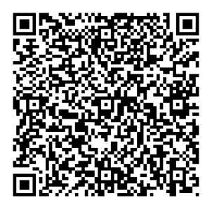
GIVING OF OUR GIFTS & OFFERTORY:
Our God has blessed us, so let us extend
God’s Blessing as we present our Tithes and Offerings.
Thank you for being faithful stewards of your
church family with your prayers, your time,
talent, and your financial resources.
Contributions may also be made:
Electronically on the church website
at fpcb-nj.org;
By reoccurring electronic withdrawal; or
By mailing your offering to the church:
P.O. Box 385, Blairstown, NJ.

Slide 14
* DOXOLOGY: No. 592 Praise God
Praise God, from whom all blessings flow;
Praise Him, all creatures here below;
Praise Him above, ye heavenly host;
Praise Father, Son, and Holy Ghost. Amen.
* PRAYER OF DEDICATION

Slide 15
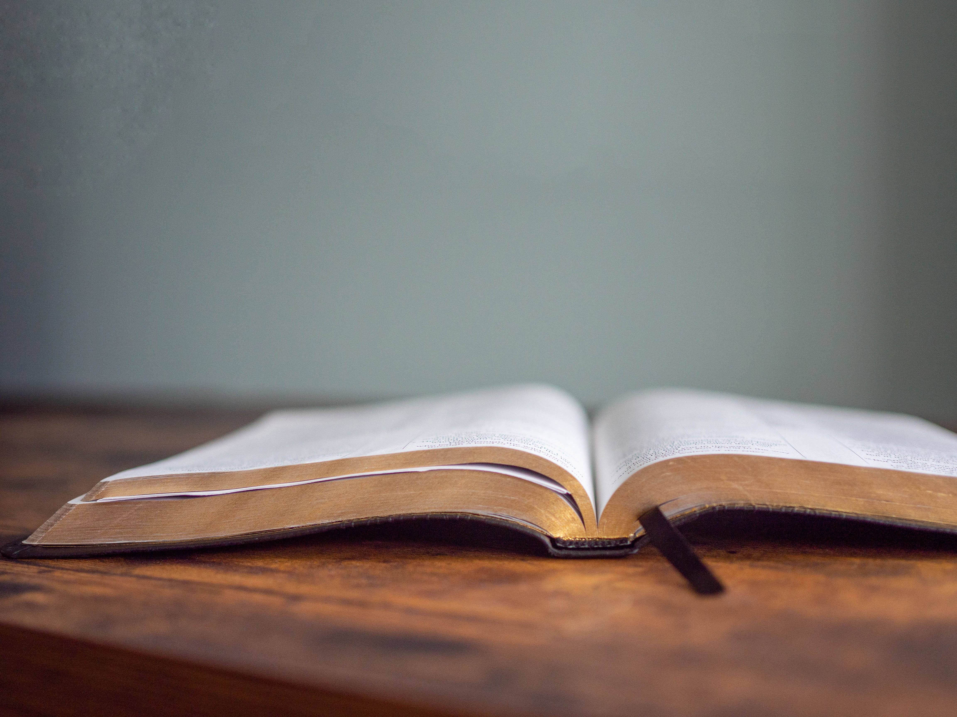
DECLARING
GOD‘S WORD

Slide 16
HEBREW LESSON: Psalm 4 NRSVUE
Our goodness reflects God’s light.
¹ Answer me when I call, O God of my right!
You gave me room when I was in distress.
Be gracious to me, and hear my prayer.
² How long, you people, shall my honor suffer shame? How long will you love vain words and seek after lies? Selah
³ But know that the Lord has set apart the faithful for himself; the Lord hears when I call to him.
. . .

Slide 17
⁴ When you are disturbed, do not sin;
ponder it on your beds, and be silent. Selah
⁵ Offer right sacrifices, and put your trust in the Lord.
⁶ There are many who say, “O that we might see some good! Let the light of your face shine on us, O Lord!”
⁷ You have put gladness in my heart
more than when their grain and wine abound.
⁸ I will both lie down and sleep in peace,
for you alone, O Lord, make me lie down in safety.

Slide 18
GOSPEL LESSON: John 8: 12–16, 53–58 NRSVUE
Jesus claims himself as “I am the light of the world.”
¹² Again Jesus spoke to them, saying, “I am the light of the world. Whoever follows me will never walk in darkness but will have the light of life.” ¹³ Then the Pharisees said to him, “You are testifying on your own behalf; your testimony is not valid.” ¹⁴ Jesus answered, “Even if I testify on my own behalf, my testimony is valid because I know where I have come from and where I am going, . . .

Slide 19
but you do not know where I come from or where I am going. ¹⁵ You judge by human standards; I judge no one. ¹⁶ Yet even if I do judge, my judgment is valid, for it is not I alone who judge but I and the Father who sent me.
John 8:53-58
⁵³ Are you greater than our father Abraham, who died? The prophets also died. Who do you claim to be?” ⁵⁴ Jesus answered, “If I glorify myself, my glory is nothing. It is my Father who glorifies me, . . .

Slide 20
he of whom you say, ‘He is our God,’ ⁵⁵ though you do not know him. But I know him; if I would say that I do not know him, I would be a liar like you. But I do know him, and I keep his word. ⁵⁶ Your ancestor Abraham rejoiced that he would see my day; he saw it and was glad.” ⁵⁷ Then the Jews said to him, “You are not yet fifty years old, and have you seen Abraham?” ⁵⁸ Jesus said to them, “Very truly, I tell you, before Abraham was, I am.”

Slide 21
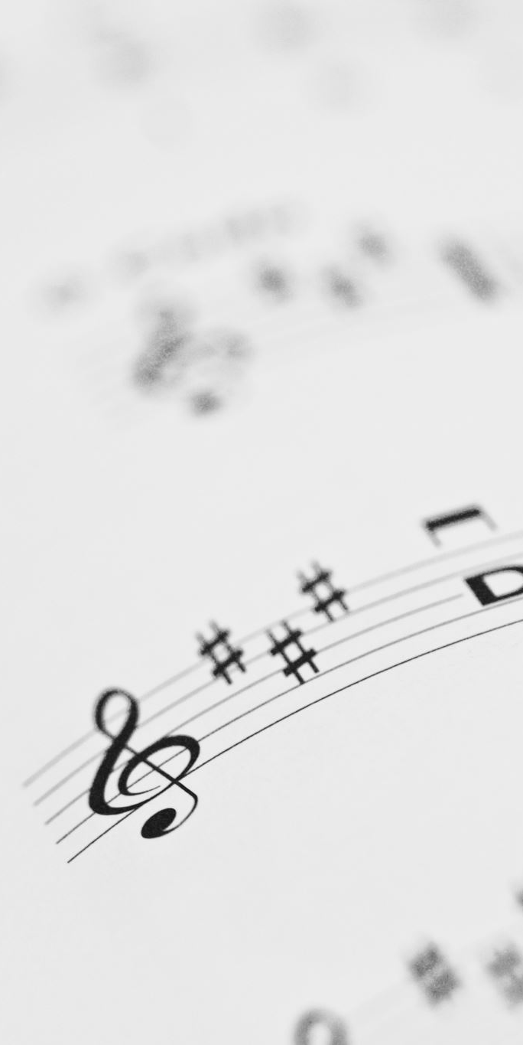
CHANCEL CHOIR ANTHEM:
“Flowers of My World”
by Loonis McGlohon

Slide 22



PASTOR DAVID’S
SERMON SERIES:
“I am”
Sayings of Jesus:
III. “The Light of
the World”

Slide 23
RESPONDING TO GOD’S WORD

Slide 24
* AFFIRMATION OF FAITH: (1 Corinthians 13: 4–13)
Love is patient; love is kind; love is not envious or boastful or arrogant or rude. It does not insist on its own way; it is not irritable or resentful; it does not rejoice in wrongdoing but rejoices in the truth. It bears all things, believes all things, hopes all things, endures all things. . . .

Slide 25
Love never ends. But as for prophecies, they will come to an end; as for tongues, they will cease; as for knowledge, it will come to an end. For we know only in part, and we prophesy only in part; but when the complete comes, the partial will come to an end. When I was a child, I spoke like a child, I thought like a child, I reasoned like a child; . . .

Slide 26
when I became an adult, I put an end to childish ways. For now we see in a mirror, dimly, but then we will see face to face. Now I know only in part; then I will know fully, even as I have been fully known. And now faith, hope, and love abide, these three; and the greatest of these is love. Amen.

Slide 27
* HYMN: Lord, the Light of Your Love Is Shining! (No. 192 GTG)
Lord, the light of your love is shining,
in the midst of the darkness, shining;
Jesus, Light of the World, shine upon us;
set us free by the truth you now bring us.
Shine on me; shine on me.
. . .

Slide 28
Shine, Jesus, shine;
fill this land with the Father’s glory.
Blaze, Spirit, blaze; set our hearts on fire.
Flow, river, flow;
flood the nations with grace and mercy.
Send forth your word, Lord,
and let there be light.
. . .

Slide 29
2
Lord, I come to your awesome presence,
from the shadows into your radiance;
by the blood I may enter your brightness.
Search me; try me;
consume all my darkness;
Shine on me; shine on me.
. . .

Slide 30
Shine, Jesus, shine;
fill this land with the Father’s glory.
Blaze, Spirit, blaze; set our hearts on fire.
Flow, river, flow;
flood the nations with grace and mercy.
Send forth your word, Lord,
and let there be light.
. . .

Slide 31
3
As we gaze on your kingly brightness,
so our faces display your likeness;
ever changing from glory to glory,
mirrored here may our lives tell your story.
Shine on me; shine on me.
. . .

Slide 32
Shine, Jesus, shine;
fill this land with the Father’s glory.
Blaze, Spirit, blaze; set our hearts on fire.
Flow, river, flow;
flood the nations with grace and mercy.
Send forth your word, Lord,
and let there be light.

Slide 33
PRAYER OF THANKSGIVING, OF THE PEOPLE,
& THE LORD’S PRAYER
Our Father who art in heaven,
Hallowed be thy name.
Thy kingdom come, thy will be done;
On earth as it is in heaven.
Give us this day our daily bread;
And forgive us our debts,
As we forgive our debtors;
And lead us not into temptation,
But deliver us from evil,
For Thine is the kingdom
And the power and the glory, forever. Amen.

Slide 34
DEPARTING IN GOD’S NAME

Slide 35
* HYMN OF PRAISE: No. 339 Be Thou My Vision vv. 1 & 3
Be Thou my vision, O Lord of my heart;
Naught be all else to me,
save that Thou art--
Thou my best thought,
by day or by night,
Waking or sleeping,
Thy presence my light.
. . .

Slide 36
2
Riches I heed not, nor vain empty praise,
Thou mine inheritance, now and always:
Thou and Thou only, first in my heart,
Great God of heaven,
my treasure Thou art.
. . .

Slide 37
3
Be Thou my wisdom,
and Thou my true word;
I ever with Thee and Thou with me, Lord;
Heart of my own heart, whatever befall,
Still be my vision, O Ruler of all.

Slide 38

* CHARGE TO THE PEOPLE & BENEDICTION
* CHORAL BENEDICTION
POSTLUDE
Our worship has ended—our Christian Witness begins!

