Slide 1

Enter in SILENCE
Wait with REVERENCE
Worship from JOY

Slide 2
PRELUDE
WELCOME & ANNOUNCEMENTS
AFFIRMATION OF MISSION STATEMENT
CHORAL INTROIT
Our Mission Statement
As disciples of Jesus Christ, led by the Holy Spirit, we experience God’s unconditional love, and we witness to others by discovering and sharing our gifts.

Slide 3
* CALL TO WORSHIP:
Almighty God, grace this church with your blessing and love this day.
Let the faithful find salvation and the careless be renewed.
Let the doubting find faith and the worried be renewed.
Let the broken experience healing, and the weary find rest.
. . .

Slide 4
Let the aged receive peace and the young be inspired.
Let us all have grateful hearts and joyful praise flow from our lips.
With joyful praise, let us worship God.

Slide 5
* HYMN OF PRAISE: No. 288 I Sing the Mighty Power of God vv. 1 & 2
I sing the mighty power of God
That made the mountains rise;
That spread the flowing seas abroad
And built the lofty skies.
I sing the wisdom that ordained
The sun to rule the day;
The moon shines full at God’s command,
And all the stars obey.
Cont’d.

Slide 6
I sing the goodness of the Lord
That filled the earth with food;
God formed the creatures with a word
And then pronounced them good.
Lord, how Thy wonders are displayed,
Where’er I turn my eyes;
If I survey the ground I tread,
Or gaze upon the skies!

Slide 7
PRAYER OF CONFESSION: (in silence then in unison)
Almighty and merciful God, you raised Jesus from the grave, shattering the power of sin and demonstrating divine victory over death. We confess we neglect to see and feel the pain of others by overlooking the poor and the hungry and not noticing the broken within our midst. . . .

Slide 8
We walk by those in need and even abuse the earth that you have made.
Forgive our sin, O God. Awaken us to your power to change the things that need to be changed. Help us to know the abundant joy of your salvation, to grow in the goodness of your love, and to bravely live and be led into the wonder of your grace and truth. . . .

Slide 9
In the strong name of Jesus, we pray. Amen.

Slide 10
ASSURANCE OF CHRIST’S FORGIVENESS:
Baptized in Jesus’ name and forgiven by Jesus, be ready to forgive to live and forgive as freely as Christ has first freely loved and forgiven us.
In Jesus Christ, we are forgiven! Let us forgive one another.

Slide 11
* CELEBRATING CHRIST’S FORGIVENESS: No. 304 Jesus Loves Me v. 1
Jesus loves me! This I know,
For the Bible tells me so;
Little ones to Him belong;
They are weak, but He is strong.
Yes, Jesus loves me!
Yes, Jesus loves me!
Yes, Jesus loves me!
The Bible tells me so.

Slide 12

* EXCHANGE OF CHRIST’S PEACE:
Pastor: The peace of Christ be with you.
People: And also with you.
Welcome one another with the peace of Christ.
~ Children may go downstairs for Sunday School ~

Slide 13

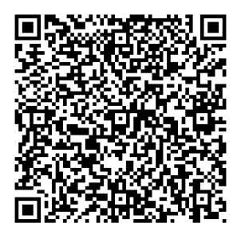
GIVING OF OUR GIFTS & OFFERTORY:
Our God has blessed us, so let us extend God’s Blessing as we present our Tithes and Offerings.
Thank you for being faithful stewards of your church family with your prayers, your time, talent, and your financial resources.
Contributions may also be made:
Electronically on the church website at fpcb-nj.org;
By reoccurring electronic withdrawal; or
By mailing your offering to the church: P.O. Box 385, Blairstown, NJ.

Slide 14
* DOXOLOGY: No. 592 Praise God
Praise God, from whom all blessings flow;
Praise Him, all creatures here below;
Praise Him above, ye heavenly host;
Praise Father, Son, and Holy Ghost. Amen.
* PRAYER OF DEDICATION

Slide 15
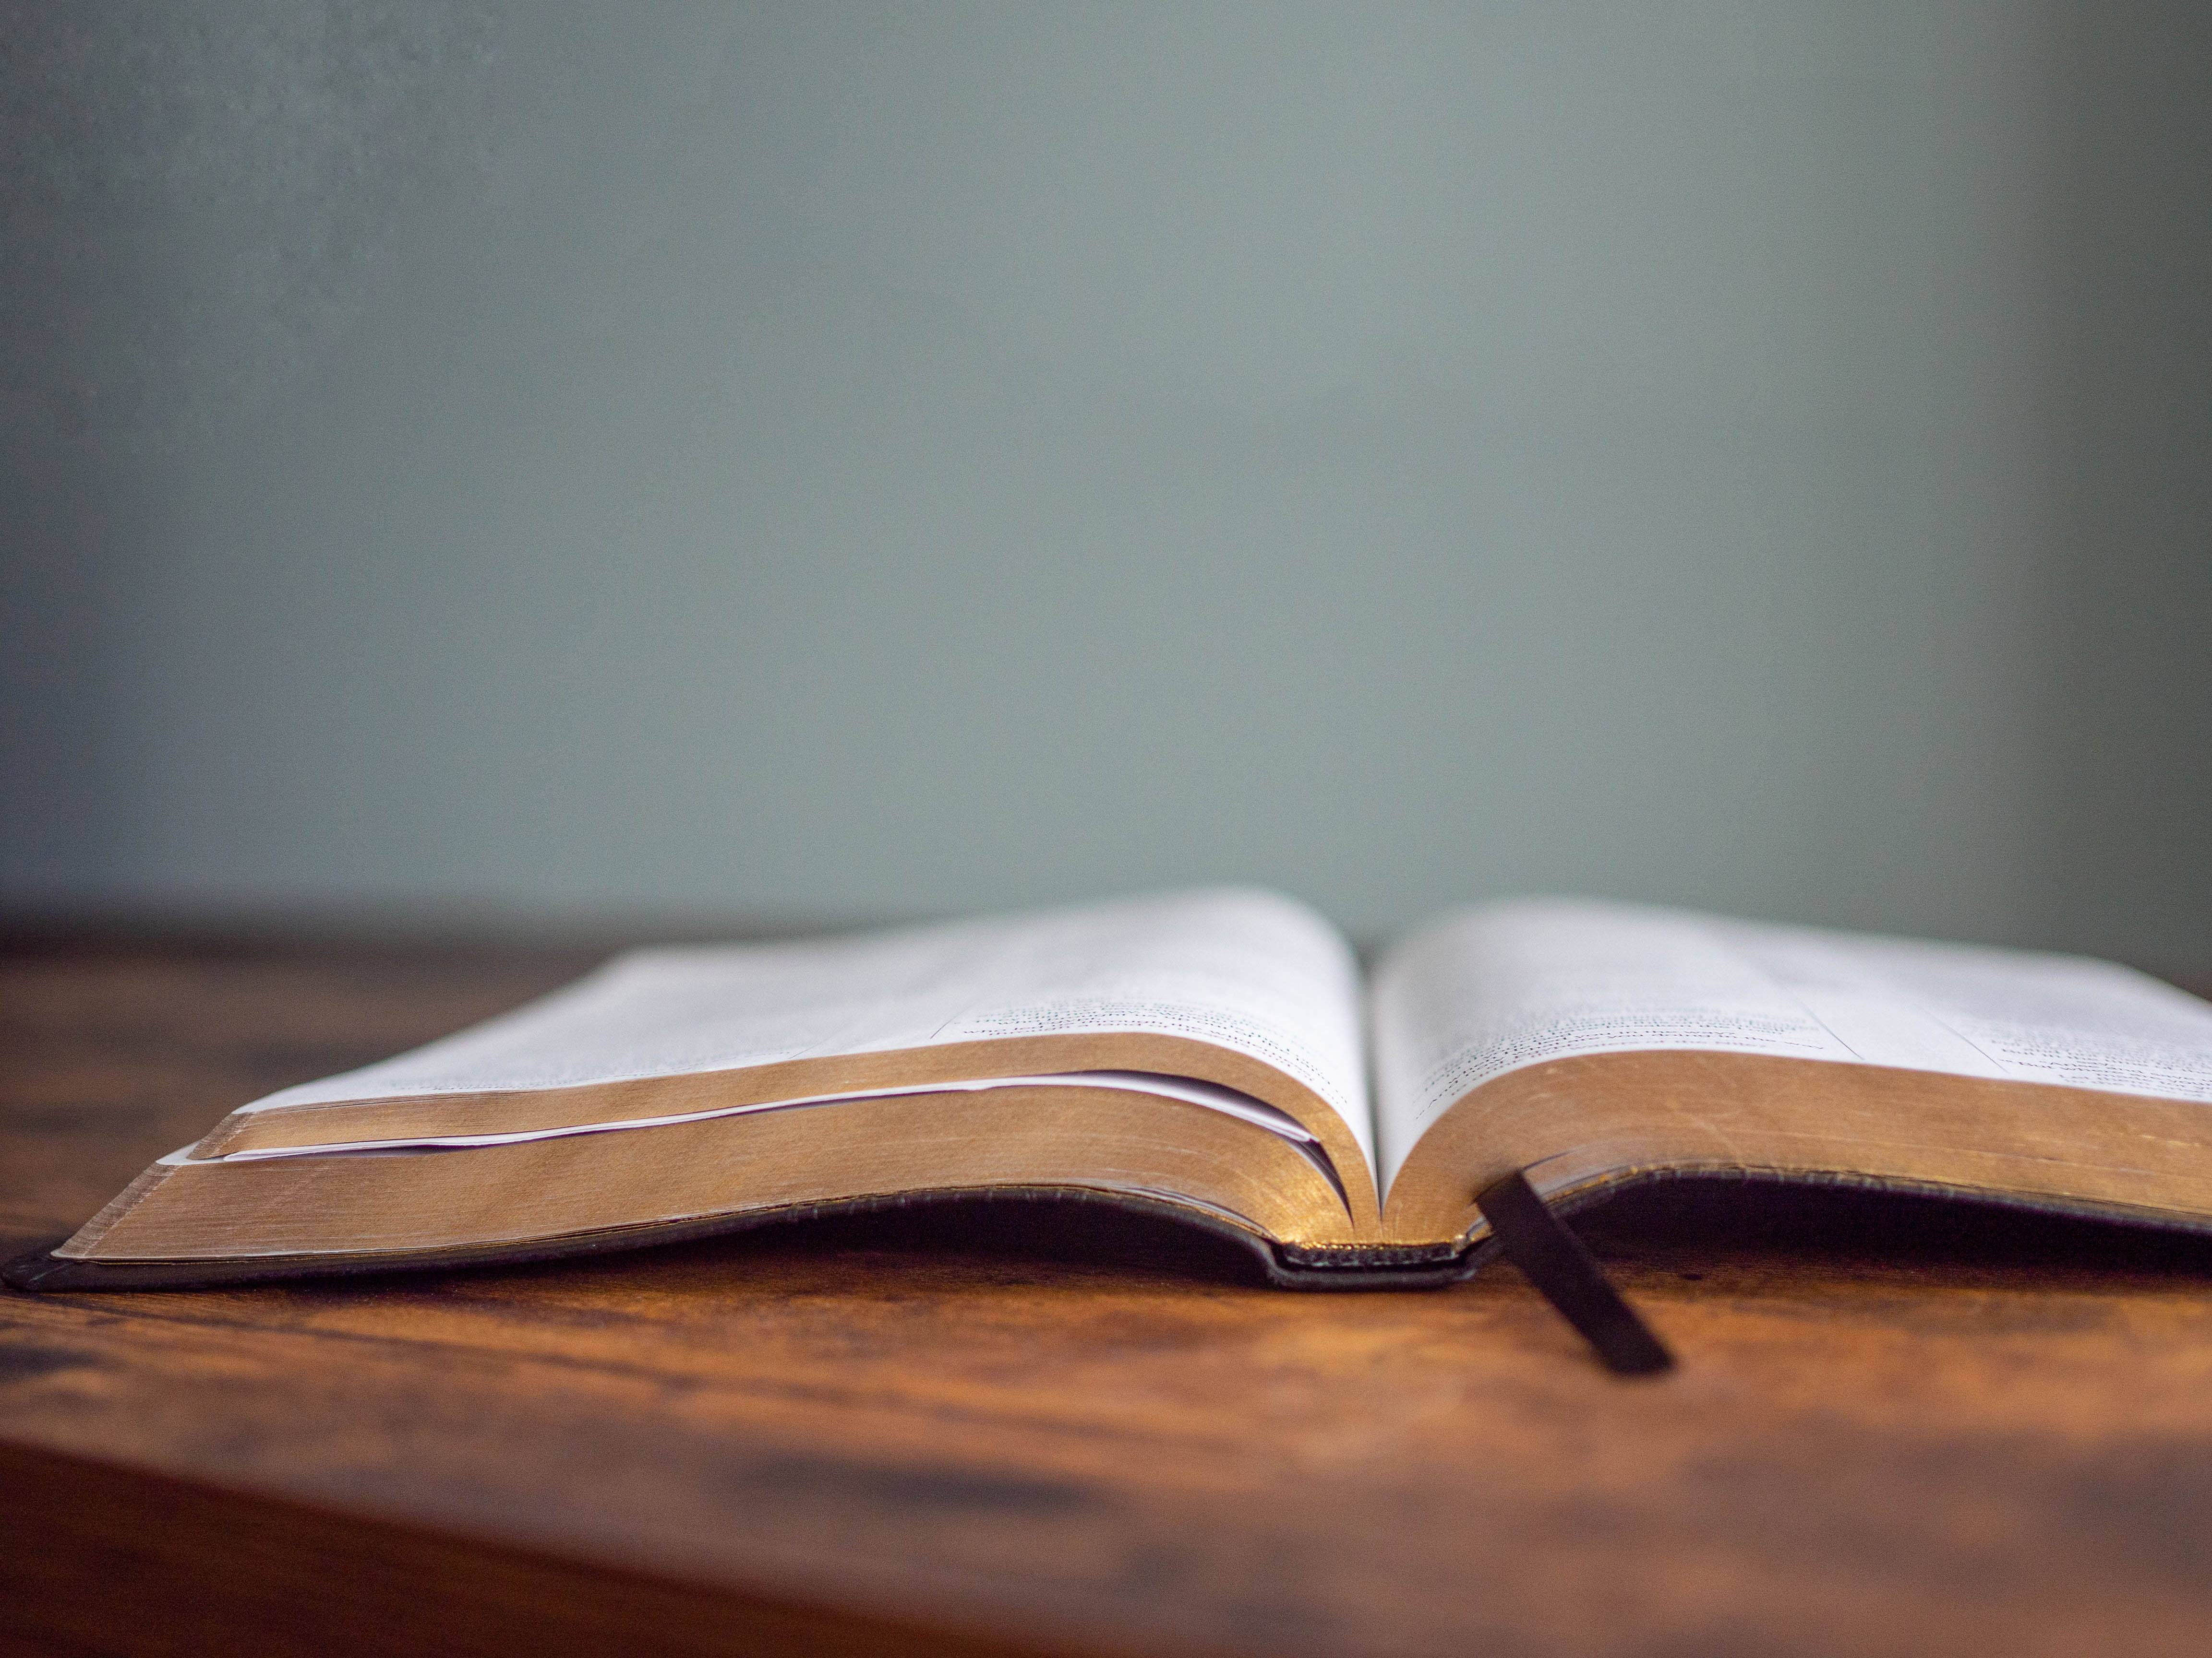
DECLARING GOD‘S WORD

Slide 16
GOSPEL LESSON: John 6: 25–35
Jesus declares himself the bread of life.
²⁵ When they found him on the other side of the sea, they said to him, “Rabbi, when did you come here?” ²⁶ Jesus answered them, “Very truly, I tell you, you are looking for me not because you saw signs but because you ate your fill of the loaves. ²⁷ Do not work for the food that perishes but for the food that endures for eternal life, which the Son of Man will give you. . . .

Slide 17
For it is on him that God the Father has set his seal.” ²⁸ Then they said to him, “What must we do to perform the works of God?” ²⁹ Jesus answered them, “This is the work of God, that you believe in him whom he has sent.” ³⁰ So they said to him, “What sign are you going to give us, then, so that we may see it and believe you? What work are you performing? ³¹ Our ancestors ate the manna in the wilderness, as it is written, . . .

Slide 18
‘He gave them bread from heaven to eat.’ ” ³² Then Jesus said to them, “Very truly, I tell you, it was not Moses who gave you the bread from heaven, but it is my Father who gives you the true bread from heaven. ³³ For the bread of God is that which comes down from heaven and gives life to the world.” ³⁴ They said to him, “Sir, give us this bread always.” . . .

Slide 19
³⁵ Jesus said to them, “I am the bread of life. Whoever comes to me will never be hungry, and whoever believes in me will never be thirsty.

Slide 20
GOSPEL LESSON: John 6: 48–59
In eating the bread, Jesus promises to remain in
us and be with us.
⁴⁸ I am the bread of life. ⁴⁹ Your ancestors ate the manna in the wilderness, and they died. ⁵⁰ This is the bread that comes down from heaven, so that one may eat of it and not die. ⁵¹ I am the living bread that came down from heaven. Whoever eats of this bread will live forever, and the bread that I will give for the life of the world is my flesh.” . . .

Slide 21
⁵² The Jews then disputed among themselves, saying, “How can this man give us his flesh to eat?” ⁵³ So Jesus said to them, “Very truly, I tell you, unless you eat the flesh of the Son of Man and drink his blood, you have no life in you. ⁵⁴ Those who eat my flesh and drink my blood have eternal life, and I will raise them up on the last day, ⁵⁵ for my flesh is true food, and my blood is true drink. ⁵⁶ Those who eat my flesh and drink my blood abide in me and I in them. . . .

Slide 22
⁵⁷ Just as the living Father sent me and I live because of the Father, so whoever eats me will live because of me. ⁵⁸ This is the bread that came down from heaven, not like that which the ancestors ate, and they died. But the one who eats this bread will live forever.” ⁵⁹ He said these things while he was teaching in a synagogue at Capernaum.

Slide 23
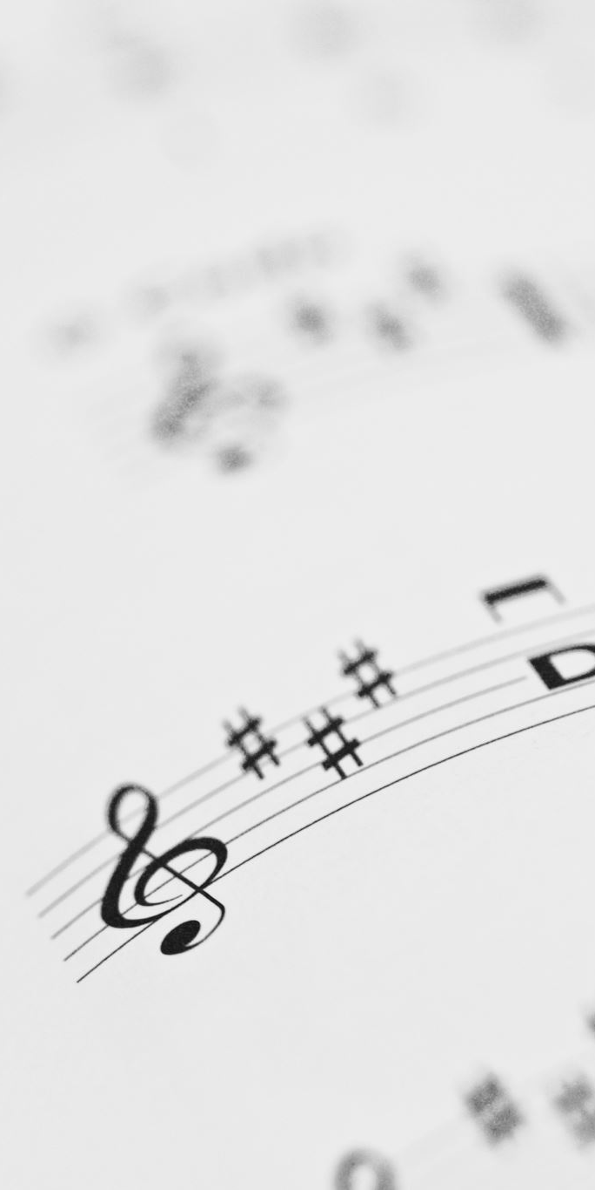
CHANCEL CHOIR ANTHEM
“We Come Together Here”
by J. Stevens

Slide 24

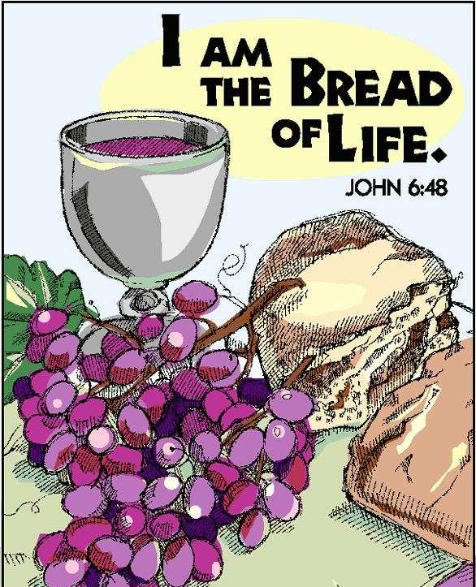
PASTOR DAVID’S SERMON SERIES:
Jesus said . . .
I. “I am the Bread of Life.”

Slide 25
RESPONDING TO GOD’S WORD

Slide 26
* AFFIRMATION OF FAITH: (responsive) A Brief Statement of Faith, 1990
We trust in God the Holy Spirit . . . all believers in the one body of Christ the Church.
The same Spirit who inspired the prophets and apostles rules our faith and life in Christ through Scripture, engages us to the Word proclaimed, claims us in the waters of baptism, feeds us with the bread of life and the cup of salvation, . . .

Slide 27
and calls women and men to all the ministries of the church.
We trust in Jesus Christ, fully human, fully God.
In everlasting love, the God of Abraham and Sarah chose a covenant people to bless all families of the earth. . . .

Slide 28
With believers in every time and place, we rejoice that nothing in life and in death can separate us from the love of God in Christ Jesus our Lord. Amen.

Slide 29
* COMMUNION HYMN: For Everyone Born, vv. 1, 3–5 No. 769, GTG
For everyone born, a place at the table,
for everyone born, clean water and bread,
a shelter, a space, a safe place for growing,
for everyone born, a star overhead,
and God will delight when we are creators of justice and joy, compassion and peace:
yes, God will delight when we are creators of justice, . . . justice and joy!
. . .

Slide 30
For young and for old, a place at the table,
a voice to be heard, a part in the song,
the hands of a child in hands that are wrinkled, for young and for old, the right to belong, and God will delight when we are creators of justice and joy, compassion and peace: yes, God will delight when we are creators of justice, . . . justice and joy!
. . .

Slide 31
For just and unjust, a place at the table,
abuser, abused, with need to forgive,
in anger, in hurt, a mindset of mercy,
for just and unjust, a new way to live,
and God will delight when we are creators of justice and joy, compassion and peace:
yes, God will delight when we are creators of justice, . . . justice and joy!
. . .

Slide 32
For everyone born, a place at the table,
to live without fear, and simply to be,
to work, to speak out,
to witness and worship,
for everyone born, the right to be free,
and God will delight when we are creators of justice and joy, compassion and peace:
yes, God will delight when we are creators of justice, . . . justice and joy!

Slide 33


Slide 34
SACRAMENT OF HOLY COMMUNION
INVITATION TO THE LORD’S TABLE:
L: Friends, this is the joyful feast of the people of God!
P: People will come from east and west, and from north and south, and sit at the table in the kingdom of God.

Slide 35
L: Behold, how good and pleasant it is when brothers and sisters dwell in unity.
P: God sent the whole world God’s only Son. Since God loved us so much, we too, should love one another.
L: This is the Lord’s Table. Our Savior invites all who are truly sorry for their sins and would humbly put their trust in him to come to the feast which he has prepared. Listen to the gracious words of our Savior Jesus Christ:

Slide 36
“Come to me, all you that are weary and are carrying heavy burdens, and I will give you rest. Take my yoke upon you, and learn from me; for I am gentle and humble in heart, and you will find rest for your souls. For my yoke is easy, and my burden is light.“ Matthew 11: 28–30
”This is indeed the will of my Father, that all who see the Son and believe in him may have eternal life, and I will raise them up on the last day.” John 6: 40
“Behold, I stand at the door and knock; if those who hear my voice open the door, I will come in to them and eat with them, and they with me.” Revelation 3: 20

Slide 37
L: The Lord be with you.
P: And with your spirit.
L: Lift up your hearts.
P: We lift them to the Lord.
L: Let us give thanks to the Lord our God.
P: It is right to give God our thanks and praise.

Slide 38
PRAYER OF THANKSGIVING, PRAYERS OF THE PEOPLE, & THE LORD’S PRAYER:
L: Holy Lord . . . as we pray together:
O God, who called us from death to life: We give ourselves to you; and with the church through all the ages and in all places, we thank you for your saving love in Jesus Christ, who taught us to pray, . . .

Slide 39
Our Father who art in heaven,
Hallowed be thy name.
Thy kingdom come, thy will be done;
On earth as it is in heaven.
Give us this day our daily bread;
And forgive us our debts,
As we forgive our debtors;
And lead us not into temptation,
But deliver us from evil,
For Thine is the kingdom
And the power and the glory, forever. Amen.

Slide 40


Slide 41

OFFERING OF THE ELEMENTS:
Approach the Table,
receive the bread, take the cup,
and return to your pew.

Slide 42
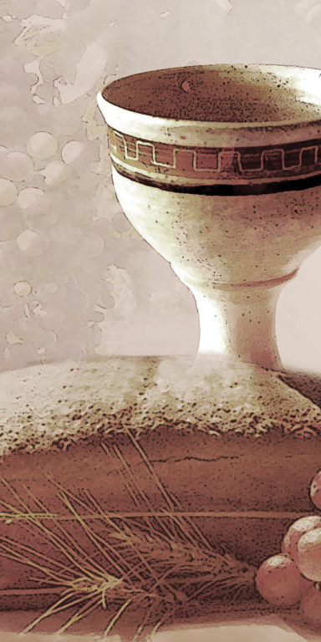
SHARING THE BREAD:
Jesus said, “I am the bread of life. Whoever comes to me will never be hungry...” (Jn. 6:35a)
Let us eat this bread in remembrance of Christ and may the spirit that is in him be in us also.
DRINKING THE CUP:
Jesus said, “I am the vine, you are the branches, apart from him, we can do nothing.”
Drink this cup in remembrance of Christ and may the spirit in which he died be our Spirit.

Slide 43
COMMUNION BLESSING: Let us give thanks to the Lord our God.
We give you thanks, great God, for the hope we have in Jesus, who died, is risen and rules over all. We praise you for his comforting and guiding presence with us, for the bread which is his body and the cup which is his blood that nurtures and nourishes us with his divine grace. . . .

Slide 44
Because Jesus lives, we look to eternal life, knowing that nothing past, present or yet to come can separate us from your Son’s great love; Amen.

Slide 45
DEPARTING IN GOD’S NAME

Slide 46
* HYMN: No. 422 God, Whose Giving Knows No Ending
God, whose giving knows no ending,
From Your rich and endless store,
Nature's wonder, Jesus' wisdom,
Costly cross, grave's shattered door:
Gifted by You, we turn to You,
Offering up ourselves in praise;
Thankful song shall rise forever,
Gracious donor of our days.
. . .

Slide 47
Skills and time are ours for pressing
Toward the goals of Christ, your Son:
All at peace in health and freedom,
Races joined, the church made one.
Now direct our daily labor,
Lest we strive for self alone;
Born with talents, make us servants
Fit to answer at Your throne.
. . .

Slide 48
Treasure too You have entrusted,
Gain through powers Your grace conferred;
Ours to use for home and kindred,
And to spread the gospel Word.
Open wide our hands, in sharing,
As we heed Christ's ageless call,
Healing, teaching, and reclaiming,
Serving You by loving all.

Slide 49



* CHARGE TO THE PEOPLE & BENEDICTION
* CHORAL BENEDICTION
POSTLUDE
Our worship has ended —
our Christian Witness begins!
for refreshments & fellowship.

