Slide 1

Enter in SILENCE
Wait with REVERENCE
Worship from JOY

Slide 2
PRELUDE
WELCOME & ANNOUNCEMENTS
AFFIRMATION OF MISSION STATEMENT
CHORAL INTROIT
Our Mission Statement
As disciples of Jesus Christ, led by the Holy Spirit, we experience God’s unconditional love, and we witness to others by discovering and sharing our gifts.

Slide 3
* CALL TO WORSHIP:
Shout with joy to the Lord, all the earth.
Worship the Lord with gladness.
Come before God, singing with joy. Acknowledge that the Lord is God.
God made us. We are God’s, the sheep of God’s pasture.
. . .

Slide 4
Enter God’s gates with thanksgiving and God’s courts with praise.
For the Lord God is good. God’s unfailing love continues forever.
With grateful hearts and with lips of praise, let us worship God.

Slide 5
* HYMN: No. 144 Alleluia! Sing to Jesus!
Alleluia! Sing to Jesus!
His the scepter, His the throne.
Alleluia! His the triumph,
His the victory alone!
Hark! the songs of peaceful Zion
Thunder like a mighty flood;
Jesus out of every nation
Hath redeemed us by His blood. . . .

Slide 6
Alleluia! Bread of angels,
Thou on earth our food, our stay.
Alleluia! Here the sinful
Flee to Thee from day to day.
Intercessor, Friend of sinners,
Earth’s Redeemer, plead for me,
Where the songs of all the sinless
Sweep across the crystal sea.
. . .

Slide 7
PRAYER OF CONFESSION: (in silence then in unison)
Almighty and merciful God, we have erred and strayed from your ways like lost sheep. We follow too much the devices and the desires of our own hearts. We also offend your holy laws. We have left undone those things we ought to have done, . . .

Slide 8
and we have done those things which we ought not to have done.
Forgive our sins, Lord Jesus Christ, and grant us your mercy that we may live a holy, just, and humble life, for the glory of your holy name. Amen.

Slide 9
ASSURANCE OF CHRIST’S FORGIVENESS:
The mercy of the Lord is from everlasting to everlasting. I declare to you in the name of Jesus Christ, you are forgiven.
May the mercy of the Lord forgive our sins, strengthen us in all goodness, by the power of the Holy Spirit, keep us in eternal life.

Slide 10
* CELEBRATING CHRIST’S FORGIVENESS: Give Thanks (No. 647 GTG)
Give thanks with a grateful heart,
give thanks to the Holy One;
Give thanks, because we’re given
Jesus Christ the Son.
And now let the weak say,
“we are strong”; let the poor say,
“We are rich, because of what the
Lord has done for us!”
Give thanks.

Slide 11

* EXCHANGE OF CHRIST’S PEACE:
Pastor: The peace of Christ be with you.
People: And also with you.
Welcome one another with the peace of Christ.
~ Children may go downstairs for Sunday School ~

Slide 12

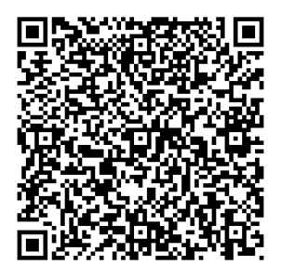
GIVING OF OUR GIFTS & OFFERTORY:
Our God has blessed us, so let us extend God’s Blessing as we present our Tithes and Offerings.
Thank you for being faithful stewards of your church family with your prayers, your time, talent, and your financial resources.
Contributions may also be made:
Electronically on the church website at fpcb-nj.org;
By reoccurring electronic withdrawal; or
By mailing your offering to the church: P.O. Box 385, Blairstown, NJ.

Slide 13
* DOXOLOGY: No. 592 Praise God
Praise God, from whom all blessings flow;
Praise Him, all creatures here below;
Praise Him above, ye heavenly host;
Praise Father, Son, and Holy Ghost. Amen.
* PRAYER OF DEDICATION

Slide 14
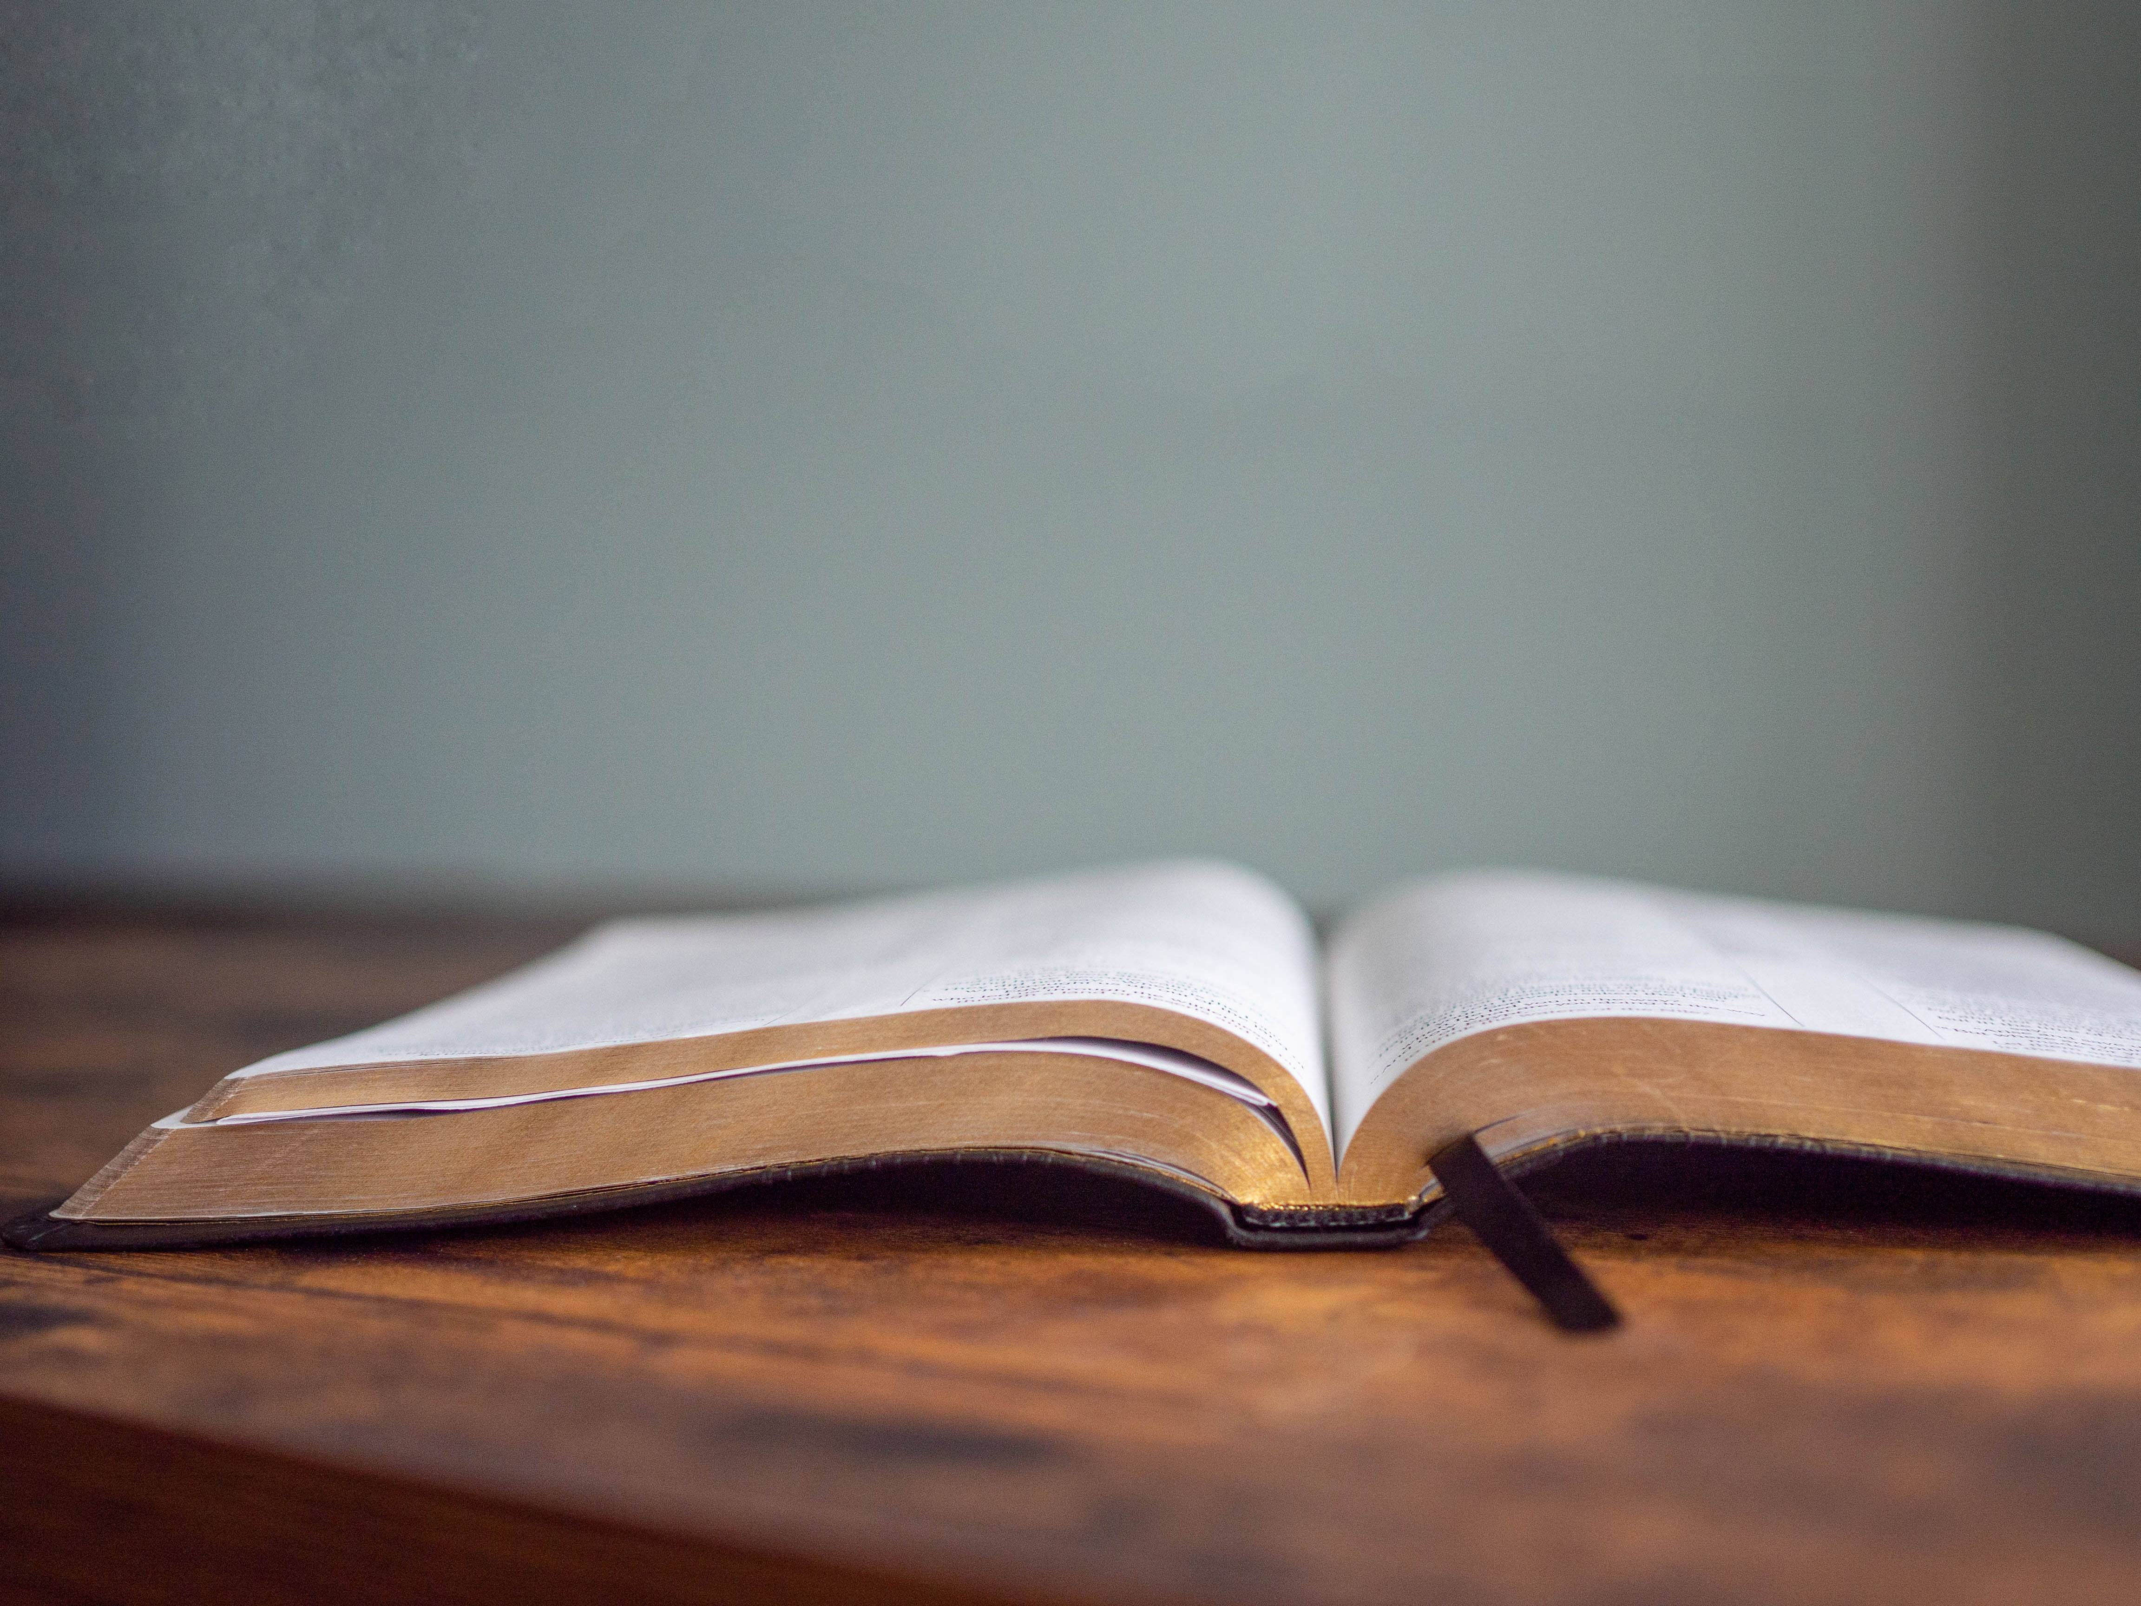
DECLARING GOD‘S WORD

Slide 15
PASTORAL EPISTLE: 1 Peter 2: 16–17, 19–25 NRSVUE
Christ is the Shepherd.
¹⁶ As servants of God, live as free people, yet do not use your freedom as a pretext for evil. ¹⁷ Honor everyone. Love the family of believers. Fear God. Honor the emperor.
¹⁹ For it is a commendable thing if, being aware of God, a person endures pain while suffering unjustly. ²⁰ If you endure when you are beaten for doing wrong, what credit is that? . . .

Slide 16
But if you endure when you do good and suffer for it, this is a commendable thing before God. ²¹ For to this you have been called, because Christ also suffered for you, leaving you an example, so that you should follow in his steps.
²² “He committed no sin, and no deceit was found in his mouth.”
²³ When he was abused, he did not return abuse; when he suffered, he did not threaten, . . .

Slide 17
but he entrusted himself to the one who judges justly. ²⁴ He himself bore our sins in his body on the cross, so that, having died to sins, we might live for righteousness; by his wounds you have been healed. ²⁵ For you were going astray like sheep, but now you have returned to the shepherd and guardian of your souls.

Slide 18
GOSPEL LESSON: John 10: 7–21
Jesus is the good Shepherd.
⁷ So again Jesus said to them, “Very truly, I tell you, I am the gate for the sheep. ⁸ All who came before me are thieves and bandits, but the sheep did not listen to them. ⁹ I am the gate. Whoever enters by me will be saved and will come in and go out and find pasture. ¹⁰ The thief comes only to steal and kill and destroy. I came that they may have life and have it abundantly. . . .

Slide 19
¹¹ “I am the good shepherd. The good shepherd lays down his life for the sheep. ¹² The hired hand, who is not the shepherd and does not own the sheep, sees the wolf coming and leaves the sheep and runs away, and the wolf snatches them and scatters them. ¹³ The hired hand runs away because a hired hand does not care for the sheep. ¹⁴ I am the good shepherd. I know my own, and my own know me, ¹⁵ just as the Father knows me, and I know the Father. . . .

Slide 20
And I lay down my life for the sheep. ¹⁶ I have other sheep that do not belong to this fold. I must bring them also, and they will listen to my voice. So there will be one flock, one shepherd. ¹⁷ For this reason the Father loves me, because I lay down my life in order to take it up again. ¹⁸ No one takes it from me, but I lay it down of my own accord. I have power to lay it down, and I have power to take it up again. I have received this command from my Father.” . . .

Slide 21
¹⁹ Again the Jews were divided because of these words. ²⁰ Many of them were saying, “He has a demon and is out of his mind. Why listen to him?” ²¹ Others were saying, “These are not the words of one who has a demon. Can a demon open the eyes of the blind?”

Slide 22
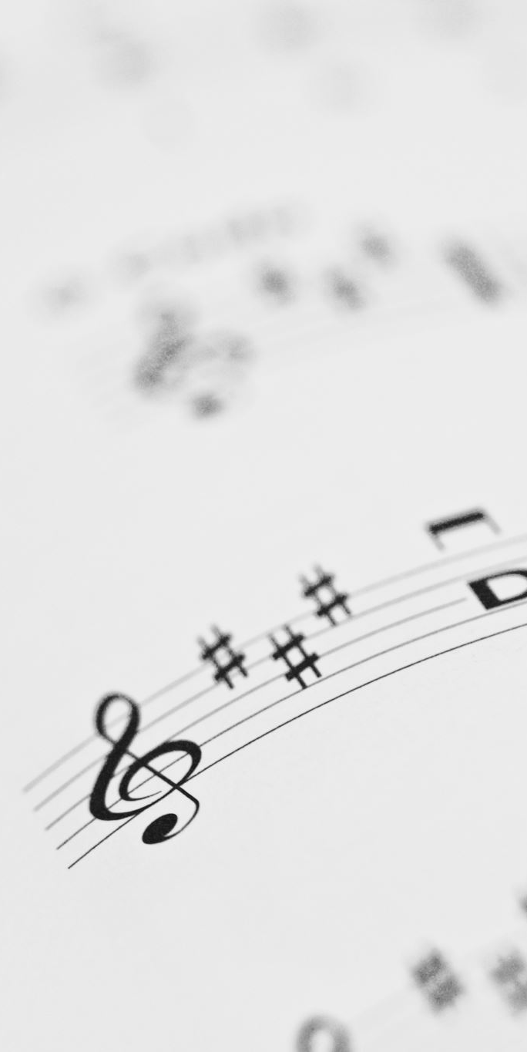
CHANCEL CHOIR ANTHEM:
“Come Unto Me”
Attrib. J. S. Bach

Slide 23

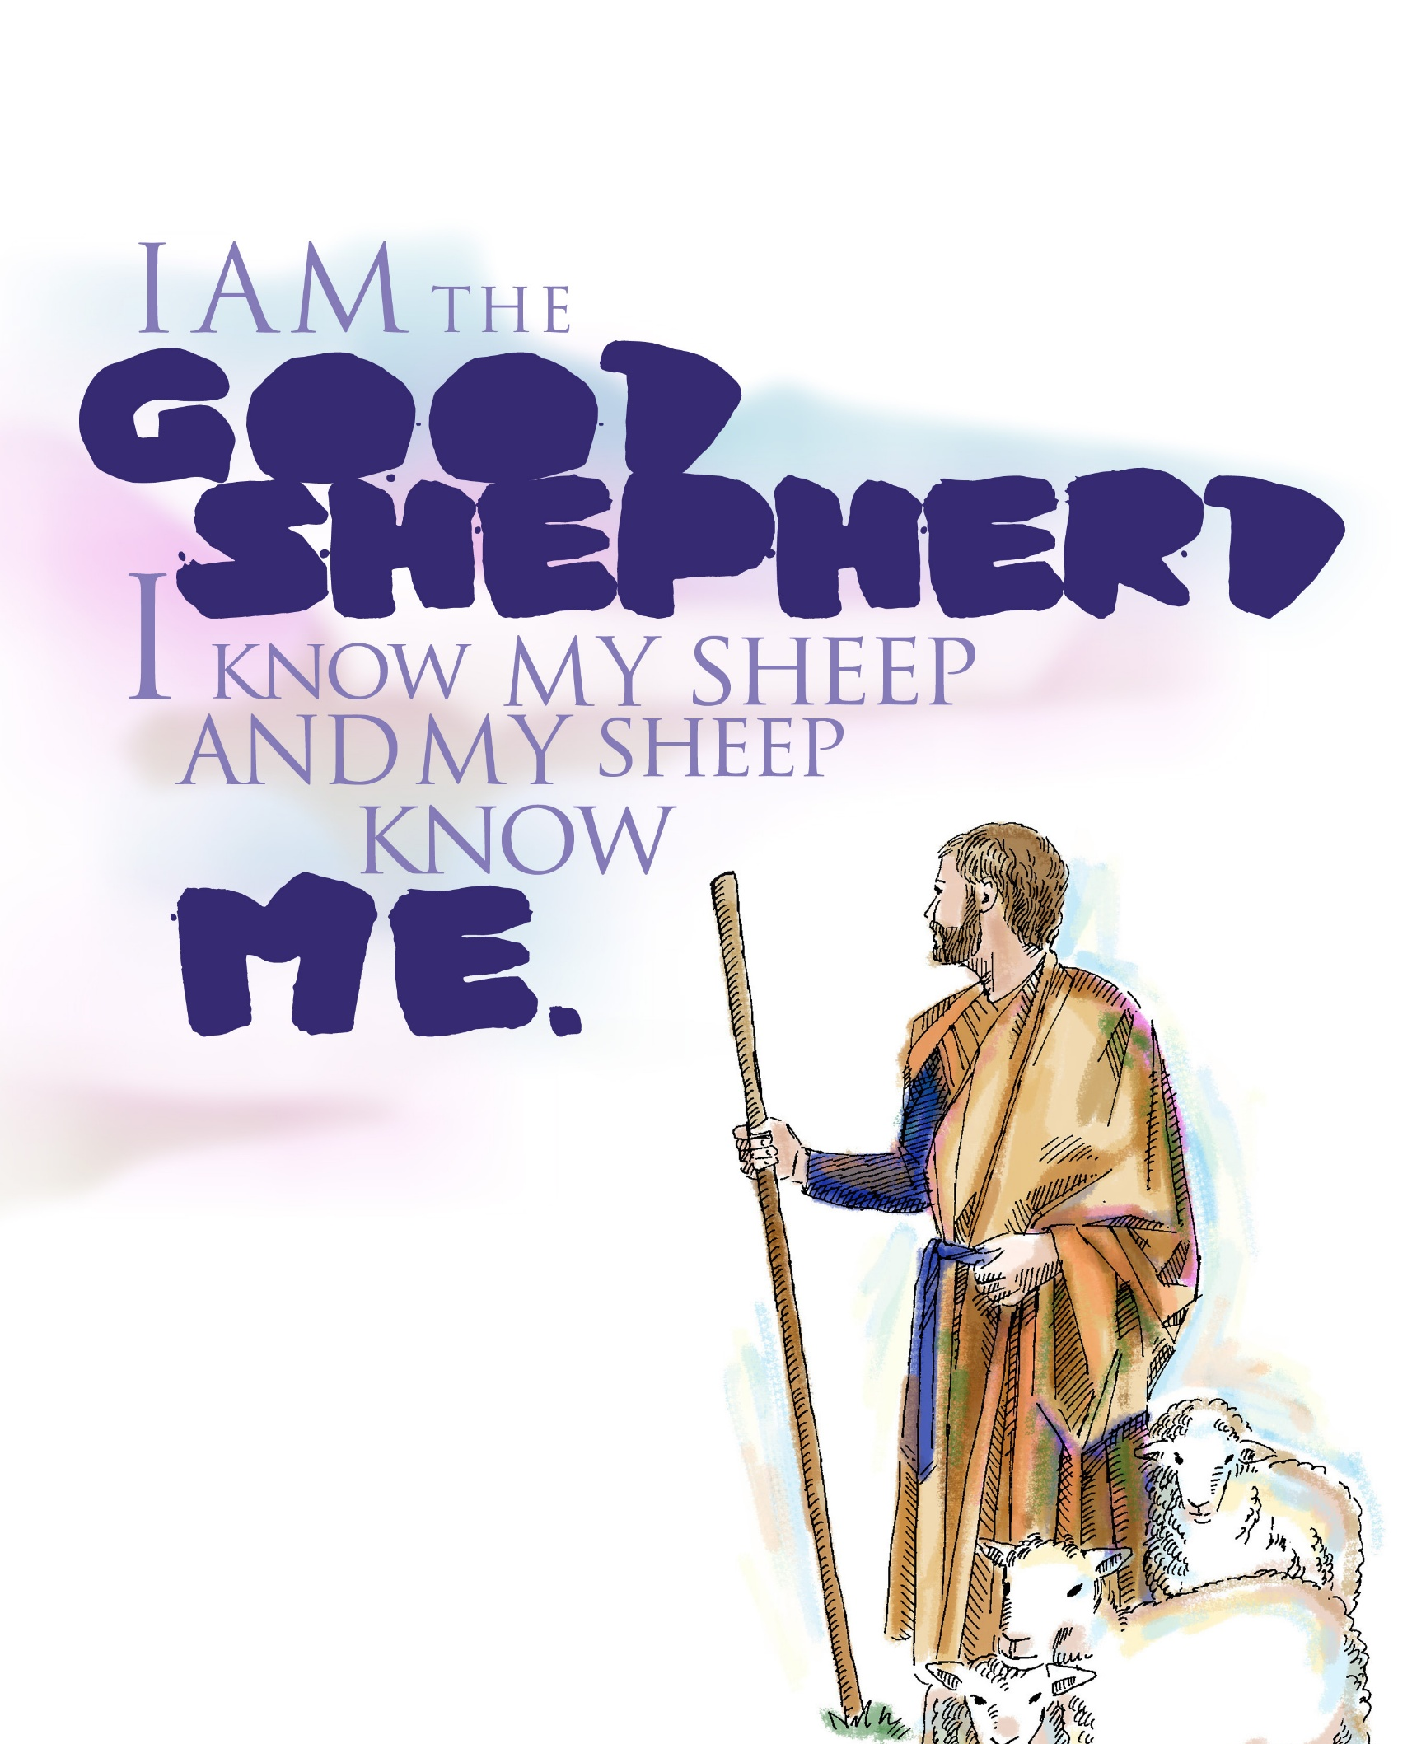
PASTOR DAVID’S SERMON:
“Shepherd-Folk”

Slide 24
RESPONDING TO GOD’S WORD

Slide 25
* AFFIRMATION OF FAITH: (Psalm 23, KJV)
The Lord is my shepherd; I shall not want. He maketh me to lie down in green pastures: he leadeth me beside the still waters. He restoreth my soul: he leadeth me in the paths of righteousness for his name's sake.
Yea, though I walk through the valley of the shadow of death, . . .

Slide 26
I will fear no evil: for thou art with me; thy rod and thy staff they comfort me. Thou preparest a table before me in the presence of mine enemies: thou anointest my head with oil; my cup runneth over. Surely goodness and mercy shall follow me all the days of my life: and I will dwell in the house of the Lord for ever. Amen.

Slide 27
* HYMN: Lord, You Are My Shepherd Tune #485 | vv. 1–2
Copyright © 2012 by Carolyn Winfrey Gillette
Lord, you are my shepherd
and so I am blessed;
You make me lie down
in green pastures to rest.
You lead me beside the still waters, O Lord;
In you I find peace and my soul is restored.
. . .

Slide 28
Refrain
In this world, there is much
that can tempt me away,
Yet in you, I'm content,
as you guide me each day.
O Lord, I don't need to feel lost or alone;
For you are my Shepherd
and I am your own.
. . .

Slide 29
You lead me to do what is just,
in your name;
You guide me through valleys
of death and deep pain.
I'll fear nothing evil with you by my side;
Your rod and your staff, Lord,
will comfort and guide.
. . .

Slide 30
Refrain
In this world, there is much
that can tempt me away,
Yet in you, I'm content,
as you guide me each day.
O Lord, I don't need to feel lost or alone;
For you are my Shepherd
and I am your own.

Slide 31
PRAYER OF THANKSGIVING, OF THE PEOPLE, & THE LORD’S PRAYER
Our Father who art in heaven,
Hallowed be thy name.
Thy kingdom come, thy will be done;
On earth as it is in heaven.
Give us this day our daily bread;
And forgive us our debts,
As we forgive our debtors;
And lead us not into temptation,
But deliver us from evil,
For Thine is the kingdom
And the power and the glory, forever. Amen.

Slide 32
DEPARTING IN GOD’S NAME

Slide 33
* HYMN: The Earth is the Lord’s Tune 263 \ vv. 1, 2, 4
© 2001 by Carolyn Winfrey Gillette
"The earth is the Lord’s
and the fullness thereof."
Creation reminds us, O God, of your love.
By grace we are learning,
as year leads to year,
We're called to be stewards,
your caretakers here.
. . .

Slide 34
Your rainforests nurture
the world that we share.
Your wetlands give animals
shelter and care.
Your coral reefs cradle the life of the sea.
You've shown us, in love,
what your good world can be.
. . .

Slide 35
May we be good stewards
of all that you give,
Protecting creation wherever we live.
May we be a church
that renews and restores
And lovingly cares
for this earth that is yours.

Slide 36

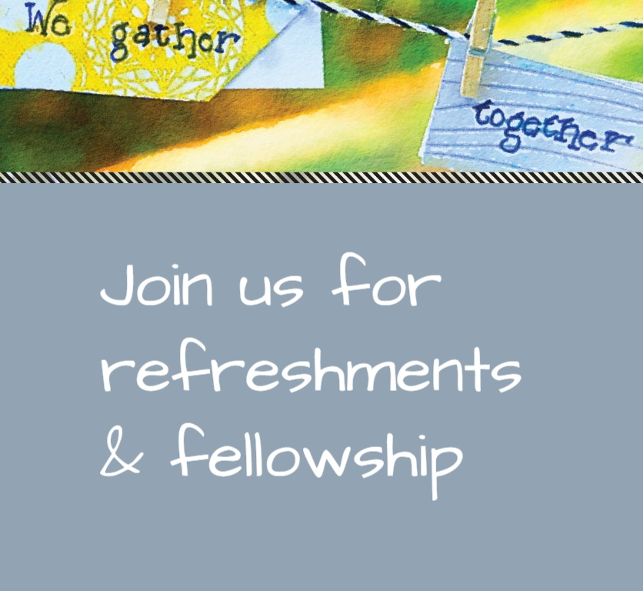
* CHARGE TO THE PEOPLE & BENEDICTION
* CHORAL BENEDICTION
POSTLUDE
Our worship has ended—our Christian Witness begins!

