Slide 1

Enter in
SILENCE
Wait with
REVERENCE
Worship from
JOY

Slide 2
PRELUDE
WELCOME & ANNOUNCEMENTS
AFFIRMATION OF MISSION STATEMENT
CHORAL INTROIT
Our Mission Statement
As disciples of Jesus Christ,
led by the Holy Spirit,
we experience God’s unconditional love,
and we witness to others
by discovering and sharing our gifts.

Slide 3
* CALL TO WORSHIP:
God is our refuge and strength, a very present help in time of trouble.
Therefore, we will not fear; though the earth should change and the mountains shake in the heart of the sea.
In our hour of need, we lift our eyes to the hills—from where our help will come.
Our help comes from the Lord, maker of heaven and earth. . . .

Slide 4
We gather today to thank and praise God for those whom God calls to respond to human hurts with hands of help,
and those first responders who offer voices of hope and gestures of compassion in time of need.
With grateful hearts and with lips of praise,
let us worship God.

Slide 5
* HYMN: No. 210 Our God, Our Help in Ages Past vv. 1–3 & 5
Our God, our help in ages past,
Our hope for years to come,
Our shelter from the stormy blast,
And our eternal home:
. . .

Slide 6
Before the hills in order stood,
Or earth received its frame,
From everlasting Thou art God,
To endless years the same.
. . .

Slide 7
A thousand ages in Thy sight
Are like an evening gone;
Short as the watch that ends the night
Before the rising sun.
. . .

Slide 8
Our God, our help in ages past,
Our hope for years to come,
Be Thou our guard while life shall last,
And our eternal home.

Slide 9
PRAYER OF CONFESSION: (in silence then in unison)
Universal God, we confess that we often take for granted the peace and safety of our community, and we sometimes look away or turn away from the suffering of our neighbors, while there are others who courageously run toward it. Forgive us when we fail to support those who carry the heavy burden . . .

Slide 10
of our collective community crises. Forgive us of our apathy and develop within us greater empathy. Forgive us of our cowardice and increase within us the grace of courage for those who serve us. Grant us all the courage to be agents of your shalom. In the name of the risen Christ, we pray. Amen.

Slide 11
ASSURANCE OF CHRIST’S FORGIVENESS:
In Christ, barriers are broken down, borders collapse, new friendships are formed; a new community is fashioned. All life becomes brand spankin’ new. Friends, rejoice and be glad!
In Jesus Christ, we are forgiven! Let us forgive one another.

Slide 12
* CELEBRATING CHRIST’S FORGIVENESS: No. 582 (GTG)
Glory to God, whose goodness
shines on me; and to the Son,
whose grace has pardoned me;
and to the Spirit,
whose love has set me free.
As it was in the beginning,
is now, and ever shall be. Amen.

Slide 13

* EXCHANGE OF CHRIST’S PEACE:
Pastor: The peace of Christ be with you.
People: And also with you.
Welcome one another
with the peace of Christ.

Slide 14
A LITANY OF COMMENDATION & BLESSING:
Eternal God, you are the ultimate healer and protector. We come before you today with hearts full of gratitude for those who serve as first responders. For the Firefighters, who face the heat and danger of the flame to protect our homes and our lives.
We thank you, O God, for their courage.
For the Police Officers and Law Enforcement, who walk into uncertainty to preserve peace and seek justice in our streets:
We thank you, O God, for their watchfulness.
. . .

Slide 15
For the EMTs, Paramedics, and Flight Medics, whose skilled hands and steady spirits bring healing in the golden hour of need:
We thank you, O God, for their compassion.
For the Dispatchers, the calm voices in the dark who bridge the gap between crisis and help:
We thank you, O God, for their guidance.
. . .

Slide 16
For men and women who serve in our Nation’s Armed Forces, who step up and march into foreign lands to protect the people of this great land.
We thank you God, for bravery and their courage.
We also remember their families—those who wait, who pray, and who support their loved ones in this difficult calling.
Surround them with your peace which passes all understanding.
. . .

Slide 17
Holy Spirit, sustain these servants. In the face of trauma, give them resilience. In the face of exhaustion, give them rest. In the face of cynicism, give them hope.
May they know that their work is seen by you, and their lives are held by you. Amen.
~ Children may go downstairs for Sunday School ~

Slide 18

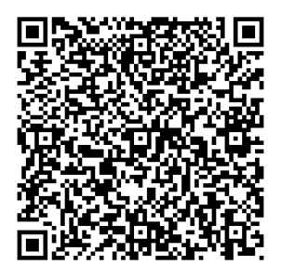
GIVING OF OUR GIFTS & OFFERTORY:
Our God has blessed us, so let us extend
God’s Blessing as we present our Tithes and Offerings.
Thank you for being faithful stewards of your
church family with your prayers, your time,
talent, and your financial resources.
Contributions may also be made:
Electronically on the church website
at fpcb-nj.org;
By reoccurring electronic withdrawal; or
By mailing your offering to the church:
P.O. Box 385, Blairstown, NJ.

Slide 19
* DOXOLOGY: No. 577 Glory Be to the Father
Glory be to the Father, and the Son,
and the Holy Ghost; As it was in the beginning, is now, and ever shall be,
world without end. Amen.
As it was in the beginning, is now,
and ever shall be, world without end. Amen. Amen. Amen.
Amen. Amen. Amen. Amen. Amen.
* PRAYER OF DEDICATION

Slide 20
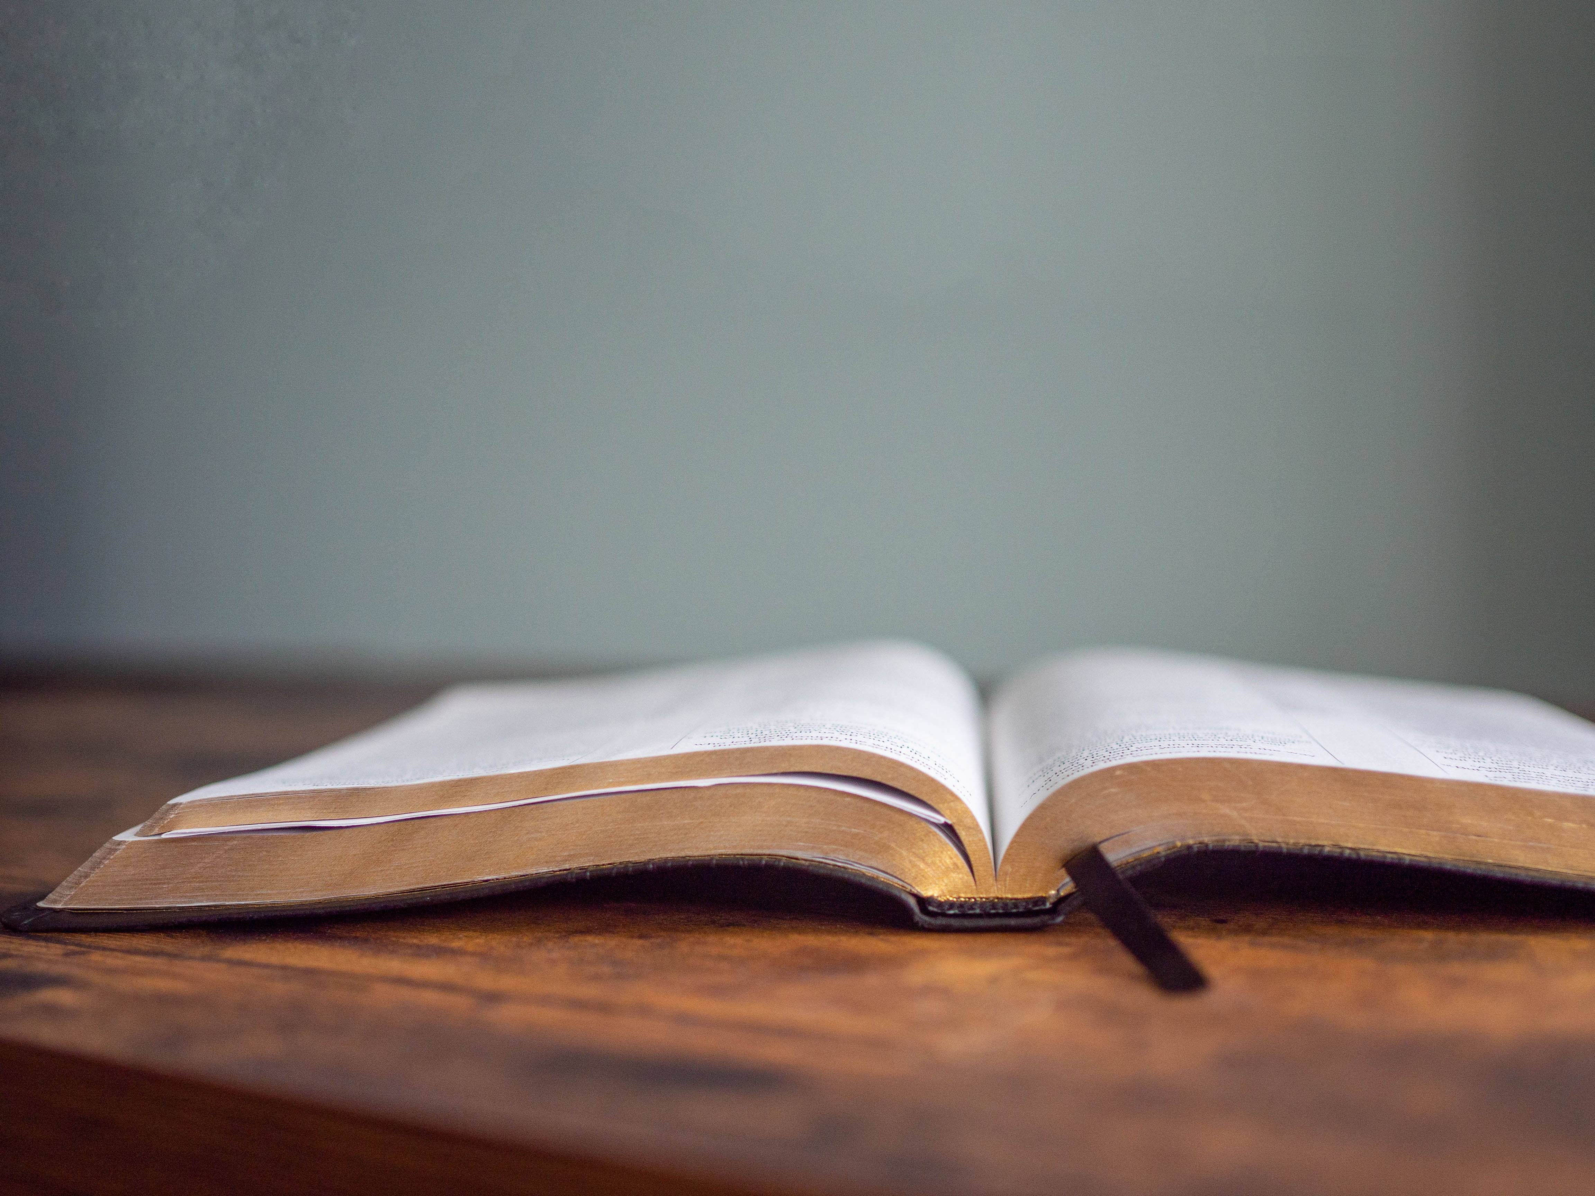
DECLARING
GOD‘S WORD

Slide 21
PASTORAL EPISTLE: 1 Peter 1: 17–23
Live each day with reverent awe.
¹⁷ If you invoke as Father the one who judges impartially according to each person’s work, live in fear during the time of your exile. ¹⁸ You know that you were ransomed from the futile conduct inherited from your ancestors, not with perishable things like silver or gold ¹⁹ but with the precious blood of Christ, like that of a lamb without defect or blemish. ²⁰ He was destined before the foundation of the world . . .

Slide 22
but was revealed at the end of the ages for your sake. ²¹ Through him you have come to trust in God, who raised him from the dead and gave him glory, so that your trust and hope are in God.
²² Now that you have purified your souls by your obedience to the truth so that you have genuine mutual affection, love one another deeply from the heart. ²³ You have been born anew, not of perishable but of imperishable seed, through the living and enduring word of God.

Slide 23
GOSPEL LESSON: Luke 24: 13–35
Jesus is revealed through astonishing things and happenings.
¹³ Now on that same day two of them were going to a village called Emmaus, about seven miles from Jerusalem, ¹⁴ and talking with each other about all these things that had happened. ¹⁵ While they were talking and discussing, Jesus himself came near and went with them, ¹⁶ but their eyes were kept from recognizing him. ¹⁷ And he said to them, “What are you discussing with each other while you walk along?” They stood still, looking sad. . . .

Slide 24
¹⁸ Then one of them, whose name was Cleopas, answered him, “Are you the only stranger in Jerusalem who does not know the things that have taken place there in these days?” ¹⁹ He asked them, “What things?” They replied, “The things about Jesus of Nazareth, who was a prophet mighty in deed and word before God and all the people, ²⁰ and how our chief priests and leaders handed him over to be condemned to death and crucified him. . . .

Slide 25
²¹ But we had hoped that he was the one to redeem Israel. Yes, and besides all this, it is now the third day since these things took place. ²² Moreover, some women of our group astounded us. They were at the tomb early this morning, ²³ and when they did not find his body there they came back and told us that they had indeed seen a vision of angels who said that he was alive. ²⁴ Some of those who were with us went to the tomb and found it just as the women had said, but they did not see him.” . . .

Slide 26
²⁵ Then he said to them, “Oh, how foolish you are and how slow of heart to believe all that the prophets have declared! ²⁶ Was it not necessary that the Messiah should suffer these things and then enter into his glory?” ²⁷ Then beginning with Moses and all the prophets, he interpreted to them the things about himself in all the scriptures.
²⁸ As they came near the village to which they were going, he walked ahead as if he were going on. ²⁹ But they urged him strongly, saying, . . .

Slide 27
“Stay with us, because it is almost evening and the day is now nearly over.” So he went in to stay with them. ³⁰ When he was at the table with them, he took bread, blessed and broke it, and gave it to them. ³¹ Then their eyes were opened, and they recognized him, and he vanished from their sight. ³² They said to each other, “Were not our hearts burning within us while he was talking to us on the road, while he was opening the scriptures to us?” . . .

Slide 28
³³ That same hour they got up and returned to Jerusalem, and they found the eleven and their companions gathered together. ³⁴ They were saying, “The Lord has risen indeed, and he has appeared to Simon!” ³⁵ Then they told what had happened on the road and how he had been made known to them in the breaking of the bread.

Slide 29
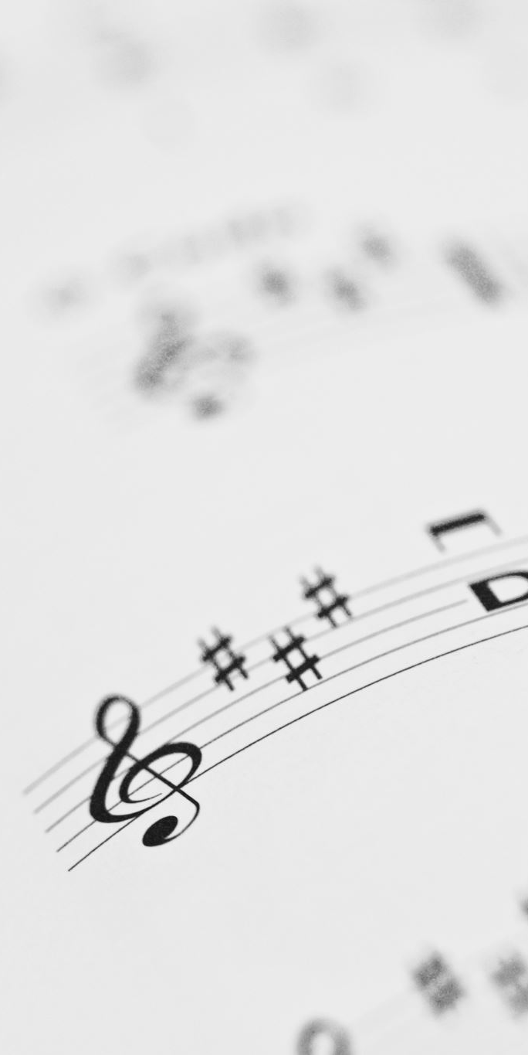
CHANCEL CHOIR ANTHEM:
“Sing a Song of Thanks and Joy”
by Hal Hopson

Slide 30


PASTOR DAVID’S
SERMON:
“He Walks with Us!”

Slide 31
RESPONDING TO GOD’S WORD

Slide 32
* AFFIRMATION OF FAITH: Philippians 2: 3–11 NRSVACE
Do nothing from selfish ambition or conceit, but in humility regard others as better than yourselves. Let each of you look not to your own interests, but to the interests of others. Let the same mind be in you that was in Christ Jesus, who, though he was in the form of God, did not regard equality with God . . .

Slide 33
as something to be exploited, but emptied himself, taking the form of a slave, being born in human likeness. And being found in human form, he humbled himself and became obedient to the point of death—even death on a cross.
Therefore, God also highly exalted him and gave him the name that is above every name, . . .

Slide 34
so that at the name of Jesus every knee should bend, in heaven and on earth and under the earth, and every tongue should confess that Jesus Christ is Lord, to the glory of God the Father. Amen.

Slide 35
* HYMN: Emmaus-Bound on Easter Day Tune #335 | vv. 1–2
Copyright © 2009 by Carolyn Winfrey Gillette
Emmaus-bound on Easter Day,
Two travelers walked along the way.
They'd once had hope, but hope had died
When you, O Lord, were crucified.
. . .

Slide 36
2
When you appeared beside the two,
They could not see that it was you;
But as they talked and shared their pain,
You gave them hope and joy again.

Slide 37
PRAYER OF THANKSGIVING, OF THE PEOPLE,
& THE LORD’S PRAYER
Our Father who art in heaven,
Hallowed be thy name.
Thy kingdom come, thy will be done;
On earth as it is in heaven.
Give us this day our daily bread;
And forgive us our debts,
As we forgive our debtors;
And lead us not into temptation,
But deliver us from evil,
For Thine is the kingdom
And the power and the glory, forever. Amen.

Slide 38
DEPARTING IN GOD’S NAME

Slide 39
* HYMN: No. 420 God of Grace and God of Glory vv. 1, 3–5
God of grace and God of glory,
On Thy people pour Thy power;
Crown Thine ancient church’s story;
Bring its bud to glorious flower.
Grant us wisdom, grant us courage,
For the facing of this hour,
For the facing of this hour.
Cont’d.

Slide 40
Cure thy children’s warring madness,
Bend our pride to Thy control;
Shame our wanton, selfish gladness,
Rich in things and poor in soul.
Grant us wisdom, grant us courage,
Lest we miss Thy kingdom’s goal,
Lest we miss Thy kingdom’s goal.
Cont’d.

Slide 41
Set our feet on lofty places;
Gird our lives that they may be
Armored with all Christ-like graces,
Pledged to set all captives free.
Grant us wisdom, grant us courage,
That we fail not them nor Thee!
That we fail not them nor Thee!
Cont’d.

Slide 42
Save us from weak resignation
To the evils we deplore;
Let the gift of Thy salvation
Be our glory evermore.
Grant us wisdom, grant us courage,
Serving Thee whom we adore,
Serving Thee whom we adore.

Slide 43

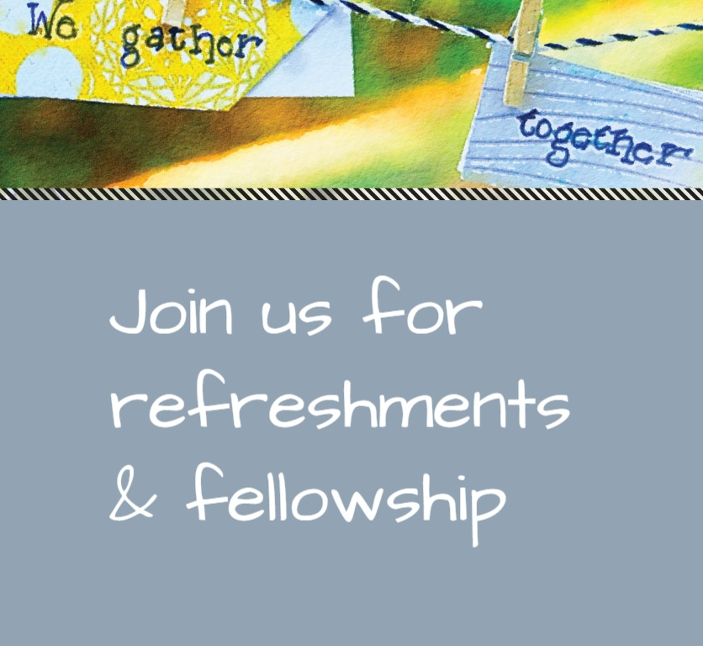
* CHARGE TO THE PEOPLE & BENEDICTION
* CHORAL BENEDICTION
POSTLUDE
Our worship has ended—our Christian Witness begins!

