Slide 1

Enter in SILENCE
Wait with REVERENCE
Worship from JOY

Slide 2
PRELUDE
WELCOME & ANNOUNCEMENTS
AFFIRMATION OF MISSION STATEMENT
CHORAL INTROIT
Our Mission Statement
As disciples of Jesus Christ, led by the Holy Spirit, we experience God’s unconditional love, and we witness to others by discovering and sharing our gifts.

Slide 3
* CALL TO WORSHIP:
Praise the Lord!
Give thanks to the Lord!
Praise the Lord and give thanks to the Lord.
Especially in the company of the congregation.
. . .

Slide 4
Great are the works of the Lord, studied by all who delight in them.
Full of honor and majesty, renowned are God’s deeds.
The Lord is gracious and merciful, providing food for all who fear him.
With praise on our lips and joy in our hearts, we praise the Lord!

Slide 5
* HYMN OF PRAISE: No. 267 All Things Bright and Beautiful
All things bright and beautiful,
all creatures great and small, All things wise and wonderful:
The Lord God made them all.
Each little flower that opens,
each little bird that sings:
God made their glowing colors,
God made their tiny wings. Cont’d.

Slide 6
The purple-headed mountain,
the river running by, The sunset, and the morning
that brightens up the sky.
The cold wind in the winter,
the pleasant summer sun, The ripe fruits in the garden:
God made them every one.
Cont’d.

Slide 7
God gave us eyes to see them,
and lips that we might tell How great is God Almighty,
who has made all things well.
All things bright and beautiful,
all creatures great and small, All things wise and wonderful:
The Lord God made them all.

Slide 8
PRAYER OF CONFESSION: (in silence then in unison)
Almighty and forgiving God, who revealed the fullness of your power by raising Jesus from the dead: forgive us when we ask you to bless what we do rather than strive to do what you bless. Forgive us for seeking concessions rather than asking for your guidance.
. . .

Slide 9
Forgive us when our worship shapes what we want rather than what you will. Meet us here, we pray, that our doubts may be filled with declarations, and that hesitations may be replaced with courage, our doubts rekindled with hope, and our disbelief renewed by faith in your risen Son; in Jesus’ name. Amen.

Slide 10
ASSURANCE OF CHRIST’S FORGIVENESS:
Hear the good news! Who is in a position to condemn? Only Christ, who died for us. Christ rose for us. Christ reigns in power for us; Christ prays for us. Anyone who is in Christ is made alive in Christ and is a new creation. The old life is gone. The new life has begun. Know that you are forgiven and be at peace.
In Jesus Christ, we are forgiven! Let us forgive one another.

Slide 11
* CELEBRATING CHRIST’S FORGIVENESS: No. 582 (GTG)
Glory to God, whose goodness
shines on me; and to the Son,
whose grace has pardoned me;
and to the Spirit,
whose love has set me free.
As it was in the beginning,
is now, and ever shall be. Amen.

Slide 12

* EXCHANGE OF CHRIST’S PEACE:
Pastor: The peace of Christ be with you.
People: And also with you.
Welcome one another with the peace of Christ.
~ Children may go downstairs for Sunday School ~

Slide 13

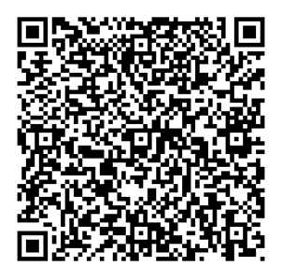
GIVING OF OUR GIFTS & OFFERTORY:
Our God has blessed us, so let us extend God’s Blessing as we present our Tithes and Offerings.
Thank you for being faithful stewards of your church family with your prayers, your time, talent, and your financial resources.
Contributions may also be made:
Electronically on the church website at fpcb-nj.org;
By reoccurring electronic withdrawal; or
By mailing your offering to the church: P.O. Box 385, Blairstown, NJ.

Slide 14
* DOXOLOGY: No. 577 Glory Be to the Father
Glory be to the Father, and the Son,
and the Holy Ghost; As it was in the beginning, is now, and ever shall be,
world without end. Amen.
As it was in the beginning, is now,
and ever shall be, world without end. Amen. Amen. Amen.
Amen. Amen. Amen. Amen. Amen.
* PRAYER OF DEDICATION

Slide 15
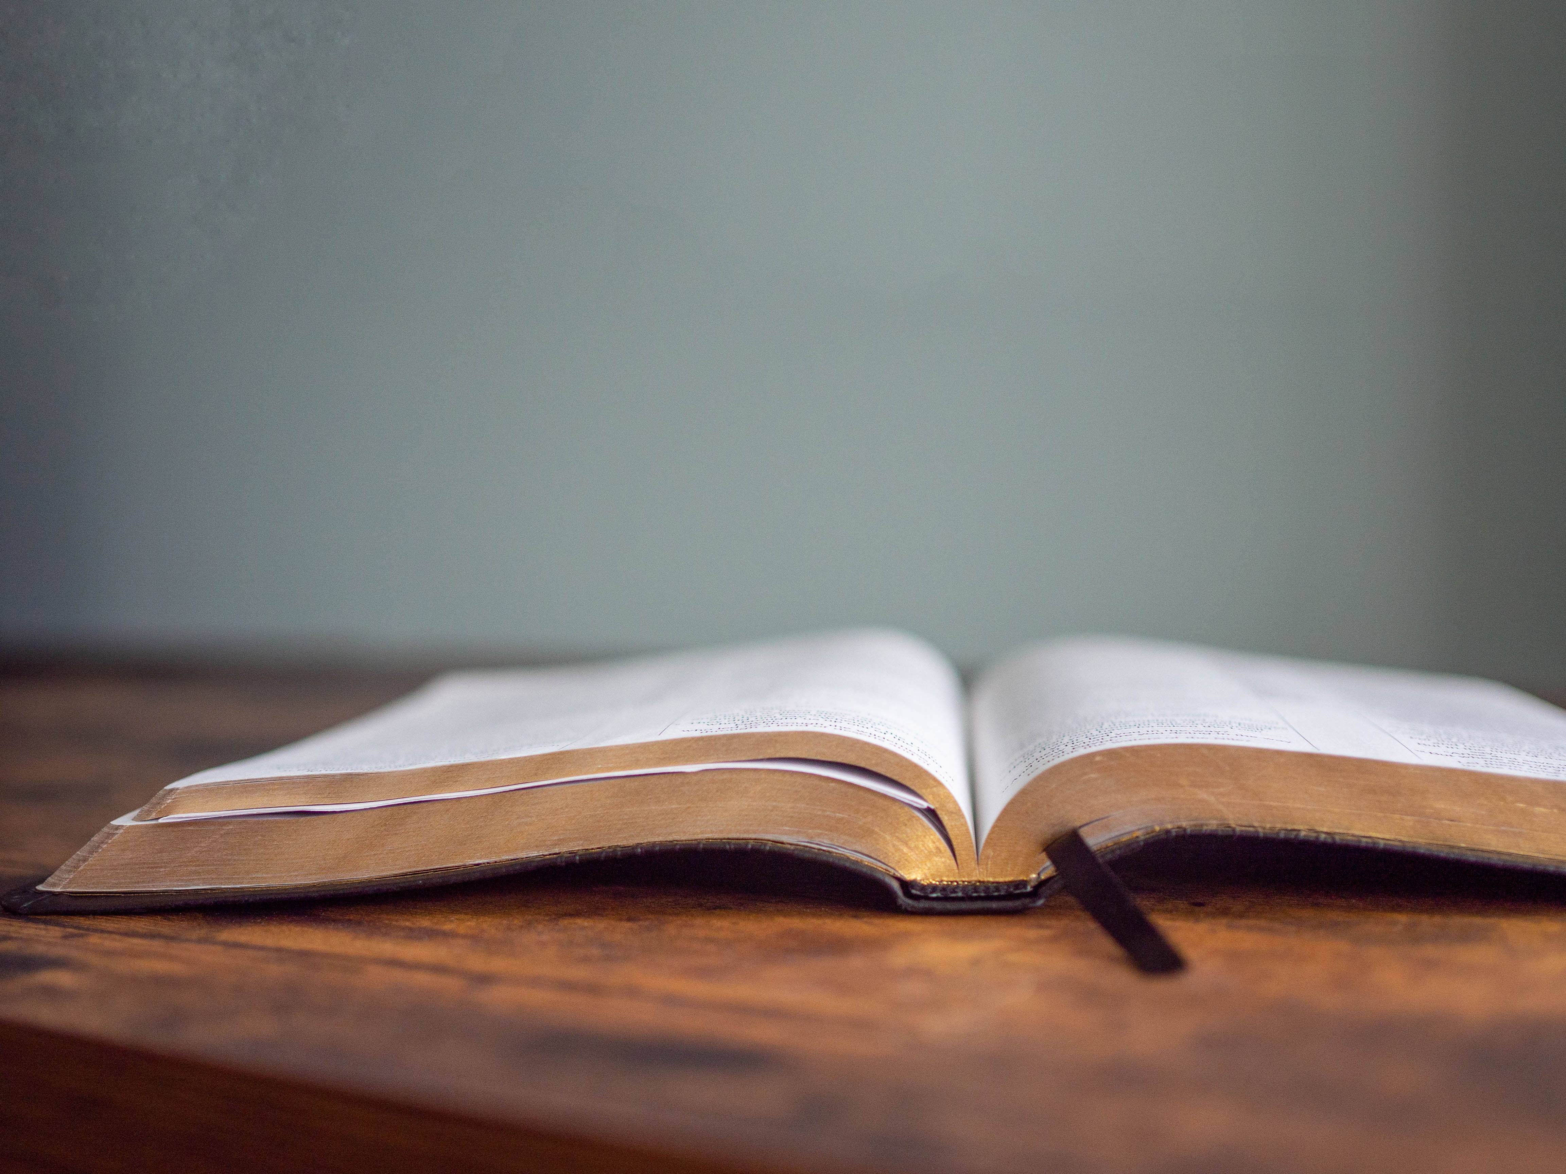
DECLARING GOD‘S WORD

Slide 16
HEBREW LESSON: Exodus 15: 1–11
The Hebrews sing of God’s mighty works!
15 Then Moses and the Israelites sang this song to the Lord:
“I will sing to the Lord, for he has triumphed gloriously; horse and rider he has thrown into the sea. ² The Lord is my strength and my might, and he has become my salvation; this is my God, and I will praise him; my father’s God, and I will exalt him. . . .

Slide 17
³ The Lord is a warrior; the Lord is his name.
⁴ Pharaoh’s chariots and his army he cast into the sea; his elite officers were sunk in the Red Sea. ⁵ The floods covered them; they went down into the depths like a stone. ⁶ Your right hand, O Lord, glorious in power— your right hand, O Lord, shattered the enemy. ⁷ In the greatness of your majesty you overthrew your adversaries; . . .

Slide 18
you sent out your fury; it consumed them like stubble. ⁸ At the blast of your nostrils the waters piled up; the floods stood up in a heap; the deeps congealed in the heart of the sea. ⁹ The enemy said, ‘I will pursue; I will overtake; I will divide the spoil; my desire shall have its fill of them. I will draw my sword; my hand shall destroy them.’ ¹⁰ You blew with your wind; the sea covered them; . . .

Slide 19
they sank like lead in the mighty waters.
¹¹ Who is like you, O Lord, among the gods? Who is like you, majestic in holiness, awesome in splendor, doing wonders?

Slide 20
GOSPEL LESSON: John 20: 19–32
Thomas believes and declares Jesus is risen!
¹⁹ When it was evening on that day, the first day of the week, and the doors were locked where the disciples were, for fear of the Jews, Jesus came and stood among them and said, “Peace be with you.” ²⁰ After he said this, he showed them his hands and his side. Then the disciples rejoiced when they saw the Lord. ²¹ Jesus said to them again, “Peace be with you. As the Father has sent me, so I send you.” . . .

Slide 21
²² When he had said this, he breathed on them and said to them, “Receive the Holy Spirit. ²³ If you forgive the sins of any, they are forgiven them; if you retain the sins of any, they are retained.”
²⁴ But Thomas (who was called the Twin), one of the twelve, was not with them when Jesus came. ²⁵ So the other disciples told him, “We have seen the Lord.” But he said to them, “Unless I see the mark of the nails in his hands and put my finger in the mark of the nails and my hand in his side, . . .

Slide 22
I will not believe.”
²⁶ A week later his disciples were again in the house, and Thomas was with them. Although the doors were shut, Jesus came and stood among them and said, “Peace be with you.” ²⁷ Then he said to Thomas, “Put your finger here and see my hands. Reach out your hand and put it in my side. Do not doubt but believe.” ²⁸ Thomas answered him, “My Lord and my God!” ²⁹ Jesus said to him, “Have you believed because you have seen me? . . .

Slide 23
Blessed are those who have not seen and yet have come to believe.”
³⁰ Now Jesus did many other signs in the presence of his disciples that are not written in this book. ³¹ But these are written so that you may continue to believe that Jesus is the Messiah, the Son of God, and that through believing you may have life in his name.

Slide 24
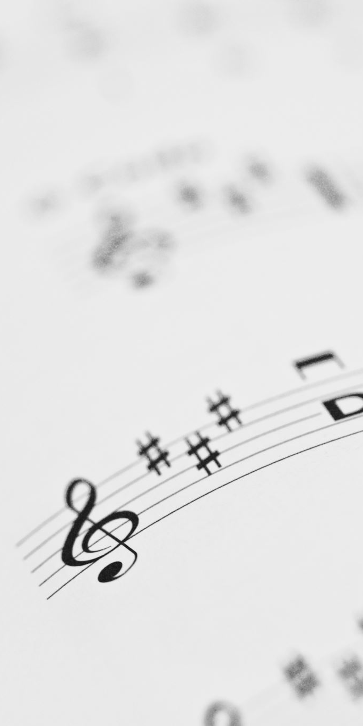
CHANCEL CHOIR ANTHEM:
“Come, Sing unto the Lord”
by Joseph Martin

Slide 25


PASTOR DAVID’S SERMON

Slide 26
RESPONDING TO GOD’S WORD

Slide 27
* AFFIRMATION OF FAITH: Colossians 1: 15–20
I believe in God who places joy in our souls, dancing in our toes and songs in our hearts. I believe God wanted gladness to flow like a river, so the Good Lord created a bountiful earth with plenty for all to share.
I believe in Jesus, who turned water into wine, . . .

Slide 28
partied with outcasts and sinners, and touched the broken so they could leap and dance. I believe Jesus opened the doors and set an extra place so we could feast.
I believe in the Holy Spirit, who prompts us to smile, who sends us invitations to come and dine, who nudges us to openness and tenderness. . . .

Slide 29
I believe the Spirit is present every time we gather to break bread and stirs within us the desire to live joyfully, to walk hopefully, and to enact justice boldly. Forever, I will live in the embrace of God and be a witness to Christ’s resurrection joy. Amen.

Slide 30
* HYMN: When Thomas Heard from Jesus Tune 442 | vv. 1, 2, 4, 5
Copyright © 2012 by Carolyn Winfrey Gillette
When Thomas heard from Jesus,
"Now come and follow me,"
He surely went with gladness,
for there was much to see.
He witnessed Jesus' teaching
and saw his healing touch;
He found a faith to guide him,
a friend he loved so much. . . .

Slide 31
2
When Jesus spoke of heaven,
bold Thomas dared to say,
"We don't know where you're going!
How can we know the way?"
He wanted understanding
of what he could not see.
Then Jesus reassured him,
"The way is here — through me."
. . .

Slide 32
4
What joy on Easter evening
when many saw the Lord!
Yet Thomas was not with them
and would not trust their word.
When Christ appeared before him,
his doubts were quickly gone;
He gladly knew that evening
the joy of Easter dawn.
. . .

Slide 33
5
That man of faith saw Jesus
at breakfast by the sea;
At Pentecost he witnessed
so others would believe.
O Lord, may we — like Thomas —
keep growing day by day;
Increase our faith and guide us,
for Lord, you are the Way.

Slide 34
PRAYER OF THANKSGIVING, OF THE PEOPLE, & THE LORD’S PRAYER
Our Father who art in heaven,
Hallowed be thy name.
Thy kingdom come, thy will be done;
On earth as it is in heaven.
Give us this day our daily bread;
And forgive us our debts,
As we forgive our debtors;
And lead us not into temptation,
But deliver us from evil,
For Thine is the kingdom
And the power and the glory, forever. Amen.

Slide 35
DEPARTING IN GOD’S NAME

Slide 36
* HYMN: No. 108 Christ Is Alive!
Christ is alive! Let Christians sing.
The cross stands empty to the sky.
Let streets and homes with praises ring.
Love, drowned in death, shall never die.
. . .

Slide 37
4
In every insult, rift and war,
Where color, scorn or wealth divide,
Christ suffers still, yet loves the more,
And lives, where even hope has died.
. . .

Slide 38
5
Christ is alive, and comes to bring
Good news to this and every age,
Till earth and sky and ocean ring
With joy, with justice, love and praise.

Slide 39


* CHARGE TO THE PEOPLE & BENEDICTION
* CHORAL BENEDICTION
POSTLUDE
Our worship has ended—our Christian Witness begins!

