Slide 1
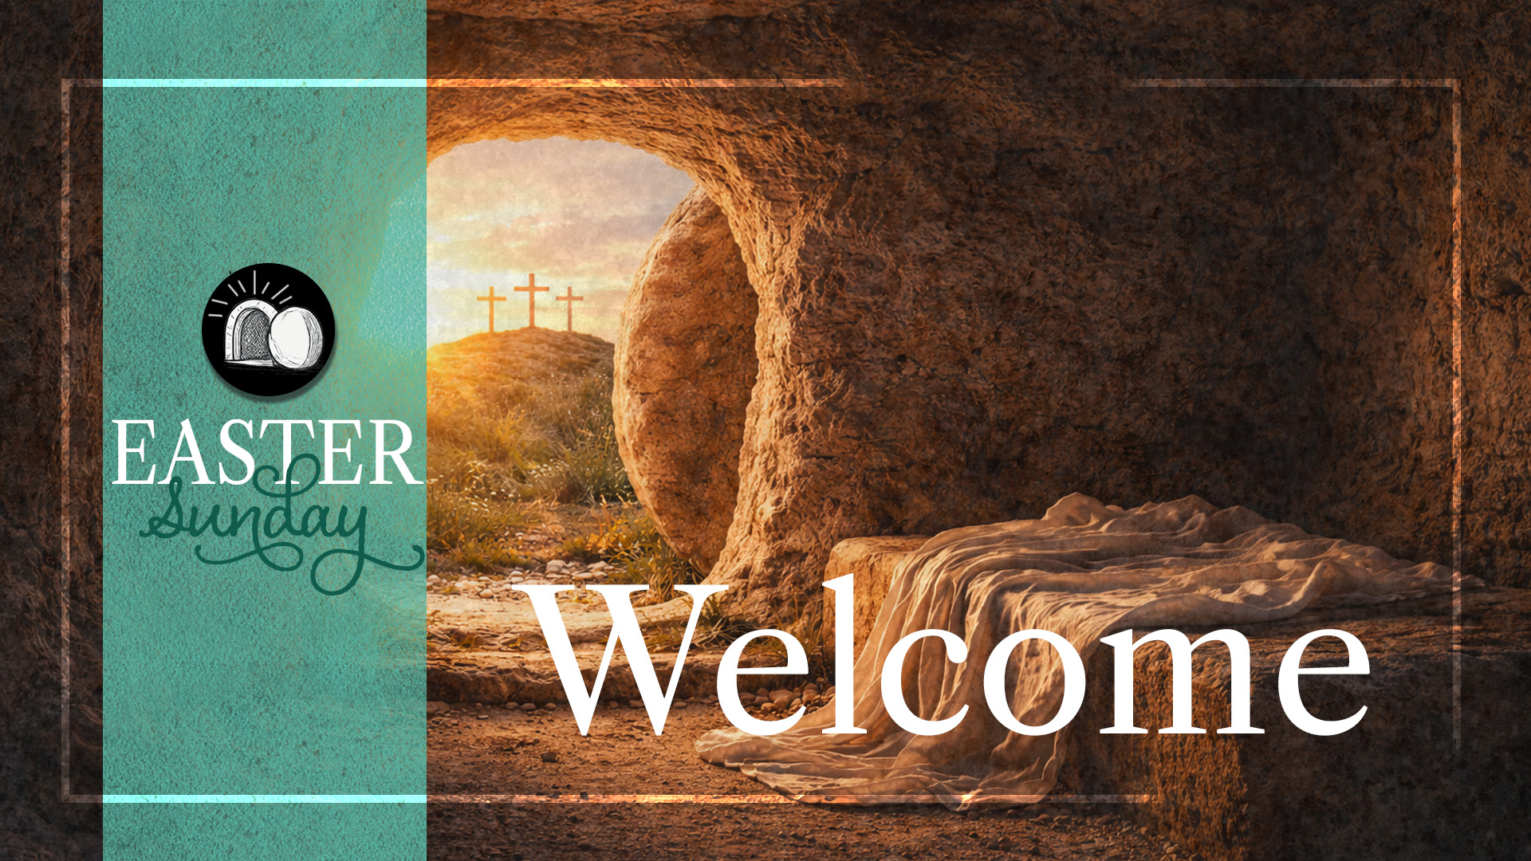
Enter in SILENCE
Wait with REVERENCE
Worship from JOY

Slide 2
PRELUDE
WELCOME & ANNOUNCEMENTS
AFFIRMATION OF MISSION STATEMENT
CHORAL INTROIT
Our Mission Statement
As disciples of Jesus Christ, led by the Holy Spirit, we experience God’s unconditional love, and we witness to others by discovering and sharing our gifts.

Slide 3
* CALL TO WORSHIP:
Christ is Risen! From the depths of Death Valley to Mount Everest’s summit: Shout!
Christ is risen!
From the jagged walls of the Grand Canyon to the falling, majestic waters of Niagara Falls: Rejoice!
Christ is risen!
From the empty tomb of Jerusalem to the Great Wall of China: Exclaim!
Christ is risen!
. . .

Slide 4
From the outer reaches of the cosmos above to the inner cells of our souls: Declare!
Christ is risen, indeed!
With grateful hearts and joyful praise on our lips, let us worship God.

Slide 5
* HYMN OF PRAISE: No. 123 Jesus Christ Is Risen Today
Jesus Christ is risen today, Alleluia!
Our triumphant holy day, Alleluia!
Who did once, upon the cross, Alleluia!
Suffer to redeem our loss. Alleluia!
Cont’d.

Slide 6
Hymns of praise then let us sing, Alleluia!
Unto Christ, our heavenly King, Alleluia!
Who endured the cross and grave, Alleluia!
Sinners to redeem and save. Alleluia!
Cont’d.

Slide 7
But the pains which He endured, Alleluia!
Our salvation have procured; Alleluia!
Now above the sky He’s king, Alleluia!
Where the angels ever sing. Alleluia!
Cont’d.

Slide 8
Sing we to our God above, Alleluia!
Praise eternal as God's love; Alleluia!
Praise our God, ye heavenly host,
Alleluia! Father, Son, and Holy Ghost. Alleluia!

Slide 9
PRAYER OF CONFESSION: (in silence then in unison)
God of great grace and abundant goodness, for the glorious and life-giving resurrection of your Son, Jesus, we give you thanks and praise. Forgive us of our sins, O God, especially when we grow cranky, live joylessly, and speak negatively of the many blessings of life we receive throughout the day and the year. . . .

Slide 10
Awaken us to the promise of Jesus’ resurrection that we may experience the awesome aliveness and the wonder of Jesus’ presence and the transformative power of his healing salvation—as we wait patiently for the day when we inherit the heavenly prize of your eternal Kingdom; in the name our risen Lord, Jesus the Christ. Amen.

Slide 11
ASSURANCE OF CHRIST’S FORGIVENESS:
Friends — hear, believe, and claim the good news of God’s powerful, life transforming, joy-generating love!
Christ is risen! In Jesus Christ, we are forgiven. Let us forgive one another.

Slide 12
* CHRIST’S VICTORY SONG:
No. 108 Christ Is Alive! (v. 1)
Christ is alive! Let Christians sing.
The cross stands empty to the sky.
Let streets and homes
with praises ring.
Love, drowned in death,
shall never die.

Slide 13

* EXCHANGE OF CHRIST’S PEACE:
Pastor: The peace of Christ be with you.
People: And also with you.
Welcome one another with the peace of Christ.

Slide 14

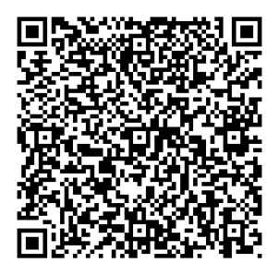
GIVING OF OUR GIFTS & OFFERTORY:
Our God has blessed us, so let us extend God’s Blessing as we present our Tithes and Offerings.
Thank you for being faithful stewards of your church family with your prayers, your time, talent, and your financial resources.
Contributions may also be made:
Electronically on the church website at fpcb-nj.org;
By reoccurring electronic withdrawal; or
By mailing your offering to the church: P.O. Box 385, Blairstown, NJ.

Slide 15
* DOXOLOGY: No. 122 Thine Is the Glory (v. 1 with refrain)
Thine is the glory, Risen, conquering Son;
Endless is the victory
Thou o’er death hast won.
Angels in bright raiment
Rolled the stone away,
Kept the folded grave clothes
Where Thy body lay.
Cont’d.

Slide 16
Refrain: Thine is the glory,
Risen, conquering Son;
Endless is the victory
Thou o’er death hast won.
* PRAYER OF DEDICATION

Slide 17
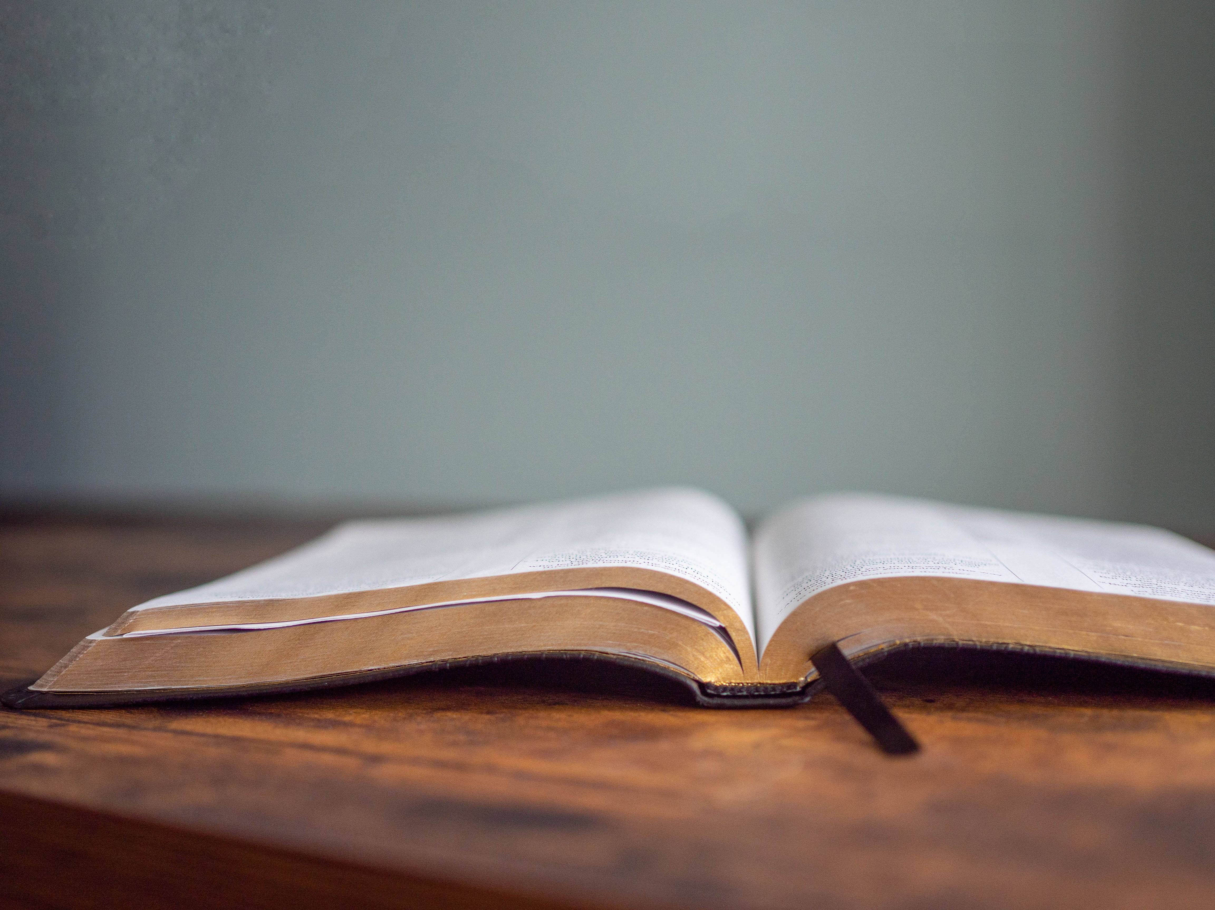
DECLARING GOD‘S WORD

Slide 18
NEW TESTAMENT: 1 Corinthians 15: 35–44, 51–58
St. Paul explains the resurrection.
³⁵ But someone will ask, “How are the dead raised? With what kind of body do they come?” ³⁶ Fool! What you sow does not come to life unless it dies. ³⁷ And as for what you sow, you do not sow the body that is to be but a bare seed, perhaps of wheat or of some other grain. ³⁸ But God gives it a body as he has chosen and to each kind of seed its own body. ³⁹ Not all flesh is alike, but there is one flesh for humans, another for animals, . . .

Slide 19
another for birds, and another for fish. ⁴⁰ There are both heavenly bodies and earthly bodies, but the glory of the heavenly is one thing, and that of the earthly is another. ⁴¹ There is one glory of the sun and another glory of the moon and another glory of the stars; indeed, star differs from star in glory.
⁴² So it is with the resurrection of the dead. What is sown is perishable; what is raised is imperishable. ⁴³ It is sown in dishonor; it is raised in glory. It is sown in weakness; it is raised in power. . . .

Slide 20
⁴⁴ It is sown a physical body; it is raised a spiritual body. If there is a physical body, there is also a spiritual body.
⁵¹ Look, I will tell you a mystery! We will not all die, but we will all be changed, ⁵² in a moment, in the twinkling of an eye, at the last trumpet. For the trumpet will sound, and the dead will be raised imperishable, and we will be changed. ⁵³ For this perishable body must put on imperishability, and this mortal body must put on immortality. . . .

Slide 21
⁵⁴ When this perishable body puts on imperishability and this mortal body puts on immortality, then the saying that is written will be fulfilled:
“Death has been swallowed up in victory.” ⁵⁵ “Where, O death, is your victory? Where, O death, is your sting?”
⁵⁶ The sting of death is sin, and the power of sin is the law. ⁵⁷ But thanks be to God, who gives us the victory through our Lord Jesus Christ. . . .

Slide 22
⁵⁸ Therefore, my beloved brothers and sisters, be steadfast, immovable, always excelling in the work of the Lord because you know that in the Lord your labor is not in vain.

Slide 23
GOSPEL LESSON: Matthew 28: 1–10
Mary Magdalene experiences the living Lord.
28 After the Sabbath, as the first day of the week was dawning, Mary Magdalene and the other Mary went to see the tomb. ² And suddenly there was a great earthquake, for an angel of the Lord, descending from heaven, came and rolled back the stone and sat on it. ³ His appearance was like lightning and his clothing white as snow. ⁴ For fear of him the guards shook and became like dead men. ⁵ But the angel said to the women, . . .

Slide 24
“Do not be afraid, for I know that you are looking for Jesus who was crucified. ⁶ He is not here, for he has been raised, as he said. Come, see the place where he lay. ⁷ Then go quickly and tell his disciples, ‘He has been raised from the dead, and indeed he is going ahead of you to Galilee; there you will see him.’ This is my message for you.” ⁸ So they left the tomb quickly with fear and great joy and ran to tell his disciples. ⁹ Suddenly Jesus met them and said, “Greetings!” . . .

Slide 25
And they came to him, took hold of his feet, and worshiped him. ¹⁰ Then Jesus said to them, “Do not be afraid; go and tell my brothers and sisters to go to Galilee; there they will see me.”

Slide 26
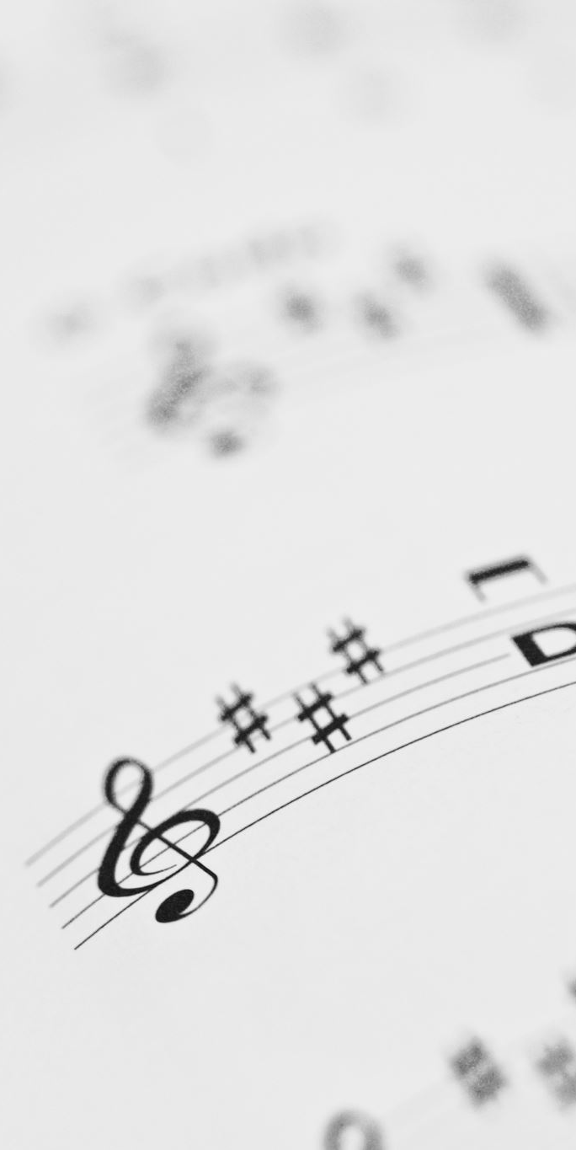
CHANCEL CHOIR ANTHEM:
“Praise Him, Alleluia!”
by Eugene Butler

Slide 27

PASTOR DAVID’S SERMON:
Holy Resurrection!

Slide 28
RESPONDING TO GOD’S WORD

Slide 29
RESPONDING TO GOD’S WORD
* AFFIRMATION OF FAITH: 1 Corinthians 15: 1–6, Colossians 1: 19–20
L: This is the good news that we have received, in which we stand, and by which we are being saved, if we hold firmly to the message proclaimed:
P: That Christ Jesus died for our sins according to the scriptures, that he was buried, that he was raised on the third day, and that he appeared first to the women, . . .

Slide 30
then to Peter, and to the Twelve, and then to many faithful witnesses. In him all the fullness of God was pleased to dwell, and through him God was pleased to reconcile to himself all things, whether on earth or in heaven, by making peace through the blood of his cross. Amen.

Slide 31
* HYMN: No. 507 I Come with Joy vv. 1, 5
I come with joy to meet my Lord,
Forgiven, loved, and free,
In awe and wonder to recall
His life laid down for me,
His life laid down for me.
. . .

Slide 32
5
Together met, together bound
We'll go our different ways,
And as His people in the world,
We'll live and speak His praise,
We'll live and speak His praise.

Slide 33
PRAYER OF THANKSGIVING, OF THE PEOPLE, & THE LORD’S PRAYER
Our Father who art in heaven,
Hallowed be thy name.
Thy kingdom come, thy will be done;
On earth as it is in heaven.
Give us this day our daily bread;
And forgive us our debts,
As we forgive our debtors;
And lead us not into temptation,
But deliver us from evil,
For Thine is the kingdom
And the power and the glory, forever. Amen.

Slide 34
DEPARTING IN GOD’S NAME

Slide 35
* HYMN: Lord, the Light of Your Love Is Shining!
vv. 1, 2 | No. 192 GTG
Lord, the light of your love is shining, in the midst of the darkness, shining; Jesus, Light of the World, shine upon us; set us free by the truth you now bring us. Shine on me; shine on me.
. . .

Slide 36
REFRAIN: Shine, Jesus, shine;
fill this land with the Father’s glory. Blaze, Spirit, blaze; set our hearts on fire. Flow, river, flow; flood the nations with grace and mercy. Send forth your word, Lord,
and let there be light.
. . .

Slide 37
2
Lord, I come to your awesome presence, from the shadows into your radiance; by the blood I may enter your brightness. Search me; try me;
consume all my darkness; Shine on me; shine on me.
. . .

Slide 38


Slide 39
SACRAMENT OF HOLY COMMUNION
INVITATION TO THE LORD’S TABLE:
L: Friends, this is the joyful feast of the people of God!
P: People will come from east and west, and from north and south, and sit at the table in the kingdom of God.

Slide 40
L: Behold, how good and pleasant it is when brothers and sisters dwell in unity.
P: God sent the whole world God’s only Son. Since God loved us so much, we too, should love one another.
L: This is the Lord’s Table. Our Savior invites all who are truly sorry for their sins and would humbly put their trust in him to come to the feast which he has prepared. Listen to the gracious words of our Savior Jesus Christ:

Slide 41
“Come to me, all you that are weary and are carrying heavy burdens, and I will give you rest. Take my yoke upon you, and learn from me; for I am gentle and humble in heart, and you will find rest for your souls. For my yoke is easy, and my burden is light.“ Matthew 11: 28–30
“Behold, I stand at the door and knock; if those who hear my voice open the door, I will come in to them and eat with them, and they with me.” Revelation 3: 20

Slide 42
L: The Lord be with you.
P: And with your spirit.
L: Lift up your hearts.
P: We lift them to the Lord.
L: Let us give thanks to the Lord our God.
P: It is right to give God our thanks and praise.

Slide 43
PRAYER OF THANKSGIVING, PRAYERS OF THE PEOPLE, & THE LORD’S PRAYER:
L: Holy Lord . . . as we pray together:
As we have eaten the bread and consumed the cup, O God, may the power of Christ’s resurrection fill us with the joy of life. May we lead a life worthy of our calling as witnesses of Christ’s resurrection. In Jesus’ name we joyfully pray together:

Slide 44
Our Father who art in heaven,
Hallowed be thy name.
Thy kingdom come, thy will be done;
On earth as it is in heaven.
Give us this day our daily bread;
And forgive us our debts,
As we forgive our debtors;
And lead us not into temptation,
But deliver us from evil,
For Thine is the kingdom
And the power and the glory, forever. Amen.

Slide 45
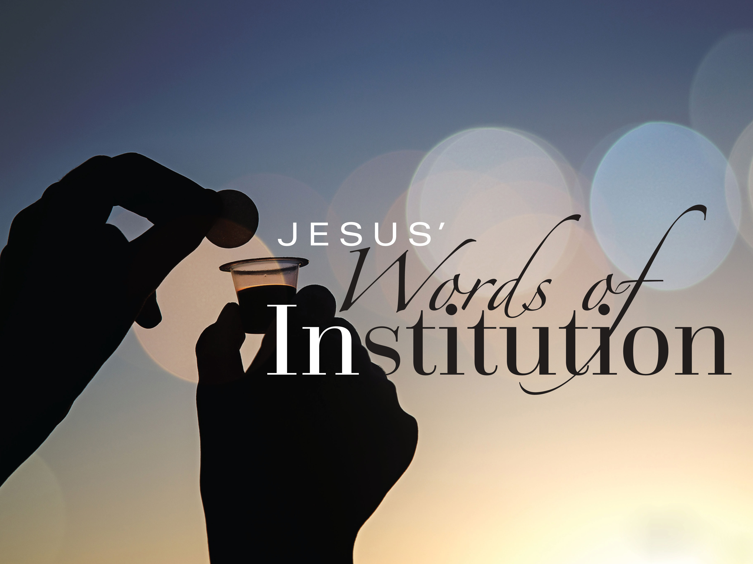

Slide 46

OFFERING OF THE ELEMENTS:
Approach the Table,
receive the bread, take the cup,
and return to your pew.

Slide 47
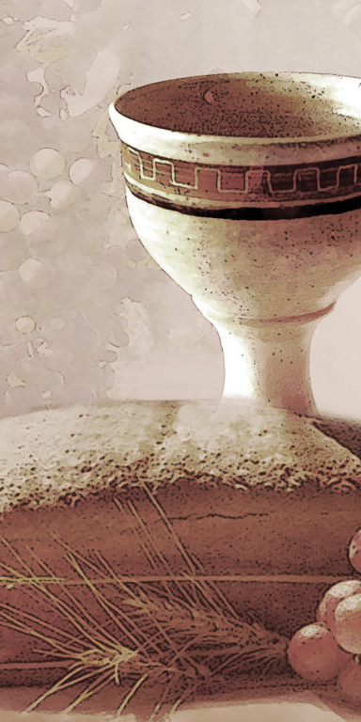
SHARING THE BREAD:
Jesus said, “I am the bread of life. Whoever comes to me will never be hungry...” (Jn. 6:35a)
Let us eat this bread in remembrance of Christ and may the spirit that is in him be in us also.
DRINKING THE CUP:
Jesus said, “I am the vine, you are the branches, apart from him, we can do nothing.”
Drink this cup in remembrance of Christ and may the spirit in which he died be our Spirit.

Slide 48
COMMUNION BLESSING: Let us give thanks to the Lord our God.
Awesome God, we give you thanks for the hope we have in Jesus, who died, is risen and reigns over all. Because he lives, we look forward to eternal life, knowing that nothing past, present, or yet to come shall ever separate us from your mysterious and miraculous love made known in Jesus Christ our Lord. Amen.

Slide 49
DEPARTING IN GOD’S NAME

Slide 50
* HYMN: No. 104 Christ Is Risen! Shout Hosanna!
Christ is risen! Shout hosanna!
Celebrate this day of days!
Christ is risen! Hush in wonder:
All creation is amazed.
In the desert all-surrounding,
See, a spreading tree has grown.
Healing leaves of grace abounding
Bring a taste of love unknown.
. . .

Slide 51
Christ is risen! Raise your spirits
From the caverns of despair.
Walk with gladness in the morning.
See what love can do and dare.
Drink the wine of resurrection,
Not a servant, but a friend.
Jesus is our strong companion.
Joy and peace shall never end.
. . .

Slide 52
Christ is risen! Earth and heaven
Nevermore shall be the same.
Break the bread of new creation
Where the world is still in pain.
Tell its grim, demonic chorus:
"Christ is risen! Get you gone!"
God the First and Last is with us.
Sing Hosanna, everyone!

Slide 53

* CHARGE TO THE PEOPLE & BENEDICTION
* CHORAL BENEDICTION: Chancel Choir
POSTLUDE: Tu es Petra, toccata Tim Topolski
by Henri Mulet
Our Worship has ended —our Christian Witness begins!

Slide 54

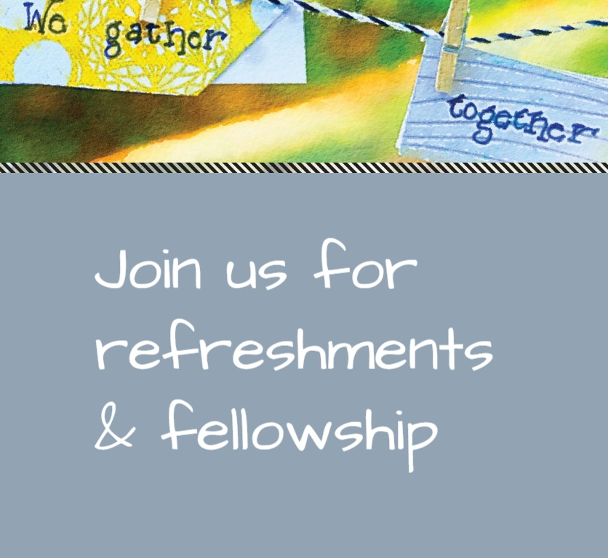
* CHARGE TO THE PEOPLE & BENEDICTION
* CHORAL BENEDICTION
POSTLUDE
Our worship has ended—our Christian Witness begins!

