Slide 1

Enter in SILENCE
Wait with REVERENCE
Worship from JOY

Slide 2
PRELUDE
WELCOME & ANNOUNCEMENTS
AFFIRMATION OF MISSION STATEMENT
Our Mission Statement
As disciples of Jesus Christ, led by the Holy Spirit, we experience God’s unconditional love, and we witness to others by discovering and sharing our gifts.

Slide 3


CHORAL INTROIT Hosanna, Loud, Hosanna

Slide 4
* CALL TO WORSHIP:
This is the day on which the Lord has acted.
Let us rejoice and be glad in it.
Blessed is the one who comes in the name of the Lord.
Hosanna in the highest!
With grateful hearts and with lips of praise, let us worship God.

Slide 5
* HYMN OF PRAISE: Christ Jesus, on Sunday, You Rode into Town vv. 1, 4, 5
Christ Jesus, on Sunday,
you rode into town;
The crowds laid their coats and some palms on the ground.
They made you a welcome
and called you their king,
But they did not know
of the reign you would bring. . . .

Slide 6
With basin and towel,
with washing of feet,
You showed us where love
and humility meet.
You loved till your love
led to suffering and loss;
You knelt down to serve us,
then hung on a cross. . . .

Slide 7
On Friday, you died,
and the next day was bleak.
O Christ, we remember
your whole Holy Week.
We can't avoid suffering,
or turn from what's true,
For out of your death,
we find new life in you.

Slide 8
PRAYER OF CONFESSION: In silence then unison
Lord Jesus Christ, as you rode a donkey and her foal amid the crowds while people shouted your praises, your royal monarchy was displayed as one of humility and peace. We confess our lack of humility and our reluctance to live drawn to your peace. . . .

Slide 9
Our wills are often rebellious, and our faith is often more show than substance. Our attitudes and actions need your cleansing power.
Have mercy on us and forgive our sins, Lord Jesus, Son of David. Help us to lay at your feet all that we have and all that we are, . . .

Slide 10
that we may sing your praises, know the joy of your salvation, and delight in living your will in our daily lives. In Jesus’ name, we pray. Amen.

Slide 11
ASSURANCE OF CHRIST’S FORGIVENESS:
Blessed is the one who comes in the name of the Lord, the one who comes to us and has done for us what we unable to do for ourselves.
Blessed is the One who offers us abundant life and eternal love. In Jesus Christ, we are forgiven! Let us forgive one another.

Slide 12
* SONG OF CHRIST’S FORGIVENESS: No. 370 v. 1
Just as I am, without one plea
But that Thy blood was shed for me,
And that Thou bidst me come to Thee,
O Lamb of God, I come, I come!

Slide 13

* EXCHANGE OF CHRIST’S PEACE:
L: The peace of Christ be with you.
P: And also with you.
Welcome one another with the peace of Christ.

Slide 14
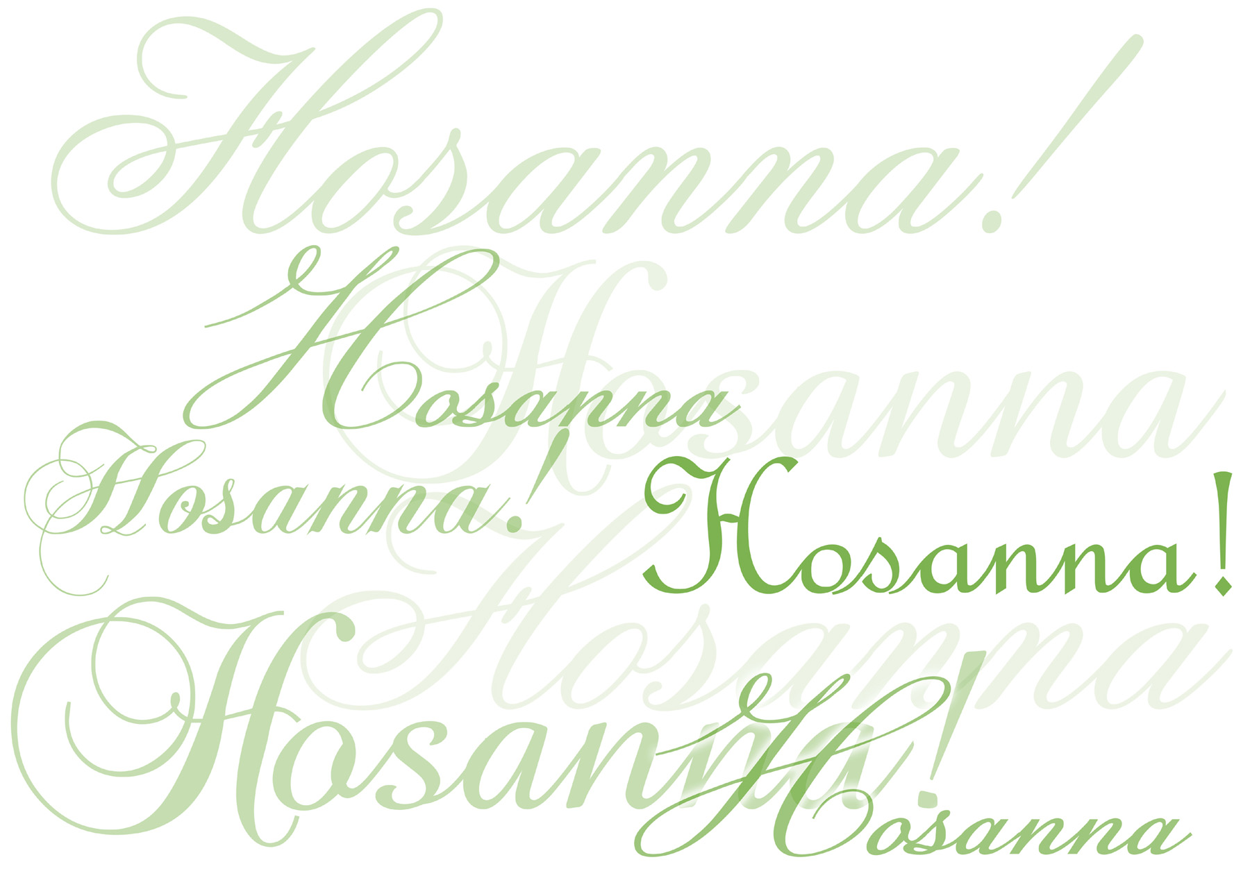
CHILDREN’S MESSAGE:

Slide 15
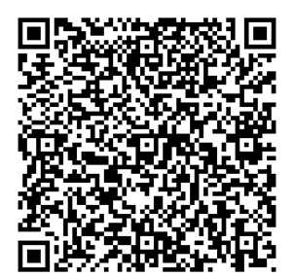
~ Children may go downstairs for Sunday School ~
GIVING OF OUR GIFTS & OFFERTORY:
Our God has blessed us, so let us extend God’s Blessing as we present our Tithes and Offerings.
Thank you for being faithful stewards of your church family with your prayers, your time, talent, and your financial resources.
Contributions may also be made:
Electronically on the church website at fpcb-nj.org;
By reoccurring electronic withdrawal; or by
By mailing your offering to the church: P.O. Box 385, Blairstown, NJ.

Slide 16
* DOXOLOGY: No. 592 Praise God
Praise God, from whom all blessings flow; Praise Him all creatures here below;
Praise Him above, ye heavenly host;
Praise Father, Son, and Holy Ghost. Amen.
* PRAYER OF DEDICATION

Slide 17

DECLARING GOD‘S WORD

Slide 18
HEBREW LESSON: Zechariah 9: 9–10
Zechariah proclaims the Lord’s coming.
⁹ Rejoice greatly, O daughter Zion! Shout aloud, O daughter Jerusalem! See, your king comes to you; triumphant and victorious is he, humble and riding on a donkey, on a colt, the foal of a donkey. ¹⁰ He will cut off the chariot from Ephraim and the war horse from Jerusalem; . . .

Slide 19
and the battle bow shall be cut off, and he shall command peace to the nations; his dominion shall be from sea to sea and from the River to the ends of the earth.

Slide 20
GOSPEL LESSON: Matthew 21: 1–13
Jesus comes riding triumphantly into Jerusalem.
21 When they had come near Jerusalem and had reached Bethphage, at the Mount of Olives, Jesus sent two disciples, ² saying to them, “Go into the village ahead of you, and immediately you will find a donkey tied and a colt with her; untie them and bring them to me. ³ If anyone says anything to you, just say this, ‘The Lord needs them.’ And he will send them immediately.” ⁴ This took place to fulfill what had been spoken through the prophet: . . .

Slide 21
⁵ “Tell the daughter of Zion, Look, your king is coming to you, humble and mounted on a donkey, and on a colt, the foal of a donkey.”
⁶ The disciples went and did as Jesus had directed them; ⁷ they brought the donkey and the colt and put their cloaks on them, and he sat on them. ⁸ A very large crowd spread their cloaks on the road, and others cut branches from the trees and spread them on the road. . . .

Slide 22
⁹ The crowds that went ahead of him and that followed were shouting,
“Hosanna to the Son of David! Blessed is the one who comes in the name of the Lord! Hosanna in the highest heaven!”
¹⁰ When he entered Jerusalem, the whole city was in turmoil, asking, “Who is this?” ¹¹ The crowds were saying, “This is the prophet Jesus from Nazareth in Galilee.” . . .

Slide 23
¹² Then Jesus entered the temple and drove out all who were selling and buying in the temple, and he overturned the tables of the money changers and the seats of those who sold doves. ¹³ He said to them, “It is written,
‘My house shall be called a house of prayer,’ but you are making it a den of robbers.”

Slide 24
ANTHEM with the Chancel Choir:
Hail to the King Triumphant
by Ruth Elaine Schram

Slide 25

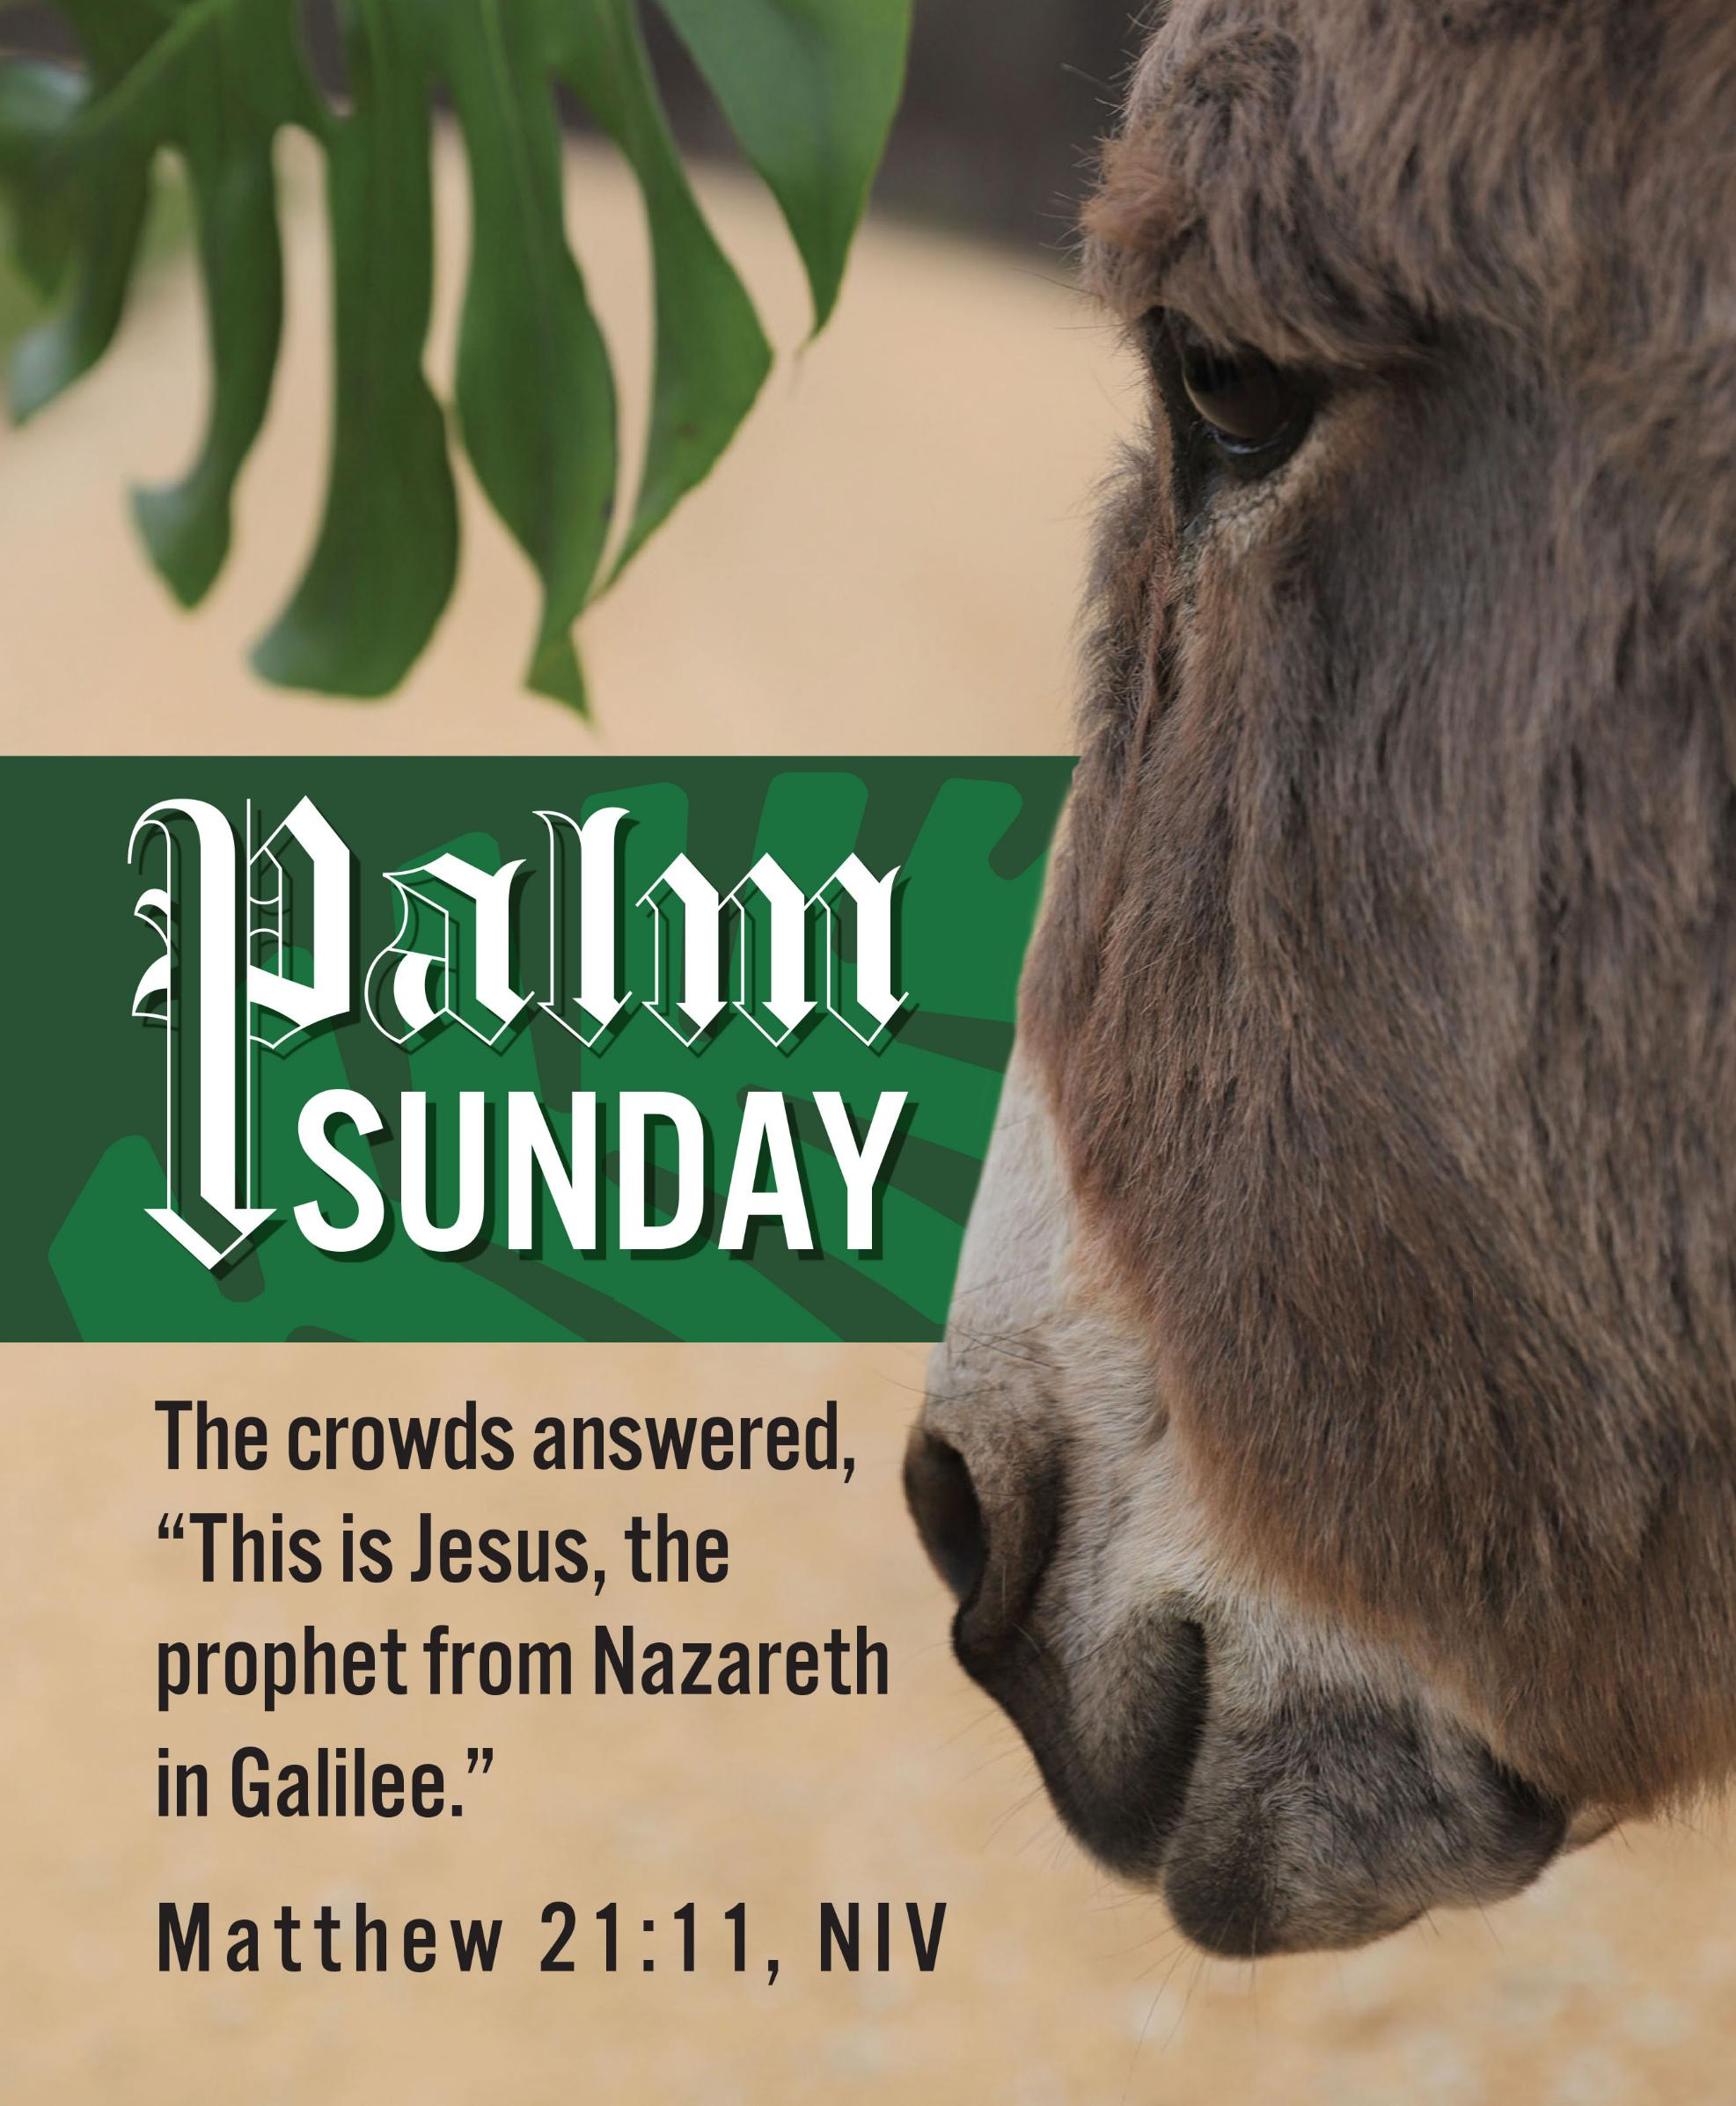
Pastor David’s
SERMON
What King Is He?

Slide 26
RESPONDING TO GOD’S WORD

Slide 27
RESPONDING TO GOD’S WORD
* AFFIRMATION OF FAITH: Philippians 2: 4–11
Let each of you look not to your own interests, but to the interests of others. Let the same mind be in you that was in Christ Jesus, who, though he was in the form of God, did not regard equality with God as something to be exploited, . . .

Slide 28
but emptied himself, taking the form of a slave, being born in human likeness. And being found in human form, he humbled himself and became obedient to the point of death—even death on a cross.
Therefore, God also highly exalted him and gave him the name that is above every name, . . .

Slide 29
so that at the name of Jesus every knee should bend, in heaven and on earth and under the earth, and every tongue should confess that Jesus Christ is Lord, to the glory of God the Father. Amen

Slide 30
* HYMN: We Long to Know Peace! Tune 476 | vv. 1, 4
Copyright © 2016 by Carolyn Winfrey Gillette
"We long to know peace!" Jerusalem said
As Caesar's great troops
filled people with dread.
As soldiers and armies
marched in with great might,
No justice was found
and no peace was in sight.
. . .

Slide 31
"We long to know peace!"
O God, we still say,
Yet when Jesus calls we turn him away.
O God, may we see in this non-violent king
The peace that you offer,
the life that you bring.

Slide 32
PRAYER OF THANKSGIVING, OF THE PEOPLE, & THE LORD’S PRAYER
Our Father who art in heaven,
Hallowed be thy name.
Thy kingdom come, thy will be done;
On earth as it is in heaven.
Give us this day our daily bread;
And forgive us our debts,
As we forgive our debtors;
And lead us not into temptation,
But deliver us from evil,
For Thine is the kingdom
And the power and the glory, forever. Amen.

Slide 33
DEPARTING IN GOD’S NAME

Slide 34
* HYMN: No. 91 Ride On, Ride on in Majesty! vv. 1 & 2
Ride on! ride on in majesty!
Hark! all the tribes Hosanna cry;
O Savior meek, pursue Thy road
With palms and scattered garments strowed.
. . .

Slide 35
2
Ride on! ride on in majesty!
In lowly pomp ride on to die;
O Christ, Thy triumphs now begin
O'er captive death and conquered sin..

Slide 36


* CHARGE TO THE PEOPLE & BENEDICTION
* CHORAL BENEDICTION
POSTLUDE
Our worship has ended—our Christian Witness begins!

