Slide 1

Enter in
SILENCE
Wait with
REVERENCE
Worship from
JOY

Slide 2
PRELUDE
WELCOME & ANNOUNCEMENTS
AFFIRMATION OF MISSION STATEMENT
CHORAL INTROIT
Our Mission Statement
As disciples of Jesus Christ,
led by the Holy Spirit,
we experience God’s unconditional love,
and we witness to others
by discovering and sharing our gifts.

Slide 3
* CALL TO WORSHIP:
Out of the depths, I call to you, Yahweh:
Lord, my cry. Listen attentively to the sound of my pleading.
Rely, all of us—our whole being on Yahweh—on Yahweh’s promise!
My whole being hopes in the Lord, God’s people hope in Yahweh.
. . .

Slide 4
Yahweh is faithful love; with God comes a generous ransom.
Abundant in steadfast love and mercy, God will ransom us.
With grateful hearts and with lips of praise,
let us worship God.

Slide 5
* HYMN: No. 476 O Worship the King, All Glorious Above!
O worship the King, all glorious above!
O gratefully sing God's power
and God's love;
Our shield and defender,
the Ancient of Days,
Pavilioned in splendor
and girded with praise.
. . .

Slide 6
5
Frail children of dust, and feeble as frail,
In Thee do we trust, nor find Thee to fail;
Thy mercies how tender,
how firm to the end,
Our maker, defender,
redeemer, and friend.

Slide 7
PRAYER OF CONFESSION: (in silence then in unison)
Merciful God, in whom we trust and hope, we are called to believe in you, to trust in you, to rely on you. And yet sometimes this can be a difficult thing to do. Life does not go the way we want. We confuse our way with your will, and sometimes we are constantly fighting the forces of life, . . .

Slide 8
like a salmon swimming upstream.
Forgive us when our trials, our temptations, and our sins get the best of us. Help us align our lives with your will. Teach us the workings of your love and your Spirit; that we may live as your children, faithful lives, freed and forgiven. In Jesus’ name, we pray. Amen.

Slide 9
ASSURANCE OF CHRIST’S FORGIVENESS:
Happy are those who delight in the saving grace of Jesus, our Lord.
In Jesus Christ, we are forgiven! Let us forgive one another.

Slide 10
* CELEBRATING CHRIST’S FORGIVENESS: Give Thanks (No. 647 GTG)
Give thanks with a grateful heart,
give thanks to the Holy One;
Give thanks, because we’re given Jesus Christ the Son. And now let the weak say, “we are strong”; let the poor say,
“We are rich, because of what the Lord has done for us!” Give thanks.

Slide 11

* EXCHANGE OF CHRIST’S PEACE:
Pastor: The peace of Christ be with you.
People: And also with you.
Welcome one another
with the peace of Christ.
~ Children may go downstairs for Sunday School ~

Slide 12

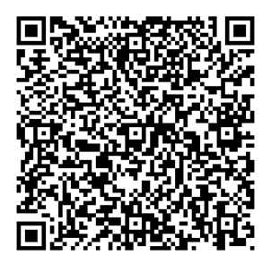
GIVING OF OUR GIFTS & OFFERTORY:
Our God has blessed us, so let us extend
God’s Blessing as we present our Tithes and Offerings.
Thank you for being faithful stewards of your
church family with your prayers, your time,
talent, and your financial resources.
Contributions may also be made:
Electronically on the church website
at fpcb-nj.org;
By reoccurring electronic withdrawal; or
By mailing your offering to the church:
P.O. Box 385, Blairstown, NJ.

Slide 13
* DOXOLOGY: No. 592 Praise God
Praise God, from whom all blessings flow; Praise Him all creatures here below;
Praise Him above, ye heavenly host;
Praise Father, Son, and Holy Ghost. Amen.
* PRAYER OF DEDICATION

Slide 14
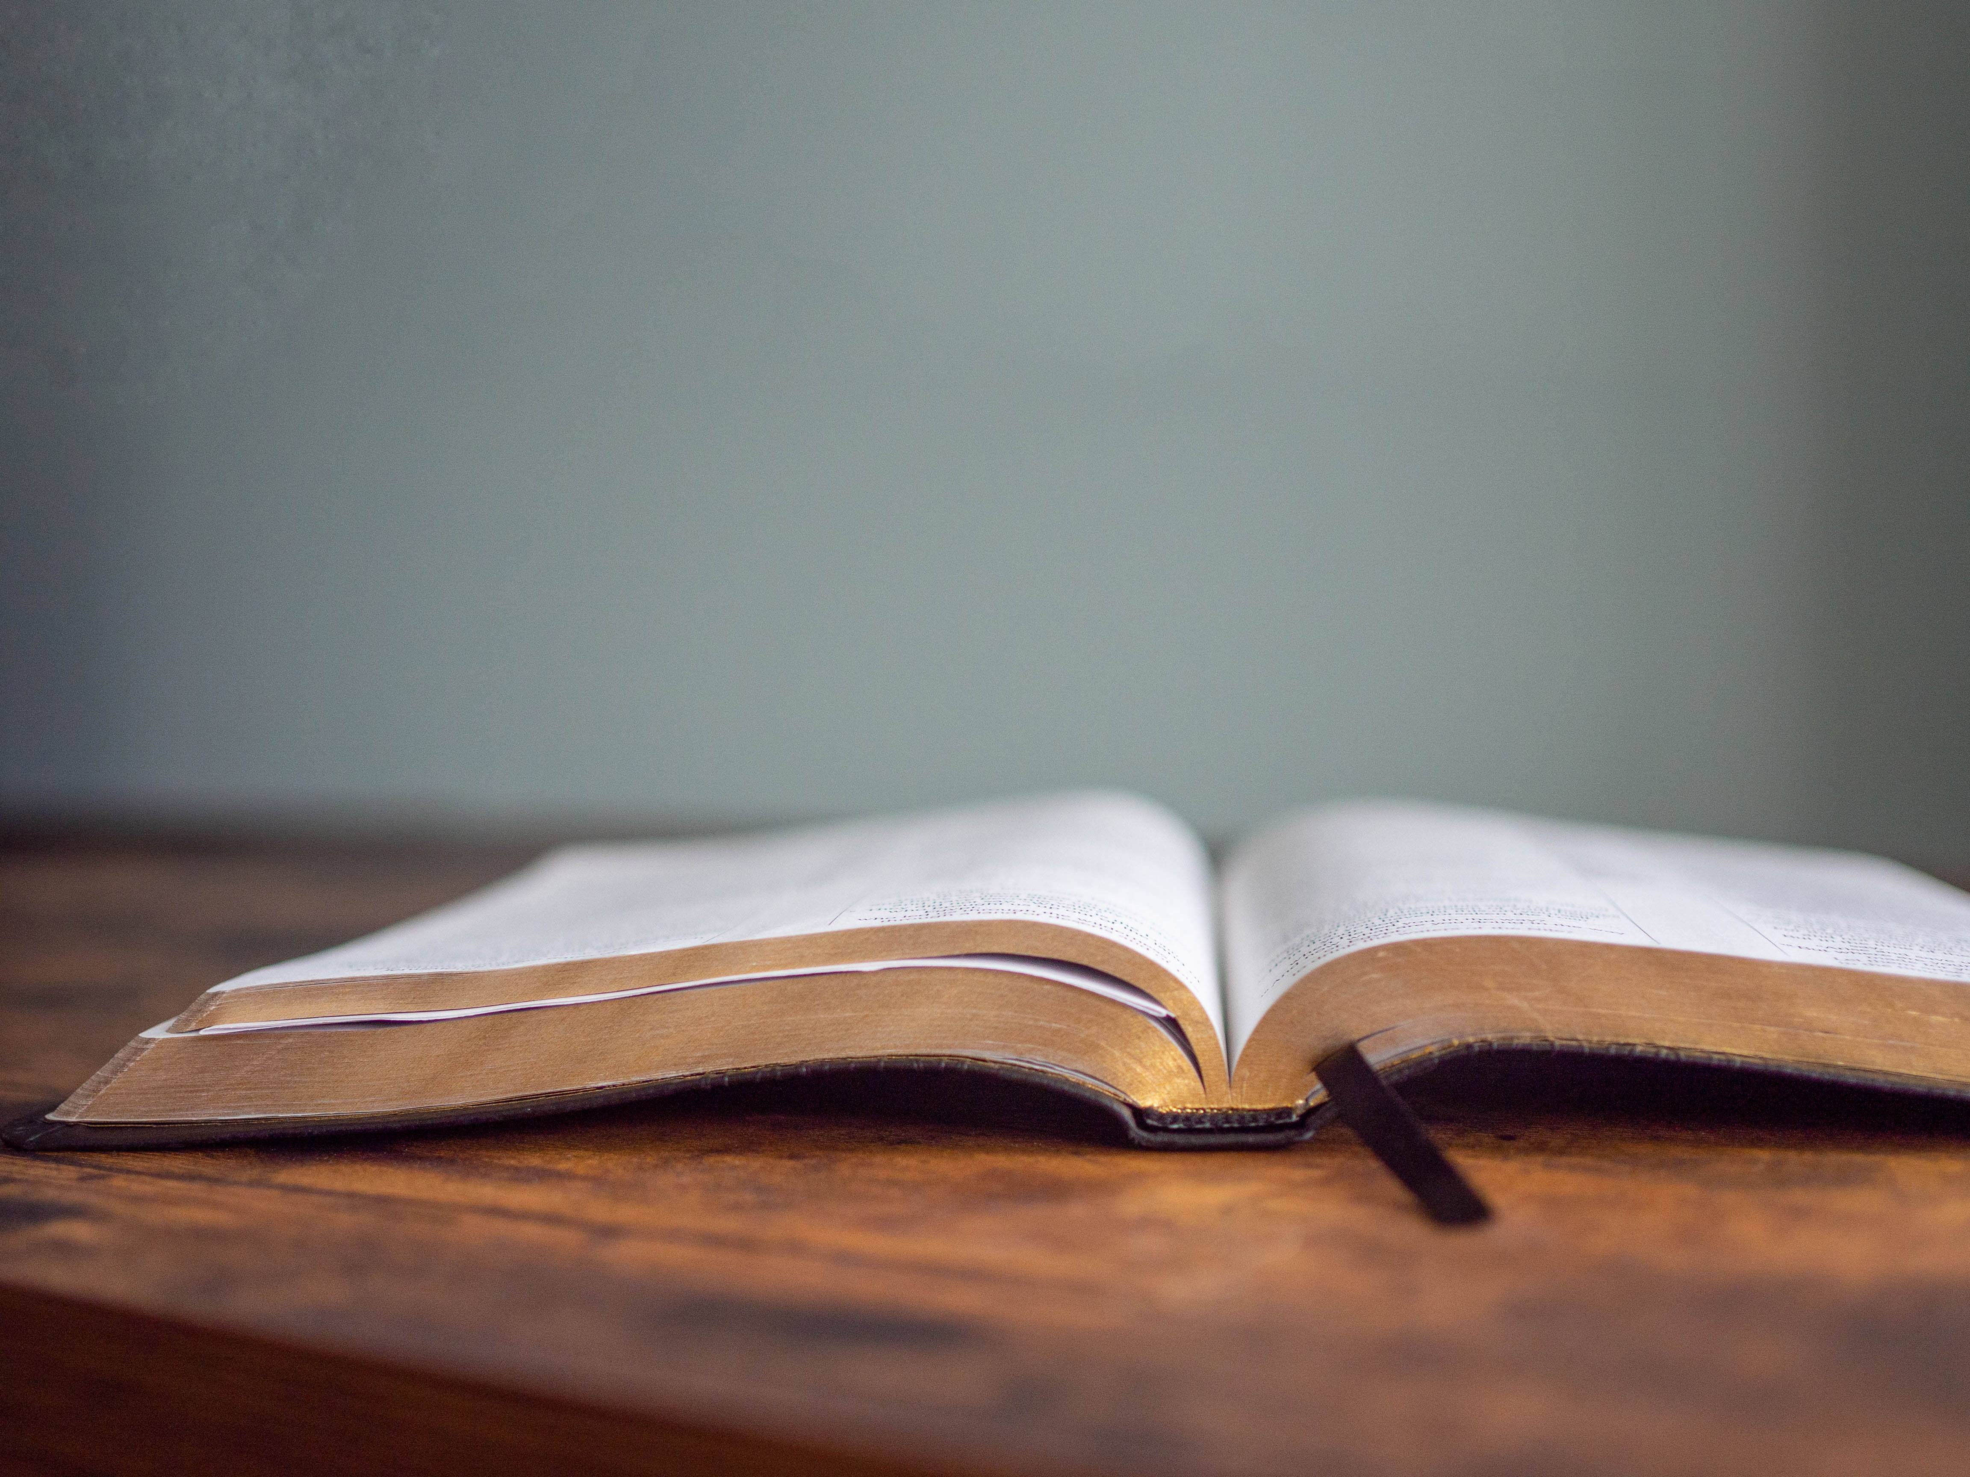
DECLARING
GOD‘S WORD

Slide 15
HEBREW LESSON: Ezekiel 37: 1–14
In and with God, we have hope.
37 The hand of the Lord came upon me, and he brought me out by the spirit of the Lord and set me down in the middle of a valley; it was full of bones. ² He led me all around them; there were very many lying in the valley, and they were very dry. ³ He said to me, “Mortal, can these bones live?” I answered, “O Lord God, you know.” ⁴ Then he said to me, “Prophesy to these bones and say to them: O dry bones, hear the word of the Lord. . . .

Slide 16
⁵ Thus says the Lord God to these bones: I will cause breath to enter you, and you shall live. ⁶ I will lay sinews on you and will cause flesh to come upon you and cover you with skin and put breath in you, and you shall live, and you shall know that I am the Lord.”
⁷ So I prophesied as I had been commanded, and as I prophesied, suddenly there was a noise, a rattling, and the bones came together, bone to its bone. ⁸ I looked, and there were sinews on them, and flesh had come upon them, and skin had covered them, . . .

Slide 17
but there was no breath in them. ⁹ Then he said to me, “Prophesy to the breath, prophesy, mortal, and say to the breath: Thus says the Lord God: Come from the four winds, O breath, and breathe upon these slain, that they may live.” ¹⁰ I prophesied as he commanded me, and the breath came into them, and they lived and stood on their feet, a vast multitude.
¹¹ Then he said to me, “Mortal, these bones are the whole house of Israel. They say, ‘Our bones are dried up, and our hope is lost; . . .

Slide 18
we are cut off completely.’ ¹² Therefore prophesy and say to them: Thus says the Lord God: I am going to open your graves and bring you up from your graves, O my people, and I will bring you back to the land of Israel. ¹³ And you shall know that I am the Lord when I open your graves and bring you up from your graves, O my people. ¹⁴ I will put my spirit within you, and you shall live, and I will place you on your own soil; then you shall know that I, the Lord, have spoken and will act, says the Lord.”

Slide 19
GOSPEL LESSON: John 11: 1–35
Jesus performs a great miracle.
11 Now a certain man was ill, Lazarus of Bethany, the village of Mary and her sister Martha. ² Mary was the one who anointed the Lord with perfume and wiped his feet with her hair; her brother Lazarus was ill. ³ So the sisters sent a message to Jesus, “Lord, he whom you love is ill.” ⁴ But when Jesus heard it, he said, “This illness does not lead to death; rather, it is for God’s glory, so that the Son of God may be glorified through it.” . . .

Slide 20
⁵ Accordingly, though Jesus loved Martha and her sister and Lazarus, ⁶ after having heard that Lazarus was ill, he stayed two days longer in the place where he was.
⁷ Then after this he said to the disciples, “Let us go to Judea again.” ⁸ The disciples said to him, “Rabbi, the Jews were just now trying to stone you, and are you going there again?” ⁹ Jesus answered, “Are there not twelve hours of daylight? . . .

Slide 21
Those who walk during the day do not stumble because they see the light of this world. ¹⁰ But those who walk at night stumble because the light is not in them.” ¹¹ After saying this, he told them, “Our friend Lazarus has fallen asleep, but I am going there to awaken him.” ¹² The disciples said to him, “Lord, if he has fallen asleep, he will be all right.” ¹³ Jesus, however, had been speaking about his death, but they thought that he was referring merely to sleep. ¹⁴ Then Jesus told them plainly, . . .

Slide 22
“Lazarus is dead. ¹⁵ For your sake I am glad I was not there, so that you may believe. But let us go to him.” ¹⁶ Thomas, who was called the Twin, said to his fellow disciples, “Let us also go, that we may die with him.”
¹⁷ When Jesus arrived, he found that Lazarus had already been in the tomb four days. ¹⁸ Now Bethany was near Jerusalem, some two miles away, ¹⁹ and many of the Jews had come to Martha and Mary to console them about their brother. . . .

Slide 23
²⁰ When Martha heard that Jesus was coming, she went and met him, while Mary stayed at home. ²¹ Martha said to Jesus, “Lord, if you had been here, my brother would not have died. ²² But even now I know that God will give you whatever you ask of him.” ²³ Jesus said to her, “Your brother will rise again.” ²⁴ Martha said to him, “I know that he will rise again in the resurrection on the last day.” ²⁵ Jesus said to her, “I am the resurrection and the life. Those who believe in me, . . .

Slide 24
even though they die, will live, ²⁶ and everyone who lives and believes in me will never die. Do you believe this?” ²⁷ She said to him, “Yes, Lord, I believe that you are the Messiah, the Son of God, the one coming into the world.”
²⁸ When she had said this, she went back and called her sister Mary and told her privately, “The Teacher is here and is calling for you.” ²⁹ And when she heard it, she got up quickly and went to him. . . .

Slide 25
³⁰ Now Jesus had not yet come to the village but was still at the place where Martha had met him. ³¹ The Jews who were with her in the house consoling her saw Mary get up quickly and go out. They followed her because they thought that she was going to the tomb to weep there. ³² When Mary came where Jesus was and saw him, she knelt at his feet and said to him, “Lord, if you had been here, my brother would not have died.” . . .

Slide 26
³³ When Jesus saw her weeping and the Jews who came with her also weeping, he was greatly disturbed in spirit and deeply moved. ³⁴ He said, “Where have you laid him?” They said to him, “Lord, come and see.” ³⁵ Jesus began to weep.

Slide 27
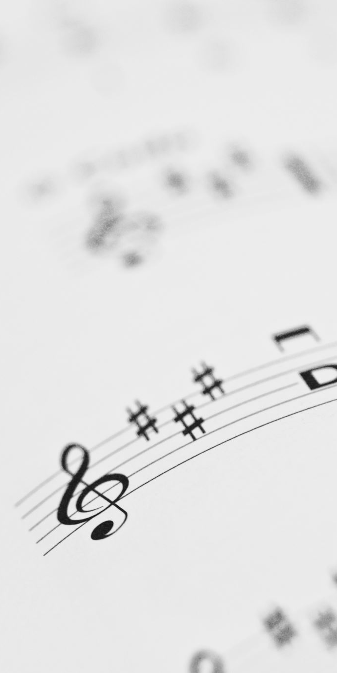
CHANCEL CHOIR ANTHEM:
“Abide with Me”
by Victor C. Johnson

Slide 28

PASTOR DAVID’S
SERMON:
God at Work?

Slide 29
RESPONDING TO GOD’S WORD

Slide 30
* AFFIRMATION OF FAITH: Romans 8: 28, 35, 37–39
We know that all things work together for good, for those who love God, who are called according to his purpose. Who will separate us from the love of Christ? Will hardship, or distress, or persecution, or famine, or nakedness, or peril, or sword?
. . .

Slide 31
No, in all these things we are more than conquerors through him who loved us. Neither death nor life, nor angels, nor rulers, nor things present, nor things to come, nor powers, nor height, nor depth, nor anything else in all creation, will be able to separate us from the love of God in Christ Jesus our Lord. Amen.

Slide 32
* HYMN: No. 85 What Wondrous Love Is This vv. 1, 2
What wondrous love is this,
O my soul, O my soul,
What wondrous love is this, O my soul!
What wondrous love is this
that caused the Lord of bliss
To bear the heavy cross for my soul,
for my soul,
To bear the heavy cross for my soul!
. . .

Slide 33
To God and to the Lamb,
I will sing, I will sing,
To God and to the Lamb, I will sing;
To God and to the Lamb
who is the great I Am,
While millions join the theme,
I will sing, I will sing;
While millions join the theme, I will sing!

Slide 34
PRAYER OF THANKSGIVING, OF THE PEOPLE,
& THE LORD’S PRAYER
Our Father who art in heaven,
Hallowed be thy name.
Thy kingdom come, thy will be done;
On earth as it is in heaven.
Give us this day our daily bread;
And forgive us our debts,
As we forgive our debtors;
And lead us not into temptation,
But deliver us from evil,
For Thine is the kingdom
And the power and the glory, forever. Amen.

Slide 35
DEPARTING IN GOD’S NAME

Slide 36
* HYMN: Lord, the Light of Your Love Is Shining!
vv. 1, 2 | No. 192 GTG
Lord, the light of your love is shining,
in the midst of the darkness, shining;
Jesus, Light of the World, shine upon us;
set us free by the truth you now bring us.
Shine on me; shine on me.
. . .

Slide 37
REFRAIN: Shine, Jesus, shine;
fill this land with the Father’s glory.
Blaze, Spirit, blaze; set our hearts on fire.
Flow, river, flow;
flood the nations with grace and mercy.
Send forth your word, Lord,
and let there be light.
. . .

Slide 38
2
Lord, I come to your awesome presence,
from the shadows into your radiance;
by the blood I may enter your brightness.
Search me; try me;
consume all my darkness;
Shine on me; shine on me.
. . .

Slide 39
REFRAIN: Shine, Jesus, shine;
fill this land with the Father’s glory.
Blaze, Spirit, blaze; set our hearts on fire.
Flow, river, flow;
flood the nations with grace and mercy.
Send forth your word, Lord,
and let there be light.

Slide 40


* CHARGE TO THE PEOPLE & BENEDICTION
* CHORAL BENEDICTION
POSTLUDE
Our worship has ended—our Christian Witness begins!

