Slide 1

Enter in SILENCE
Wait with REVERENCE
Worship from JOY

Slide 2
PRELUDE
WELCOME & ANNOUNCEMENTS
AFFIRMATION OF MISSION STATEMENT
CHORAL INTROIT
Our Mission Statement
As disciples of Jesus Christ, led by the Holy Spirit, we experience God’s unconditional love, and we witness to others by discovering and sharing our gifts.

Slide 3
* CALL TO WORSHIP:
Let us raise a joyful song to the Lord.
Let us come into God’s presence with gratitude and singing;
For the Lord is a great God, the ruler over all gods.
The sea belongs to God, for the Lord made it!
. . .

Slide 4
The dry land belongs to God as well. God’s hands fashioned it!
God is our God. We are the people God chooses to shepherd.
With grateful hearts and with lips of praise, let us worship God.

Slide 5
* HYMN OF PRAISE: Here in This Place (Gather Us in) (No. 401, GTG)
Here in this place
the new light is streaming;
Now is the darkness vanished away;
See in this space
our fears and our dreamings
Brought here to you
in the light of this day.
. . .

Slide 6
Gather us in, the lost and forsaken;
Gather us in, the blind and the lame;
Call to us now, and we shall awaken;
We shall arise at the sound of our name.
. . .

Slide 7
We are the young, our lives are a mystery.
We are the old who yearn for your face.
We have been sung
throughout all of history,
Called to be light to the whole human race.
. . .

Slide 8
Gather us in, the rich and the haughty;
Gather us in, the proud and the strong;
Give us a heart, so meek and so lowly;
Give us the courage to enter the song.
. . .

Slide 9
Here we will take the wine and the water;
Here we will take the bread of new birth.
Here you shall call your sons
and your daughters,
Call us anew to be salt for the earth.
. . .

Slide 10
Give us to drink the wine of compassion;
Give us to eat the bread that is you;
Nourish us well, and teach us to fashion
Lives that are holy
and hearts that are true.
. . .

Slide 11
Not in the dark of buildings confining,
Not in some heaven, light years away:
Here in this place the new light is shining;
Now is the kingdom, now is the day.
. . .

Slide 12
Gather us in and hold us forever;
Gather us in and make us your own;
Gather us in, all peoples together,
Fire of love in our flesh and our bone.

Slide 13
PRAYER OF CONFESSION: (in silence then in unison)
Gracious God we confess our sins are too heavy to carry, too real to hide, and too deep to undo. Forgive what our lips tremble to name, what our hearts can no longer bear, and what has become for us a consuming fire of judgement.
. . .

Slide 14
Set us free from a past we cannot change; open us to a future in which we can be changed; and grant us grace to grow more and more in your holy likeness and image through Jesus Christ, your Son, our Savior. Amen.

Slide 15
ASSURANCE OF CHRIST’S FORGIVENESS:
In Christ, barriers are broken down, borders collapse, new friendships are formed; reconciliation occurs; a new community is forged. All because Christ has forgiven us.
In Jesus Christ, we are forgiven! Let us forgive one another.

Slide 16
* CELEBRATING CHRIST’S FORGIVENESS: Give Thanks (No. 647 GTG)
Give thanks with a grateful heart,
give thanks to the Holy One;
Give thanks, because we’re given Jesus Christ the Son. And now let the weak say, “we are strong”; let the poor say,
“We are rich, because of what the Lord has done for us!” Give thanks.

Slide 17

* EXCHANGE OF CHRIST’S PEACE:
Pastor: The peace of Christ be with you.
People: And also with you.
Welcome one another with the peace of Christ.
~ Children may go downstairs for Sunday School ~

Slide 18
GIVING OF OUR GIFTS & OFFERTORY:
Our God has blessed us, so let us extend God’s Blessing as we present our Tithes and Offerings.
Thank you for being faithful stewards of your church family with your prayers, your time, talent, and your financial resources.
Contributions may also be made:
Electronically on the church website at fpcb-nj.org;
By reoccurring electronic withdrawal; or by
By mailing your offering to the church: P.O. Box 385, Blairstown, NJ.

Slide 19
* DOXOLOGY: No. 555 Now Thank We All Our God v. 1
Now thank we all our God
With heart and hands and voices,
Who wondrous things hath done,
In whom this world rejoices;
Who, from our mothers’ arms
Hath blessed us on our way
With countless gifts of love,
and still is ours today.
* PRAYER OF DEDICATION

Slide 20
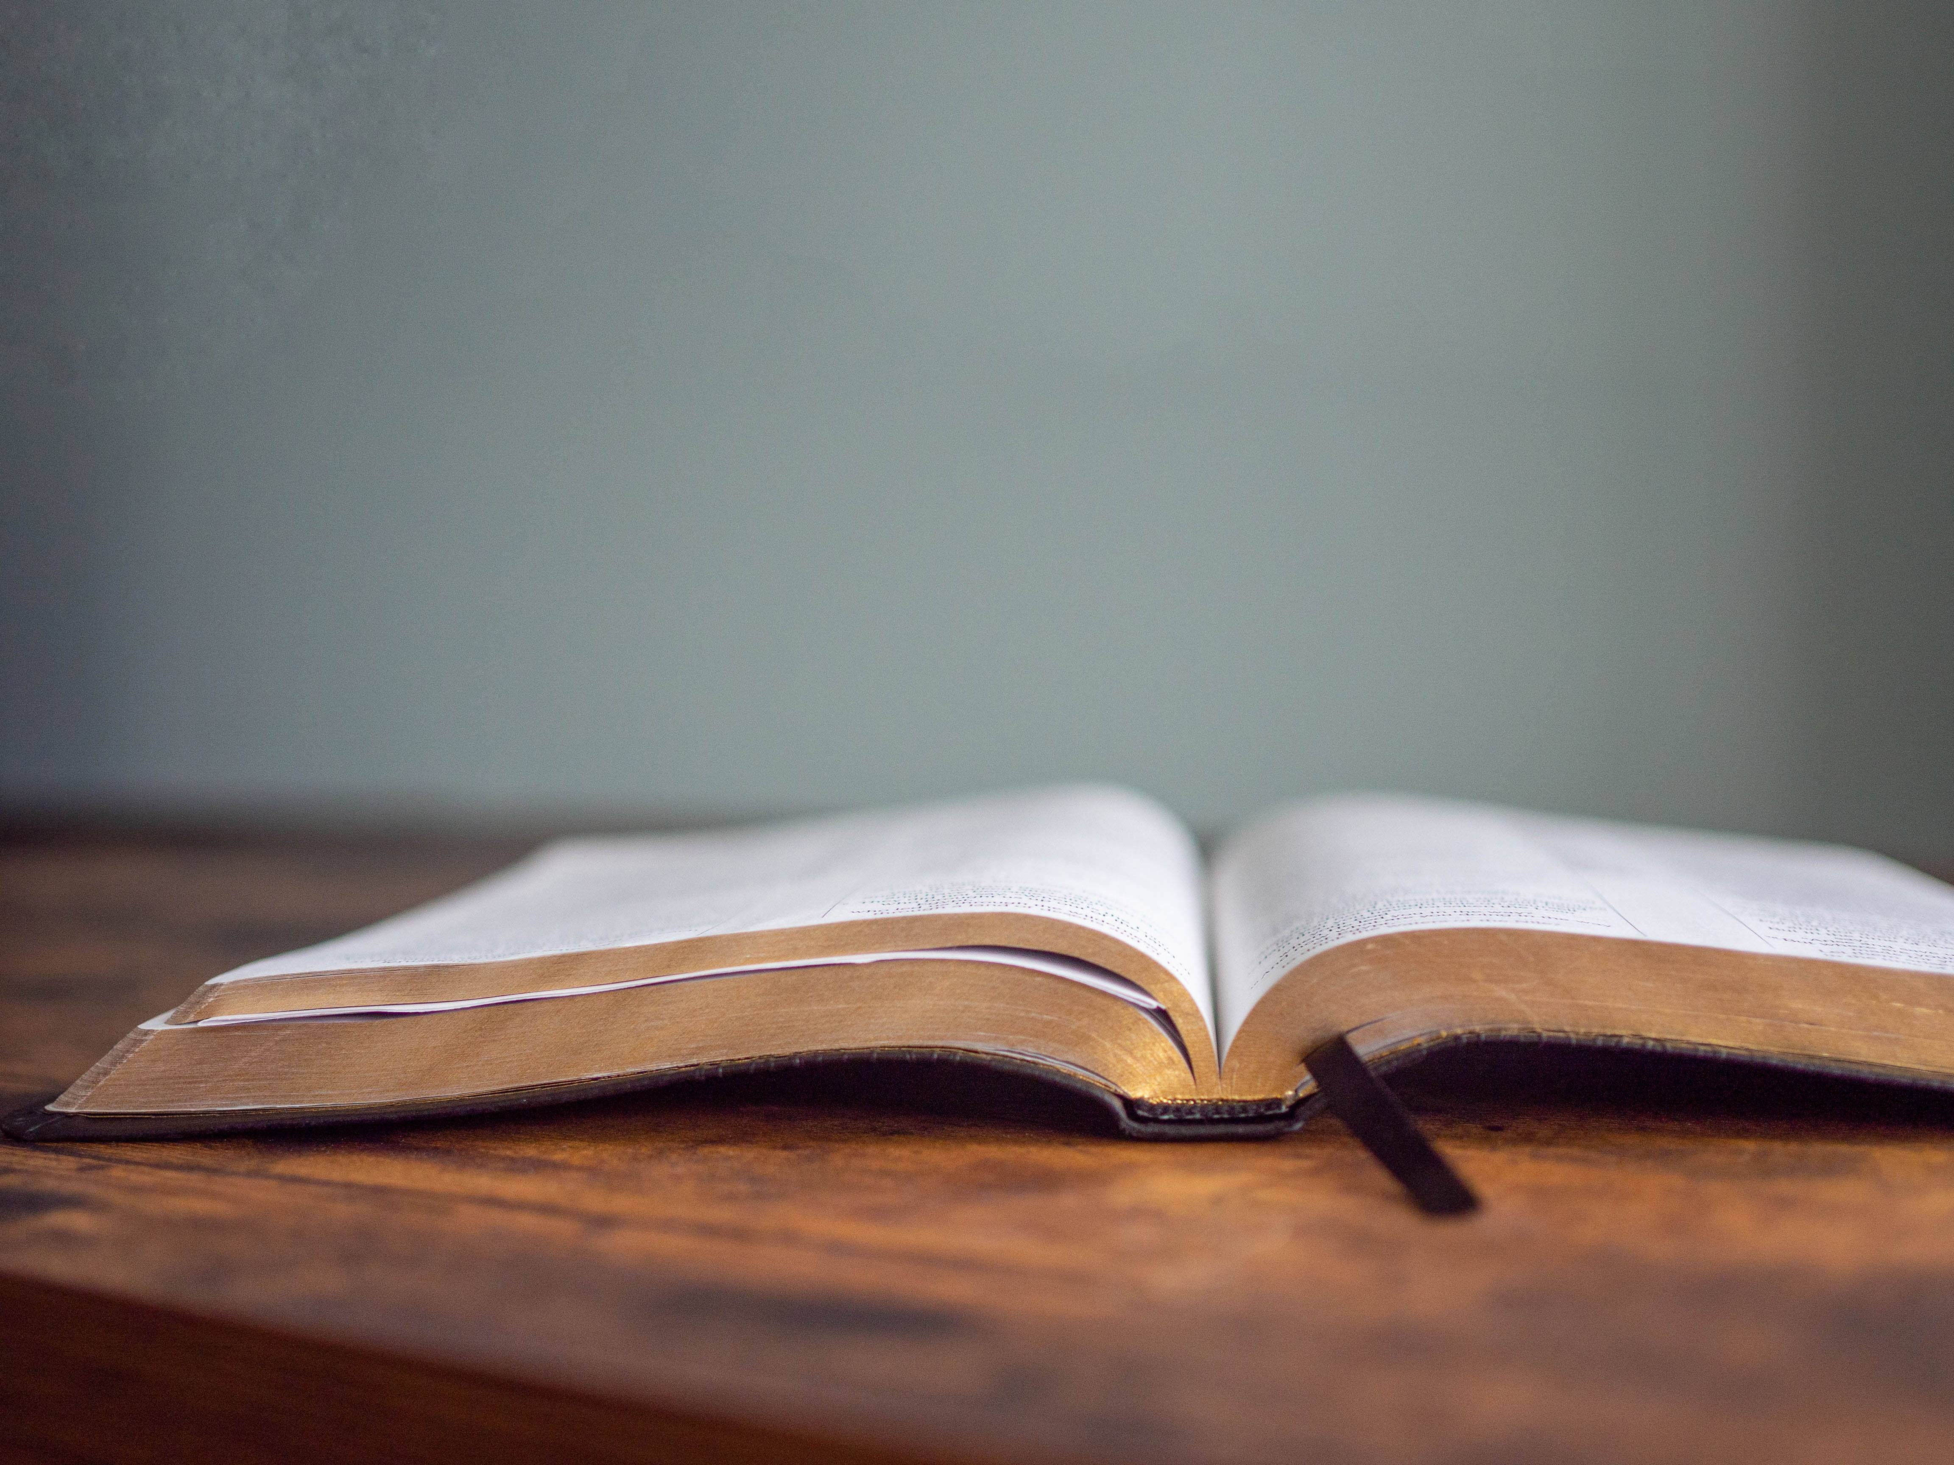
DECLARING GOD‘S WORD

Slide 21
HEBREW LESSON: Exodus 17: 1–7
The people hold contempt for the Lord.
17 From the wilderness of Sin the whole congregation of the Israelites journeyed by stages, as the Lord commanded. They camped at Rephidim, but there was no water for the people to drink. ² The people quarreled with Moses and said, “Give us water to drink.” Moses said to them, “Why do you quarrel with me? Why do you test the Lord?” ³ But the people thirsted there for water, and the people complained against Moses and said, . . .

Slide 22
“Why did you bring us out of Egypt, to kill us and our children and livestock with thirst?” ⁴ So Moses cried out to the Lord, “What shall I do for this people? They are almost ready to stone me.” ⁵ The Lord said to Moses, “Go on ahead of the people and take some of the elders of Israel with you; take in your hand the staff with which you struck the Nile and go. ⁶ I will be standing there in front of you on the rock at Horeb. Strike the rock, and water will come out of it, so that the people may drink.” . . .

Slide 23
Moses did so, in the sight of the elders of Israel. ⁷ He called the place Massah and Meribah, because the Israelites quarreled and tested the Lord, saying, “Is the Lord among us or not?”
⁸ Then Amalek came and fought with Israel at Rephidim. ⁹ Moses said to Joshua, “Choose some men for us and go out; fight with Amalek. Tomorrow I will stand on the top of the hill with the staff of God in my hand.” . . .

Slide 24
¹⁰ So Joshua did as Moses told him and fought with Amalek, while Moses, Aaron, and Hur went up to the top of the hill. ¹¹ Whenever Moses held up his hand, Israel prevailed, and whenever he lowered his hand, Amalek prevailed. ¹² But Moses’s hands grew heavy, so they took a stone and put it under him, and he sat on it. Aaron and Hur held up his hands, one on either side, so his hands were steady until the sun set. ¹³ And Joshua defeated Amalek and his people with the sword. . . .

Slide 25
¹⁴ Then the Lord said to Moses, “Write this as a remembrance in a book and recite it in the hearing of Joshua: I will utterly blot out the memory of Amalek from under heaven.” ¹⁵ And Moses built an altar and called it, The Lord is my banner. ¹⁶ He said, “A hand upon the banner of the Lord! The Lord will have war with Amalek from generation to generation.”

Slide 26
GOSPEL LESSON: John 4: 5–42
Jesus has a shocking conversation with a Samaritan woman.
⁵ So he came to a Samaritan city called Sychar, near the plot of ground that Jacob had given to his son Joseph. ⁶ Jacob’s well was there, and Jesus, tired out by his journey, was sitting by the well. It was about noon.
⁷ A Samaritan woman came to draw water, and Jesus said to her, “Give me a drink.” ⁸ (His disciples had gone to the city to buy food.) ⁹ The Samaritan woman said to him, . . .

Slide 27
“How is it that you, a Jew, ask a drink of me, a woman of Samaria?” (Jews do not share things in common with Samaritans.) ¹⁰ Jesus answered her, “If you knew the gift of God and who it is that is saying to you, ‘Give me a drink,’ you would have asked him, and he would have given you living water.” ¹¹ The woman said to him, “Sir, you have no bucket, and the well is deep. Where do you get that living water? . . .

Slide 28
¹² Are you greater than our ancestor Jacob, who gave us the well and with his sons and his flocks drank from it?” ¹³ Jesus said to her, “Everyone who drinks of this water will be thirsty again, ¹⁴ but those who drink of the water that I will give them will never be thirsty. The water that I will give will become in them a spring of water gushing up to eternal life.” ¹⁵ The woman said to him, “Sir, give me this water, so that I may never be thirsty or have to keep coming here to draw water.” . . .

Slide 29
¹⁶ Jesus said to her, “Go, call your husband, and come back.” ¹⁷ The woman answered him, “I have no husband.” Jesus said to her, “You are right in saying, ‘I have no husband,’ ¹⁸ for you have had five husbands, and the one you have now is not your husband. What you have said is true!” ¹⁹ The woman said to him, “Sir, I see that you are a prophet. ²⁰ Our ancestors worshiped on this mountain, but you say that the place where people must worship is in Jerusalem.” . . .

Slide 30
²¹ Jesus said to her, “Woman, believe me, the hour is coming when you will worship the Father neither on this mountain nor in Jerusalem. ²² You worship what you do not know; we worship what we know, for salvation is from the Jews. ²³ But the hour is coming and is now here when the true worshipers will worship the Father in spirit and truth, for the Father seeks such as these to worship him. ²⁴ God is spirit, and those who worship him must worship in spirit and truth.” . . .

Slide 31
²⁵ The woman said to him, “I know that Messiah is coming” (who is called Christ). “When he comes, he will proclaim all things to us.” ²⁶ Jesus said to her, “I am he, the one who is speaking to you.”
²⁷ Just then his disciples came. They were astonished that he was speaking with a woman, but no one said, “What do you want?” or, “Why are you speaking with her?” ²⁸ Then the woman left her water jar and went back to the city. She said to the people, . . .

Slide 32
²⁹ “Come and see a man who told me everything I have ever done! He cannot be the Messiah, can he?” ³⁰ They left the city and were on their way to him.
³¹ Meanwhile the disciples were urging him, “Rabbi, eat something.” ³² But he said to them, “I have food to eat that you do not know about.” ³³ So the disciples said to one another, “Surely no one has brought him something to eat?” ³⁴ Jesus said to them, . . .

Slide 33
“My food is to do the will of him who sent me and to complete his work. ³⁵ Do you not say, ‘Four months more, then comes the harvest’? But I tell you, look around you, and see how the fields are ripe for harvesting. ³⁶ The reaper is already receiving wages and is gathering fruit for eternal life, so that sower and reaper may rejoice together. ³⁷ For here the saying holds true, ‘One sows and another reaps.’ . . .

Slide 34
³⁸ I sent you to reap that for which you did not labor. Others have labored, and you have entered into their labor.”
³⁹ Many Samaritans from that city believed in him because of the woman’s testimony, “He told me everything I have ever done.” ⁴⁰ So when the Samaritans came to him, they asked him to stay with them, and he stayed there two days. ⁴¹ And many more believed because of his word. . . .

Slide 35
⁴² They said to the woman, “It is no longer because of what you said that we believe, for we have heard for ourselves, and we know that this is truly the Savior of the world.”

Slide 36
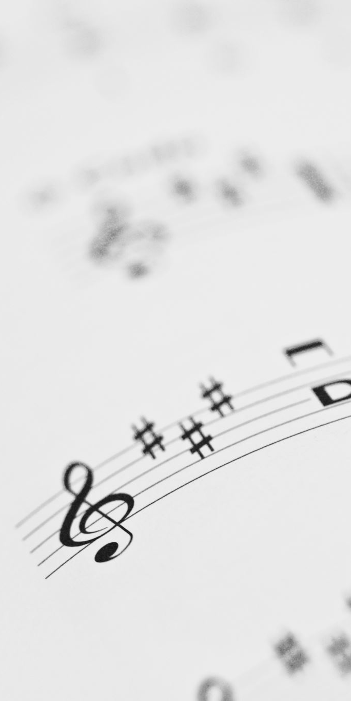
CHANCEL CHOIR ANTHEM:
“Christ Has Broken
Down the Wall”
by Mark A. Miller
Don Nicholls, Soloist

Slide 37

PASTOR DAVID’S SERMON:
What’s Wrong with
This Picture?

Slide 38
RESPONDING TO GOD’S WORD

Slide 39
* AFFIRMATION OF FAITH: A Brief Statement of Faith, 1990
We trust in Jesus Christ, fully human and fully God. Jesus proclaimed the reign of God: Preaching good news to the poor and release to the captives, teaching by word and deed and blessing the children, healing the sick and binding up the broken-hearted, eating with outcasts, forgiving sinners, . . .

Slide 40
and calling all to repent and believe the gospel.
In gratitude to God, empowered by the Spirit, we strive to serve Christ in our daily tasks, and to live holy and joyful lives even as we watch for God’s new heaven and new earth praying, “Come, Lord Jesus!” Amen.

Slide 41
* HYMN: We Yearn, O Christ, for Wholeness vv. 1 & 3 | Tune #98
We yearn, O Christ, for wholeness
and for your healing touch;
too long have we felt helpless;
our burdens seemed too much.
Forgetting all pretenses
we make our pleadings heard,
in hope and expectation
await your gracious Word. . . .

Slide 42
We need your living presence,
O Christ of Galilee,
a presence that revives us
and sets our spirits free.
No longer are we fearful,
your love pervades each place.
Empower us with courage
to claim your healing grace.

Slide 43
PRAYER OF THANKSGIVING, OF THE PEOPLE, & THE LORD’S PRAYER
Our Father who art in heaven,
Hallowed be thy name.
Thy kingdom come, thy will be done;
On earth as it is in heaven.
Give us this day our daily bread;
And forgive us our debts,
As we forgive our debtors;
And lead us not into temptation,
But deliver us from evil,
For Thine is the kingdom
And the power and the glory, forever. Amen.

Slide 44
DEPARTING IN GOD’S NAME

Slide 45
* HYMN: No. 361 How Firm a Foundation vv. 1, 2, 4, 5
How firm a foundation,
ye saints of the Lord,
Is laid for your faith
in God's excellent Word!
What more can be said
than to you God hath said,
To you, who for refuge to Jesus have fled?
. . .

Slide 46
"Fear not, I am with thee,
O be not dismayed,
For I am thy God
and will still give thee aid;
I’ll strengthen thee, help thee,
and cause thee to stand,
Upheld by My righteous,
omnipotent hand.
. . .

Slide 47
"When through fiery trials
thy pathway shall lie,
My grace, all-sufficient,
shall be thy supply;
The flame shall not hurt thee;
I only design
Thy dross to consume,
and thy gold to refine.
. . .

Slide 48
"The soul that on Jesus
hath leaned for repose,
I will not, I will not
desert to its foes;
That soul, though all hell
should endeavor to shake,
I’ll never, no never, no never forsake."

Slide 49

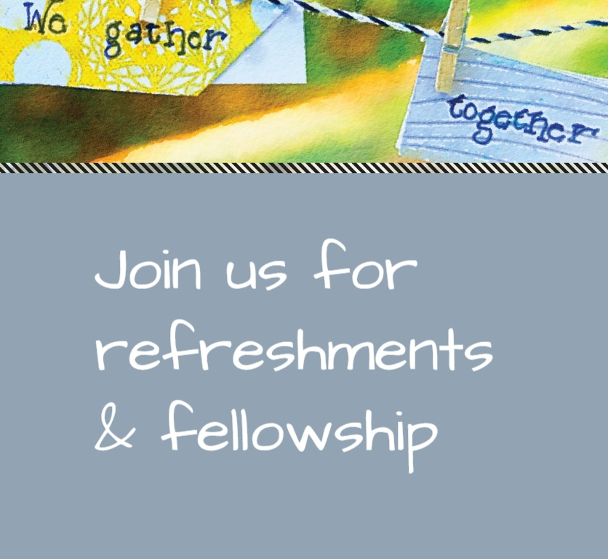
* CHARGE TO THE PEOPLE & BENEDICTION
* CHORAL BENEDICTION
POSTLUDE
Our worship has ended—our Christian Witness begins!

