Slide 1

Enter in SILENCE
Wait with REVERENCE
Worship from JOY

Slide 2
PRELUDE
WELCOME & ANNOUNCEMENTS
AFFIRMATION OF MISSION STATEMENT
CHORAL INTROIT
Our Mission Statement
As disciples of Jesus Christ, led by the Holy Spirit, we experience God’s unconditional love, and we witness to others by discovering and sharing our gifts.

Slide 3
* CALL TO WORSHIP:
We lift our eyes unto the hills and remember this:
From whence cometh our help. Our help cometh from the Lord, which made heaven and earth.
Our Lord will not suffer thy foot to be moved: he that keepeth thee will not slumber.
Behold, he that keepeth Israel shall neither slumber nor sleep. . . .

Slide 4
The Lord is thy keeper. The Lord is thy shade upon thy right hand.
The sun shall not smite us by day, nor the moon by night.
The Lord shall preserve thee from all evil. God shall preserve thy soul.
The Lord shall preserve thy going out and thy coming in from this time forth, and even for evermore.
With grateful hearts and with lips of praise, let us worship God.

Slide 5
* HYMN OF PRAISE: No. 455 All Creatures of Our God and King
vv. 1, 3, 5, 6
All creatures of our God and King,
Lift up your voice and with us sing,
Alleluia! Alleluia!
Thou burning sun with golden beam,
Thou silver moon with softer gleam,
Alleluia! Alleluia!
Alleluia! Alleluia! Alleluia!
. . .

Slide 6
Thou flowing water, pure and clear,
Make music for thy Lord to hear,
Alleluia! Alleluia!
Thou fire so masterful and bright,
That givest man both warmth and light,
Alleluia! Alleluia!
Alleluia! Alleluia! Alleluia!
…

Slide 7
And everyone of tender heart,
Forgiving others, take your part,
O sing ye! Alleluia!
Ye who long pain and sorrow bear,
Praise God and cast on God your care!
Alleluia! Alleluia!
Alleluia! Alleluia! Alleluia!
. . .

Slide 8
All creatures, your Creator bless,
And worship God in humbleness.
O sing ye! Alleluia!
Praise, praise the Father, praise the Son,
And praise the Spirit, Three in One!
Alleluia! Alleluia!
Alleluia! Alleluia! Alleluia!

Slide 9
PRAYER OF CONFESSION: (in silence then in unison)
God of mercy, you sent Jesus, your Son, to seek and save the lost. We confess that too frequently we stray from your will. Misguided by our pride, we often view ourselves pure when we are stained, great when we are small, loving when we fail to love as you first loved us.
. . .

Slide 10
Forgive us when we have neglected to do what is right, to love loyalty, and to walk humbly with you, our God. Grant us grace and wisdom to walk your righteous path and to live faithful in life and restored unto the joy of your salvation. Amen.

Slide 11
ASSURANCE OF CHRIST’S FORGIVENESS:
L: God, who raised Jesus from the dead, welcomes all who truly repent in Jesus’ name and rejoices when we open our lives to God’s saving love in Christ.
P: In Jesus Christ, we are forgiven! Let us forgive one another.

Slide 12
* GLORIA PATRI: No. 579 Glory Be to the Father
Glory be to the Father, and to the Son,
and to the Holy Ghost;
As it was in the beginning,
is now, and ever shall be,
world without end. Amen.

Slide 13

* EXCHANGE OF CHRIST’S PEACE:
Pastor: The peace of Christ be with you.
People: And also with you.
Welcome one another with the peace of Christ.
~ Children may go downstairs for Sunday School ~

Slide 14


GIVING OF OUR GIFTS & OFFERTORY:
Our God has blessed us, so let us extend God’s Blessing as we present our Tithes and Offerings.
Thank you for being faithful stewards of your church family with your prayers, your time, talent, and your financial resources.
Contributions may also be made:
Electronically on the church website at fpcb-nj.org;
By reoccurring electronic withdrawal; or by
By mailing your offering to the church: P.O. Box 385, Blairstown, NJ.

Slide 15
* DOXOLOGY: No. 577 Glory Be to the Father
Glory be to the Father, and the Son,
and the Holy Ghost; As it was in the beginning, is now, and ever shall be,
world without end. Amen.
As it was in the beginning, is now,
and ever shall be, world without end. Amen. Amen. Amen.
Amen. Amen. Amen. Amen. Amen.
* PRAYER OF DEDICATION

Slide 16
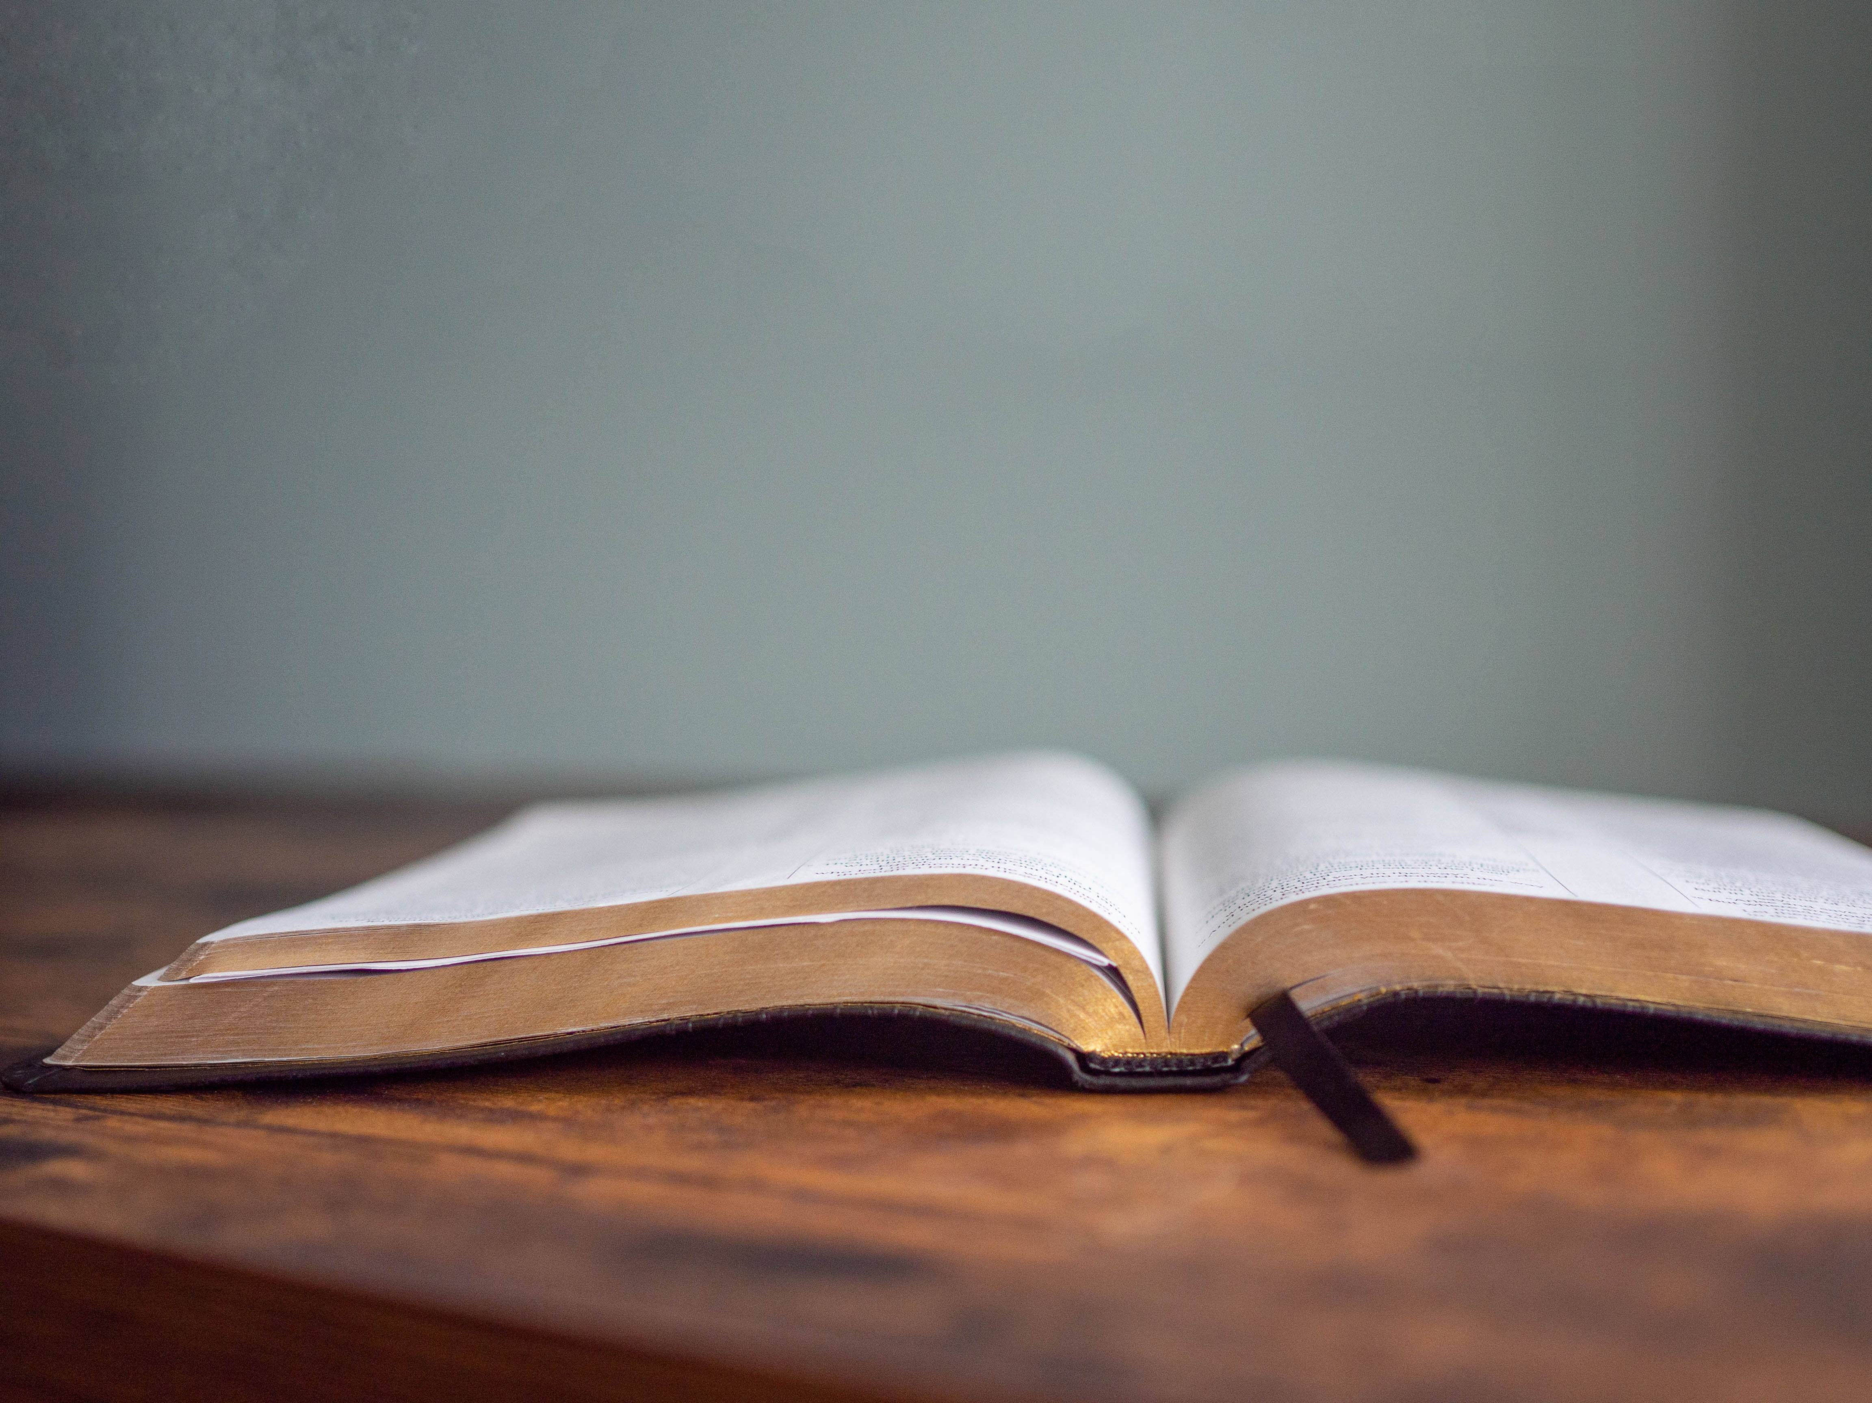
DECLARING GOD‘S WORD

Slide 17
HEBREW LESSON: Genesis 12: 1–4 God promises Abram and Sarai they will become parents of a great nation.
12 Now the Lord said to Abram, “Go from your country and your kindred and your father’s house to the land that I will show you. ² I will make of you a great nation, and I will bless you and make your name great, so that you will be a blessing. ³ I will bless those who bless you, and the one who curses you I will curse, and in you all the families of the earth shall be blessed.” . . .

Slide 18
⁴ So Abram went, as the Lord had told him, and Lot went with him. Abram was seventy-five years old when he departed from Haran.

Slide 19
GOSPEL LESSON: John 3: 1–17
Jesus tells Nicodemus he must be born from above.
3 Now there was a Pharisee named Nicodemus, a leader of the Jews. ² He came to Jesus by night and said to him, “Rabbi, we know that you are a teacher who has come from God, for no one can do these signs that you do unless God is with that person.” ³ Jesus answered him, “Very truly, I tell you, no one can see the kingdom of God without being born from above.” . . .

Slide 20
⁴ Nicodemus said to him, “How can anyone be born after having grown old? Can one enter a second time into the mother’s womb and be born?” ⁵ Jesus answered, “Very truly, I tell you, no one can enter the kingdom of God without being born of water and Spirit. ⁶ What is born of the flesh is flesh, and what is born of the Spirit is spirit. ⁷ Do not be astonished that I said to you, ‘You must be born from above.’ ⁸ The wind blows where it chooses, and you hear the sound of it, . . .

Slide 21
but you do not know where it comes from or where it goes. So it is with everyone who is born of the Spirit.” ⁹ Nicodemus said to him, “How can these things be?” ¹⁰ Jesus answered him, “Are you the teacher of Israel, and yet you do not understand these things?
¹¹ “Very truly, I tell you, we speak of what we know and testify to what we have seen, yet you do not receive our testimony. ¹² If I have told you about earthly things and you do not believe, . . .

Slide 22
how can you believe if I tell you about heavenly things? ¹³ No one has ascended into heaven except the one who descended from heaven, the Son of Man. ¹⁴ And just as Moses lifted up the serpent in the wilderness, so must the Son of Man be lifted up, ¹⁵ that whoever believes in him may have eternal life.
¹⁶ “For God so loved the world that he gave his only Son, so that everyone who believes in him may not perish but may have eternal life. . . .

Slide 23
¹⁷ “Indeed, God did not send the Son into the world to condemn the world but in order that the world might be saved through him.

Slide 24
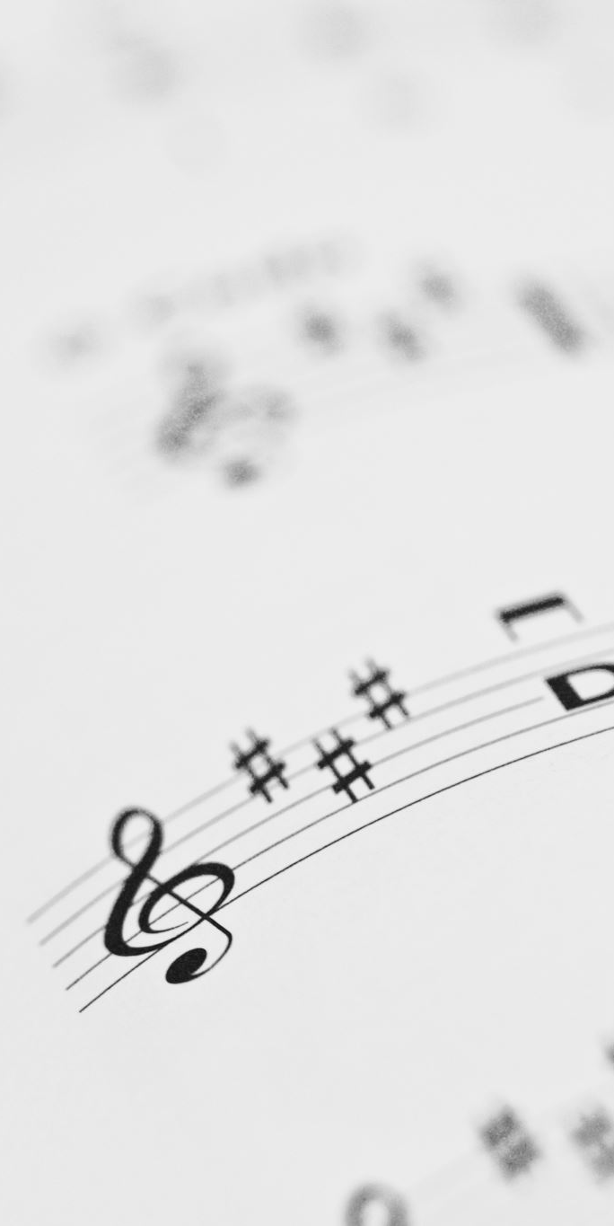
CHANCEL CHOIR ANTHEM
“In Your House,
O Lord”
by Jay Turner

Slide 25

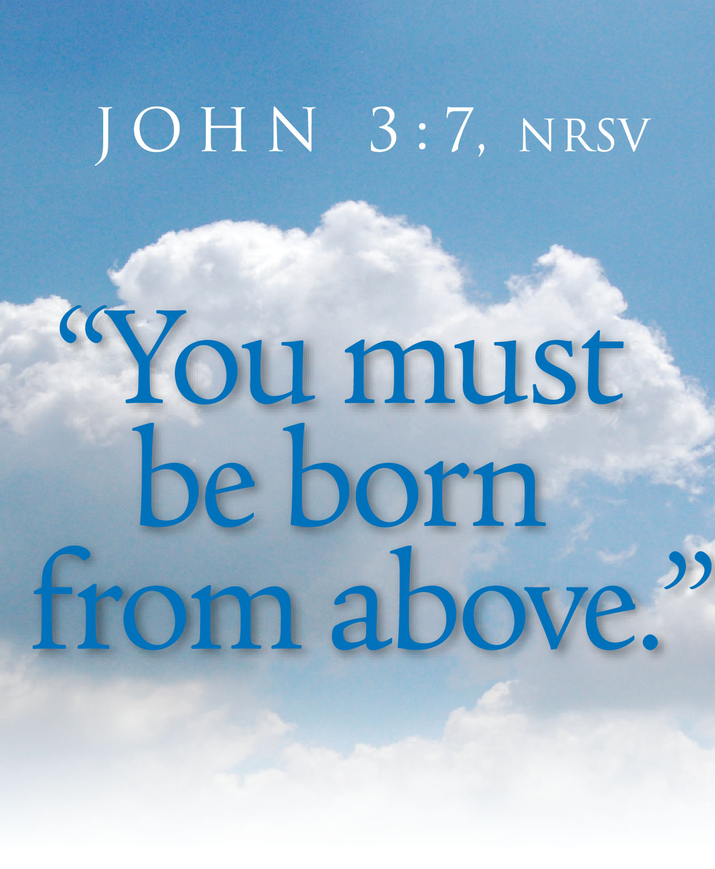
PASTOR DAVID’S SERMON:
The Joy of New Life

Slide 26
RESPONDING TO GOD’S WORD

Slide 27
* AFFIRMATION OF FAITH: (A Brief Statement of Faith, 1990)
We trust in Jesus Christ, fully human, fully God. In everlasting love, the God of Abraham and Sarah chose a covenant people to bless all families of the earth. Loving us still, God makes us heirs with Christ of the covenant. Like a mother who will not forsake her nursing child, . . .

Slide 28
like a father who runs to welcome the prodigal home, God is faithful still.
With believers in every time and place, we rejoice that nothing in life and in death can separate us from the love of God in Christ Jesus our Lord. Amen.

Slide 29
* COMMUNION HYMN: For Everyone Born, vv. 1, 3–5 No. 769, GTG
For everyone born, a place at the table,
for everyone born, clean water and bread,
a shelter, a space, a safe place for growing,
for everyone born, a star overhead,
and God will delight when we are creators of justice and joy, compassion and peace:
yes, God will delight when we are creators of justice, . . . justice and joy!
. . .

Slide 30
For young and for old, a place at the table,
a voice to be heard, a part in the song,
the hands of a child in hands that are wrinkled, for young and for old, the right to belong, and God will delight when we are creators of justice and joy, compassion and peace: yes, God will delight when we are creators of justice, . . . justice and joy!
. . .

Slide 31
For just and unjust, a place at the table,
abuser, abused, with need to forgive,
in anger, in hurt, a mindset of mercy,
for just and unjust, a new way to live,
and God will delight when we are creators of justice and joy, compassion and peace:
yes, God will delight when we are creators of justice, . . . justice and joy!
. . .

Slide 32
For everyone born, a place at the table,
to live without fear, and simply to be,
to work, to speak out,
to witness and worship,
for everyone born, the right to be free,
and God will delight when we are creators of justice and joy, compassion and peace:
yes, God will delight when we are creators of justice, . . . justice and joy!

Slide 33


Slide 34
SACRAMENT OF HOLY COMMUNION
INVITATION TO THE LORD’S TABLE:
L: Friends, this is the joyful feast of the people of God!
P: People will come from east and west, and from north and south, and sit at the table in the kingdom of God.

Slide 35
L: Behold, how good and pleasant it is when brothers and sisters dwell in unity.
P: God sent the whole world God’s only Son. Since God loved us so much, we too, should love one another.
L: This is the Lord’s Table. Our Savior invites all who are truly sorry for their sins and would humbly put their trust in him to come to the feast which he has prepared. Listen to the gracious words of our Savior Jesus Christ:

Slide 36
“Come to me, all you that are weary and are carrying heavy burdens, and I will give you rest. Take my yoke upon you, and learn from me; for I am gentle and humble in heart, and you will find rest for your souls. For my yoke is easy, and my burden is light.“ Matthew 11: 28–30
”I am the bread of life. Whoever comes to me will never be hungry, and whoever believes in me will never be thirsty. No one who comes to me will I cast out.” John 6: 35, 37

Slide 37
”This is indeed the will of my Father, that all who see the Son and believe in him may have eternal life, and I will raise them up on the last day.” John 6: 40
“Behold, I stand at the door and knock; if those who hear my voice open the door, I will come in to them and eat with them, and they with me.” Revelation 3: 20

Slide 38
L: The Lord be with you.
P: And with your spirit.
L: Lift up your hearts.
P: We lift them to the Lord.
L: Let us give thanks to the Lord our God.
P: It is right to give God our thanks and praise.

Slide 39
PRAYER OF THANKSGIVING, PRAYERS OF THE PEOPLE, & THE LORD’S PRAYER:
L: Holy Lord . . . as we pray together:
O God, who called us from death to life, through your Son Jesus Christ, you reconciled your people to yourself. Following his example of prayer and fasting, we obey you with willing hearts and serve one another in holy love, . . .

Slide 40
giving ourselves to you and to the church through all the ages and in all places. This we pray as your Son, Jesus taught us to pray . . .

Slide 41
Our Father who art in heaven,
Hallowed be thy name.
Thy kingdom come, thy will be done;
On earth as it is in heaven.
Give us this day our daily bread;
And forgive us our debts,
As we forgive our debtors;
And lead us not into temptation,
But deliver us from evil,
For Thine is the kingdom
And the power and the glory, forever. Amen.

Slide 42


Slide 43

OFFERING OF THE ELEMENTS:
Approach the Table,
receive the bread, take the cup,
and return to your pew.

Slide 44
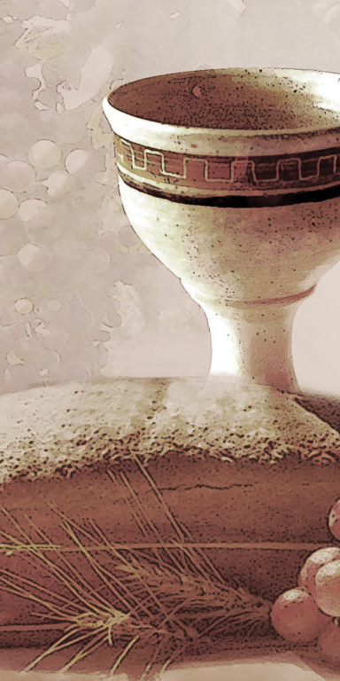
SHARING THE BREAD:
Jesus said, “I am the bread of life. Whoever comes to me will never be hungry...” (Jn. 6:35a)
Let us eat this bread in remembrance of Christ and may the spirit that is in him be in us also.
DRINKING THE CUP:
Jesus said, “I am the vine, you are the branches, apart from him, we can do nothing.”
Drink this cup in remembrance of Christ and may the spirit in which he died be our Spirit.

Slide 45
COMMUNION BLESSING: Let us give thanks to the Lord our God.
We give you thanks, great God, for the hope we have in Jesus, who died and is risen and rules over all. We praise you for his presence with us. Because He lives, we look for eternal life, knowing that nothing past, present or yet to come can separate us from your great love made known in Jesus Christ our Lord. Amen.

Slide 46
DEPARTING IN GOD’S NAME

Slide 47
* HYMN: No. 485 To God Be the Glory
To God be the glory,
great things He hath done!
So loved He the world
that He gave us His Son,
Who yielded His life an atonement for sin,
And opened the life gate that all may go in.
. . .

Slide 48
Praise the Lord, praise the Lord,
Let the earth hear His voice!
Praise the Lord, praise the Lord,
Let the people rejoice!
O come to the Father
through Jesus the Son,
And give Him the glory:
great things He hath done.
. . .

Slide 49
Great things He hath taught us,
great things He hath done,
And great our rejoicing
through Jesus the Son;
But purer, and higher, and greater will be
Our wonder, our transport,
when Jesus we see.
. . .

Slide 50
Praise the Lord, praise the Lord,
Let the earth hear His voice!
Praise the Lord, praise the Lord,
Let the people rejoice!
O come to the Father
through Jesus the Son,
And give Him the glory:
great things He hath done.

Slide 51


* CHARGE TO THE PEOPLE & BENEDICTION
* CHORAL BENEDICTION
POSTLUDE
Our worship has ended —
our Christian Witness begins!
for refreshments & fellowship.

