Slide 1

Enter in SILENCE
Wait with REVERENCE
Worship from JOY

Slide 2
PRELUDE
WELCOME & ANNOUNCEMENTS
AFFIRMATION OF MISSION STATEMENT
CHORAL INTROIT
Our Mission Statement
As disciples of Jesus Christ, led by the Holy Spirit, we experience God’s unconditional love, and we witness to others by discovering and sharing our gifts.

Slide 3
* CALL TO WORSHIP:
God of compassion, we commit and commend ourselves to you, in whom we live, move, and have our being.
Be the goal of my earthly pilgrimage, and my heartfelt rest along the way.
May our souls take refuge from the crowding turmoil of worldly thought beneath the shadow of your wings.
May our hearts, this sea of restless waves, find peace in you, O God.
That with grateful hearts and with lips of praise, we may worship God.

Slide 4
* HYMN: No. 355 Hear the Good News of Salvation
Hear the good news of salvation:
Jesus died to show God’s love.
Such great kindness! Such great mercy!
Come to us from heaven above.
Jesus Christ, how much I love You!
Jesus Christ, You save from sin!
How I love You! Look upon me.
Love me still and cleanse within.
. . .

Slide 5
All the sins I have committed
To my Saviour now I bring.
I bow down with ears of anguish;
Christ forgives and so I sing:
Jesus Christ, how much I love You!
Jesus Christ, You save from sin!
How I love You! Look upon me.
Love me still and cleanse within.

Slide 6
PRAYER OF CONFESSION: (in silence then in unison)
God of mercy, you sent Jesus, your Son, to seek and save the lost. We confess that too frequently we stray from your will. Misguided by our pride, we often view ourselves pure when we are stained, great when we are small, loving when we fail to love as you first loved us. . . .

Slide 7
Forgive us when we have neglected to do what is right, to love loyalty, and to walk humbly with you, our God. Grant us grace and wisdom to walk your righteous path and to live restored unto the joy of your salvation. Amen.

Slide 8
ASSURANCE OF CHRIST’S FORGIVENESS:
By the saving work of Jesus’ death on the cross and by
the power of his resurrection…
In Jesus Christ, we are forgiven! Let us forgive one another.

Slide 9
* GLORIA PATRI: No. 579 Glory Be to the Father
Glory be to the Father, and to the Son,
and to the Holy Ghost;
As it was in the beginning,
is now, and ever shall be,
world without end. Amen.

Slide 10

* EXCHANGE OF CHRIST’S PEACE:
Pastor: The peace of Christ be with you.
People: And also with you.
Welcome one another with the peace of Christ.

Slide 11
GIVING OF OUR GIFTS & OFFERTORY:
Our God has blessed us, so let us extend God’s Blessing as we present our Tithes and Offerings.
Thank you for being faithful stewards of your church family with your prayers, your time, talent, and your financial resources.
Contributions may also be made:
Electronically on the church website at fpcb-nj.org;
By reoccurring electronic withdrawal; or by
By mailing your offering to the church: P.O. Box 385, Blairstown, NJ.

Slide 12
* DOXOLOGY: No. 592 Praise God
Praise God, from whom all blessings flow;
Praise Him, all creatures here below;
Praise Him above, ye heavenly host;
Praise Father, Son, and Holy Ghost. Amen.
* PRAYER OF DEDICATION

Slide 13

DECLARING GOD‘S WORD

Slide 14
HEBREW LESSON: Genesis 2:15–17; 3:1–7
The fall of humanity.
¹⁵ The Lord God took the man and put him in the garden of Eden to till it and keep it. ¹⁶ And the Lord God commanded the man, “You may freely eat of every tree of the garden, ¹⁷ but of the tree of the knowledge of good and evil you shall not eat, for in the day that you eat of it you shall die.”
3 Now the serpent was more crafty than any other wild animal that the Lord God had made. . . .

Slide 15
He said to the woman, “Did God say, ‘You shall not eat from any tree in the garden’?” ² The woman said to the serpent, “We may eat of the fruit of the trees in the garden, ³ but God said, ‘You shall not eat of the fruit of the tree that is in the middle of the garden, nor shall you touch it, or you shall die.’ ” ⁴ But the serpent said to the woman, “You will not die, ⁵ for God knows that when you eat of it your eyes will be opened, and you will be like God, knowing good and evil.” . . .

Slide 16
⁶ So when the woman saw that the tree was good for food and that it was a delight to the eyes and that the tree was to be desired to make one wise, she took of its fruit and ate, and she also gave some to her husband, who was with her, and he ate. ⁷ Then the eyes of both were opened, and they knew that they were naked, and they sewed fig leaves together and made loincloths for themselves.

Slide 17
GOSPEL LESSON: Matthew 4: 1–11
Jesus resists temptation.
4 Then Jesus was led up by the Spirit into the wilderness to be tested by the devil. ² He fasted forty days and forty nights, and afterward he was famished. ³ The tempter came and said to him, “If you are the Son of God, command these stones to become loaves of bread.” ⁴ But he answered, “It is written,
. . .

Slide 18
‘One does not live by bread alone, but by every word that comes from the mouth of God.’ ”
⁵ Then the devil took him to the holy city and placed him on the pinnacle of the temple, ⁶ saying to him, “If you are the Son of God, throw yourself down, for it is written,
‘He will command his angels concerning you,’ and ‘On their hands they will bear you up,
. . .

Slide 19
so that you will not dash your foot against a stone.’ ”
⁷ Jesus said to him, “Again it is written, ‘Do not put the Lord your God to the test.’ ”
⁸ Again, the devil took him to a very high mountain and showed him all the kingdoms of the world and their glory, ⁹ and he said to him, “All these I will give you, if you will fall down and worship me.” ¹⁰ Then Jesus said to him, “Away with you, Satan! for it is written, . . .

Slide 20
‘Worship the Lord your God, and serve only him.’ ”
¹¹ Then the devil left him, and suddenly angels came and waited on him.

Slide 21
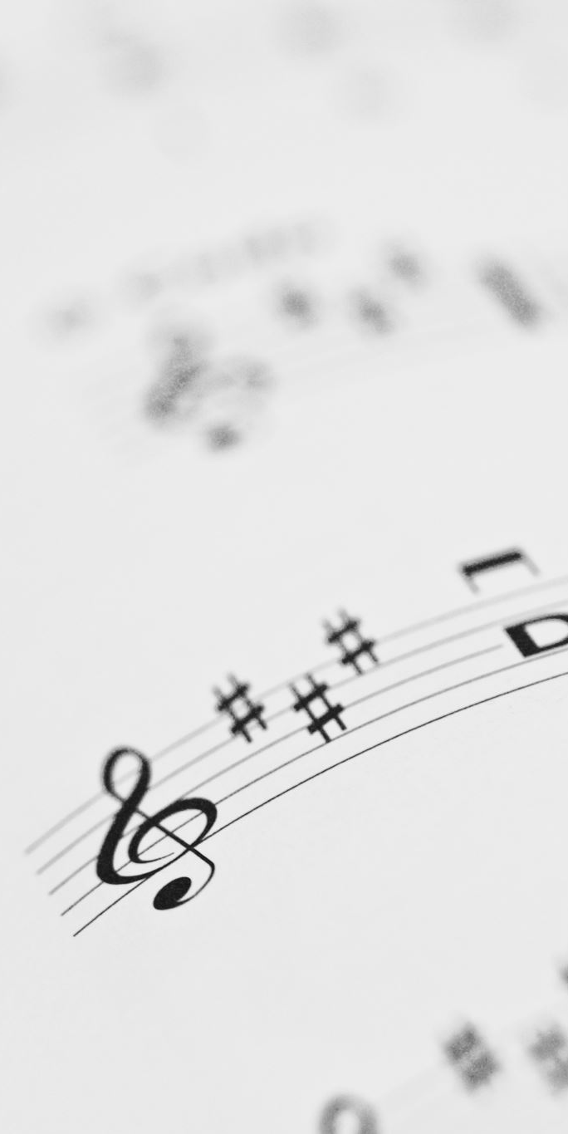
CHANCEL CHOIR ANTHEM:
“In Your House, O Lord”
by Jay Turner

Slide 22

PASTOR DAVID’S MEDITATION:
Trials, Temptations, & Triumphs

Slide 23
RESPONDING TO GOD’S WORD

Slide 24
* AFFIRMATION OF FAITH: A Contemporary Apostle’s Creed
I believe in God who places joy in our souls, dancing in our toes and songs in our hearts. I believe God wanted gladness to flow like a river so the Good Lord created a bountiful earth with plenty for all to share. . . .

Slide 25
I believe in Jesus, who turned water into wine, partied with outcasts and sinners, and touched the broken so they could leap and dance. I believe Jesus opened the doors and set an extra place so we could feast.
I believe in the Holy Spirit, who prompts us to smile, who sends us invitations to come and dine, . . .

Slide 26
who nudges us to openness and tenderness.
I believe the Spirit is present every time we gather to break bread and stirs within us the desire to live joyfully and walk hopefully. Forever, I will live in the embrace of God and be a witness to Christ’s resurrection joy. Amen.

Slide 27
* HYMN: O Lord, You Were Sent Tune #361
© 2000 by Carolyn Winfrey Gillette
Our Lord, you were sent
to a place wild and vast
To ponder your mission, to pray and to fast;
Then hungry and weary,
you faced night and day
The subtle temptations
to turn from God's way.
. . .

Slide 28
How could it be wrong
to want bread on the shelf?
To seek, in one's serving,
to first serve one's self?
But by God's own word
you remained ever sure:
It's only in God that our lives are secure.
. . .

Slide 29
How could it be wrong
to just once bow the knee,
To shake hands with sin to achieve victory?
Yet you made it clear
that no matter the cost:
Your path was obedience,
your way was the cross.
. . .

Slide 30
Our Lord, in your struggle
you chose to obey;
God's word filled your heart
and you trusted God's way.
Now risen, you save us
from sins that destroy;
You give us your Spirit,
your peace and your joy.

Slide 31
PRAYER OF THANKSGIVING, OF THE PEOPLE, & THE LORD’S PRAYER
Our Father who art in heaven,
Hallowed be thy name.
Thy kingdom come, thy will be done;
On earth as it is in heaven.
Give us this day our daily bread;
And forgive us our debts,
As we forgive our debtors;
And lead us not into temptation,
But deliver us from evil,
For Thine is the kingdom
And the power and the glory, forever. Amen.

Slide 32
DEPARTING IN GOD’S NAME

Slide 33
* HYMN: One Person’s Sin Changed Every Life Tune: #370
© 2011 by Carolyn Winfrey Gillette
One person's sin changed every life;
When Adam strayed, we too were lost.
The world soon filled with death and strife
And every person bears the cost.
. . .

Slide 34
Not satisfied with what you gave,
Your people sought to be like you.
Those early humans disobeyed—
Their story is our story, too.
. . .

Slide 35
Then, God, in love you sent your Son,
For as in Adam we did fall,
So through the faithfulness of One,
Salvation was your gift to all.
. . .

Slide 36
O God, we've seen what death can do,
And now with joy we know rebirth.
In Jesus Christ, you make us new
And give your life for all the earth.

Slide 37


* CHARGE TO THE PEOPLE & BENEDICTION
* CHORAL BENEDICTION
POSTLUDE
Our worship has ended—our Christian Witness begins!

