Slide 1

Enter in
SILENCE
Wait with
REVERENCE
Worship from
JOY

Slide 2
PRELUDE
WELCOME & ANNOUNCEMENTS
AFFIRMATION OF MISSION STATEMENT
CHORAL INTROIT
Our Mission Statement
As disciples of Jesus Christ,
led by the Holy Spirit,
we experience God’s unconditional love,
and we witness to others
by discovering and sharing our gifts.

Slide 3
* CALL TO WORSHIP:
This is the day the Lord has made!
Let us rejoice and be glad in it.
God is love. Those who abide in love abide in God,
And God abides in them.
Dear friends, let us love one another, for love comes from God.
Everyone who loves has been born of God and knows God.
. . .

Slide 4
We love, because he first loved us.
With joyful hearts and praise on our lips, let us worship God!

Slide 5
* HYMN: No. 482 Praise Ye the Lord, the Almighty
Praise ye the Lord, the Almighty,
the King of creation!
O my soul, praise Him,
for He is thy health and salvation!
All ye who hear,
now to His temple draw near;
Praise Him in glad adoration! . . .

Slide 6
Praise ye the Lord, who o'er all things so wondrously reigneth,
Shelters thee under His wings, yea,
so gently sustaineth!
Hast thou not seen
how thy desires ever have been
Granted in what He ordaineth?
. . .

Slide 7
Praise ye the Lord!
O let all that is in me adore Him!
All that hath life and breath,
come now with praises before Him.
Let the Amen sound
from His people again,
Gladly for aye we adore Him.

Slide 8
PRAYER OF CONFESSION: (in silence then in unison)
God of compassion and grace, you call us to center our lives on the person of Jesus, to be ambassadors of Christ’s love to the world, yet too often turn away, distracted by our own plans. We often speak when we should listen. We do not always live the life of Jesus in our daily lives, and our commitments . . .

Slide 9
are frequently directed towards our own preferences rather than seeking your kingdom.
Forgive our sins, O God. Grant us wisdom to live in your light and inspire us to live as responsible stewards of the Gospel of our Lord, that we may serve you with energy, intelligence, imagination, passion, and love; in Jesus’ name, we pray. Amen.

Slide 10
ASSURANCE OF CHRIST’S FORGIVENESS:
Friends, in Jesus Christ, we are redeemed, reconciled and restored to a right relationship with God and our neighbor, I declare in the name of Jesus Christ, ,
We are forgiven! Let us live reconciled to one another.

Slide 11
* SONG OF CHRIST’S FORGIVENESS: No. 582 (GTG)
Glory to God, whose goodness
shines on me; and to the Son,
whose grace has pardoned me;
and to the Spirit,
whose love has set me free.
As it was in the beginning,
is now, and ever shall be. Amen.

Slide 12

* EXCHANGE OF CHRIST’S PEACE:
Pastor: The peace of Christ be with you.
People: And also with you.
Welcome one another
with the peace of Christ.

Slide 13
GIVING OF OUR GIFTS & OFFERTORY:
Our God has blessed us, so let us extend
God’s Blessing as we present our Tithes and Offerings.
Thank you for being faithful stewards of your
church family with your prayers, your time,
talent, and your financial resources.
Contributions may also be made:
Electronically on the church website at fpcb-nj.org;
By reoccurring electronic withdrawal; or by
By mailing your offering to the church:
P.O. Box 385, Blairstown, NJ.

Slide 14
* PRAISE: No. 428 We Give Thee but Thine Own v. 1
We give Thee but Thine own,
Whate’er the gift may be;
All that we have is Thine alone,
A trust, O Lord, from Thee.
* PRAYER OF DEDICATION

Slide 15

DECLARING
GOD‘S WORD

Slide 16
HEBREW LESSON: Exodus 24: 12–18
Moses receives God’s covenant on Mt. Sinai.
¹² The Lord said to Moses, “Come up to me on the mountain and wait there; I will give you the tablets of stone, with the law and the commandment, which I have written for their instruction.” ¹³ So Moses set out with his assistant Joshua, and Moses went up onto the mountain of God. ¹⁴ To the elders he had said, “Wait here for us, until we come back to you. Look, Aaron and Hur are with you; whoever has a dispute may go to them.” . . .

Slide 17
¹⁵ Then Moses went up on the mountain, and the cloud covered the mountain. ¹⁶ The glory of the Lord settled on Mount Sinai, and the cloud covered it for six days; on the seventh day he called to Moses out of the cloud. ¹⁷ Now the appearance of the glory of the Lord was like a devouring fire on the top of the mountain in the sight of the Israelites. ¹⁸ Moses entered the cloud and went up on the mountain. Moses was on the mountain for forty days and forty nights.

Slide 18
GOSPEL LESSON: Matthew 17: 1–9
Jesus is transfigured into his most exalted image.
17 Six days later, Jesus took with him Peter and James and his brother John and led them up a high mountain, by themselves. ² And he was transfigured before them, and his face shone like the sun, and his clothes became bright as light. ³ Suddenly there appeared to them Moses and Elijah, talking with him. ⁴ Then Peter said to Jesus, . . .

Slide 19
“Lord, it is good for us to be here; if you wish, I will set up three tents here, one for you, one for Moses, and one for Elijah.” ⁵ While he was still speaking, suddenly a bright cloud overshadowed them, and a voice from the cloud said, “This is my Son, the Beloved; with him I am well pleased; listen to him!” ⁶ When the disciples heard this, they fell to the ground and were overcome by fear. ⁷ But Jesus came and touched them, saying, . . .

Slide 20
“Get up and do not be afraid.” ⁸ And when they raised their eyes, they saw no one except Jesus himself alone.
⁹ As they were coming down the mountain, Jesus ordered them, “Tell no one about the vision until after the Son of Man has been raised from the dead.”

Slide 21
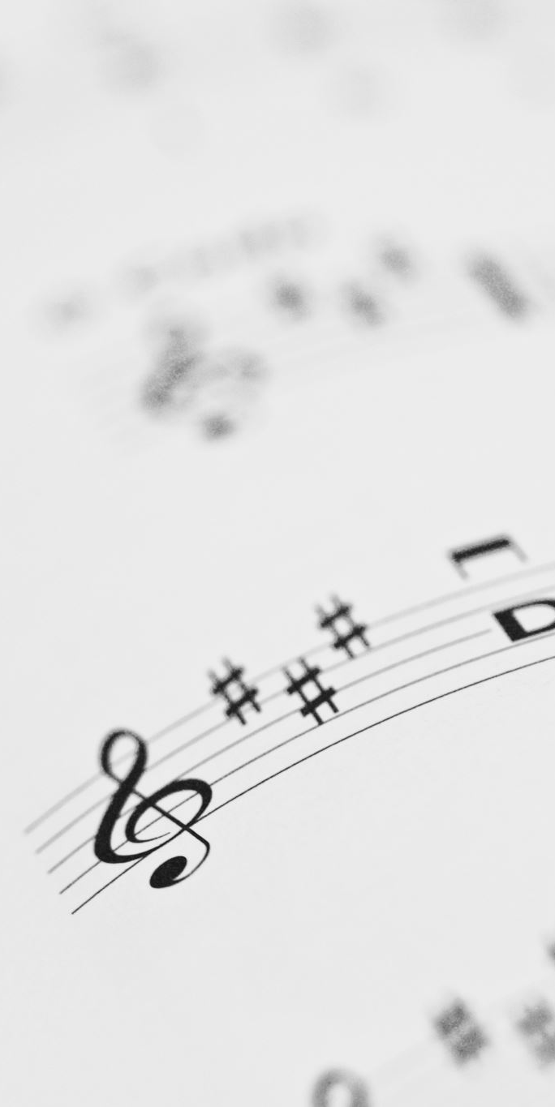
CHANCEL CHOIR ANTHEM

Slide 22

PASTOR DAVID’S
MEDITATION :
An Unexpected Transfiguration

Slide 23
RESPONDING TO GOD’S WORD

Slide 24
* AFFIRMATION OF FAITH: Philippians 2: 3–10
We affirm our desire to “Do nothing from selfish ambition or conceit, but in humility regard others as better than yourselves.” We strive to “look not to your own interests, but to the interests of others, letting the same mind be in us that was in Christ Jesus, who, though, he was in the form of God, . . .

Slide 25
did not regard equality with God as something to be exploited, but emptied himself, taking the form of a slave, being born in human likeness. And being found in human likeness, he humbled himself and became obedient to the point of death —even death on a cross. . . .

Slide 26
Therefore God also highly exalted himself and gave him the name that is above every name, so that at the name of Jesus every knee should bend, in heaven and on earth and under the earth, and every tongue should confess that Jesus Christ is Lord, to the glory of God the Father.” Amen.

Slide 27
* HYMN: No. 438 Blest Be the Tie That Binds
Blest be the tie that binds
Our hearts in Christian love;
The fellowship of kindred minds
Is like to that above.
Before our Father’s throne
We pour our ardent prayers;
Our fears, our hopes, our aims are one,
Our comforts and our cares. . . .

Slide 28
We share our mutual woes,
Our mutual burdens bear,
And often for each other flows
The sympathizing tear.
From sorrow, toil, and pain,
And sin we shall be free;
And perfect love and friendship reign
Through all eternity.

Slide 29
PRAYER OF THANKSGIVING, OF THE PEOPLE,
& THE LORD’S PRAYER
Our Father who art in heaven,
Hallowed be thy name.
Thy kingdom come, thy will be done;
On earth as it is in heaven.
Give us this day our daily bread;
And forgive us our debts,
As we forgive our debtors;
And lead us not into temptation,
But deliver us from evil,
For Thine is the kingdom
And the power and the glory, forever. Amen.

Slide 30
DEPARTING IN GOD’S NAME

Slide 31
* HYMN: No. 417 Christ Has Made the Sure Foundation
Christ is made the sure foundation,
Christ the head and cornerstone,
Chosen of the Lord and precious,
Binding all the church in one;
Holy Zion’s help forever,
And our confidence alone.
. . .

Slide 32
To this temple, where we call You,
Come, O Lord of Hosts, today;
With Your wonted lovingkindness
Hear Your people as they pray.
And Your fullest benediction
Shed within its walls alway.
. . .

Slide 33
Here bestow to all Your servants
What they ask of You to gain,
What they gain from You forever
With the blessèd to retain,
And hereafter in Your glory
Evermore with You to reign.
. . .

Slide 34
Laud and honor to the Father,
Laud and honor to the Son,
Laud and honor to the Spirit,
Ever Three and ever one;
One in might and one in glory
While unending ages run.

Slide 35


* CHARGE TO THE PEOPLE & BENEDICTION
* CHORAL BENEDICTION
POSTLUDE
Our worship has ended—our Christian Witness begins!

