Slide 1

Enter in
SILENCE
Wait with
REVERENCE
Worship from
JOY

Slide 2
PRELUDE
WELCOME & ANNOUNCEMENTS
AFFIRMATION OF MISSION STATEMENT
CHORAL INTROIT
Our Mission Statement
As disciples of Jesus Christ,
led by the Holy Spirit,
we experience God’s unconditional love,
and we witness to others
by discovering and sharing our gifts.

Slide 3
* CALL TO WORSHIP:
L: This is the day the Lord has made.
P: Let us rejoice and be glad in it.
L: God is love. Those who abide in love abide in God,
P: And God abides in them.
L: With hearts of gratitude and lips of praise, let us worship God.

Slide 4
* HYMN OF PRAISE: #121 That Easter Day with Joy Was Bright (vv. 1 & 3)
That Easter day with joy was bright,
The sun shone out with fairer light,
When, to their longing eyes restored,
The apostles saw their risen Lord.
From every weapon death can wield,
Your own redeemed forever shield.
O Lord of all, with us abide
In this our joyful Eastertide.

Slide 5
PRAYER OF CONFESSION: (in silence then unison)
Gracious God, when we are burdened by life, feeling bruised and brow-beaten, and our sins are too heavy to hide, too deep to undo, and too real to deny, love us anyway, we pray, and forgive us. Forgive what our lips tremble to name and what our hearts can no longer bear.
. . .

Slide 6
Set us free from a past we cannot change. Open us to a future in which we can be changed; and grant us your amazing grace that we may grow more and more into the likeness and image of your Son, Jesus, our Lord. Amen.

Slide 7
ASSURANCE OF CHRIST’S FORGIVENESS:
L: Christ transforms. Christ redeems. Christ renews. Christ reconciles. Christ restores. Through Christ’s death and resurrection, we are a new creation, ready and able to sing and to testify to God’s saving grace, revealed in Jesus Christ, our Lord.
P: In Jesus Christ, we are forgiven! Let us forgive one another.

Slide 8
* CELEBRATION OF CHRIST’S FORGIVENESS: No. 151 v. 1
Crown Him with Many Crowns
Crown Him with many crowns,
The Lamb upon His throne;
Hark, how the heavenly anthem drowns
All music but its own!
Awake, my soul, and sing
Of Him who died for thee,
And hail Him as thy matchless King
Through all eternity.

Slide 9

* EXCHANGE OF CHRIST’S PEACE:
L: The peace of Christ be with you.
P: And also with you.
Welcome one another
with the peace of Christ.
~ Children may go downstairs for Sunday School ~

Slide 10


GIVING OF OUR GIFTS & OFFERTORY:
Our God has blessed us, so let us extend
God’s Blessing as we present our Tithes and Offerings.
Thank you for being faithful stewards of your
church family with your prayers, your time,
talent, and your financial resources.
Contributions may also be made:
Electronically on the church website
at fpcb-nj.org;
By reoccurring electronic withdrawal; or by
By mailing your offering to the church:
P.O. Box 385, Blairstown, NJ.

Slide 11
* DOXOLOGY: No. 577 Glory Be to the Father
Glory be to the Father, and the Son,
and the Holy Ghost;
As it was in the beginning, is now, and
ever shall be, world without end. Amen.
As it was in the beginning, is now, and ever shall be, world without end. Amen.
Amen. Amen. Amen. Amen.
Amen. Amen. Amen.
* PRAYER OF DEDICATION

Slide 12
DECLARING GOD‘S WORD
NEW TESTAMENT LESSON: Acts 9: 1–20
Saul experiences and proclaims Jesus as the risen Lord.
9 Meanwhile Saul, still breathing threats and murder against the disciples of the Lord, went to the high priest ² and asked him for letters to the synagogues at Damascus, so that if he found any who belonged to the Way, men or women, he might bring them bound to Jerusalem. ³ Now as he was going along and approaching Damascus, suddenly a light from heaven flashed around him. . . .

Slide 13
⁴ He fell to the ground and heard a voice saying to him, “Saul, Saul, why do you persecute me?” ⁵ He asked, “Who are you, Lord?” The reply came, “I am Jesus, whom you are persecuting. ⁶ But get up and enter the city, and you will be told what you are to do.” ⁷ The men who were traveling with him stood speechless because they heard the voice but saw no one. ⁸ Saul got up from the ground, and though his eyes were open, he could see nothing; . . .

Slide 14
so they led him by the hand and brought him into Damascus. ⁹ For three days he was without sight and neither ate nor drank.
¹⁰ Now there was a disciple in Damascus named Ananias. The Lord said to him in a vision, “Ananias.” He answered, “Here I am, Lord.” ¹¹ The Lord said to him, “Get up and go to the street called Straight, and at the house of Judas look for a man of Tarsus named Saul. At this moment he is praying, . . .

Slide 15
¹² and he has seen in a vision a man named Ananias come in and lay his hands on him so that he might regain his sight.” ¹³ But Ananias answered, “Lord, I have heard from many about this man, how much evil he has done to your saints in Jerusalem, ¹⁴ and here he has authority from the chief priests to bind all who invoke your name.” ¹⁵ But the Lord said to him, “Go, for he is an instrument whom I have chosen to bring my name before gentiles and kings and before the people of Israel; . . .

Slide 16
¹⁶ I myself will show him how much he must suffer for the sake of my name.” ¹⁷ So Ananias went and entered the house. He laid his hands on Saul and said, “Brother Saul, the Lord Jesus, who appeared to you on your way here, has sent me so that you may regain your sight and be filled with the Holy Spirit.” ¹⁸ And immediately something like scales fell from his eyes, and his sight was restored. Then he got up and was baptized, ¹⁹ and after taking some food, he regained his strength. . . .

Slide 17
For several days he was with the disciples in Damascus, ²⁰ and immediately he began to proclaim Jesus in the synagogues, saying, “He is the Son of God.”

Slide 18
GOSPEL READING: John 21: 1–19
Jesus cooks breakfast for the disciples.
21 After these things Jesus showed himself again to the disciples by the Sea of Tiberias, and he showed himself in this way. ² Gathered there together were Simon Peter, Thomas called the Twin, Nathanael of Cana in Galilee, the sons of Zebedee, and two others of his disciples. ³ Simon Peter said to them, “I am going fishing.” They said to him, “We will go with you.” . . .

Slide 19
They went out and got into the boat, but that night they caught nothing.
⁴ Just after daybreak, Jesus stood on the beach, but the disciples did not know that it was Jesus. ⁵ Jesus said to them, “Children, you have no fish, have you?” They answered him, “No.” ⁶ He said to them, “Cast the net to the right side of the boat, and you will find some.” So they cast it, and now they were not able to haul it in because there were so many fish. . . .

Slide 20
⁷ That disciple whom Jesus loved said to Peter, “It is the Lord!” When Simon Peter heard that it was the Lord, he put on his outer garment, for he had taken it off, and jumped into the sea. ⁸ But the other disciples came in the boat, dragging the net full of fish, for they were not far from the land, only about a hundred yards off.
⁹ When they had gone ashore, they saw a charcoal fire there, with fish on it, and bread. ¹⁰ Jesus said to them, . . .

Slide 21
“Bring some of the fish that you have just caught.” ¹¹ So Simon Peter went aboard and hauled the net ashore, full of large fish, a hundred fifty-three of them, and though there were so many, the net was not torn. ¹² Jesus said to them, “Come and have breakfast.” Now none of the disciples dared to ask him, “Who are you?” because they knew it was the Lord. ¹³ Jesus came and took the bread and gave it to them and did the same with the fish. . . .

Slide 22
¹⁴ This was now the third time that Jesus appeared to the disciples after he was raised from the dead.
¹⁵ When they had finished breakfast, Jesus said to Simon Peter, “Simon son of John, do you love me more than these?” He said to him, “Yes, Lord; you know that I love you.” Jesus said to him, “Feed my lambs.” ¹⁶ A second time he said to him, “Simon son of John, do you love me?” He said to him, “Yes, Lord; you know that I love you.” Jesus said to him, “Tend my sheep.” . . .

Slide 23
¹⁷ He said to him the third time, “Simon son of John, do you love me?” Peter felt hurt because he said to him the third time, “Do you love me?” And he said to him, “Lord, you know everything; you know that I love you.” Jesus said to him, “Feed my sheep. ¹⁸ Very truly, I tell you, when you were younger, you used to fasten your own belt and to go wherever you wished. But when you grow old, you will stretch out your hands, . . .

Slide 24
and someone else will fasten a belt around you and take you where you do not wish to go.” ¹⁹ (He said this to indicate the kind of death by which he would glorify God.) After this he said to him, “Follow me.”

Slide 25


CHANCEL CHOIR ANTHEM:
“A Jubilant Song”
by Mary Lynn Lightfoot

Slide 26
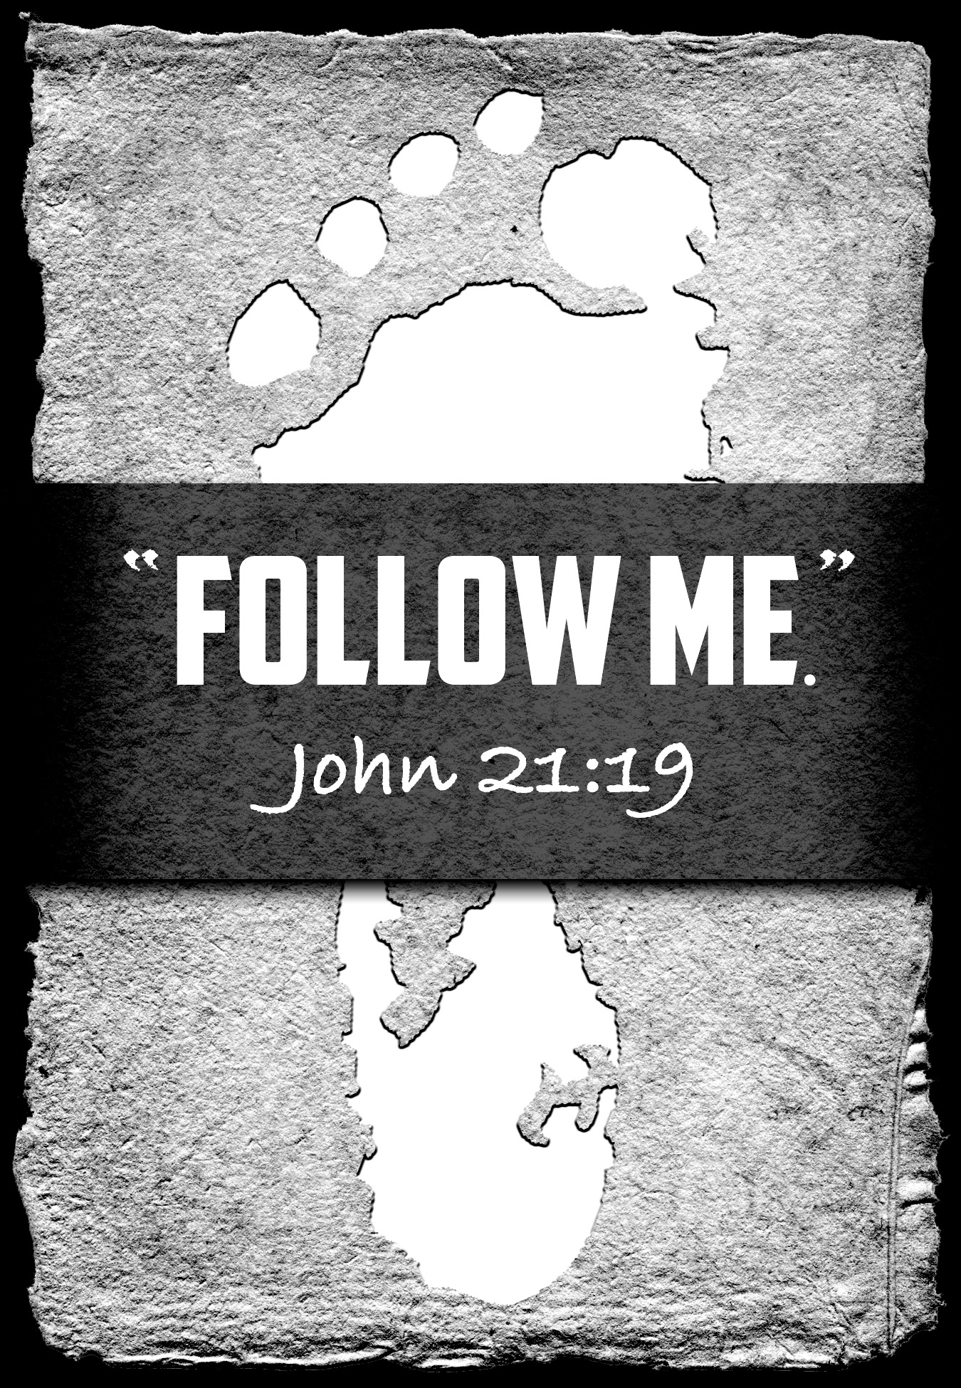
Pastor David’s
SERMON:
Experience,
Experienced,
Experiencing
Jesus

Slide 27
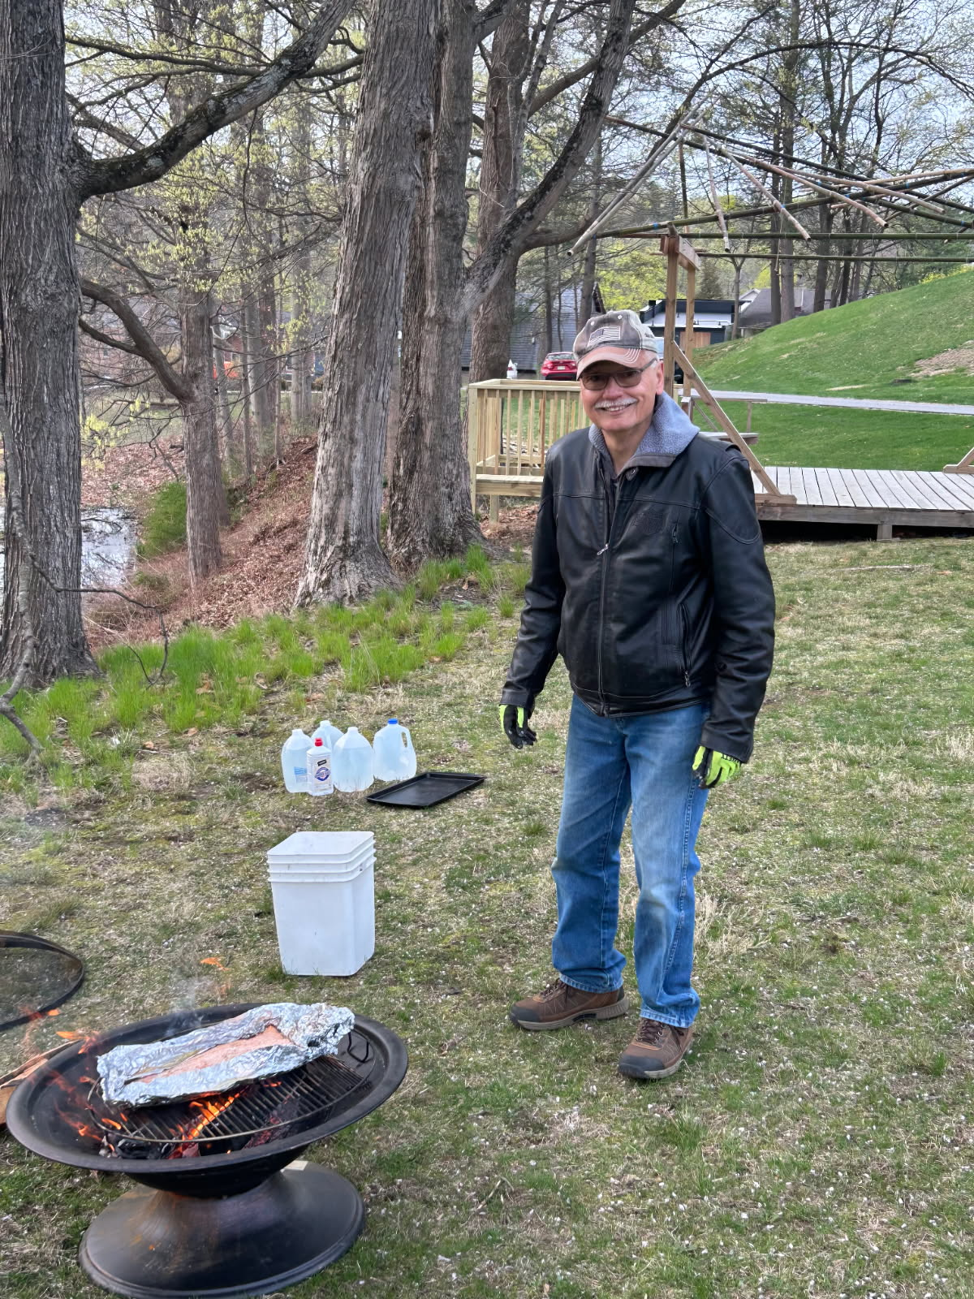

Slide 28
RESPONDING TO GOD’S WORD
* AFFIRMATION OF FAITH: The Contemporary Apostles’ Creed
I believe in God who places joy in our souls, dancing in our toes and songs in our hearts. I believe God wanted gladness to flow like a river, so the Good Lord created a bountiful earth with plenty for all to share. . . .

Slide 29
I believe in Jesus, who turned water into wine, partied with outcasts and sinners, and touched the broken so they could leap and dance. I believe Jesus opened the doors and set an extra place so we could feast.
I believe in the Holy Spirit, who prompts us to smile, who sends us invitations to come and dine, . . .

Slide 30
who nudges us to openness and tenderness. I believe the Spirit is present every time we gather to break bread and stirs within us the desire to live joyfully, to walk hopefully, and to enact justice boldly. Forever, I will live in the embrace of God and be a witness to Christ’s resurrection joy. Amen.

Slide 31
* COMMUNION HYMN: No. 392 vv. 1, 3, 4 (Tune 375)
Take Thou, Our Minds, Dear Lord
Take Thou our minds,
dear Lord, we humbly pray;
Give us the mind of Christ
each passing day;
Teach us to know
the truth that sets us free;
Grant us in all our thoughts to honor Thee.
. . .

Slide 32
Take Thou our wills,
Most High! Hold Thou full sway;
Have in our inmost souls Thy perfect way;
Guard Thou each sacred hour
from selfish ease;
Guide Thou our ordered lives
as Thou dost please.
. . .

Slide 33
Take Thou ourselves,
O Lord, heart, mind, and will;
Through our surrendered souls
Thy plans fulfill.
We yield ourselves to Thee—
time, talents, all;
We hear, and henceforth heed,
Thy sovereign call.

Slide 34


Slide 35
SACRAMENT OF HOLY COMMUNION
INVITATION TO THE LORD’S TABLE:
L: Friends, this is the joyful feast of the people of God!
P: People will come from east and west, and from north and south, and sit at the table in the kingdom of God.

Slide 36
L: Behold, how good and pleasant it is when brothers and sisters dwell in unity.
P: God sent the whole world God’s only Son. Since God loved us so much, we too, should love one another.
L: This is the Lord’s Table. Our Savior invites all who are truly sorry for their sins and would humbly put their trust in him to come to the feast which he has prepared. Listen to the gracious words of our Savior Jesus Christ:

Slide 37
“Come to me, all you that are weary and are carrying heavy burdens, and I will give you rest. Take my yoke upon you, and learn from me; for I am gentle and humble in heart, and you will find rest for your souls. For my yoke is easy, and my burden is light.“ Matthew 11: 28–30
”This is indeed the will of my Father, that all who see the Son and believe in him may have eternal life, and I will raise them up on the last day.” John 6: 40
“Behold, I stand at the door and knock; if those who hear my voice open the door, I will come in to them and eat with them, and they with me.” Revelation 3: 20

Slide 38
L: The Lord be with you.
P: And with your spirit.
L: Lift up your hearts.
P: We lift them to the Lord.
L: Let us give thanks to the Lord our God.
P: It is right to give God our thanks and praise.

Slide 39
PRAYER OF THANKSGIVING, PRAYERS OF THE PEOPLE,
& THE LORD’S PRAYER:
L: Holy Lord . . . as we pray together:
God of all power, where two or more are gathered, you are with us. Therefore, we eat this bread and drink this wine with celebration for the joy of our redemption, won for us through Jesus, your Son. . . . .

Slide 40
Send your Holy Spirit upon us that we may live bound together by faith in Jesus’ name, grateful for the life we share together. In our love for Jesus and one another, we pray as Jesus taught, praying . . .

Slide 41
Our Father who art in heaven,
Hallowed be thy name.
Thy kingdom come, thy will be done;
On earth as it is in heaven.
Give us this day our daily bread;
And forgive us our debts,
As we forgive our debtors;
And lead us not into temptation,
But deliver us from evil,
For Thine is the kingdom
And the power and the glory, forever. Amen.

Slide 42


Slide 43

OFFERING OF THE ELEMENTS:
Approach the Table,
receive the bread,
take the cup,
and return to your pew.

Slide 44
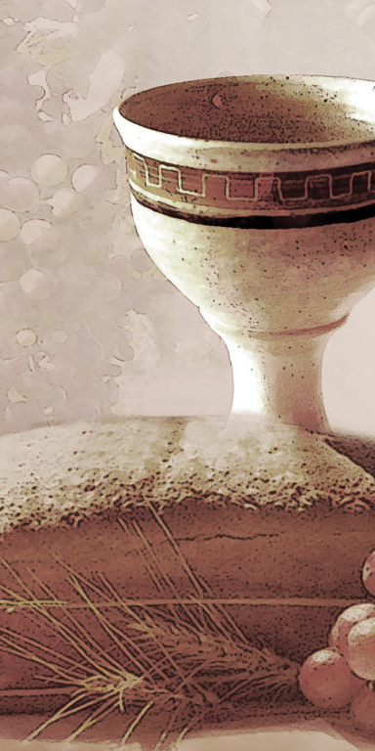
SHARING THE BREAD:
Jesus said, “I am the bread of life. Whoever comes to me will never be hungry...” (Jn. 6:35a)
Let us eat this bread in remembrance of Christ and may the spirit that is in him be in us also.
DRINKING THE CUP:
Jesus said, “I am the vine, you are the branches, apart from him, we can do nothing.”
Drink this cup in remembrance of Christ and may the spirit in which he died be our Spirit.

Slide 45
COMMUNION BLESSING:
L: Let us give thanks to the Lord our God.
By your Spirit, O God, strengthen our souls that we may be bold in faith and brave in Christ’s Service. Use our offerings and our lives for your glory and gain, in Jesus’ name, our crucified and risen Lord, we pray. Amen.

Slide 46
DEPARTING IN GOD’S NAME
* HYMN: No. 155 Rejoice, the Lord Is King
Rejoice, the Lord is King!
Your Lord and King adore!
Rejoice, give thanks, and sing,
And triumph evermore:
Lift up your heart, lift up your voice!
Rejoice, again I say, rejoice!
. . .

Slide 47
God's kingdom cannot fail,
Christ rules o’er earth and heaven;
The keys of death and hell
Are to our Jesus given:
Lift up your heart, lift up your voice!
Rejoice, again I say, rejoice!
. . .

Slide 48
Rejoice in glorious hope!
For Christ the Judge shall come
To glorify the saints
For their eternal home:
Lift up your heart, lift up your voice!
Rejoice, again I say, rejoice!

Slide 49


* CHARGE TO THE PEOPLE &
BENEDICTION
* CHORAL BENEDICTION
POSTLUDE
Our worship has ended —
our Christian Witness begins!
for refreshments & fellowship.

