Slide 1
Enter in SILENCE
Wait with REVERENCE
Worship from JOY

Slide 2
PRELUDE
WELCOME & ANNOUNCEMENTS
AFFIRMATION OF MISSION STATEMENT
CHORAL INTROIT
Our Mission Statement
As disciples of Jesus Christ, led by the Holy Spirit, we experience God’s unconditional love, and we witness to others by discovering and sharing our gifts.

Slide 3
* CALL TO WORSHIP:
L: Clap your hands, all you peoples;
P: Shout to God with loud songs of joy.
L: For the Lord, the Most High, is awesome.
P: A great king over all the earth.
L: The Lord is king, robed in majesty; he is girded with;”
P: Who is this King of glory?
L: Who is this King of glory. The Lord of Hosts;
P: God alone is the King of glory.
L: With great gratitude and gladness, let us worship God.

Slide 4
* HYMN OF PRAISE: No. 476 vv. 1–2
O Worship the King, All Glorious Above!
O worship the King, all glorious above!
O gratefully sing God's power
and God's love;
Our shield and defender,
the Ancient of Days,
Pavilioned in splendor
and girded with praise. . . .

Slide 5
O tell of God's might,
O sing of God's grace,
Whose robe is the light,
whose canopy space,
His chariots of heaven
the deep thunderclouds form,
And bright is God's path
on the wings of the storm.

Slide 6
PRAYER OF CONFESSION: (in silence then unison)
We come this day of ascension, merciful God, confessing our erroring ways and our lack of trust. While we sing of your lordship over creation, we acknowledge we deny rather than declare your power over the unfortunate happenings of our day. . . .

Slide 7
Forgive our sins. Help us embrace the mystery of the future with hope that we may live each day assured of your presence and confident that your way will not fail; in Jesus’ name, we pray. Amen.

Slide 8
ASSURANCE OF CHRIST’S FORGIVENESS:
L: Claimed by God in baptism, forgiven by Jesus through his death on the cross, live merciful in action, humble in mind and heart, willing to love and forgive as freely as God has first freely loved and forgiven us.
P: In Jesus Christ, we are forgiven! Let us forgive one another.

Slide 9
* CELEBRATION OF CHRIST’S FORGIVENESS: No. 151 v. 1
Crown Him with Many Crowns
Crown Him with many crowns,
The Lamb upon His throne;
Hark, how the heavenly anthem drowns
All music but its own!
Awake, my soul, and sing
Of Him who died for thee,
And hail Him as thy matchless King
Through all eternity.

Slide 10
* EXCHANGE OF CHRIST’S PEACE:
L: The peace of Christ be with you.
P: And also with you.
Welcome one another with the peace of Christ.
~ Children may go downstairs for Sunday School ~

Slide 11
GIVING OF OUR GIFTS & OFFERTORY:
Our God has blessed us, so let us extend God’s Blessing as we present our Tithes and Offerings.
Thank you for being faithful stewards of your church family with your prayers, your time, talent, and your financial resources.
Contributions may also be made:
Electronically on the church website at fpcb-nj.org;
By reoccurring electronic withdrawal; or by
By mailing your offering to the church: P.O. Box 385, Blairstown, NJ.

Slide 12
* DOXOLOGY: No. 577 Glory Be to the Father
Glory be to the Father, and the Son,
and the Holy Ghost;
As it was in the beginning, is now, and ever shall be, world without end. Amen.
As it was in the beginning, is now, and ever shall be, world without end. Amen.
Amen. Amen. Amen. Amen.
Amen. Amen. Amen.
* PRAYER OF DEDICATION

Slide 13
DECLARING GOD‘S WORD
NEW TESTAMENT: Acts 1: 1–14
The apostles witness Jesus’ ascension.
1 In the first book, Theophilus, I wrote about all that Jesus began to do and teach ² until the day when he was taken up to heaven, after giving instructions through the Holy Spirit to the apostles whom he had chosen. ³ After his suffering he presented himself alive to them by many convincing proofs, appearing to them during forty days and speaking about the kingdom of God. . . .

Slide 14
⁴ While staying with them, he ordered them not to leave Jerusalem but to wait there for the promise of the Father. “This,” he said, “is what you have heard from me; ⁵ for John baptized with water, but you will be baptized with the Holy Spirit not many days from now.”
⁶ So when they had come together, they asked him, “Lord, is this the time when you will restore the kingdom to Israel?” . . .

Slide 15
⁷ He replied, “It is not for you to know the times or periods that the Father has set by his own authority. ⁸ But you will receive power when the Holy Spirit has come upon you, and you will be my witnesses in Jerusalem, in all Judea and Samaria, and to the ends of the earth.” ⁹ When he had said this, as they were watching, he was lifted up, and a cloud took him out of their sight. ¹⁰ While he was going and they were gazing up toward heaven, suddenly two men in white robes stood by them. . . .

Slide 16
¹¹ They said, “Men of Galilee, why do you stand looking up toward heaven? This Jesus, who has been taken up from you into heaven, will come in the same way as you saw him go into heaven.”
¹² Then they returned to Jerusalem from the mount called Olivet, which is near Jerusalem, a Sabbath day’s journey away. ¹³ When they had entered the city, they went to the room upstairs where they were staying: Peter, and John, and James, and Andrew, Philip and Thomas, Bartholomew and Matthew, . . .

Slide 17
James son of Alphaeus, and Simon the Zealot, and Judas son of James. ¹⁴ All these were constantly devoting themselves to prayer, together with certain women, including Mary the mother of Jesus, as well as his brothers.

Slide 18
GOSPEL READING: Luke 24: 44–53
After witnessing Jesus’ ascension into heaven, the apostles are sent into the world.
⁴⁴ Then he said to them, “These are my words that I spoke to you while I was still with you—that everything written about me in the law of Moses, the prophets, and the psalms must be fulfilled.” ⁴⁵ Then he opened their minds to understand the scriptures, ⁴⁶ and he said to them, “Thus it is written, that the Messiah is to suffer and to rise from the dead on the third day . . .

Slide 19
⁴⁷ and that repentance and forgiveness of sins is to be proclaimed in his name to all nations, beginning from Jerusalem. ⁴⁸ You are witnesses of these things. ⁴⁹ And see, I am sending upon you what my Father promised, so stay here in the city until you have been clothed with power from on high.”
⁵⁰ Then he led them out as far as Bethany, and, lifting up his hands, he blessed them. ⁵¹ While he was blessing them, he withdrew from them and was carried up into heaven. . . .

Slide 20
⁵² And they worshiped him and returned to Jerusalem with great joy, ⁵³ and they were continually in the temple blessing God.

Slide 21
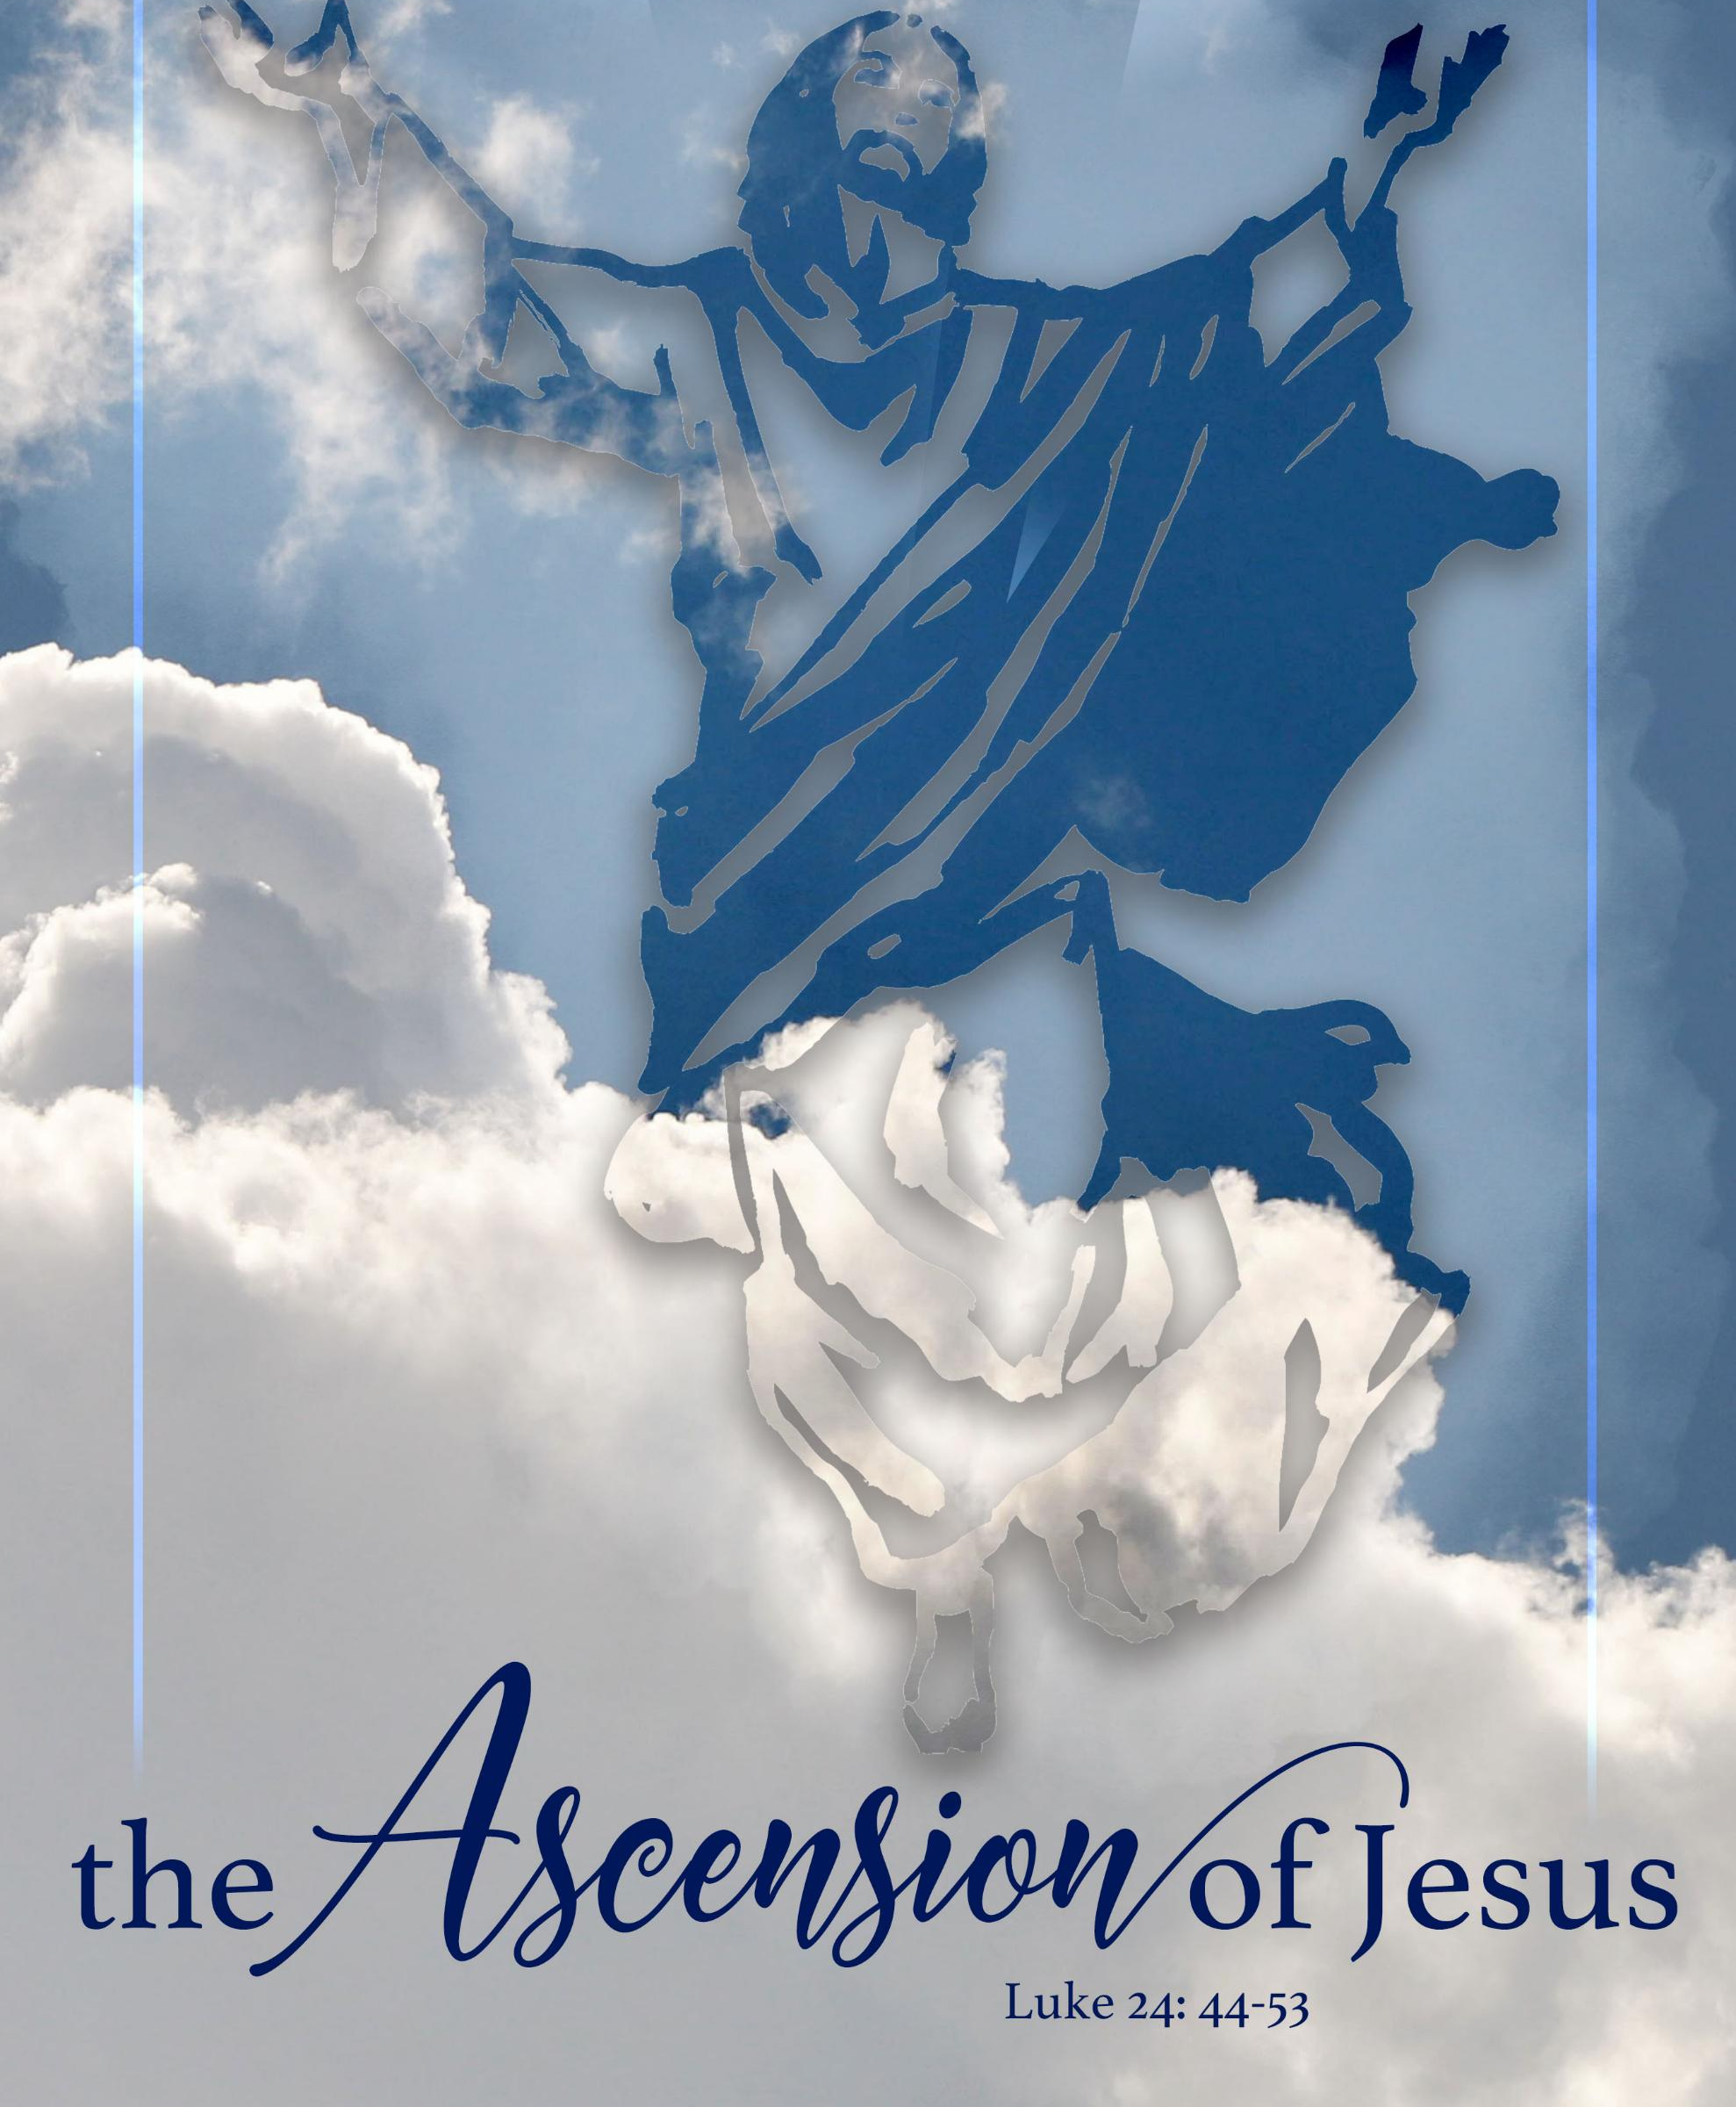
Pastor David’s
SERMON:
Ascending, Descending, and Sending

Slide 22
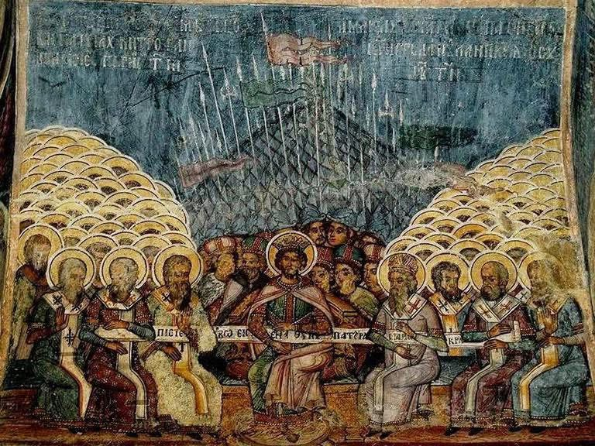

Slide 23
RESPONDING TO GOD’S WORD
* AFFIRMATION OF FAITH: The Nicene Creed, AD 325
I believe in heaven and earth, of all that is, seen and unseen. We believe in one Lord, Jesus Christ, the only Son of God, eternally begotten of the Father, God from God, light from light, true God from true God, begotten not made, of one Being with the Father; . . .

Slide 24
through him all things were made. For us and for our salvation he came down from heaven, was incarnate of the Holy Spirit and the Virgin Mary and became truly human. For our sake he was crucified under Pontious Pilate; he suffered death and was buried. On the third day he rose again in accordance with the Scriptures; . . .

Slide 25
he ascended into heaven and is seated on the right hand of the Father. He will come again in glory to judge the living and the dead, and his kingdom will have no end.
We believe in the Holy Spirit, the Lord, giver of life, who proceeds from the Father (and the Son), . . .

Slide 26
who with the Father and the Son is worshiped and glorified, and who has spoken through the prophets. We believe in one holy catholic and apostolic Church. We acknowledge one baptism for the forgiveness of sins. We look for the resurrection of the dead, and the life of the world to come. Amen.

Slide 27
* COMMUNION HYMN: No. 508 For the Bread Which You Have Broken
For the bread which You have broken,
For the wine which You have poured,
For the words which You have spoken,
Now we give You thanks, O Lord.
By this promise that You love us,
By Your gift of peace restored,
By Your call to heaven above us,
Hallow all our lives, O Lord. . . .

Slide 28
With the saints who now adore You
Seated at the heavenly board,
May the Church still waiting for You
Keep love’s tie unbroken, Lord.
In Your service, Lord, defend us;
In our hearts keep watch and ward;
In the world to which You send us
Let Your kingdom come, O Lord.

Slide 30
SACRAMENT OF HOLY COMMUNION
INVITATION TO THE LORD’S TABLE:
L: Friends, this is the joyful feast of the people of God!
P: People will come from east and west, and from north and south, and sit at the table in the kingdom of God.

Slide 31
L: Behold, how good and pleasant it is when brothers and sisters dwell in unity.
P: God sent the whole world God’s only Son. Since God loved us so much, we too, should love one another.
L: This is the Lord’s Table. Our Savior invites all who are truly sorry for their sins and would humbly put their trust in him to come to the feast which he has prepared. Listen to the gracious words of our Savior Jesus Christ:

Slide 32
“Come to me, all you that are weary and are carrying heavy burdens, and I will give you rest. Take my yoke upon you, and learn from me; for I am gentle and humble in heart, and you will find rest for your souls. For my yoke is easy, and my burden is light.“ Matthew 11: 28–30
”This is indeed the will of my Father, that all who see the Son and believe in him may have eternal life, and I will raise them up on the last day.” John 6: 40
“Behold, I stand at the door and knock; if those who hear my voice open the door, I will come in to them and eat with them, and they with me.” Revelation 3: 20

Slide 33
L: The Lord be with you.
P: And with your spirit.
L: Lift up your hearts.
P: We lift them to the Lord.
L: Let us give thanks to the Lord our God.
P: It is right to give God our thanks and praise.

Slide 34
PRAYER OF THANKSGIVING, PRAYERS OF THE PEOPLE, & THE LORD’S PRAYER:
L: Holy Lord . . . as we pray together:
God of all power, where two or more are gathered, you are with us. Therefore, we eat this bread and drink this wine with celebration for the joy of our redemption, won for us through Jesus, your Son. . .

Slide 35
Send your Holy Spirit upon us that we may live bound together by faith in Jesus’ name, grateful for the life we share together. In our love for Jesus and one another, we pray as Jesus taught, praying . . .

Slide 36
Our Father who art in heaven,
Hallowed be thy name.
Thy kingdom come, thy will be done;
On earth as it is in heaven.
Give us this day our daily bread;
And forgive us our debts,
As we forgive our debtors;
And lead us not into temptation,
But deliver us from evil,
For Thine is the kingdom
And the power and the glory, forever. Amen.

Slide 38
OFFERING OF THE ELEMENTS:
Approach the Table,
receive the bread, take the cup,
and return to your pew.

Slide 39
SHARING THE BREAD:
Jesus said, “I am the bread of life. Whoever comes to me will never be hungry...” (Jn. 6:35a)
Let us eat this bread in remembrance of Christ and may the spirit that is in him be in us also.
DRINKING THE CUP:
Jesus said, “I am the vine, you are the branches, apart from him, we can do nothing.”
Drink this cup in remembrance of Christ and may the spirit in which he died be our Spirit.

Slide 40
COMMUNION BLESSING:
L: Let us give thanks to the Lord our God.
By your Spirit, O God, strengthen our souls that we may be bold in faith and brave in Christ’s Service. Use our offerings and our lives for your glory and gain, in Jesus’ name, our crucified and risen Lord, we pray. Amen.

Slide 41
DEPARTING IN GOD’S NAME
* HYMN: No. 307 Fight the Good Fight
Fight the good fight with all thy might;
Christ is thy strength, and Christ thy right;
Lay hold on life, and it shall be
Thy joy and crown eternally.
. . .

Slide 42
Run the straight race
through God’s good grace,
Lift up thine eyes,
and seek Christ's face;
Life with its way before us lies,
Christ is the path, and Christ the prize.
. . .

Slide 43
Cast care aside, lean on thy guide;
God's boundless mercy will provide;
Trust, and thy trusting soul shall prove
Christ is its life, and Christ its love.
Faint not nor fear, God's arms are near;
God changeth not, and thou art dear;
Only believe, and thou shalt see
That Christ is all in all to thee.

Slide 44
* CHARGE TO THE PEOPLE & BENEDICTION
* CHORAL BENEDICTION
POSTLUDE
Our worship has ended—our Christian Witness begins!

