Slide 1
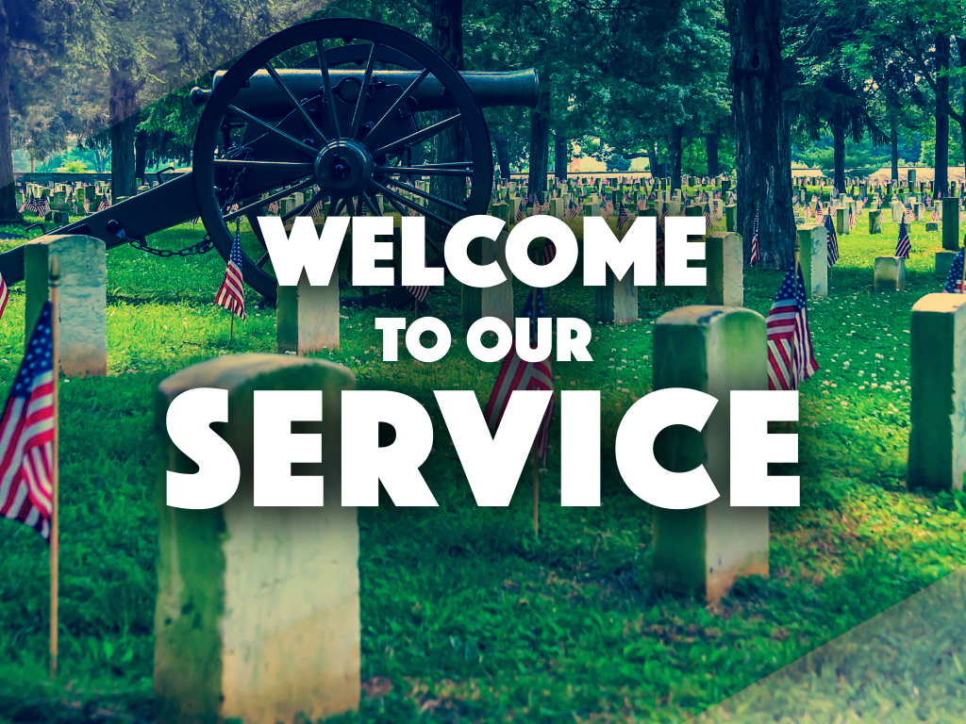
Enter in SILENCE Wait with REVERENCE
Worship from JOY

Slide 2
PRELUDE
WELCOME & ANNOUNCEMENTS
AFFIRMATION OF MISSION STATEMENT
CHORAL INTROIT: Chancel Choir
Our Mission Statement
As disciples of Jesus Christ, led by the Holy Spirit, we experience God’s unconditional love, and we witness to others by discovering and sharing our gifts.

Slide 3
* CALL TO WORSHIP:
L: May God be merciful and bless us.
P: May God’s face smile with favor on us.
L: May the nations praise you, O God.
P: Yes, may all the nations praise you.
L: Let the whole world sing for joy, because you govern the nations with justice.
P: And guide the people of the whole world. . . .

Slide 4
L: May the nations praise you, O God.
P: Yes, may all the nations praise you.
L: Then the earth will yield its harvests, and God, our God, will richly bless us.
P: With great joy and praise on our lips, let us worship God.

Slide 5
* HYMN OF PRAISE: No. 262 God of the Ages, Whose Almighty Hand
God of the ages, whose almighty hand
Leads forth in beauty all the starry band
Of shining worlds in splendor
through the skies,
Our grateful songs before
Thy throne arise.
. . .

Slide 6
Thy love divine hath led us in the past;
In this free land by Thee our lot is cast;
Be Thou our ruler, guardian,
guide and stay;
Thy Word our law, Thy paths
our chosen way.
. . .

Slide 7
From war’s alarms, from deadly pestilence,
Be Thy strong arm our ever sure defense;
Thy true religion in our hearts increase;
Thy bounteous goodness
nourish us in peace.
. . .

Slide 8
Refresh Thy people on their toilsome way,
Lead us from night to never-ending day;
Fill all our lives with love and grace divine,
And glory, laud, and praise be ever Thine.

Slide 9
PRAYER OF CONFESSION: In silence then in unison
Almighty and merciful God, author of covenants and Creator of all creation, in baptism you promise us forgiveness and lead us to your Promised Land. We confess, we are a detour kind of people. We get sidetracked and venture off on our own adventures, sometimes unconcerned about whether you are leading us. . . .

Slide 10
Forgive us when we cling to destructive habits and hold grudges and act less than welcoming and hospitable. Remind us again of your hospitable love and mercy. Make us new people that we may rise to a new life and live into your grace and truth; in Jesus’ name, we pray. Amen.

Slide 11
ASSURANCE OF CHRIST’S FORGIVENESS:
L: Friends—hear, believe, accept and live the good news of the gospel of Christ’s love.
P: In Jesus Christ, we are forgiven! Let us forgive one another.

Slide 12
* CELEBRATING CHRIST’S FORGIVENESS: Give Thanks (No. 647 GTG)
Give thanks with a grateful heart,
give thanks to the Holy One;
Give thanks, because we’re given
Jesus Christ the Son.
And now let the weak say, “we are strong”;
let the poor say,
“We are rich, because of what the
Lord has done for us!”
Give thanks.

Slide 13
* EXCHANGE OF CHRIST’S PEACE:
L: The peace of Christ be with you.
P: And also with you.
Welcome one another with Christ’s peace.

Slide 14
GIVING OF OUR GIFTS & OFFERTORY:
Our God has blessed us, so let us extend God’s Blessing as we present our Tithes and Offerings.
Thank you for being faithful stewards of your church family with your prayers, your time, talent, and your financial resources.
Contributions may also be made:
Electronically on the church website at fpcb-nj.org;
By reoccurring electronic withdrawal; or by
By mailing your offering to the church: P.O. Box 385, Blairstown, NJ.

Slide 15
* DOXOLOGY: No. 592 Praise God
Praise God, from whom all blessings flow;
Praise Him, all creatures here below;
Praise Him above, ye heavenly host;
Praise Father, Son, and Holy Ghost. Amen.
* PRAYER OF DEDICATION

Slide 16
DECLARING GOD‘S WORD
HEBREW SCRIPTURE: Deuteronomy 34: 1–6
Moses views the Promised Land and dies.
34 Then Moses went up from the plains of Moab to Mount Nebo, to the top of Pisgah, which is opposite Jericho, and the Lord showed him the whole land: Gilead as far as Dan, ² all Naphtali, the land of Ephraim and Manasseh, all the land of Judah as far as the Western Sea, ³ the Negeb, and the Plain—that is, the valley of Jericho, the city of palm trees—as far as Zoar. ⁴ The Lord said to him, . . .

Slide 17
“This is the land of which I swore to Abraham, to Isaac, and to Jacob, saying, ‘I will give it to your descendants.’ I have let you see it with your eyes, but you shall not cross over there.” ⁵ Then Moses, the servant of the Lord, died there in the land of Moab, at the Lord’s command. ⁶ He buried him in a valley in the land of Moab, opposite Beth-peor, but no one knows his burial place to this day.

Slide 18
NEW TESTAMENT READING: Revelation 21: 1–3, 10, 22:1–6 God creates the new heaven and new earth.
21 Then I saw a new heaven and a new earth, for the first heaven and the first earth had passed away, and the sea was no more. ² And I saw the holy city, the new Jerusalem, coming down out of heaven from God, prepared as a bride adorned for her husband. ³ And I heard a loud voice from the throne saying, . . .

Slide 19
“See, the home of God is among mortals. He will dwell with them; they will be his peoples, and God himself will be with them and be their God;
¹⁰ And in the spirit he carried me away to a great, high mountain and showed me the holy city Jerusalem coming down out of heaven from God. . . .

Slide 20
22 Then the angel showed me the river of the water of life, bright as crystal, flowing from the throne of God and of the Lamb ² through the middle of the street of the city. On either side of the river is the tree of life with its twelve kinds of fruit, producing its fruit each month, and the leaves of the tree are for the healing of the nations. ³ Nothing accursed will be found there any more. But the throne of God and of the Lamb will be in it, and his servants will worship him; ⁴ they will see his face, . . .

Slide 21
and his name will be on their foreheads. ⁵ And there will be no more night; they need no light of lamp or sun, for the Lord God will be their light, and they will reign forever and ever.
⁶ And he said to me, “These words are trustworthy and true, for the Lord, the God of the spirits of the prophets, has sent his angel to show his servants what must soon take place.”

Slide 22
GOSPEL LESSON: John 5:1–9
Much to the chagrined of the Pharisees, Jesus heals on the sabbath.
5 After this there was a festival of the Jews, and Jesus went up to Jerusalem.
² Now in Jerusalem by the Sheep Gate there is a pool, called in Hebrew Beth-zatha, which has five porticoes. ³ In these lay many ill, blind, lame, and paralyzed people. ⁵ One man was there who had been ill for thirty-eight years. . . .

Slide 23
⁶ When Jesus saw him lying there and knew that he had been there a long time, he said to him, “Do you want to be made well?” ⁷ The ill man answered him, “Sir, I have no one to put me into the pool when the water is stirred up, and while I am making my way someone else steps down ahead of me.” ⁸ Jesus said to him, “Stand up, take your mat and walk.” ⁹ At once the man was made well, and he took up his mat and began to walk.
Now that day was a Sabbath.

Slide 24
CHANCEL CHOIR ANTHEM:
Sing a Song of
Thanks and Joy
by Hal H. Hopson

Slide 25
PASTOR DAVID’S SERMON:
From Pisgah to the Promised Land

Slide 26
RESPONDING TO GOD’S WORD
* A LITANY FOR MEMORIAL DAY
L: Let us give thanks to God for the beauty, the bounty, and the blessing of this land with all its chartered liberties and opportunities given to us; for the awesome wonder of America.
P: We offer our thanks and praise, O God.
L: For elected leaders who serve us at the federal, the state and the local levels, for their aspirations and inspiration of upholding the ideals that perpetuate our nation’s story,
P: We offer our hearts in thankful praise, O God.
Cont’d.

Slide 27
L: For men and women, young and old, who bravely and boldly enlist in our nation’s armed services, placing their lives on the line in our country’s finest hour, and especially those who gave even their lives in service, defending freedom and faith.
P: We declare our thankful praise, O God.
L: Almighty God and merciful Father, as we remember these your servants, remembering with gratitude their courage and compassion, their heroic strength and valor, we also hold before you those who mourn them.
Cont’d.

Slide 28
All: Look upon your bereaved servants with divine and tender mercy. As we enjoy the freedoms that we do, may we remember with appreciation and gratitude the men and women who have fought and who have died, and who in their dying allow us to live freely and enjoy life abundantly. In Jesus’ name, we pray. Amen.

Slide 29
* HYMN: This Is My Song (No. 340, GTG vv. 1 & 3)
This is my song, O God of all the nations, a song of peace for lands afar and mine. This is my home, the country where my heart is; here are my hopes, my dreams,
my holy shrine;but other hearts in other lands are beating with hopes and dreams as true and
high as mine.

Slide 30
This is my prayer, O Lord of all earth’s kingdoms: they kingdom come;
on earth thy will be done. Let Christ be lifted up till all shall serve him, and hearts united learn to live as one. So hear my prayer, O God of all the nations: myself I give thee; let thy will be done.

Slide 31
PRAYER OF THANKSGIVING, OF THE PEOPLE, & THE LORD’S PRAYER
Our Father who art in heaven,
Hallowed be thy name.
Thy kingdom come, thy will be done;
On earth as it is in heaven.
Give us this day our daily bread;
And forgive us our debts,
As we forgive our debtors;
And lead us not into temptation,
But deliver us from evil,
For Thine is the kingdom
And the power and the glory, forever. Amen.

Slide 32
DEPARTING IN GOD’S NAME
* HYMN: No. 564 O Beautiful for Spacious Skies
O beautiful for spacious skies,
For amber waves of grain,
For purple mountain majesties
Above the fruited plain! America! America!
God shed His grace on thee,
And crown thy good with servanthood
From sea to shining sea!
. . .

Slide 33
O beautiful for pilgrim feet,
Whose stern, impassioned stress
A thoroughfare for freedom beat
Across the wilderness! America! America!
God mend thine every flaw,
Confirm thy soul in self-control,
Thy liberty in law!
. . .

Slide 34
O beautiful for heroes proved
In liberating strife,
Who more than self their country loved,
And mercy more than life!
America! America!
May God thy gold refine
Till all success be nobleness
And every gain divine.
. . .

Slide 35
O beautiful for patriot dream
That sees beyond the years
Thine alabaster cities gleam,
Undimmed by human tears! America! America!
God shed His grace on thee
And crown thy good with servanthood
From sea to shining sea!

Slide 36
* CHARGE TO THE PEOPLE & BENEDICTION
* CHORAL BENEDICTION
POSTLUDE
Our worship has ended—our Christian Witness begins!

