Slide 1
Enter in SILENCE
Wait with REVERENCE
Worship from JOY

Slide 2
PRELUDE
WELCOME & ANNOUNCEMENTS
AFFIRMATION OF MISSION STATEMENT
Our Mission Statement
As disciples of Jesus Christ, led by the Holy Spirit, we experience God’s unconditional love, and we witness to others by discovering and sharing our gifts.

Slide 3
* SONG OF PRAISE: Lord, Prepare Me (Sanctuary) No. 701 GTG
Lord, prepare me to be a sanctuary,
pure and holy, tried and true.
With thanksgiving, I’ll be a living sanctuary for you.

Slide 4
* CALL TO WORSHIP:
L: Praise the Lord!
P: Praise the Lord from the heavens! Praise God from the skies!
L: Praise God, sun and moon! Praise God, all you twinkling stars!
P: Praise the Lord from the earth, Praise him, all you twinkling stars!
. . .

Slide 5
L: Praise God, skies above. Praise God, vapors high above the clouds!
P: Let every created thing give praise to the Lord.
L: With great joy and praise on our lips, let us worship God.

Slide 6
* HYMN OF PRAISE: No. 455 All Creatures of Our God and King (vv. 1, 4–6)
All creatures of our God and King,
Lift up your voice and with us sing,
Alleluia! Alleluia!
Thou burning sun with golden beam,
Thou silver moon with softer gleam,
Alleluia! Alleluia!
Alleluia! Alleluia! Alleluia!
. . .
Cont’d.

Slide 7
Thou fertile earth, that day by day
Unfoldest blessings on our way,
O sing ye! Alleluia!
The flowers and fruits that in thee grow,
Let them God's glory also show!
Alleluia! Alleluia!
Alleluia! Alleluia! Alleluia!
. . .

Slide 8
And everyone of tender heart,
Forgiving others, take your part,
O sing ye! Alleluia!
Ye who long pain and sorrow bear,
Praise God and cast on God your care!
Alleluia! Alleluia!
Alleluia! Alleluia! Alleluia!
. . .

Slide 9
All creatures, your Creator bless,
And worship God in humbleness.
O sing ye! Alleluia!
Praise, praise the Father, praise the Son,
And praise the Spirit, Three in One!
Alleluia! Alleluia!
Alleluia! Alleluia! Alleluia!

Slide 10
PRAYER OF CONFESSION: In silence then in unison
God of sovereign love, in Jesus, your Son, you reveal to us the fullness of your gracious love. In Jesus, we witness and are witnesses of your immortal love. Yet, we can be blind to, even disenchanted with, Jesus’ obedient love. Our wills get in the way of his will for us.
. . .

Slide 11
Forgive our sins and humble our hearts. Align our reality with his reality. Help us to love another as Jesus first loved and forgave us. In the strong name of Jesus, we pray. Amen.

Slide 12
ASSURANCE OF CHRIST’S FORGIVENESS:
L: Infused with God’s creative and redemptive spirit, forgiven by Jesus, called to a life of kindness and compassion, to a life lived with humility and civility, know this:
P: In Jesus Christ, we are forgiven! Let us forgive one another.

Slide 13
* CELEBRATION OF CHRIST’S FORGIVENESS: No. 304 Jesus Loves Me v. 1
Jesus loves me! This I know,
For the Bible tells me so;
Little ones to Him belong;
They are weak, but He is strong.
Yes, Jesus loves me!
Yes, Jesus loves me!
Yes, Jesus loves me!
The Bible tells me so.

Slide 14
* EXCHANGE OF CHRIST’S PEACE:
L: The peace of Christ be with you.
P: And also with you.
Welcome one another with Christ’s peace.

Slide 15
GIVING OF OUR GIFTS & OFFERTORY:
Our God has blessed us, so let us extend God’s Blessing as we present our Tithes and Offerings.
Thank you for being faithful stewards of your church family with your prayers, your time, talent, and your financial resources.
Contributions may also be made:
Electronically on the church website at fpcb-nj.org;
By reoccurring electronic withdrawal; or by
By mailing your offering to the church: P.O. Box 385, Blairstown, NJ.

Slide 16
* DOXOLOGY: No. 592 Praise God
Praise God, from whom all blessings flow;
Praise Him, all creatures here below;
Praise Him above, ye heavenly host;
Praise Father, Son, and Holy Ghost. Amen.
* PRAYER OF DEDICATION

Slide 17
DECLARING GOD‘S WORD
NEW TESTAMENT READING: Acts 11: 1–18
Peter testifies to God’s expanding inclusive love.
11 Now the apostles and the brothers and sisters who were in Judea heard that the gentiles had also accepted the word of God. ² So when Peter went up to Jerusalem, the circumcised believers criticized him, ³ saying, “Why did you go to uncircumcised men and eat with them?” ⁴ Then Peter began to explain it to them, step by step, saying, ⁵ “I was in the city of Joppa praying, and in a trance I saw a vision. . . .

Slide 18
There was something like a large sheet coming down from heaven, being lowered by its four corners, and it came close to me. ⁶ As I looked at it closely I saw four-footed animals, beasts of prey, reptiles, and birds of the air. ⁷ I also heard a voice saying to me, ‘Get up, Peter; kill and eat.’ ⁸ But I replied, ‘By no means, Lord, for nothing profane or unclean has ever entered my mouth.’ ⁹ But a second time the voice answered from heaven, ‘What God has made clean, you must not call profane.’ . . .

Slide 19
¹⁰ This happened three times; then everything was pulled up again to heaven. ¹¹ At that very moment three men, sent to me from Caesarea, arrived at the house where we were. ¹² The Spirit told me to go with them and not to make a distinction between them and us. These six brothers also accompanied me, and we entered the man’s house. ¹³ He told us how he had seen the angel standing in his house and saying, ‘Send to Joppa and bring Simon, who is called Peter; . . .

Slide 20
¹⁴ he will give you a message by which you and your entire household will be saved.’ ¹⁵ And as I began to speak, the Holy Spirit fell upon them just as it had upon us at the beginning. ¹⁶ And I remembered the word of the Lord, how he had said, ‘John baptized with water, but you will be baptized with the Holy Spirit.’ ¹⁷ If then God gave them the same gift that he gave us when we believed in the Lord Jesus Christ, who was I that I could hinder God?” ¹⁸ When they heard this, they were silenced. . . .

Slide 21
And they praised God, saying, “Then God has given even to the gentiles the repentance that leads to life.”

Slide 22
GOSPEL LESSON: John 13: 31–35
Jesus commands us to love one another.
³¹ When he had gone out, Jesus said, “Now the Son of Man has been glorified, and God has been glorified in him. ³² If God has been glorified in him, God will also glorify him in himself and will glorify him at once. ³³ Little children, I am with you only a little longer. You will look for me, and as I said to the Jews so now I say to you, ‘Where I am going, you cannot come.’ . . .

Slide 23
³⁴ I give you a new commandment, that you love one another. Just as I have loved you, you also should love one another. ³⁵ By this everyone will know that you are my disciples, if you have love for one another.”

Slide 24
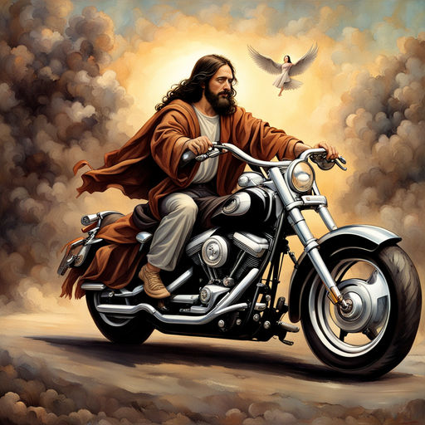
Elder Bill Olivier & Pastor David’s
SERMON:
CMA: Would Jesus Ride a Harley?

Slide 25
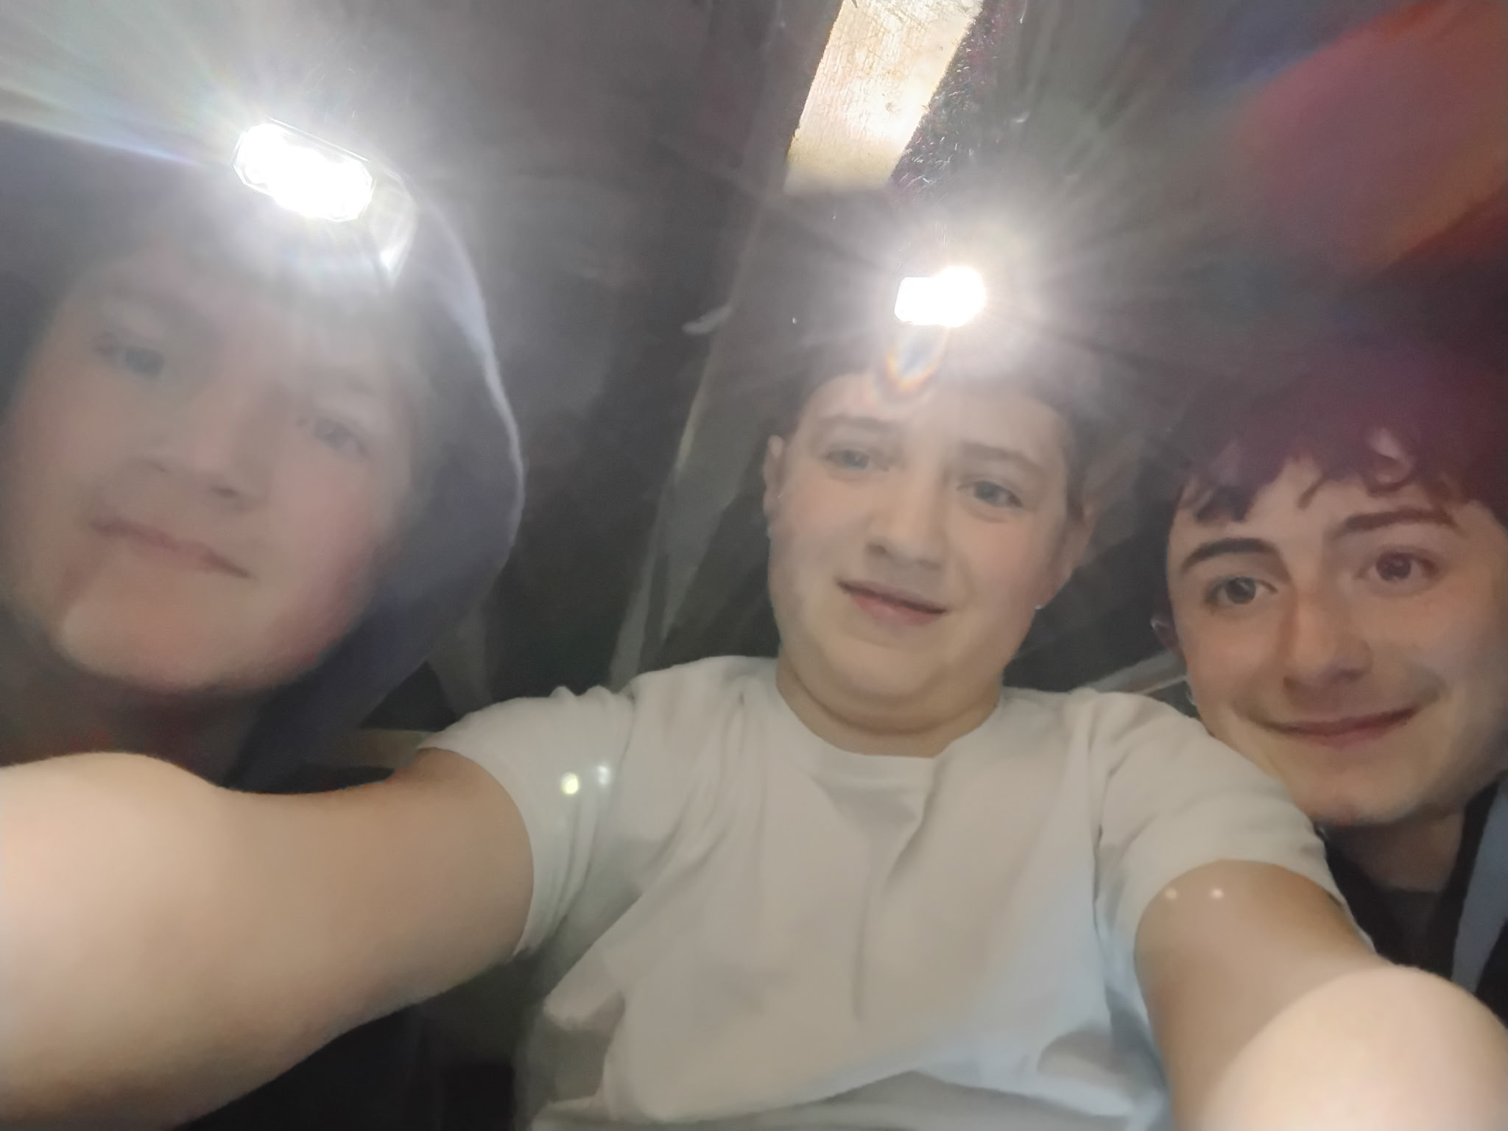

Slide 26
* AFFIRMATION OF FAITH: 1 Corinthians 13: 4–8a, 12–13
Love is patient; love is kind; love is not envious or boastful or arrogant or rude. It does not insist on its own way; it is not irritable or resentful; it does not rejoice in wrongdoing but rejoices in the truth. It bears all things, believes all things, hopes all things, endures all things.
. . .

Slide 27
Love never ends. For now, we see in a mirror, dimly, but then we will see face to face. Now I know only in part; then I will know fully, even as I have been fully known. And now faith, hope, and love abide, these three; and the greatest of these is love. Amen.

Slide 28
* HYMN: No. 367 Jesus, Jesu, Fill Us with Your Love (vv. 1, 2, 4)
Refrain:
Jesu, Jesu, Fill us with Your love,
Show us how to serve the neighbors we have from You.
Kneels at the feet of his friends,
Silently washes their feet,
Master who acts as a slave to them. (Refrain)

Slide 29
Neighbors are rich and poor,
Varied in color and race,
Neighbors are near and far away.
Jesu, Jesu, Fill us with Your love,
Show us how to serve the neighbors we have from You.
. . .

Slide 30
Loving puts us on our knees,
Serving as though we are slaves,
This is the way we should live with You. Jesu, Jesu, Fill us with Your love,
Show us how to serve the neighbors we have from You.

Slide 31
PRAYER OF THANKSGIVING, OF THE PEOPLE, & THE LORD’S PRAYER
Our Father who art in heaven,
Hallowed be thy name.
Thy kingdom come, thy will be done;
On earth as it is in heaven.
Give us this day our daily bread;
And forgive us our debts,
As we forgive our debtors;
And lead us not into temptation,
But deliver us from evil,
For Thine is the kingdom
And the power and the glory, forever. Amen.

Slide 32
DEPARTING IN GOD’S NAME
* HYMN: We Are One in the Spirit (No. 300, GTG)
(They’ll Know We Are Christians by Our Love)
We are one in the Spirit, we are one in the Lord, we are one in the Spirit,
we are one in the Lord, and we pray that all unity may one day be restored:
And they’ll know we are Christians
by our love, by our love; Yes, they’ll know
we are Christians by our love. . . .

Slide 33
We will walk with each other;
we will walk hand in hand;
We will walk with each other;
we will walk hand in hand,
and together we’ll spread the news
that God is in our land:
And they’ll know we are Christians
by our love, by our love; Yes, they’ll know
we are Christians by our love. . . .

Slide 34
We will work with each other,
we will work side by side,
we will work with each other,
we will work side by side,
and we‘ll guard human dignity
and save human pride:
And they’ll know we are Christians
by our love, by our love; Yes, they’ll know
we are Christians by our love. . . .

Slide 35
All praise to the Father whom all things come and all praise to Christ Jesus,
God’s only Son, and all praise to the Spirit,
who makes us one:
And they’ll know we are Christians
By our love, by our love;
Yes, they’ll know we are Christians
by our love.

Slide 36
* CHARGE TO THE PEOPLE & BENEDICTION
* CONGREGATIONAL BENEDICTION: “May the Lord, Mighty God”
(sung to the tune of “Edelweiss”) No. 596
May the Lord, mighty God,
bless and keep you forever.
Grant you peace, perfect peace,
courage in every endeavor.
Lift up your eyes and see God’s face,
full of grace forever;
May the Lord, mighty God,
bless and keep you forever.

Slide 37
POSTLUDE
Our worship has ended—our Christian Witness begins!

