Slide 1
Enter in SILENCE
Wait with REVERENCE
Worship from JOY

Slide 3
PRELUDE
WELCOME & ANNOUNCEMENTS
AFFIRMATION OF MISSION STATEMENT
CHORAL INTROIT
Our Mission Statement
As disciples of Jesus Christ, led by the Holy Spirit, we experience God’s unconditional love, and we witness to others by discovering and sharing our gifts.

Slide 4
* CALL TO WORSHIP:
L: The Lord is my Shepherd I shall not want.
P: The Lord maketh me to lie down in green pastures; the Lord leadeth me beside the still waters.
L: The Lord restoreth my soul; the Lord leadeth me in the paths of righteousness for his name’s sake.
P: Yea, though I walk through the valley of the shadow of death,
. . .

Slide 5
L: I will fear no evil, for thou art with me. Thy rod and thy staff they comfort me.
P: Thou preparest a table before me in the presence of my enemies; thou anointest my head with oil. My cup runneth over.
L: Surely, goodness and mercy shall follow me all the days of my life.
P: And I shall dwell in the house of the Lord forever. . . .

Slide 6
L: With joyful hearts, grateful lives, praise and hope that fills the air, let us worship God.

Slide 7
* HYMN OF PRAISE: No. 464 Joyful, Joyful, We Adore Thee
Joyful, joyful, we adore Thee,
God of glory, Lord of love;
Hearts unfold like flowers before Thee,
Opening to the sun above.
Melt the clouds of sin and sadness;
Drive the gloom of doubt away;
Giver of immortal gladness,
Fill us with the light of day.
. . .

Slide 8
All Thy works with joy surround Thee,
Earth and heaven reflect Thy rays,
Stars and angels sing around Thee,
Center of unbroken praise.
Field and forest, vale and mountain,
Flowery meadow, flashing sea,
Chanting bird and flowing fountain,
Call us to rejoice in Thee.
. . .

Slide 9
Mortals, join the happy chorus
Which the morning stars began;
Love divine is reigning o’er us,
Joining all in heaven's plan.
Ever singing, march we onward,
Victors in the midst of strife,
Joyful music leads us sunward
In the triumph song of life.

Slide 10
PRAYER OF CONFESSION: In silence then in unison
O God, our Shepherd, we confess that we can be like sheep. We get lost and sometimes even do things that are wrong. We forget that your love is for all people, especially when our love is selective, misinformed, and often misguided. . . .

Slide 11
Forgive our sins. Fill our hearts with Christ’s love and remind us once again that Jesus died for all. In Jesus’ precious name, we pray. Amen.

Slide 12
ASSURANCE OF CHRIST’S FORGIVENESS:
L: Here are words we may trust . . . believe the good news of the gospel and live into Christ’s joy.
P: In Jesus Christ, we are forgiven! Let us forgive one another.

Slide 13
* CELEBRATION OF CHRIST’S FORGIVENESS: No. 304 Jesus Loves Me v. 1
Jesus loves me! This I know,
For the Bible tells me so;
Little ones to Him belong;
They are weak, but He is strong.
Yes, Jesus loves me!
Yes, Jesus loves me!
Yes, Jesus loves me!
The Bible tells me so.

Slide 14
* EXCHANGE OF CHRIST’S PEACE:
L: The peace of Christ be with you.
P: And also with you.
Welcome one another with Christ’s peace.

Slide 15
GIVING OF OUR GIFTS & OFFERTORY:
Our God has blessed us, so let us extend God’s Blessing as we present our Tithes and Offerings.
Thank you for being faithful stewards of your church family with your prayers, your time, talent, and your financial resources.
Contributions may also be made:
Electronically on the church website at fpcb-nj.org;
By reoccurring electronic withdrawal; or by
By mailing your offering to the church: P.O. Box 385, Blairstown, NJ.

Slide 16
* DOXOLOGY: No. 577 Glory Be to the Father
Glory be to the Father, and the Son,
and the Holy Ghost;
As it was in the beginning, is now, and
ever shall be, world without end. Amen.
As it was in the beginning, is now, and ever shall be, world without end. Amen.
Amen. Amen. Amen. Amen.
Amen. Amen. Amen.
* PRAYER OF DEDICATION

Slide 17
DECLARING GOD‘S WORD
PSALTER READING: Psalm 78: 1–7
The psalmist says tell and teach God’s story.
¹ Give ear, O my people, to my teaching; incline your ears to the words of my mouth. ² I will open my mouth in a parable; I will utter dark sayings from of old, ³ things that we have heard and known, that our ancestors have told us. ⁴ We will not hide them from their children; we will tell to the coming generation . . .

Slide 18
the glorious deeds of the Lord and his might and the wonders that he has done.
⁵ He established a decree in Jacob and appointed a law in Israel, which he commanded our ancestors to teach to their children, ⁶ that the next generation might know them, the children yet unborn, and rise up and tell them to their children, . . .

Slide 19
⁷ so that they should set their hope in God, and not forget the works of God, but keep his commandments;

Slide 20
GOSPEL LESSON: John 10: 1–18, 25–30
Jesus is our Good Shepherd.
10 “Very truly, I tell you, anyone who does not enter the sheepfold by the gate but climbs in by another way is a thief and a bandit. ² The one who enters by the gate is the shepherd of the sheep. ³ The gatekeeper opens the gate for him, and the sheep hear his voice. He calls his own sheep by name and leads them out. ⁴ When he has brought out all his own, he goes ahead of them, . . .

Slide 21
and the sheep follow him because they know his voice. ⁵ They will not follow a stranger, but they will run from him because they do not know the voice of strangers.” ⁶ Jesus used this figure of speech with them, but they did not understand what he was saying to them.
⁷ So again Jesus said to them, “Very truly, I tell you, I am the gate for the sheep. ⁸ All who came before me are thieves and bandits, . . .

Slide 22
but the sheep did not listen to them. ⁹ I am the gate. Whoever enters by me will be saved and will come in and go out and find pasture. ¹⁰ The thief comes only to steal and kill and destroy. I came that they may have life and have it abundantly.
¹¹ “I am the good shepherd. The good shepherd lays down his life for the sheep. ¹² The hired hand, who is not the shepherd and does not own the sheep, sees the wolf coming and leaves the sheep and runs away, and the wolf snatches them . . .

Slide 23
and scatters them. ¹³ The hired hand runs away because a hired hand does not care for the sheep. ¹⁴ I am the good shepherd. I know my own, and my own know me, ¹⁵ just as the Father knows me, and I know the Father. And I lay down my life for the sheep. ¹⁶ I have other sheep that do not belong to this fold. I must bring them also, and they will listen to my voice. So there will be one flock, one shepherd. . . .

Slide 24
¹⁷ For this reason the Father loves me, because I lay down my life in order to take it up again. ¹⁸ No one takes it from me, but I lay it down of my own accord. I have power to lay it down, and I have power to take it up again. I have received this command from my Father.”
²⁵ Jesus answered, “I have told you, and you do not believe. The works that I do in my Father’s name testify to me, ²⁶ but you do not believe because you do not belong to my sheep. . . .

Slide 25
²⁷ My sheep hear my voice. I know them, and they follow me. ²⁸ I give them eternal life, and they will never perish. No one will snatch them out of my hand. ²⁹ My Father, in regard to what he has given me, is greater than all, and no one can snatch them out of the Father’s hand. ³⁰ The Father and I are one.”

Slide 26
CHANCEL CHOIR ANTHEM:
“The Flowers of My World’
by Loonis McGlohon

Slide 27
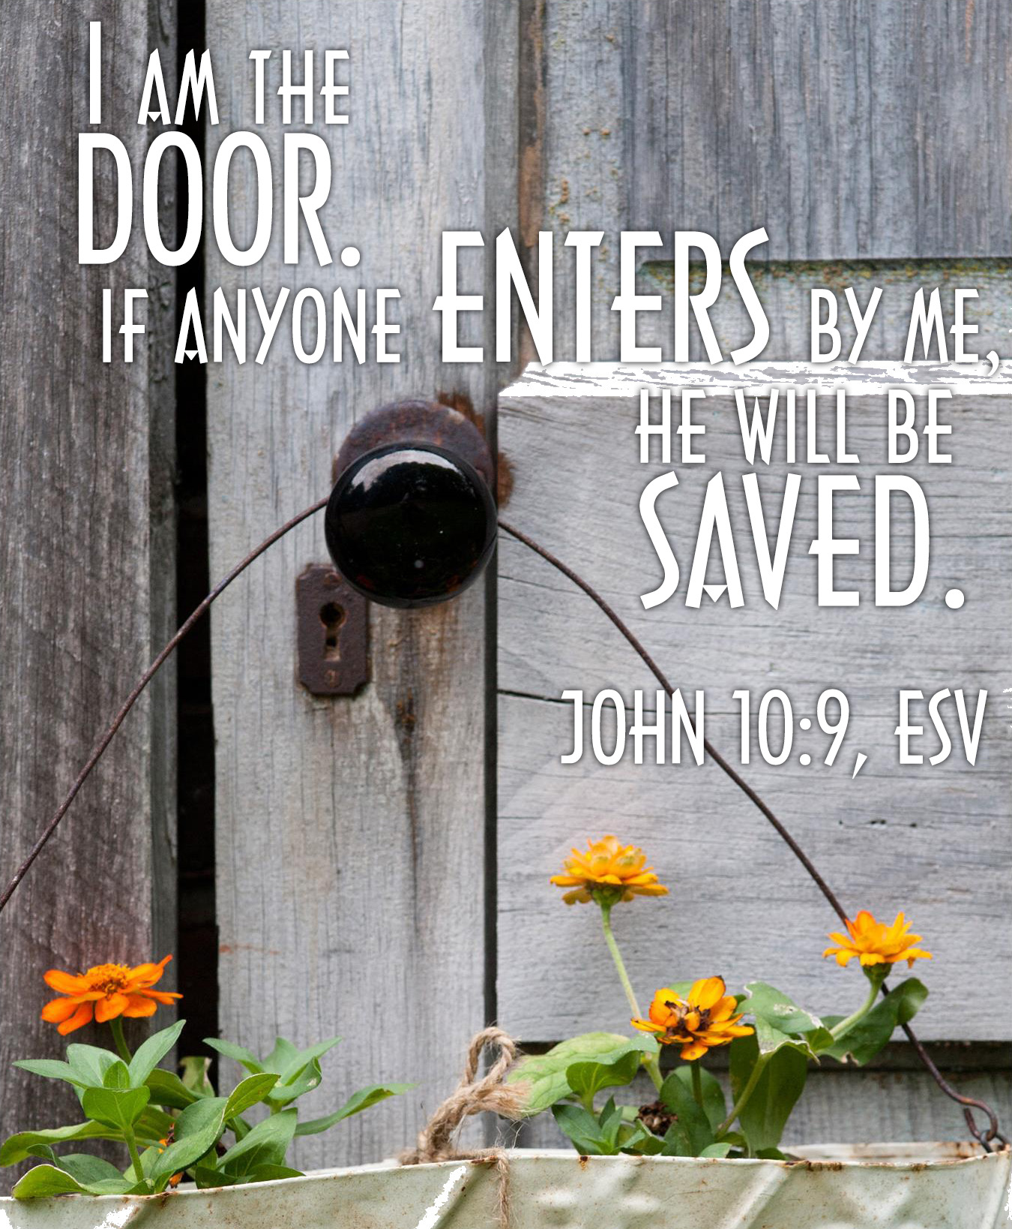
Pastor David’s
MEDITATION
with the Confirmands
Telling & Teaching Jesus’ Story

Slide 28
SERvice OF CONFIRMATION COMMISSIONING
Levi Charles Arena
(Sponsor: Frank Wilson)
Owen Joseph Besser
(Sponsor: Gail Weber)
Ryan Burke
(Sponsor: Don Nicholls)

Slide 29
INVITATION OF DISCIPLESHIP:
Hear the words of Jesus:
All authority in heaven and on earth has been given to me.
Go therefore and make disciples of all nations, baptizing them in the name of the Father and of the Son and of the Holy Spirit, and teaching them to obey everything that I have commanded you. And remember, I am with you always, to the end of the age.
Matthew 28: 18–20

Slide 30
Hear also these words from the Holy Scripture:
There is one body and one Spirit, just as you were called to the one hope of your calling, one Lord, one faith, one baptism, one God and Father of all, who is above all and through all and in all.
Ephesians 4: 4–6
As many of you as were baptized into Christ have clothed yourselves with Christ. There is no longer Jew or Greek, there is no longer slave or free, there is no longer male and female; for all of you are one in Christ Jesus.
Galatians 3: 27–28

Slide 31
PRESENTATION OF THE CONFIRMANDS:
Levi, Owen, and Ryan, having been received into membership by the Session of the First Presbyterian Church, Blairstown, NJ May 8, 2025 and presented for Confirmation May 11, 2025 now desire to profess their faith publicly and to accept greater responsibility in the life of the church and God’s mission in the world.
We rejoice that you now desire to declare your faith and to share with us in our common ministry. In Baptism you were joined to Christ and made members of his body. In the community of the people of God you have learned of God’s purposed for you and for all creation. You have been nurtured at the table of our Lord and called to witness to the gospel of Jesus Christ.
I ask that you come forward with your shepherds.

Slide 32
QUESTION OF INTENT
TO THE CONFIRMANDS: Pastor David Harvey
Q. To you, confirmands, relying on God’s grace, do you promise to live the Christian life and to continue learning about the faith throughout your life’s journey?
I do.
QUESTION OF INTENT TO THE PARENTS & SHEPHERDS:
To shepherds and parents, do you promise through prayer and example to support and encourage your son or daughter as they grow and mature in the Christian faith?
A. I do.

Slide 33
QUESTION OF INTENT TO THE CONGREGATION:
Q. To the members of this church, do you promise to guide and nurture our young people by word and deed, with love and prayer, encouraging them to know Christ, to follow Christ, and to grow in faith in Christ through the fellowship of this church family?
A. We do.

Slide 34
AFFIRMATION OF CHRIST’S LOVE
& PROFESSION OF FAITH (to the Confirmands):
Q. Trusting in the gracious mercy of God, do you affirm God’s love and claim on your life?
A. I do.
Q. Who is your Lord and Savior?
A. Jesus Christ is my Lord and Savior.
Q. Will you be Christ’s faithful disciples, obeying his Word and showing his love?
A. I will, with Christ’s help.
Q. Will you devote yourself to the church’s teaching and fellowship, to the breaking of bread and the prayers?
A. I will, with Christ’s help.

Slide 35
* AFFIRMATION OF FAITH: The Apostles’ Creed
L. Let us confess the faith of our baptism, as we affirm our faith reciting the Apostles’ Creed.
I believe in God, the Father almighty, creator of heaven and earth. I believe in Jesus Christ, God’s only Son, our Lord, who was born of the Virgin Mary, suffered under Pontius Pilate, was crucified, died, and was buried. . . .

Slide 36
On the third day, he rose again; he ascended into Heaven, he is seated at the right hand of the Father, and he will come again to judge the living and the dead.
I believe in the Holy Spirit, the holy Catholic Church, the communion of saints, the forgiveness of sins, the resurrection of the body, and the life everlasting. Amen.

Slide 37
PRESENTATION OF THE CONFIRMANDS BY THE SHEPHERDS
READING OF THEIR STATEMENT OF FAITH: The Confirmands
CONFIRMAND | SHEPHERD
Levi Charles Arena Owen Joseph Besser Ryan Burke | Frank Wilson Gail Weber Don Nicholls

Slide 38
THE CONFIRMATION:
L: By professing your faith publicly, you have expressed your intention to grow in the covenant God made with you in your baptism. May the Spirit continue to strengthen and sustain you in the worship and mission of the church.
P: Amen. Alleluia!

Slide 39
PRAYER FOR THE CONFIRMANDS: Pastor David Harvey
CHARGE TO THE CONFIRMATION CLASS:
Ephesians 4: 1–3
I, therefore, the prisoner in the Lord, beg you to lead a life worthy of the calling to which you have been called, with all humility and gentleness, with patience, bearing with one another in love, making every effort to maintain the unity of the Spirit in the bond of peace.

Slide 40
THE WELCOME:
L. Levi, Owen, and Ryan in your baptism . . . please stand and affirm your commitment to these children of God.
* P: With joy and thanksgiving, we welcome and confirm Levi, Owen, and Ryan as ambassadors of the gospel at First Presbyterian Church, Blairstown, New Jersey. . . .

Slide 41
We promise to love, encourage, care and share the good news of the gospel with them that they may learn to live the truth of Christ’s love. Amen.

Slide 42
* HYMN OF CONFIRMATION: For Everyone Born, vv. 1, 3–5 No. 769, GTG
For everyone born, a place at the table,
for everyone born, clean water and bread,
a shelter, a space, a safe place for growing,
for everyone born, a star overhead,
and God will delight when we are creators of justice and joy, compassion and peace:
yes, God will delight when we are creators of justice, . . . justice and joy!
. . .

Slide 43
For young and for old, a place at the table,
a voice to be heard, a part in the song,
the hands of a child in hands that are wrinkled, for young and for old, the right to belong, and God will delight when we are creators of justice and joy, compassion and peace: yes, God will delight when we are creators of justice, . . . justice and joy!
. . .

Slide 44
For just and unjust, a place at the table,
abuser, abused, with need to forgive,
in anger, in hurt, a mindset of mercy,
for just and unjust, a new way to live,
and God will delight when we are creators of justice and joy, compassion and peace:
yes, God will delight when we are creators of justice, . . . justice and joy!
. . .

Slide 45
For everyone born, a place at the table,
to live without fear, and simply to be,
to work, to speak out,
to witness and worship,
for everyone born, the right to be free,
and God will delight when we are creators of justice and joy, compassion and peace:
yes, God will delight when we are creators of justice, . . . justice and joy!

Slide 46
PRAYER OF THANKSGIVING, OF THE PEOPLE, & THE LORD’S PRAYER
Our Father who art in heaven,
Hallowed be thy name.
Thy kingdom come, thy will be done;
On earth as it is in heaven.
Give us this day our daily bread;
And forgive us our debts,
As we forgive our debtors;
And lead us not into temptation,
But deliver us from evil,
For Thine is the kingdom
And the power and the glory, forever. Amen.

Slide 47
DEPARTING IN GOD’S NAME
* HYMN: No. 375 Lord, of All Good
Lord of all good, our gifts we bring to You.
Use them Your holy purpose to fulfill.
Tokens of love and pledges brought anew.
That our whole life is offered to Your will.
. . .

Slide 48
We give our minds
to understand Your ways.
Hands, eyes, and voice to serve
Your great design,
Heart with the flame
of Your own love ablaze,
Till for Your glory all our powers combine.
. . .

Slide 49
Father, whose bounty all creation shows;
Christ, by whose willing sacrifice we live;
Spirit, from whom all life in fullness flows:
To You with grave hearts
ourselves we give.

Slide 50
* CHARGE TO THE PEOPLE & BENEDICTION
* CHORAL BENEDICTION
POSTLUDE
Our worship has ended —
our Christian Witness begins!
for refreshments & fellowship.

