Slide 1
Enter in SILENCE
Wait with REVERENCE
Worship from JOY

Slide 2
PRELUDE
WELCOME & ANNOUNCEMENTS
AFFIRMATION OF MISSION STATEMENT
Our Mission Statement
As disciples of Jesus Christ, led by the Holy Spirit, we experience God’s unconditional love, and we witness to others by discovering and sharing our gifts.

Slide 3
CHORAL INTROIT Hosanna, Loud, Hosanna

Slide 4
* CALL TO WORSHIP:
L: Give thanks to the Lord, for God is good.
P: It is better to take refuge in the Lord than to trust in humans.
L: It is better to take refuge in the Lord than to trust in princes.
P: Blessed in the one who comes to us in the name of the Lord. From the house of the Lord we bless you.
L: With great praise on our lips and with profound joy in our hearts, let us worship God.

Slide 5
* HYMN OF PRAISE: No. 88 All Glory, Laud and Honor vv. 1, 3, 4
Refrain:
All glory, laud and honor
To Thee, Redeemer, King!
To whom the lips of children
Made sweet hosannas ring.
Cont’d.

Slide 6
Thou art the King of Israel,
Thou David’s royal Son,
Who in the Lord’s name comest,
The King and blessèd One.
All glory, laud and honor
To Thee, Redeemer, King!
To whom the lips of children
Made sweet hosannas ring. Cont’d.

Slide 7
To Thee, before Thy passion,
They sang their hymns of praise;
To Thee, now high exalted,
Our melody we raise.
All glory, laud and honor
To Thee, Redeemer, King!
To whom the lips of children
Made sweet hosannas ring. Cont’d.

Slide 8
Thou didst accept their praises;
Accept the prayers we bring,
Who in all good delightest,
Thou good and gracious King!
All glory, laud and honor
To Thee, Redeemer, King!
To whom the lips of children
Made sweet hosannas ring.

Slide 9
PRAYER OF CONFESSION: In silence then unison
Triumphant Lord, we rejoice in your entry into the world and into our lives! Forgive us when our hearts fail to worship you in spirit and in truth, when our minds fail to fully adore you, and when our lips which often praise you also deny and decry you. . . .

Slide 10
Lord, Jesus, forgive our capricious discipleship. Grace our hearts this day with your humiliation. Restore within us the joy of your salvation; make us mindful of your saving work which attests to your glorification that we, like the disciples, may joyfully sing your praises and proclaim your Lordship unto all the earth. In your name of Jesus, we pray. Amen.

Slide 11
ASSURANCE OF CHRIST’S FORGIVENESS:
L: Blessed is the one who has done for us what we could never do for ourselves, dying for us that his love may live abundantly and eternally in us.
P: In Jesus Christ, we are forgiven! Let us forgive one another.

Slide 12
* CELEBRATING CHRIST’S FORGIVENESS: No. 370 v. 1
Just as I am, without one plea
But that Thy blood was shed for me,
And that Thou bidst me come to Thee,
O Lamb of God, I come, I come!

Slide 13
* EXCHANGE OF CHRIST’S PEACE:
L: The peace of Christ be with you.
P: And also with you.
Welcome one another with the peace of Christ.

Slide 14
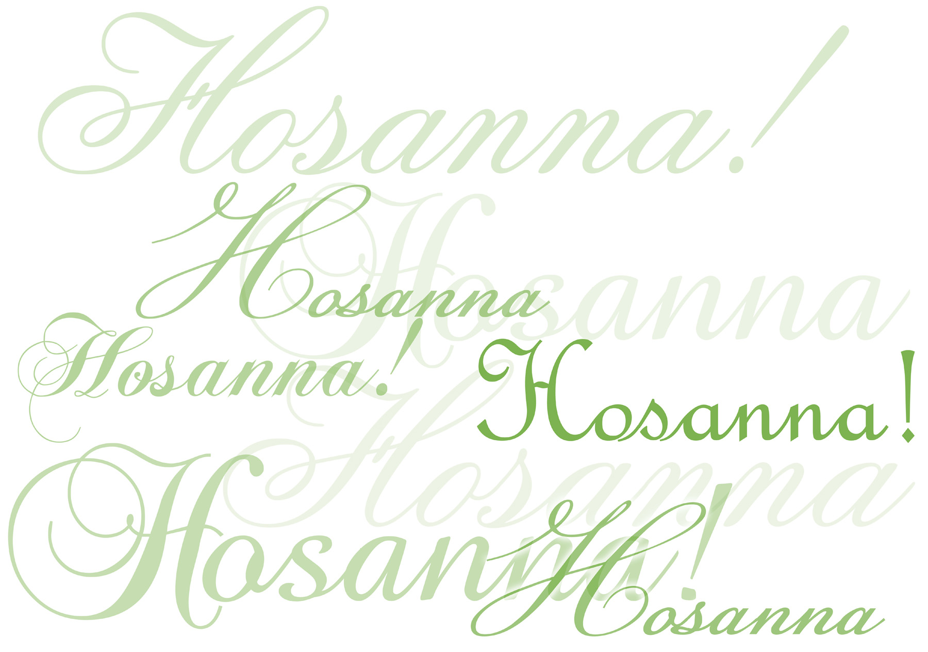
CHILDREN’S MESSAGE:

Slide 15
~ Children may go downstairs for Sunday School ~
GIVING OF OUR GIFTS & OFFERTORY:
Our God has blessed us, so let us extend God’s Blessing as we present our Tithes and Offerings.
Thank you for being faithful stewards of your church family with your prayers, your time, talent, and your financial resources.
Contributions may also be made:
Electronically on the church website at fpcb-nj.org;
By reoccurring electronic withdrawal; or by
By mailing your offering to the church: P.O. Box 385, Blairstown, NJ.

Slide 16
* DOXOLOGY: No. 577 Glory Be to the Father
Glory be to the Father, and the Son and the Holy Ghost. As it was in the beginning, is now and ever shall be,
world without end. Amen.
As it was in the beginning, is now and ever shall be, world without end. Amen. Amen. Amen. Amen. Amen.
Amen. Amen. Amen
.
* PRAYER OF DEDICATION

Slide 17
DECLARING GOD‘S WORD
PSALTER READING: Psalm 31: 9–16, 23–24 (responsive)
Love and trust in the Lord.
⁹ Be gracious to me, O Lord, for I am in distress; my eye wastes away from grief, my soul and body also.
¹⁰ For my life is spent with sorrow and my years with sighing; my strength fails because of my misery, and my bones waste away. . . .

Slide 18
¹¹ I am the scorn of all my adversaries, a horror to my neighbors, an object of dread to my acquaintances; those who see me in the street flee from me.
¹² I have passed out of mind like one who is dead; I have become like a broken vessel.
¹³ For I hear the whispering of many—terror all around!—as they scheme together against me, as they plot to take my life.
¹⁴ But I trust in you, O Lord; I say, “You are my God.” . . .

Slide 19
¹⁵ My times are in your hand; deliver me from the hand of my enemies and persecutors.
¹⁶ Let your face shine upon your servant; save me in your steadfast love.
²³ Love the Lord, all you his saints. The Lord preserves the faithful but abundantly repays the one who acts haughtily.
²⁴ Be of good courage, and he shall strengthen your heart, all ye that hope in the Lord.

Slide 20
GOSPEL LESSON: Luke 19: 28–44
Jesus ride into and weeps over Jerusalem.
²⁸ After he had said this, he went on ahead, going up to Jerusalem.
²⁹ When he had come near Bethphage and Bethany, at the place called the Mount of Olives, he sent two of the disciples, ³⁰ saying, “Go into the village ahead of you, and as you enter it you will find tied there a colt that has never been ridden. Untie it and bring it here. ³¹ If anyone asks you, ‘Why are you untying it?’ just say this, . . .

Slide 21
‘The Lord needs it.’ ” ³² So those who were sent departed and found it as he had told them. ³³ As they were untying the colt, its owners asked them, “Why are you untying the colt?” ³⁴ They said, “The Lord needs it.” ³⁵ Then they brought it to Jesus, and after throwing their cloaks on the colt, they set Jesus on it. ³⁶ As he rode along, people kept spreading their cloaks on the road. ³⁷ Now as he was approaching the path down from the Mount of Olives, the whole multitude of the disciples . . .

Slide 22
began to praise God joyfully with a loud voice for all the deeds of power that they had seen, ³⁸ saying,
“Blessed is the king who comes in the name of the Lord! Peace in heaven, and glory in the highest heaven!”
³⁹ Some of the Pharisees in the crowd said to him, “Teacher, order your disciples to stop.” . . .

Slide 23
⁴⁰ He answered, “I tell you, if these were silent, the stones would shout out.”
⁴¹ As he came near and saw the city, he wept over it, ⁴² saying, “If you, even you, had only recognized on this day the things that make for peace! But now they are hidden from your eyes. ⁴³ Indeed, the days will come upon you when your enemies will set up ramparts around you and surround you and hem you in on every side. . . .

Slide 24
⁴⁴ They will crush you to the ground, you and your children within you, and they will not leave within you one stone upon another, because you did not recognize the time of your visitation from God.”

Slide 25
ANTHEM with the Chancel Choir:
King Triumphant
by Ruth Elaine Schram

Slide 26
Pastor David’s
SERMON
Human Cries

Slide 27
* HYMN: Take On the Mind of Christ the Lord Tune 335 vv. 1 & 2
Take on the mind of Christ the Lord
who gave up life in heaven above;
he chose to suffer with the poor
to make us rich in God's great love.
Take on the way he chose to live;
he put ambition to the side.
He gave us all he had to give,
then on a cross he humbly died.

Slide 28
RESPONDING TO GOD’S WORD
* AFFIRMATION OF FAITH: Philippians 2: 4–11
Let each of you look not to your own interests, but to the interests of others. Let the same mind be in you that was in Christ Jesus, who, though he was in the form of God, did not regard equality with God as something to be exploited, but emptied himself, taking the form of a slave, . . .

Slide 29
being born in human likeness. And being found in human form, he humbled himself and became obedient to the point of death—even death on a cross.
Therefore, God also highly exalted him and gave him the name that is above every name, so that at the name of Jesus every knee should bend, in heaven and on earth and . . .

Slide 30
and under the earth, and every tongue should confess that Jesus Christ is Lord, to the glory of God the Father. Amen

Slide 31
* HYMN: Take On the Mind of Christ the Lord Tune 335 vv. 3 & 4
Take on the gift that we've been given:
God raised him up in love to reign;
and now he's Lord of earth and heaven.
Accept this gift and praise his name.
One day the world will sing and pray
and Christ will always be adored.
Until that great and glorious day,
take on the mind of Christ the Lord.

Slide 32
“Hosanna in the highest!”
That ancient song we sing,
For Christ is our Redeemer,
The Lord of heaven our King.
O may we ever praise Him
With heart and life and voice,
And in His blissful presence
Eternally rejoice.

Slide 33
PRAYER OF THANKSGIVING, OF THE PEOPLE, & THE LORD’S PRAYER
Our Father who art in heaven,
Hallowed be thy name.
Thy kingdom come, thy will be done;
On earth as it is in heaven.
Give us this day our daily bread;
And forgive us our debts,
As we forgive our debtors;
And lead us not into temptation,
But deliver us from evil,
For Thine is the kingdom
And the power and the glory, forever. Amen.

Slide 34
DEPARTING IN GOD’S NAME
* HYMN: No. 91 Ride On, Ride on in Majesty! vv. 1 & 4
Ride on! ride on in majesty!
Hark! all the tribes Hosanna cry;
O Savior meek, pursue Thy road
With palms and scattered garments strowed.
Cont’d.

Slide 35
Ride on! ride on, in majesty!
In lowly pomp ride on to die;
Bow Thy meek head to mortal pain,
Then take, O God, Thy power, and reign.

Slide 36
* CHARGE TO THE PEOPLE & BENEDICTION
* CHORAL BENEDICTION
POSTLUDE
Our worship has ended—our Christian Witness begins!

