Slide 1
Enter in SILENCE
Wait with REVERENCE
Worship from JOY

Slide 2
PRELUDE
WELCOME & ANNOUNCEMENTS
AFFIRMATION OF MISSION STATEMENT
Our Mission Statement
As disciples of Jesus Christ, led by the Holy Spirit, we experience God’s unconditional love, and we witness to others by discovering and sharing our gifts.

Slide 3
* SONG OF PRAISE: Lord, Prepare Me (Sanctuary) No. 701 GTG
Lord, prepare me to be a sanctuary,
pure and holy, tried and true.
With thanksgiving, I’ll be a living sanctuary for you.

Slide 4
* CALL TO WORSHIP:
L: Great is our God!
P: And greatly to be praised!
L: God has stretched the heavens above us
P: And filled the earth with every good thing for us to share!
L: In God, we have our being—all of us!
P: By God’s gracious love, we live, move, and have our being. . . .

Slide 5
L: In Christ’s name, we gather and give our praise!
P: With gratitude and gladness, let us worship God.

Slide 6
* HYMN OF PRAISE: When Mary Poured a Rich Perfume vv. 1 & 3
© 2001 by Carolyn Winfrey Gillette (Tune 288)
When Mary poured a rich perfume
on Jesus' weary feet,
Her caring filled that humble room;
the fragrance there was sweet.
But full of anger, Judas said,
"We could have used this more!
Why was her gift not sold instead
and given to the poor?“
. . .

Slide 7
O Christ, what can your people bring
to show you thanks and love?
You need no fragrant offering;
for now you reign above.
Since there will never cease to be the poor throughout the land,
May we, your church, serve faithfully
by offering them our hand.

Slide 8
PRAYER OF CONFESSION: (in silence then unison)
O God, with humble and contrite hearts, we confess that we do not always let our better selves be seen (or heard), and sometimes we are more proud of our self-accomplishments than what you accomplish in us. Too casually we seek your forgiveness, and yet we know our need for it. . . .

Slide 9
Forgive us of our sin and our sins. Reconcile us to you and restore us to the joy of your salvation. This we ask in Jesus’ name and for his glory. Amen.

Slide 10
ASSURANCE OF CHRIST’S FORGIVENESS:
L: By grace we have been saved through faith. This is not our own doing. It is the gift of God for all people. Let us forgive, accept, and love one another as freely as God in Christ has forgiven, accepted, and loved us all:
P: In Jesus Christ, we are forgiven! Let us forgive one another.

Slide 11
* CELEBRATION OF CHRIST’S FORGIVENESS: No. 370 vv. 1 & 4
Just as I am, without one plea
But that Thy blood was shed for me,
And that Thou bidst me come to Thee,
O Lamb of God, I come, I come!
Just as I am, Thy love unknown
Has broken every barrier down;
Now, to be Thine, yea, Thine alone,
O Lamb of God, I come, I come!

Slide 12
* EXCHANGE OF CHRIST’S PEACE:
L: The peace of Christ be with you.
P: And also with you.
Welcome one another with the peace of Christ.
~ Children may go downstairs for Sunday School ~

Slide 13
GIVING OF OUR GIFTS & OFFERTORY:
Our God has blessed us, so let us extend God’s Blessing as we present our Tithes and Offerings.
Thank you for being faithful stewards of your church family with your prayers, your time, talent, and your financial resources.
Contributions may also be made:
Electronically on the church website at fpcb-nj.org;
By reoccurring electronic withdrawal; or by
By mailing your offering to the church: P.O. Box 385, Blairstown, NJ.

Slide 14
* DOXOLOGY: No. 591
Praise God, from whom all blessings flow;
Praise Christ, all people here below;
Praise, Holy Spirit evermore;
Praise Triune God, whom we adore. Amen.
* PRAYER OF DEDICATION

Slide 15
DECLARING GOD‘S WORD
EPISTLE READING: Philippians 3: 4b–14
St. Paul says to ‘press on to know Christ.’
^{4b} If anyone else has reason to be confident in the flesh, I have more: ⁵ circumcised on the eighth day, a member of the people of Israel, of the tribe of Benjamin, a Hebrew born of Hebrews; as to the law, a Pharisee; ⁶ as to zeal, a persecutor of the church; as to righteousness under the law, blameless. . . .

Slide 16
⁷ Yet whatever gains I had, these I have come to regard as loss because of Christ. ⁸ More than that, I regard everything as loss because of the surpassing value of knowing Christ Jesus my Lord. For his sake I have suffered the loss of all things, and I regard them as rubbish, in order that I may gain Christ ⁹ and be found in him, not having a righteousness of my own that comes from the law but one that comes through faith in Christ, the righteousness from God based on faith. . . .

Slide 17
¹⁰ I want to know Christ and the power of his resurrection and the sharing of his sufferings by becoming like him in his death, ¹¹ if somehow I may attain the resurrection from the dead.
¹² Not that I have already obtained this or have already reached the goal, but I press on to lay hold of that for which Christ has laid hold of me. ¹³ Brothers and sisters, I do not consider that I have laid hold of it, but one thing I have laid hold of: . . .

Slide 18
forgetting what lies behind and straining forward to what lies ahead, ¹⁴ I press on toward the goal, toward the prize of the heavenly call of God in Christ Jesus.

Slide 19
GOSPEL READING: John 12: 1–8
Mary anoints Jesus’ feet with oil.
12 Six days before the Passover Jesus came to Bethany, the home of Lazarus, whom he had raised from the dead. ² There they gave a dinner for him. Martha served, and Lazarus was one of those reclining with him. ³ Mary took a pound of costly perfume made of pure nard, anointed Jesus’s feet, and wiped them with her hair. The house was filled with the fragrance of the perfume. . . .

Slide 20
⁴ But Judas Iscariot, one of his disciples (the one who was about to betray him), said, ⁵ “Why was this perfume not sold for three hundred denarii and the money given to the poor?” ⁶ (He said this not because he cared about the poor but because he was a thief; he kept the common purse and used to steal what was put into it.) ⁷ Jesus said, “Leave her alone. She bought it so that she might keep it for the day of my burial. ⁸ You always have the poor with you, but you do not always have me.”

Slide 21
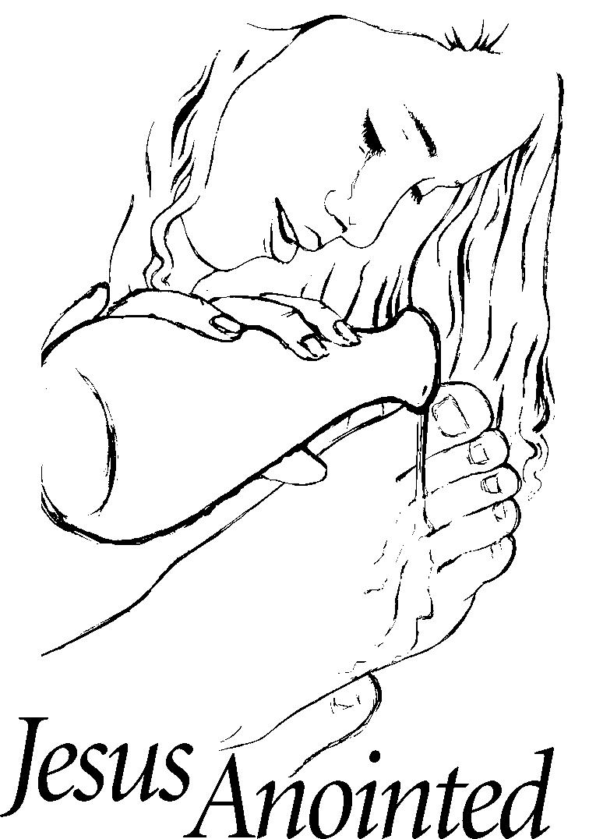
Pastor David’s
SERMON:
An Odd Faith

Slide 22
RESPONDING TO GOD’S WORD
* AFFIRMATION OF FAITH: The Contemporary Apostles’ Creed
I believe in God who places joy in our souls, dancing in our toes and songs in our hearts. I believe God wanted gladness to flow like a river, so the Good Lord created a bountiful earth with plenty for all to share. . . .

Slide 23
I believe in Jesus, who turned water into wine, partied with outcasts and sinners, and touched the broken so they could leap and dance. I believe Jesus opened the doors and set an extra place so we could feast.
I believe in the Holy Spirit, who prompts us to smile, who sends us invitations to come and dine, . . .

Slide 24
who nudges us to openness and tenderness. I believe the Spirit is present every time we gather to break bread and stirs within us the desire to live joyfully, to walk hopefully, and to enact justice boldly. Forever, I will live in the embrace of God and be a witness to Christ’s resurrection joy. Amen.

Slide 25
* COMMUNION HYMN: For Everyone Born, vv. 1, 3–5 No. 769, GTG
For everyone born, a place at the table,
for everyone born, clean water and bread,
a shelter, a space, a safe place for growing,
for everyone born, a star overhead,
and God will delight when we are creators of justice and joy, compassion and peace:
yes, God will delight when we are creators of justice, . . . justice and joy!
. . .

Slide 26
For young and for old, a place at the table,
a voice to be heard, a part in the song,
the hands of a child in hands that are wrinkled, for young and for old, the right to belong, and God will delight when we are creators of justice and joy, compassion and peace: yes, God will delight when we are creators of justice, . . . justice and joy!
. . .

Slide 27
For just and unjust, a place at the table,
abuser, abused, with need to forgive,
in anger, in hurt, a mindset of mercy,
for just and unjust, a new way to live,
and God will delight when we are creators of justice and joy, compassion and peace:
yes, God will delight when we are creators of justice, . . . justice and joy!
. . .

Slide 28
For everyone born, a place at the table,
to live without fear, and simply to be,
to work, to speak out,
to witness and worship,
for everyone born, the right to be free,
and God will delight when we are creators of justice and joy, compassion and peace:
yes, God will delight when we are creators of justice, . . . justice and joy!

Slide 31
SACRAMENT OF HOLY COMMUNION
INVITATION TO THE LORD’S TABLE:
L: Friends, this is the joyful feast of the people of God!
P: People will come from east and west, and from north and south, and sit at the table in the kingdom of God.

Slide 32
L: Behold, how good and pleasant it is when brothers and sisters dwell in unity.
P: God sent the whole world God’s only Son. Since God loved us so much, we too, should love one another.
L: This is the Lord’s Table. Our Savior invites all who are truly sorry for their sins and would humbly put their trust in him to come to the feast which he has prepared. Listen to the gracious words of our Savior Jesus Christ:

Slide 33
“Come to me, all you that are weary and are carrying heavy burdens, and I will give you rest. Take my yoke upon you, and learn from me; for I am gentle and humble in heart, and you will find rest for your souls. For my yoke is easy, and my burden is light.“ Matthew 11: 28–30
”This is indeed the will of my Father, that all who see the Son and believe in him may have eternal life, and I will raise them up on the last day.” John 6: 40
“Behold, I stand at the door and knock; if those who hear my voice open the door, I will come in to them and eat with them, and they with me.” Revelation 3: 20

Slide 34
L: The Lord be with you.
P: And with your spirit.
L: Lift up your hearts.
P: We lift them to the Lord.
L: Let us give thanks to the Lord our God.
P: It is right to give God our thanks and praise.

Slide 35
PRAYER OF THANKSGIVING, PRAYERS OF THE PEOPLE, & THE LORD’S PRAYER:
L: Holy Lord . . . as we pray together:
God of all people, send your Holy Spirit upon us, that eating the bread we may remember Jesus’ suffering and his desire to identify with those who suffer; and that drinking the cup, we may remember his blood poured out for us and the suffering of the world. . . .

Slide 36
Grant us grace and wisdom to live as the Body of Christ in the world today, united in Jesus’ name, and deeply devoted to Christ's ministry of compassion, kindness and justice. We pray this as Jesus taught us, singing . . .

Slide 37
Our Father who art in heaven,
Hallowed be thy name.
Thy kingdom come, thy will be done;
On earth as it is in heaven.
Give us this day our daily bread;
And forgive us our debts,
As we forgive our debtors;
And lead us not into temptation,
But deliver us from evil,
For Thine is the kingdom
And the power and the glory, forever. Amen.

Slide 39
OFFERING OF THE ELEMENTS:
Approach the Table,
receive the bread, take the cup,
and return to your pew.

Slide 40
SHARING THE BREAD:
Jesus said, “I am the bread of life. Whoever comes to me will never be hungry...” (Jn. 6:35a)
Let us eat this bread in remembrance of Christ and may the spirit that is in him be in us also.
DRINKING THE CUP:
Jesus said, “I am the vine, you are the branches, apart from him, we can do nothing.”
Drink this cup in remembrance of Christ and may the spirit in which he died be our Spirit.

Slide 41
COMMUNION BLESSING:
L: Let us give thanks to the Lord our God.
Through Christ, in Christ, with Christ, in the unity of the Holy Spirit, all glory and honor, dominion and power are yours, Lord Jesus, now and forever more. Amen.

Slide 42
so that we may live in your world, knowing that it is indeed your world; in Jesus’ name, we pray. Amen.

Slide 43
DEPARTING IN GOD’S NAME
* HYMN: No. 144 Alleluia! Sing to Jesus! vv. 1 & 4
Alleluia! Sing to Jesus!
His the scepter, His the throne.
Alleluia! His the triumph,
His the victory alone!
Hark! the songs of peaceful Zion
Thunder like a mighty flood;
Jesus out of every nation
Hath redeemed us by His blood. . . .

Slide 44
Alleluia! King eternal,
Thee the Lord of lords we own;
Alleluia! born of Mary,
Earth Thy footstool, heaven Thy throne.
Thou within the veil hast entered,
Robed in flesh our great High Priest;
Thou on earth both priest and victim
In the Eucharistic feast.

Slide 45
* CHARGE TO THE PEOPLE & BENEDICTION
* CONGREGATIONAL BENEDICTION: “May the Lord, Mighty God”
(sung to the tune of “Edelweiss”) No. 596
May the Lord, mighty God,
bless and keep you forever.
Grant you peace, perfect peace,
courage in every endeavor.
Lift up your eyes and see God’s face,
full of grace forever;
May the Lord, mighty God,
bless and keep you forever.

Slide 46
POSTLUDE
Our worship has ended—our Christian Witness begins!

