Slide 1
Enter in SILENCE
Wait with REVERENCE
Worship from JOY

Slide 2
PRELUDE
WELCOME & ANNOUNCEMENTS
AFFIRMATION OF MISSION STATEMENT
CHORAL INTROIT
Our Mission Statement
As disciples of Jesus Christ, led by the Holy Spirit, we experience God’s unconditional love, and we witness to others by discovering and sharing our gifts.

Slide 3
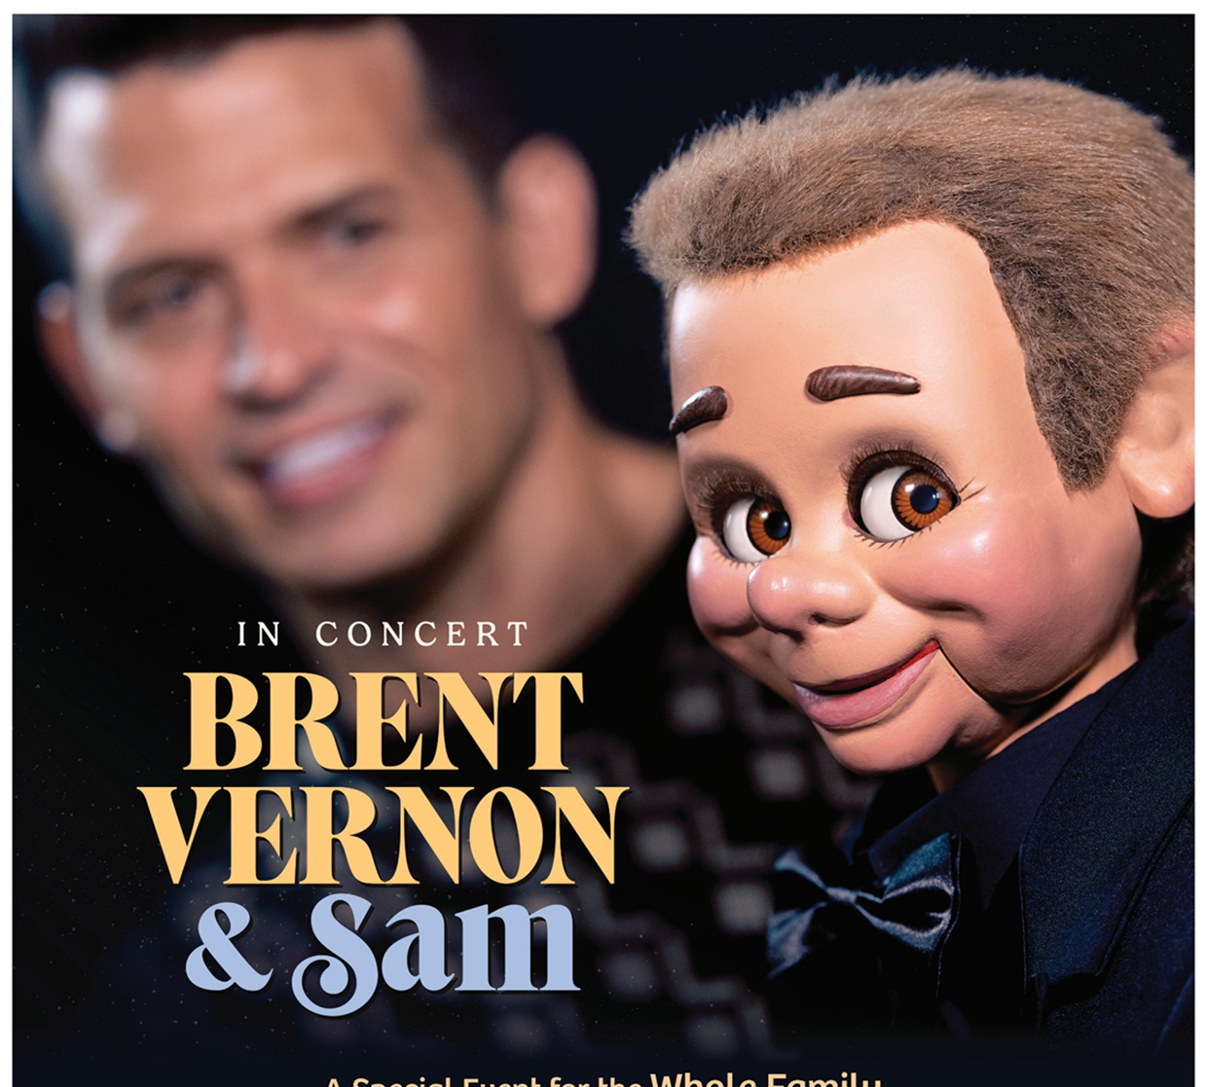
In Concert – Bret Vernon & Sam:
Friday, Apr.4 at 6:30

Slide 4
* CALL TO WORSHIP:
L: Count yourself lucky, how happy we must be.
P: God gives us a fresh start; our slate is wiped clean.
L: Don’t be ornery like a horse or a mule, creatures which need a bit and bridle to stay on track. God-deniers are always in trouble.
P: God-deniers find themselves eating slop with the pigs.
. . .

Slide 5
L: God-affirmed experience God’s love every time they turn around.
P: Celebrate God! Sing together—everyone! All you honest hearts, raise the roof!
L: With great gratitude and gladness, let us worship God.

Slide 6
* HYMN OF PRAISE: No. 476 O Worship the King! vv. 3 & 5
The earth with its store
of wonders untold,
Almighty, Thy power hath founded of old;
Hath stablished it fast by a changeless decree, and round it hath cast,
like a mantle, the sea.
. . .

Slide 7
Frail children of dust, and feeble as frail,
In Thee do we trust, nor find Thee to fail;
Thy mercies how tender,
how firm to the end,
Our maker, defender, redeemer,
and friend.

Slide 8
PRAYER OF CONFESSION: In silence then in unison
God, our Redeemer and our Friend, you welcome us with unbounded love and mercy, with the unbounded love and mercy of a parent for a lost child. Help us when we turn from your safekeeping. Watch over us when we wander into the wilderness of the lost country. Awaken us when we lose our senses. . . .

Slide 9
Forgive our sin that we may return heart, mind, body, and soul to you, encounter your mercy anew, and receive from you the joy of salvation upon our return to you. This we ask even as we turn our eyes towards the cross of Jesus who, lifted up from the earth for our sake, forgives the sins of the world. Amen.

Slide 10
ASSURANCE OF CHRIST’S FORGIVENESS:
L: Friends in Christ, happy are those . . . and restored to God.
P: In Jesus Christ, we are forgiven! Let us forgive one another.

Slide 11
* CELEBRATION OF CHRIST’S FORGIVENESS: No. 370 v. 1
Just as I Am, Without One Plea
Just as I am, without one plea
But that Thy blood was shed for me,
And that Thou bidst me come to Thee,
O Lamb of God, I come, I come!

Slide 12
* EXCHANGE OF CHRIST’S PEACE:
L: The peace of Christ be with you.
P: And also with you.
Welcome one another with Christ’s peace.

Slide 13
GIVING OF OUR GIFTS & OFFERTORY:
Our God has blessed us, so let us extend God’s Blessing as we present our Tithes and Offerings.
Thank you for being faithful stewards of your church family with your prayers, your time, talent, and your financial resources.
Contributions may also be made:
Electronically on the church website at fpcb-nj.org;
By reoccurring electronic withdrawal; or by
By mailing your offering to the church: P.O. Box 385, Blairstown, NJ.

Slide 14
* DOXOLOGY: No. 428 v. 1
We Give Thee but Thine Own
We give Thee but Thine own;
what-e’ er the gift may be;
All that we have is Thine alone,
A trust, O Lord from Thee.
* PRAYER OF DEDICATION

Slide 15
DECLARING GOD‘S WORD
EPISTLE LESSON: 2 Corinthians 5: 16–21
We are ambassadors of reconciliation.
¹⁶ From now on, therefore, we regard no one from a human point of view; even though we once knew Christ from a human point of view, we no longer know him in that way. ¹⁷ So if anyone is in Christ, there is a new creation: everything old has passed away; look, new things have come into being! ¹⁸ All this is from God, . . .

Slide 16
who reconciled us to himself through Christ and has given us the ministry of reconciliation; ¹⁹ that is, in Christ God was reconciling the world to himself, not counting their trespasses against them, and entrusting the message of reconciliation to us. ²⁰ So we are ambassadors for Christ, since God is making his appeal through us; we entreat you on behalf of Christ: be reconciled to God. ²¹ For our sake God made the one who knew no sin to be sin, so that in him we might become the righteousness of God.

Slide 17
² I urge Euodia and I urge Syntyche to be of the same mind in the Lord. ³ Yes, and I ask you also, my loyal companion, help these women, for they have struggled beside me in the work of the gospel, together with Clement and the rest of my coworkers, whose names are in the book of life.
⁴ Rejoice in the Lord always; again I will say, Rejoice.

Slide 18
GOSPEL LESSON: Luke 15: 1–3, 11b–32
A lost family experiences the salvation of God.
15 Now all the tax collectors and sinners were coming near to listen to him. ² And the Pharisees and the scribes were grumbling and saying, “This fellow welcomes sinners and eats with them.”
³ So he told them this parable:
. . .

Slide 19
“There was a man who had two sons. ¹² The younger of them said to his father, ‘Father, give me the share of the wealth that will belong to me.’ So he divided his assets between them. ¹³ A few days later the younger son gathered all he had and traveled to a distant region, and there he squandered his wealth in dissolute living. ¹⁴ When he had spent everything, a severe famine took place throughout that region, and he began to be in need. . . .

Slide 20
¹⁵ So he went and hired himself out to one of the citizens of that region, who sent him to his fields to feed the pigs. ¹⁶ He would gladly have filled his stomach with the pods that the pigs were eating, and no one gave him anything. ¹⁷ But when he came to his senses he said, ‘How many of my father’s hired hands have bread enough and to spare, but here I am dying of hunger! ¹⁸ I will get up and go to my father, and I will say to him, . . .

Slide 21
“Father, I have sinned against heaven and before you; ¹⁹ I am no longer worthy to be called your son; treat me like one of your hired hands.” ’ ²⁰ So he set off and went to his father. But while he was still far off, his father saw him and was filled with compassion; he ran and put his arms around him and kissed him. ²¹ Then the son said to him, ‘Father, I have sinned against heaven and before you; I am no longer worthy to be called your son.’ ²² But the father said to his slaves, . . .

Slide 22
‘Quickly, bring out a robe—the best one—and put it on him; put a ring on his finger and sandals on his feet. ²³ And get the fatted calf and kill it, and let us eat and celebrate, ²⁴ for this son of mine was dead and is alive again; he was lost and is found!’ And they began to celebrate.
²⁵ “Now his elder son was in the field, and as he came and approached the house, he heard music and dancing. . . .

Slide 23
²⁶ He called one of the slaves and asked what was going on. ²⁷ He replied, ‘Your brother has come, and your father has killed the fatted calf because he has got him back safe and sound.’ ²⁸ Then he became angry and refused to go in. His father came out and began to plead with him. ²⁹ But he answered his father, ‘Listen! For all these years I have been working like a slave for you, and I have never disobeyed your command, . . .

Slide 24
yet you have never given me even a young goat so that I might celebrate with my friends. ³⁰ But when this son of yours came back, who has devoured your assets with prostitutes, you killed the fatted calf for him!’ ³¹ Then the father said to him, ‘Son, you are always with me, and all that is mine is yours. ³² But we had to celebrate and rejoice, because this brother of yours was dead and has come to life; he was lost and has been found.’ ”

Slide 25
ANTHEM with the Chancel Choir:
“Come Bless the Lord”
by Robert Lau

Slide 26
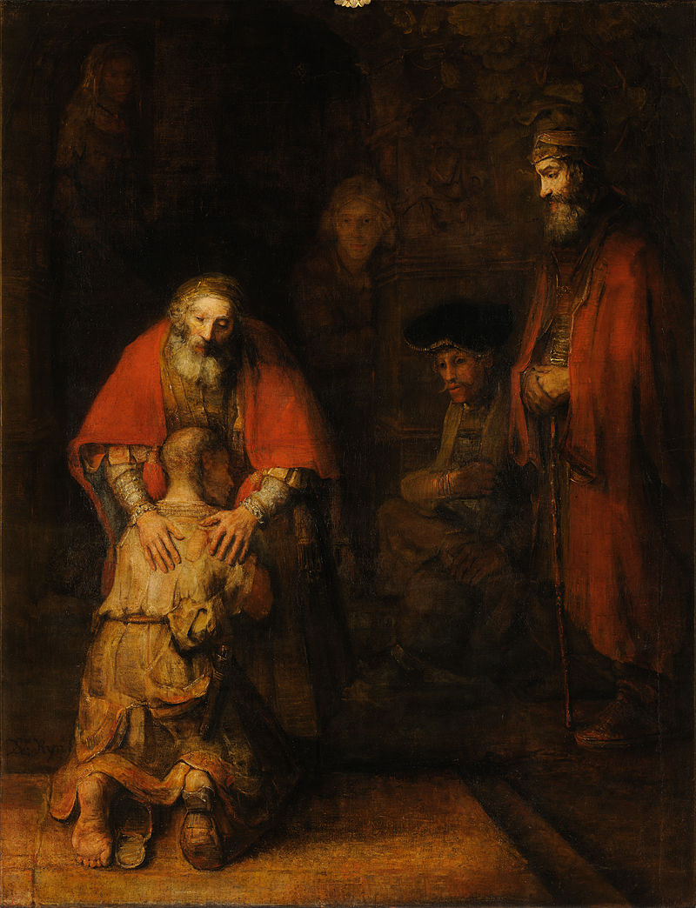
Paster David’s
SERMON
“Speaking of Sin”

Slide 27
* AFFIRMATION OF FAITH: A Brief Statement of Faith, 1990
We trust in God, whom Jesus called Abba, Father. In sovereign love God created the world good and makes everyone equally in God’s image, male and female, of every race and people, to live in one community. But we rebel against God; we hide from our Creator . . . we deserve God’s condemnation. . . .

Slide 28
Yet God acts with justice and mercy to redeem creation. In everlasting love, the God of Abraham and Sarah chose a Covenant people to bless all families of the earth. Loving us still God makes us heirs of the Covenant. Like a mother will not forsake her nursing child, like a father who runs to welcome the prodigal home, God is faithful still. . . .

Slide 29
In gratitude to God, empowered by the Spirit, we strive to serve Christ in our daily tasks and to live holy and joyful lives, even as we watch for God’s new heaven and new earth, praying, “Come, Lord Jesus!” Amen.

Slide 30
* HYMN: No. 355 Hear the Good News of Salvation
Hear the good news of salvation:
Jesus died to show God’s love.
Such great kindness! Such great mercy!
Come to us from heaven above.
Jesus Christ, how much I love You!
Jesus Christ, You save from sin!
How I love You! Look upon me.
Love me still and cleanse within.
. . .

Slide 31
All the sins I have committed
To my Saviour now I bring.
I bow down with ears of anguish;
Christ forgives and so I sing:
Jesus Christ, how much I love You!
Jesus Christ, You save from sin!
How I love You! Look upon me.
Love me still and cleanse within.

Slide 32
PRAYER OF THANKSGIVING, OF THE PEOPLE, & THE LORD’S PRAYER
Our Father who art in heaven,
Hallowed be thy name.
Thy kingdom come, thy will be done;
On earth as it is in heaven.
Give us this day our daily bread;
And forgive us our debts,
As we forgive our debtors;
And lead us not into temptation,
But deliver us from evil,
For Thine is the kingdom
And the power and the glory, forever. Amen.

Slide 33
DEPARTING IN GOD’S NAME
* HYMN: No. 302 I Danced in the Morning vv. 1, 3–5
I danced in the morning
when the world was begun,
And I danced in the moon
and the stars and the sun,
And I came down from heaven
and I danced on the earth;
At Bethlehem I had My birth.
. . .

Slide 34
Dance, then, wherever you may be:
I am the Lord of the Dance, said He,
And I’ll lead you all,
wherever you may be,
And I’ll lead you all
in the dance said He.
. . .

Slide 35
I danced on the Sabbath
and I cured the lame;
The holy people said it was a shame.
They whipped and they stripped
and they hung Me high,
And left Me there on a cross to die.
. . .

Slide 36
Dance, then, wherever you may be:
I am the Lord of the Dance, said He,
And I’ll lead you all,
wherever you may be,
And I’ll lead you all
in the dance said He.
. . .

Slide 37
I danced on a Friday when
the sky turned black;
It's hard to dance with the devil
on your back; They buried my body
and they thought I'd gone,
But I am the dance, and I still go on.
. . .

Slide 38
Dance, then, wherever you may be:
I am the Lord of the Dance, said He,
And I’ll lead you all,
wherever you may be,
And I’ll lead you all
in the dance said He.
. . .

Slide 39
They cut me down and I leap up high
I am the life that will never, never die;
I’ll live in you if you’ll live in Me:
I am the Lord of the Dance said He.
. . .

Slide 40
Dance, then, wherever you may be:
I am the Lord of the Dance, said He,
And I’ll lead you all,
wherever you may be,
And I’ll lead you all
in the dance said He.

Slide 41
* CHARGE TO THE PEOPLE & BENEDICTION
* CHORAL BENEDICTION
POSTLUDE
Our worship has ended —
our Christian Witness begins!
for refreshments & fellowship.

