Slide 1
Enter in SILENCE
Wait with REVERENCE
Worship from JOY

Slide 2
PRELUDE
WELCOME & ANNOUNCEMENTS
AFFIRMATION OF MISSION STATEMENT
CHORAL INTROIT
Our Mission Statement
As disciples of Jesus Christ, led by the Holy Spirit, we experience God’s unconditional love, and we witness to others by discovering and sharing our gifts.

Slide 3
* CALL TO WORSHIP:
L: Trust in the Lord, and do good;
P: Commit our way to the Lord, trust in the Lord, and the Lord will act.
L: Be still before the Lord and wait patiently for God.
P: Salvation of the righteous is from the Lord, our refuge in time of trouble. . .

Slide 4
L: Blessed are those who take refuge in God, our redeemer.
P: With great gratitude and gladness, let us worship God.

Slide 5
* HYMN OF PRAISE: No. 455 All Creatures of Our God and King
All creatures of our God and King,
Lift up your voice and with us sing,
Alleluia! Alleluia!
Thou burning sun with golden beam,
Thou silver moon with softer gleam,
Alleluia! Alleluia!
Alleluia! Alleluia! Alleluia!
. . .
Cont’d.

Slide 6
Thou fertile earth, that day by day
Unfoldest blessings on our way,
O sing ye! Alleluia!
The flowers and fruits that in thee grow,
Let them God's glory also show!
Alleluia! Alleluia!
Alleluia! Alleluia! Alleluia!
. . .

Slide 7
And everyone of tender heart,
Forgiving others, take your part,
O sing ye! Alleluia!
Ye who long pain and sorrow bear,
Praise God and cast on God your care!
Alleluia! Alleluia!
Alleluia! Alleluia! Alleluia!
. . .

Slide 8
All creatures, your Creator bless,
And worship God in humbleness.
O sing ye! Alleluia!
Praise, praise the Father, praise the Son,
And praise the Spirit, Three in One!
Alleluia! Alleluia!
Alleluia! Alleluia! Alleluia!

Slide 9
PRAYER OF CONFESSION: In silence then in unison
Merciful God, you see us as we are and know our inmost thoughts. We confess that we are unworthy of your gracious care. When we have failed to seek or do your will or failed to treat one another as we would want to be treated, Lord, in your mercy, forgive our sins. . . .

Slide 10
Free us from a past we cannot change; open us to a future in which we can be changed; and grant us the wisdom to live as faithful children of your grace and truth; through Jesus, your Son, our Savior. Amen.

Slide 11
ASSURANCE OF CHRIST’S FORGIVENESS:
L: Graced with the creative . . . first freely loved and forgiven us.
P: In Jesus Christ, we are forgiven! Let us forgive one another.

Slide 12
* CELEBRATION OF CHRIST’S FORGIVENESS: (No. 582, GTG)
Glory to God, whose goodness
shines on me, and to the Son,
whose grace has pardoned me,
and to the Spirit,
whose love has set me free.
As it was in the beginning,
is now and ever shall be. Amen.

Slide 13
* EXCHANGE OF CHRIST’S PEACE:
Pastor: The peace of Christ be with you.
People: And also with you.
Welcome one another with Christ’s peace.

Slide 14
GIVING OF OUR GIFTS & OFFERTORY:
Our God has blessed us, so let us extend God’s Blessing as we present our Tithes and Offerings.
Thank you for being faithful stewards of your church family with your prayers, your time, talent, and your financial resources.
Contributions may also be made:
Electronically on the church website at fpcb-nj.org;
By reoccurring electronic withdrawal; or by
By mailing your offering to the church: P.O. Box 385, Blairstown, NJ.

Slide 15
* DOXOLOGY: No. 591
Praise God, from whom all blessings flow;
Praise Christ, all people here below;
Praise, Holy Spirit evermore;
Praise Triune God, whom we adore. Amen.
* PRAYER OF DEDICATION

Slide 16
DECLARING GOD‘S WORD
HEBREW LESSON: Genesis 45: 3–11, 15
Joseph forgives his brothers.
³ Joseph said to his brothers, “I am Joseph. Is my father still alive?” But his brothers could not answer him, so dismayed were they at his presence.
⁴ Then Joseph said to his brothers, “Come closer to me.” And they came closer. He said, “I am your brother, Joseph, whom you sold into Egypt. . . .

Slide 17
⁵ And now do not be distressed or angry with yourselves because you sold me here, for God sent me before you to preserve life. ⁶ For the famine has been in the land these two years, and there are five more years in which there will be neither plowing nor harvest. ⁷ God sent me before you to preserve for you a remnant on earth and to keep alive for you many survivors. ⁸ So it was not you who sent me here but God; he has made me a father to Pharaoh and lord of all his house and ruler over all the land of Egypt. . . .

Slide 18
⁹ Hurry and go up to my father and say to him, ‘Thus says your son Joseph, God has made me lord of all Egypt; come down to me; do not delay. ¹⁰ You shall settle in the land of Goshen, and you shall be near me, you and your children and your children’s children, as well as your flocks, your herds, and all that you have. ¹¹ I will provide for you there, since there are five more years of famine to come, so that you and your household and all that you have will not come to poverty.’ . . .

Slide 19
¹⁵ And he kissed all his brothers and wept upon them, and after that his brothers talked with him.

Slide 20
GOSPEL LESSON: Luke 6: 27–38
Jesus gives the Golden Rule.
²⁷ “But I say to you who are listening: Love your enemies; do good to those who hate you; ²⁸ bless those who curse you; pray for those who mistreat you. ²⁹ If anyone strikes you on the cheek, offer the other also, and from anyone who takes away your coat do not withhold even your shirt. ³⁰ Give to everyone who asks of you, and if anyone takes away what is yours, do not ask for it back again. ³¹ Do to others as you would have them do to you. . . .

Slide 21
³² “If you love those who love you, what credit is that to you? For even sinners love those who love them. ³³ If you do good to those who do good to you, what credit is that to you? For even sinners do the same. ³⁴ If you lend to those from whom you expect to receive payment, what credit is that to you? Even sinners lend to sinners, to receive as much again. ³⁵ Instead, love your enemies, do good, and lend, expecting nothing in return. . . .

Slide 22
Your reward will be great, and you will be children of the Most High, for he himself is kind to the ungrateful and the wicked. ³⁶ Be merciful, just as your Father is merciful.
³⁷ “Do not judge, and you will not be judged; do not condemn, and you will not be condemned. Forgive, and you will be forgiven; ³⁸ give, and it will be given to you. A good measure, pressed down, shaken together, running over, will be put into your lap, for the measure you give will be the measure you get back.”

Slide 23
Paster David’s
SERMON
Golden Rule Folks

Slide 24
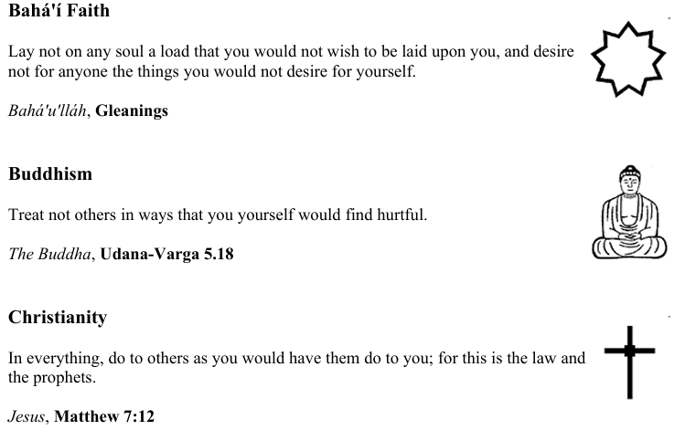

Slide 25
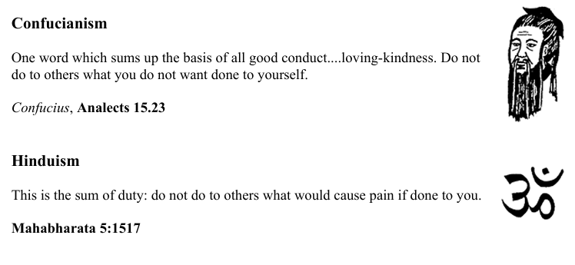

Slide 27
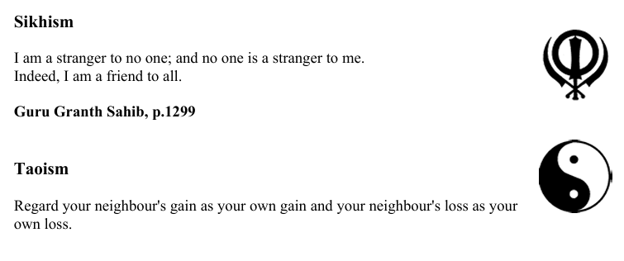

Slide 29
RESPONDING TO GOD’S WORD
* AFFIRMATION OF FAITH: (responsive) Lord, Make Me an Instrument
Attributed to St. Francis of Assisi (1181–1226)
L: Lord, make us an instrument of your peace.
P: Where there is hatred, let me sow love; where there is injury, pardon; where there is doubt, faith; where there is despair, hope; where there is darkness, light; where there is sadness, joy. . . .

Slide 30
L: O Divine Master, grant that we may seek:
P: Not so much to be consoled as to console; to be understood as to understand; to be loved as to love.
All: For it is in giving that we receive, it is in pardoning that we are pardoned, and it is in dying that we are born to eternal life. Amen.

Slide 31
* HYMN: No. 280 Amazing Grace, How Sweet the Sound (vv. 1, 2, 4, 5)
Amazing grace, how sweet the sound,
That saved a wretch like me!
I once was lost, but now am found,
Was blind, but now I see.
. . .

Slide 32
’Twas grace that taught my heart to fear,
And grace my fears relieved;
How precious did that grace appear
The hour I first believed!
. . .

Slide 33
The Lord has promised good to me,
His Word my hope secures;
He will my shield and portion be
As long as life endures.
. . .

Slide 34
When we’ve been there
ten thousand years,
Bright shining as the sun,
We’ve no less days to sing God’s praise
Than when we’d first begun.

Slide 35
PRAYER OF THANKSGIVING, OF THE PEOPLE, & THE LORD’S PRAYER
Our Father who art in heaven,
Hallowed be thy name.
Thy kingdom come, thy will be done;
On earth as it is in heaven.
Give us this day our daily bread;
And forgive us our debts,
As we forgive our debtors;
And lead us not into temptation,
But deliver us from evil,
For Thine is the kingdom
And the power and the glory, forever. Amen.

Slide 36
* HYMN: No. 446 Glorious Things of Thee Are Spoken
Glorious things of thee are spoken,
Zion, city of our God;
God, whose word cannot be broken,
Formed thee for a blest abode.
On the rock of ages founded,
What can shake thy sure repose?
With salvation’s walls surrounded,
Thou may’st smile at all thy foes.
. . .

Slide 37
See, the streams of living waters,
Springing from eternal love,
Well supply thy sons and daughters
And all fear of want remove.
Who can faint while such a river
Ever flows their thirst to assuage?
Grace, which like the Lord, the Giver,
Never fails from age to age.
. . .

Slide 38
Round each habitation hovering,
See the cloud and fire appear
For a glory and a covering,
Showing that the Lord is near.
Thus deriving from their banner
Light by night and shade by day,
Safe they feed upon the manna
Which God gives them when they pray.

Slide 39
* CHARGE TO THE PEOPLE & BENEDICTION
* CHORAL BENEDICTION
POSTLUDE
Our worship has ended —
our Christian Witness begins!
for refreshments & fellowship following worship.

