Slide 1
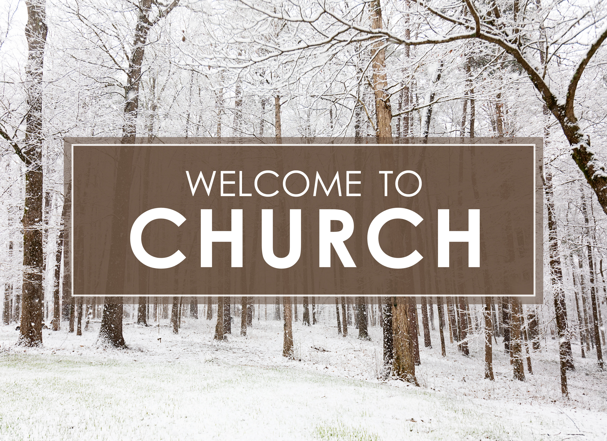
Enter in SILENCE
Wait with REVERENCE
Worship from JOY

Slide 2
PRELUDE
WELCOME & ANNOUNCEMENTS
AFFIRMATION OF MISSION STATEMENT
CHORAL INTROIT: Chancel Choir
Our Mission Statement
As disciples of Jesus Christ, led by the Holy Spirit, we experience God’s unconditional love, and we witness to others by discovering and sharing our gifts.

Slide 3
* CALL TO WORSHIP:
L: Hark, the herald angels sing!
P: Like the shepherds and the magi, let us too, go and see ‘this wondrous thing’ that has come to pass.
L: Glory to the newborn king!
P: Let us go with the poor ones and the humble ones,
. . .

Slide 4
L: Peace on earth and mercy mild.
P: God and sinners reconciled.
L: Joyful all ye nations rise, join the triumphs of the skies.
P: With angelic host proclaim, Christ is born in Bethlehem!
L: With humility, gratitude, and gladness, let us worship God!

Slide 5
HYMN: No. 31 “Hark! The Herald Angels Sing”
Hark! The herald angels sing,
"Glory to the newborn King.
Peace on earth, and mercy mild,
God and sinners reconciled!"
Joyful, all ye nations rise,
Join the triumph of the skies;
With the angelic host proclaim,
"Christ is born in Bethlehem!“
. . .

Slide 6
Refrain:
Hark! the herald angels sing,
"Glory to the newborn King!“
. . .

Slide 7
Christ, by highest heaven adored,
Christ the everlasting Lord!
Late in time, behold Him come,
Offspring of the virgin's womb.
Veiled in flesh the Godhead see;
Hail the incarnate Deity,
Pleased in flesh with us to dwell,
Jesus our Emmanuel.
. . .

Slide 8
Refrain:
Hark! the herald angels sing,
"Glory to the newborn King!“
. . .

Slide 9
Hail the heaven-born Prince of Peace!
Hail the Sun of Righteousness!
Light and life to all He brings,
Risen with healing in His wings.
Mild He lays His glory by,
Born that we no more may die.
Born to raise us from the earth,
Born to give us second birth.
. . .

Slide 10
Refrain:
Hark! the herald angels sing,
"Glory to the newborn King!"

Slide 11
PRAYER OF CONFESSION: (responsive)
God of love, all year long we find joy in the pursuit of the worldly things and sometimes our pursuits make us worldly. All season long we covet the material and do not always seek the spiritual. Through the work of the Lord Jesus, who comes among us full of grace and truth, heal us, correct us, . . .

Slide 12
forgive us, and reframe our thinking when our brains need reframing.
Then, help us see the power of praise, that like the angels, the shepherds, and the magi, we may encounter the Christ and know the joy of having experienced the birth of the Christ child. In Jesus’ name. Amen.

Slide 13
ASSURANCE OF PARDON:
L: As Christ’s Christmas people . . . In Jesus, we are forgiven and freed.
P: In Jesus Christ, we are forgiven and freed! Let us forgive one another.

Slide 14
* CELEBRATING CHRIST’S FORGIVENESS: No. 58 (v. 6)
While Shepherds Watched Their Flocks
"All glory be to God on high,
and to the Earth be peace;
Good will to all from highest heaven
Begin and never cease!"

Slide 15
* EXCHANGE OF CHRIST’S PEACE:
Pastor: The peace of Christ be with you
People: And also with you.
Welcome one another with Christ’s peace.

Slide 16
GIVING OF OUR GIFTS & OFFERTORY:
Our God has blessed us, so let us extend God’s Blessing as we present our Tithes and Offerings.
Thank you for being faithful stewards of your church family with your prayers, your time, talent, and your financial resources.
Contributions may also be made:
Electronically on the church website at fpcb-nj.org;
By reoccurring electronic withdrawal; or by
Mailing your offering to the church: P.O. Box 385, Blairstown, NJ.

Slide 17
* SONG OF GRATITUDE: No. 40 Joy to the World! v. 1
Joy to the world, the Lord is come:
Let earth receive her King;
Let every heart prepare Him room,
And heaven and nature sing,
And heaven and nature sing,
And heaven, and heaven, and nature sing.
* PRAYER OF DEDICATION

Slide 18
DECLARING GOD‘S WORD
EPISTLE LESSON: Colossians 3: 12–17.
The marks of the Christian life.
¹² Therefore, as God’s chosen ones, holy and beloved, clothe yourselves with compassion, kindness, humility, meekness, and patience. ¹³ Bear with one another and, if anyone has a complaint against another, forgive each other; just as the Lord has forgiven you, so you also must forgive. . . .

Slide 19
¹⁴ Above all, clothe yourselves with love, which binds everything together in perfect harmony. ¹⁵ And let the peace of Christ rule in your hearts, to which indeed you were called in one body. And be thankful. ¹⁶ Let the word of Christ dwell in you richly; teach and admonish one another in all wisdom; and with gratitude in your hearts sing psalms, hymns, and spiritual songs to God. ¹⁷ And whatever you do, in word or deed, do everything in the name of the Lord Jesus, giving thanks to God the Father through him.

Slide 20
GOSPEL LESSON: Luke 2: 41–52.
The teachings of the astonishing boy Jesus.
⁴¹ Now every year his parents went to Jerusalem for the festival of the Passover. ⁴² And when he was twelve years old, they went up as usual for the festival. ⁴³ When the festival was ended and they started to return, the boy Jesus stayed behind in Jerusalem, but his parents were unaware of this. ⁴⁴ Assuming that he was in the group of travelers, they went a day’s journey. . . .

Slide 21
Then they started to look for him among their relatives and friends. ⁴⁵ When they did not find him, they returned to Jerusalem to search for him. ⁴⁶ After three days they found him in the temple, sitting among the teachers, listening to them and asking them questions. ⁴⁷ And all who heard him were amazed at his understanding and his answers. ⁴⁸ When his parents saw him they were astonished, and his mother said to him, “Child, why have you treated us like this? . . .

Slide 22
Your father and I have been anxiously looking for you.” ⁴⁹ He said to them, “Why were you searching for me? Did you not know that I must be in my Father’s house?” ⁵⁰ But they did not understand what he said to them. ⁵¹ Then he went down with them and came to Nazareth and was obedient to them, and his mother treasured all these things in her heart.
⁵² And Jesus increased in wisdom and in years and in divine and human favor.

Slide 23
ANTHEM with the Chancel Choir:
See Amid the Winter’s Snow

Slide 24
PASTOR DAVID’S SERMON:
Astonished, Awed, and Amazed

Slide 25
RESPONDING TO GOD’S WORD
* AFFIRMATION OF FAITH: A Declaration of Faith: God in Christ
We affirm that God sent the promised Deliverer to his people. Jesus, the long-expected Savior, came into the world as a child, descended from David, conceived by the Holy Spirit, born of Mary, a virgin. He lived as a Jew among Jews. . . .

Slide 26
He announced to his people the coming of God’s kingdom of justice and peace on earth.
We affirm that Jesus was born of woman as is every child; yet born of God’s power as was no other child. In the person and work of Jesus, God himself and human life are united . . .

Slide 27
but not confused, distinguished but not separated.
The coming of Jesus was itself the coming of God’s promised rule. Through his birth, life, death and resurrection, Jesus brings about the relationship between God and humanity that God always intended. Amen.

Slide 28
* HYMN: No. 46 On This Day, Earth Shall Ring
On this day earth shall ring
With the song children sing
To the Lord, Christ our King,
Born on earth to save us;
Him the Father gave us.
Ideo-o-o, Ideo-o-o,
Ideo gloria in excelsis Deo!
. . .

Slide 29
His the doom, ours the mirth;
When He came down to earth
Bethlehem saw His birth;
Ox and ass beside Him
From the cold would hide Him.
Ideo-o-o, Ideo-o-o,
Ideo gloria in excelsis Deo!
. . .

Slide 30
God's bright star, o'er His head,
Wise men three to Him led,
Kneeling low by His bed,
Lay their gifts before Him,
Praise Him and adore Him.
Ideo-o-o, Ideo-o-o,
Ideo gloria in excelsis Deo!
. . .

Slide 31
On this day angels sing;
With their song earth shall ring,
Praising Christ, heaven's King,
Born on earth to save us;
Peace and love He gave us.
Ideo-o-o, Ideo-o-o,
Ideo gloria in excelsis Deo!

Slide 32
PRAYER OF THANKSGIVING, OF THE PEOPLE, & THE LORD’S PRAYER
Our Father who art in heaven,
Hallowed be thy name.
Thy kingdom come, thy will be done;
On earth as it is in heaven.
Give us this day our daily bread;
And forgive us our debts,
As we forgive our debtors;
And lead us not into temptation,
But deliver us from evil,
For Thine is the kingdom
And the power and the glory, forever. Amen.

Slide 33
* HYMN: No. 29 Go, Tell It on the Mountain! vv. 1 & 3
Refrain:
Go, tell it on the mountain
Over the hills and everywhere;
Go, tell it on the mountain,
That Jesus Christ is born.
. . .

Slide 34
While shepherds kept their watching
O'er silent flocks by night,
Behold throughout the heavens
There shone a holy light.
Go, tell it on the mountain
Over the hills and everywhere;
Go, tell it on the mountain,
That Jesus Christ is born.
. . .

Slide 35
Down in a lowly manger
The humble Christ was born,
And God sent us salvation
That blessed Christmas morn.
Go, tell it on the mountain
Over the hills and everywhere;
Go, tell it on the mountain,
That Jesus Christ is born.

Slide 36
* CHARGE TO THE PEOPLE & BENEDICTION
* CHORAL BENEDICTION: Chancel Choir
POSTLUDE
Our worship has ended —
our Christian Witness begins!
for refreshments & fellowship following worship.

