Slide 1
Tenth Sunday after Pentecost
Enter in SILENCE
Wait with REVERENCE
Worship from JOY

Slide 2
PRELUDE
WELCOME & ANNOUNCEMENTS
AFFIRMATION OF MISSION STATEMENT
Our Mission Statement
As disciples of Jesus Christ, led by the Holy Spirit, we experience God’s unconditional love, and we witness to others by discovering and sharing our gifts.

Slide 3
* SONG OF PRAISE: Lord, Prepare Me (Sanctuary) No. 701 GTG
Lord, prepare me to be a sanctuary,
pure and holy, tried and true.
With thanksgiving, I’ll be a living
sanctuary for you.

Slide 4
* CALL TO WORSHIP:
L: God our Creator, from nothing you made our world.
P: You form us, love us, and give us all that we need.
L: God our Redeemer, you rescue us from sin.
P: You have given us new life and hope of healing to the world.
L: God our Comforter, you are with us always.
P: You comfort us, renew us, and guide us into your truth.
L: Almighty God, for your gracious love for us, we praise you. Amen.

Slide 5
* HYMN OF PRAISE: No. 181. Come Sing to God vv. 1 & 2
Come sing to God, O living saints,
sing praises to God’s name.
God’s anger is not permanent,
God’s love will never wane.
Though tears may tarry for the night
with sighs of deepest pain,
Yet joy comes with the morning sun,
a peace that is not vain.
. . .

Slide 6
In my success I felt secure.
How good You’ve been to me.
I said that this is my own work,
Ascribing all to me.
But when You turned aside Your face,
My life was filled with fears.
I begged for help, to You I cried
With loud and bitter tears.

Slide 7
PRAYER OF CONFESSION: (In silence then in unison)
Eternal God, you do not change. You have revealed yourself to us in your Word. You call us to worship you in spirit and truth. We confess that we often worship not your true Self, but who we wish you to be. Too often we ask you to bless what we do rather than seeking to do what you bless. . . .

Slide 8
Forgive us when our worship shapes you into what we want instead of shaping us into what you want. Help us to meet you here, that we might bow before your unspeakable majesty and live for you now and forever, in Christ. Amen.

Slide 9
ASSURANCE OF CHRIST’S FORGIVENESS:
L: Friends — confessions, whether spoken aloud or acknowledged silently with our hearts, are pleasing to God. In the name of the Christ, you are forgiven.
P: Thanks be to God for Christ’s mercy. In the name of Christ, we are forgiven.

Slide 10
* CELEBRATING CHRIST’S FORGIVENESS: No. 376 v. 1
Love Divine, All Loves Excelling
Love divine, all loves excelling,
Joy of heaven to earth come down,
Fix in us Thy humble dwelling,
All Thy faithful mercies crown!
Jesus, Thou art all compassion,
Pure, unbounded love Thou art;
Visit us with Thy salvation,
Enter every trembling heart.

Slide 11
* EXCHANGE OF CHRIST’S PEACE:
Leader: The peace of Christ be with you. People: And also with you.
Welcome one another with Christ’s peace.

Slide 12
GIVING OF OUR GIFTS & OFFERTORY:
Our God has blessed us, so let us extend God’s Blessing as we present our Tithes and Offerings.
Thank you for being faithful stewards of your church family with your prayers, your time, talent, and your financial resources.
Contributions may also be made:
Electronically on the church website at fpcb-nj.org;
By reoccurring electronic withdrawal; or by
By mailing your offering to the church: P.O. Box 385, Blairstown, NJ.

Slide 13
* DOXOLOGY: No. 592 Praise God
Praise God, from whom all blessings flow; Praise God all creatures here below;
Praise God above, ye heavenly host;
Praise Father, Son, and Holy Ghost. Amen.
* PRAYER OF DEDICATION

Slide 14
DECLARING GOD‘S WORD
HEBREW LESSON: Jonah 1: 1-17, 2:1
Now the word of the Lord came to Jonah son of Amittai, saying, ² “Go at once to Nineveh, that great city, and cry out against it, for their wickedness has come up before me.” ³ But Jonah set out to flee to Tarshish from the presence of the Lord. He went down to Joppa and found a ship going to Tarshish; so he paid his fare and went on board, to go with them to Tarshish, away from the presence of the Lord. . . .

Slide 15
⁴ But the Lord hurled a great wind upon the sea, and such a mighty storm came upon the sea that the ship threatened to break up. ⁵ Then the sailors were afraid, and each cried to his god. They threw the cargo that was in the ship into the sea, to lighten it for them. Jonah, meanwhile, had gone down into the hold of the ship and had lain down and was fast asleep. ⁶ The captain came and said to him, “What are you doing sound asleep? Get up; call on your god! Perhaps the god will spare us a thought so that we do not perish.” . . .

Slide 16
⁷ The sailors said to one another, “Come, let us cast lots, so that we may know on whose account this calamity has come upon us.” So they cast lots, and the lot fell on Jonah. ⁸ Then they said to him, “Tell us why this calamity has come upon us. What is your occupation? Where do you come from? What is your country? And of what people are you?” ⁹ “I am a Hebrew,” he replied. “I worship the Lord, the God of heaven, who made the sea and the dry land.” ¹⁰ Then the men were even more afraid . . .

Slide 17
and said to him, “What is this that you have done!” For the men knew that he was fleeing from the presence of the Lord, because he had told them so.
¹¹ Then they said to him, “What shall we do to you, that the sea may quiet down for us?” For the sea was growing more and more tempestuous. ¹² He said to them, “Pick me up and throw me into the sea; then the sea will quiet down for you, for I know it is because of me that this great storm has come upon you.” ¹³ Nevertheless, the men rowed . . .

Slide 18
hard to bring the ship back to land, but they could not, for the sea grew more and more stormy against them. ¹⁴ Then they cried out to the Lord, “Please, O Lord, we pray, do not let us perish on account of this man’s life. Do not make us guilty of innocent blood, for you, O Lord, have done as it pleased you.” ¹⁵ So they picked Jonah up and threw him into the sea, and the sea ceased from its raging. ¹⁶ Then the men feared the Lord even more, and they offered a sacrifice to the Lord and made vows. . . .

Slide 19
¹⁷ But the Lord provided a large fish to swallow up Jonah, and Jonah was in the belly of the fish three days and three nights. Then Jonah prayed to the Lord his God from the belly of the fish.

Slide 20
HEBREW LESSON: Jonah 3: 1–5, 10, 4: 1–4
The word of the Lord came to Jonah a second time, saying, ² “Get up, go to Nineveh, that great city, and proclaim to it the message that I tell you.” ³ So Jonah set out and went to Nineveh, according to the word of the Lord. Now Nineveh was an exceedingly large city, a three days’ walk across. ⁴ Jonah began to go into the city, going a day’s walk. And he cried out, “Forty days more, and Nineveh shall be overthrown!” . . .

Slide 21
⁵ And the people of Nineveh believed God; they proclaimed a fast, and everyone, great and small, put on sackcloth.
¹⁰ When God saw what they did, how they turned from their evil ways, God changed his mind about the calamity that he had said he would bring upon them, and he did not do it.
But this was very displeasing to Jonah, and he became angry. ² He prayed to the Lord and said, . . .

Slide 22
“O Lord! Is not this what I said while I was still in my own country? That is why I fled to Tarshish at the beginning, for I knew that you are a gracious and merciful God, slow to anger, abounding in steadfast love, and relenting from punishment. ³ And now, O Lord, please take my life from me, for it is better for me to die than to live.” ⁴ And the Lord said, “Is it right for you to be angry?”

Slide 23
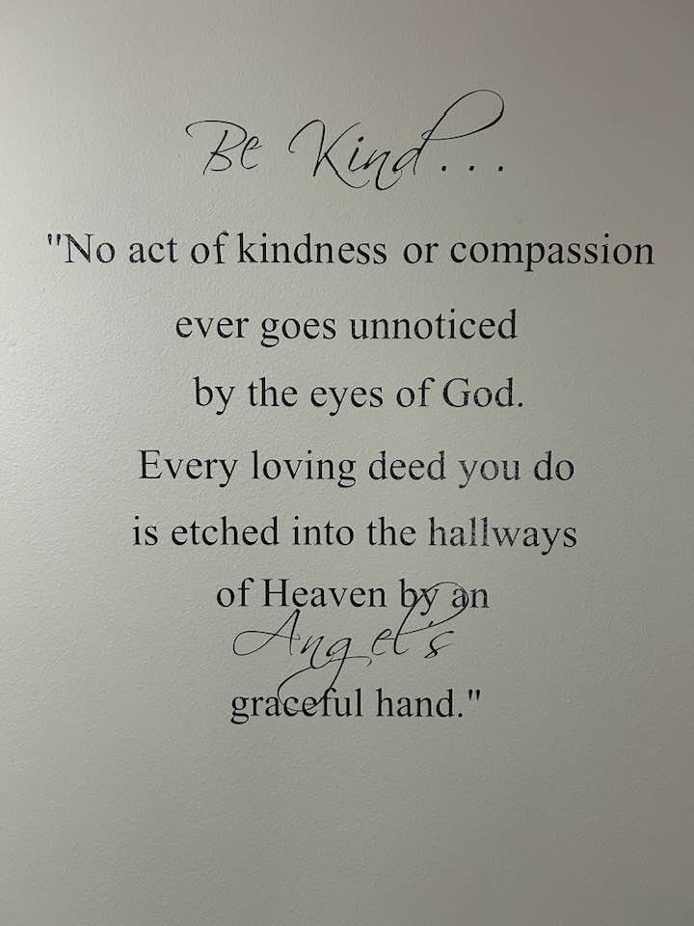
MELANIE’S MEDITATION:
Jonah: A Man on the Run

Slide 24
Be Kind . . .
“No act of kindness or compassion ever goes unnoticed
by the eyes of God.
Every loving deed you do
is etched into the hallways
of Heaven by an
Angel’s
graceful hand.”
MELANIE’S MEDITATION:
Jonah: A Man on the Run

Slide 25
RESPONDING TO GOD’S WORD
* AFFIRMATION OF FAITH: (adapted from Romans 8: 28, 38–39)
We believe there is no condemnation for those who are in Christ Jesus; for we know that all things work together for good for those who love God, who are called according to God’s purpose. We are convinced that neither death, nor life, nor angels, nor rulers, . . .

Slide 26
nor things present, nor things to come, nor powers, nor height, nor depth, not anything else in all creation, will be able to separate us from the love of God in Christ Jesus our Lord. Amen.

Slide 27
* HYMN: No. 525 Here I Am, Lord
I, the Lord of sea and sky,
I have heard My people cry.
All who dwell in deepest sin
my hand will save.
I who made the stars of night,
I will make their darkness bright.
Who will bear My light to them?
Whom shall I send?
Cont’d.

Slide 28
Here I am, Lord. Is it I, Lord?
I have heard You calling in the night
I will go, Lord, if you lead me.
I will hold Your people in my heart.
Cont’d.

Slide 29
I, the Lord of snow and rain,
I have borne My people’s pain.
I have wept for love of them,
they turn away.
I will break their hearts of stone,
Give them hearts for love alone.
I will speak My word to them.
Whom shall I send?
Cont’d.

Slide 30
Here I am, Lord. Is it I, Lord?
I have heard You calling in the night
I will go, Lord, if you lead me.
I will hold Your people in my heart.
Cont’d.

Slide 31
I, the Lord of wind and flame,
I will tend the poor and lame.
I will set a feast for them,
My hand will save.
Finest bread I will provide
Till their hearts be satisfied.
I will give My life to them.
Whom shall I send?
Cont’d.

Slide 32
Here I am, Lord. Is it I, Lord?
I have heard You calling in the night
I will go, Lord, if you lead me.
I will hold Your people in my heart.

Slide 33
PRAYER OF THANKSGIVING, OF THE PEOPLE, & THE LORD’S PRAYER:
Our Father who art in heaven,
Hallowed be thy name.
Thy kingdom come, thy will be done;
On earth as it is in heaven.
Give us this day our daily bread;
And forgive us our debts,
As we forgive our debtors;
And lead us not into temptation,
But deliver us from evil,
For Thine is the kingdom
And the power and the glory, forever. Amen.

Slide 34
DEPARTING IN GOD’S NAME
* HYMN: No. 280 Amazing Grace (vv. 1–4)
Amazing grace, how sweet the sound,
That saved a wretch like me!
I once was lost, but now am found,
Was blind, but now I see.
. . .

Slide 35
’Twas grace that taught my heart to fear,
And grace my fears relieved;
How precious did that grace appear
The hour I first believed!
. . .

Slide 36
Through many dangers, toils and snares,
I have already come;
’Tis grace hath brought me safe thus far,
And grace will lead me home.
. . .

Slide 37
The Lord has promised good to me,
His Word my hope secures;
He will my shield and portion be
As long as life endures.

Slide 38
* CHARGE TO THE PEOPLE & BENEDICTION
POSTLUDE
Our worship has ended—our Christian Witness begins!

