Slide 1
Enter in SILENCE
Wait with REVERENCE
Worship from JOY

Slide 2
PRELUDE
WELCOME & ANNOUNCEMENTS
AFFIRMATION OF MISSION STATEMENT
Our Mission Statement
As disciples of Jesus Christ, led by the Holy Spirit, we experience God’s unconditional love, and we witness to others by discovering and sharing our gifts.

Slide 3
MOMENT FOR STEWARDSHIP:
Zach Burke
CHORAL INTROIT

Slide 4
* CALL TO WORSHIP:
L: God of grace and mercy, give to know and think about you.
P: Give us hearts to have a deep love for you.
L: Grant us your Spirit of love
P: That we may celebrate your glory.
L: Grant us humility,
P: That we may worship you in spirit and in truth.
L: With humility in our hearts and praise on our lips, let us worship God!

Slide 5
* HYMN OF PRAISE: No. 469 Morning Has Broken
Morning has broken like the first morning,
Blackbird has spoken like the first bird.
Praise for the singing!
Praise for the morning!
Praise for them, springing
fresh from the Word!
Cont’d.

Slide 6
Sweet the rain’s new fall sunlit from heaven,
Like the first dewfall on the first grass.
Praise for the sweetness of the wet garden,
Sprung in completeness
where God’s feet pass.
Cont’d.

Slide 7
Mine is the sunlight! Mine is the morning
Born of the one light Eden saw play!
Praise with elation, praise every morning,
God’s recreation of the new day!

Slide 8
PRAYER OF CONFESSION: In silence then unison
Almighty and merciful God, we have erred and strayed from your ways like lost sheep. We have nibbled ourselves lost, following too frequently, the desires and devices of our own hearts. We have left undone those things we ought to have done. We have done those things we ought not to have done. . . .

Slide 9
O Lord, forgive us, we pray, and have mercy upon us. Repair our souls and restore us to the joy of your great salvation, provided to us by Jesus, your Son, our Savior and Lord. Amen.

Slide 10
ASSURANCE OF CHRIST’S FORGIVENESS:
L: Jesus, who bore our sins in his body through his death on the cross, by the power of his resurrection wills for us to be dead to sin and alive to all that is good. Since Christ has forgiven us, ...
P: Let us forgive one another.

Slide 11
* CELEBRATING CHRIST’S FORGIVENESS: Give Thanks (No. 647 GTG)
Give thanks with a grateful heart,
give thanks to the Holy One;
Give thanks, because we’re given
Jesus Christ the Son.
And now let the weak say, “we are strong”;
let the poor say, “We are rich,
because of what the Lord has done for us!”
Give thanks.

Slide 12
* EXCHANGE OF CHRIST’S PEACE:
Welcome one another with Christ’s peace.
~ Children may go downstairs
for Sunday School ~

Slide 13
GIVING OF OUR GIFTS & OFFERTORY:
Our God has blessed us, so let us extend God’s Blessing as we present our Tithes and Offerings.
Thank you for being faithful stewards of your church family with your prayers, your time, talent, and your financial resources.
Contributions may also be made:
Electronically on the church website at fpcb-nj.org;
By reoccurring electronic withdrawal; or by
By mailing your offering to the church: P.O. Box 385, Blairstown, NJ.

Slide 14
* DOXOLOGY: No. 592 Praise God
Praise God, from whom all blessings flow;
praise God all creatures here below;
Praise God above, ye heavenly host;
Praise Father, Son, and Holy Ghost. Amen.
* PRAYER OF DEDICATION

Slide 15
DECLARING GOD‘S WORD
NEW TESTAMENT LESSON: 1 John 3: 16–24, 4: 15–21
Love one another.
1 John 3: 16–24
¹⁶ We know love by this, that he laid down his life for us—and we ought to lay down our lives for the brothers and sisters. ¹⁷ How does God’s love abide in anyone who has the world’s goods and sees a brother or sister in need and yet refuses help?
¹⁸ Little children, let us love not in word or speech but in deed and truth. ¹⁹ And by this we will . . .

Slide 16
know that we are from the truth and will reassure our hearts before him ²⁰ whenever our hearts condemn us, for God is greater than our hearts, and he knows everything. ²¹ Beloved, if our hearts do not condemn us, we have boldness before God, ²² and we receive from him whatever we ask, because we obey his commandments and do what pleases him.
²³ And this is his commandment, that we should believe in the name of his Son Jesus Christ and love one another, just as he has commanded us. . . .

Slide 17
²⁴ All who obey his commandments abide in him, and he abides in them. And by this we know that he abides in us, by the Spirit that he has given us.
1 John 4: 15–21
¹⁵ God abides in those who confess that Jesus is the Son of God, and they abide in God. ¹⁶ So we have known and believe the love that God has for us. God is love, and those who abide in love abide in God, and God abides in them. . . .

Slide 18
¹⁷ Love has been perfected among us in this: that we may have boldness on the day of judgment, because as he is, so are we in this world. ¹⁸ There is no fear in love, but perfect love casts out fear; for fear has to do with punishment, and whoever fears has not reached perfection in love. ¹⁹ We love because he first loved us. ²⁰ Those who say, “I love God,” and hate a brother or sister are liars, for those who do not love a brother or sister, whom they have seen, . . .

Slide 19
cannot love God, whom they have not seen. ²¹ The commandment we have from him is this: those who love God must love their brothers and sisters also.

Slide 20
GOSPEL LESSON: John 10: 11–18
Jesus is the gatekeeper and our Shepherd.
¹¹ “I am the good shepherd. The good shepherd lays down his life for the sheep. ¹² The hired hand, who is not the shepherd and does not own the sheep, sees the wolf coming and leaves the sheep and runs away, and the wolf snatches them and scatters them. ¹³ The hired hand runs away because a hired hand does not care for the sheep. ¹⁴ I am the good shepherd. I know my own, and my own know me, ¹⁵ just as the Father knows me, . . .

Slide 21
and I know the Father. And I lay down my life for the sheep. ¹⁶ I have other sheep that do not belong to this fold. I must bring them also, and they will listen to my voice. So there will be one flock, one shepherd. ¹⁷ For this reason the Father loves me, because I lay down my life in order to take it up again. ¹⁸ No one takes it from me, but I lay it down of my own accord. I have power to lay it down, and I have power to take it up again. I have received this command from my Father.”

Slide 22
ANTHEM with the Chancel Choir:
““We Will Give Thanks”
by Mark Patterson

Slide 23
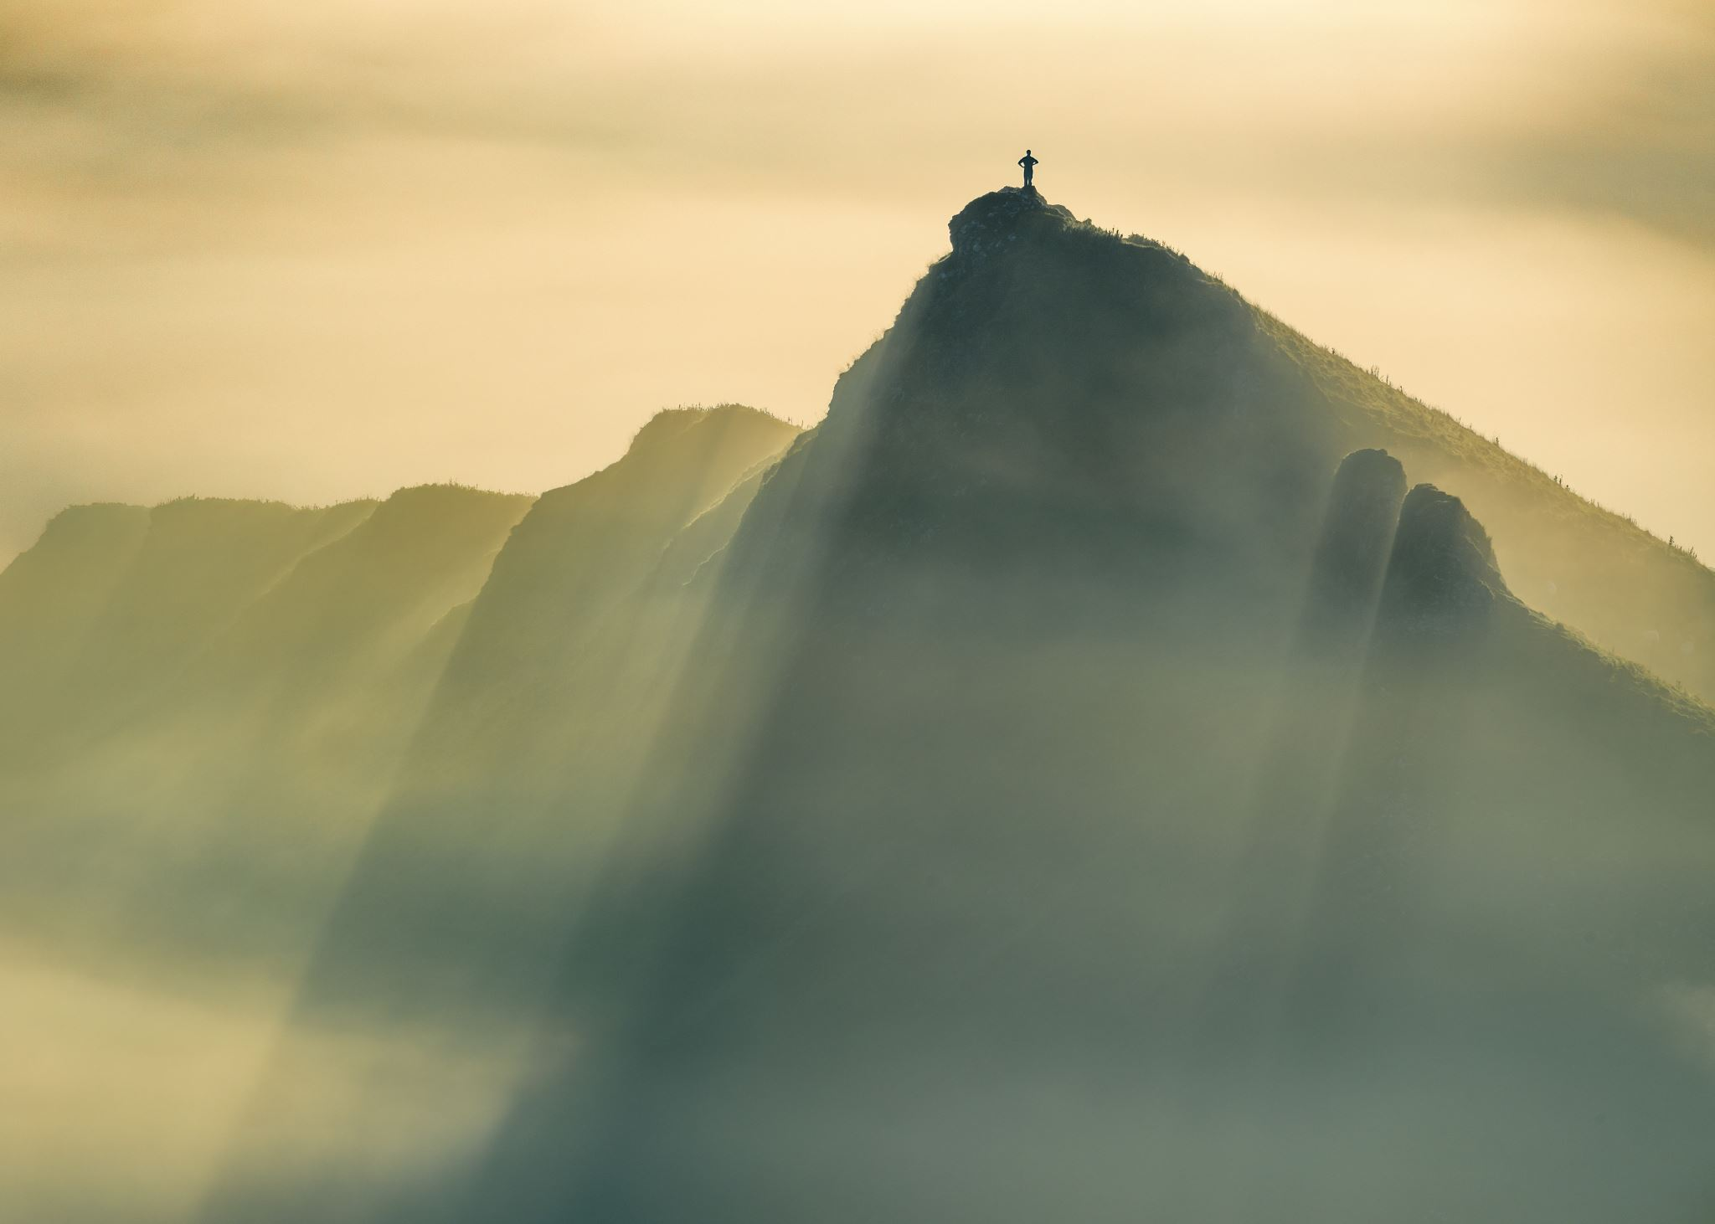
MEDITATION:
with Pastor David Harvey
Walking with the Resurrection

Slide 24
RESPONDING TO GOD’S WORD
* AFFIRMATION OF FAITH: Psalm 23, King James Version
The Lord is my shepherd; I shall not want. He maketh me to lie down in green pastures: he leadeth me beside the still waters. He restoreth my soul: he leadeth me in the paths of righteousness for his name's sake.
Yea, though I walk through the valley of the shadow of death, I will fear no evil: …

Slide 25
for thou art with me; thy rod and thy staff they comfort me.
Thou preparest a table before me in the presence of mine enemies: thou anointest my head with oil; my cup runneth over.
Surely goodness and mercy shall follow me all the days of my life: and I will dwell in the house of the Lord forever. Amen.

Slide 26
* HYMN: No. 172 My Shepherd Will Supply My Need vv. 1 & 2
My Shepherd will supply my need;
Jehovah is His Name:
In pastures fresh He makes me feed,
Beside the living stream.
He brings my wandering spirit back
When I forsake His ways,
And leads me, for His mercy’s sake,
In paths of truth and grace. Cont’d.

Slide 27
When I walk through the shades of death
Thy presence is my stay;
One word of Your supporting breath
Drives all my fears away.
Your hand, in sight of all my foes,
Does still my table spread;
My cup with blessings overflows,
Your oil anoints my head.

Slide 28
The sure provisions of my God
Attend me all my days;
O may Your house be my abode,
And all my work be praise.
There would I find a settled rest,
While others go and come;
No more a stranger, or a guest,
But like a child at home.

Slide 29
PRAYER OF THANKSGIVING, OF THE PEOPLE, & THE LORD’S PRAYER
Our Father who art in heaven,
Hallowed be thy name.
Thy kingdom come, thy will be done;
On earth as it is in heaven.
Give us this day our daily bread;
And forgive us our debts,
As we forgive our debtors;
And lead us not into temptation,
But deliver us from evil,
For Thine is the kingdom
And the power and the glory, forever. Amen.

Slide 30
* HYMN: O God, Within the Psalms © 2024 by Carolyn Winfrey Gillette
vv. 1 & 4
O God, within the Psalms
are pictures of your love:
There, young trees grow as waters flow
and mountains rise above.
The creatures with their young,
the birds that fill the air,
the gentle rain, the harvest grain
proclaim your love and care. Cont’d.

Slide 31
We see within the Psalms
a world where nature sings.
Help us to share, and work, and care
for all your growing things.
O Shepherd, we've been blessed;
may we be blessings, too.
This is our prayer: May we take care
of this good earth with you.

Slide 32
* CHARGE TO THE PEOPLE & BENEDICTION
* CHORAL BENEDICTION
POSTLUDE
Our worship has ended—our Christian Witness begins!

