Slide 1
Enter in SILENCE
Wait with REVERENCE
Worship from JOY

Slide 2
PRELUDE
WELCOME & ANNOUNCEMENTS
AFFIRMATION OF MISSION STATEMENT
CHORAL INTROIT: Chancel Choir
Our Mission Statement
As disciples of Jesus Christ, led by the Holy Spirit, we experience God’s unconditional love,
and we witness to others by discovering and sharing our gifts.

Slide 3
* SONG OF PRAISE: No. 333 Seek Ye First v. 1
Seek Ye First the kingdom of God,
and His righteousness,
And all these things
shall be added unto you.
Allelu, alleluia!

Slide 4
* CALL TO WORSHIP:
L: Joyful music is the sound we make this day.
P: Chains of doubt and fear no longer give sway.
L: Thankful is the mood of the songs we sing.
P: Hopeful is the prayer of the faith we proclaim.
L: Jesus said, ‘Where two or more gather in my name.”
P: I am there among them, and I feel their pain.
Cont’d.

Slide 5
L: May Christ’s peace and presence enrich you all.
P: And also to you.
L: With joyful praise in our lives, let us worship God!

Slide 6
* HYMN OF PRAISE: No. 150 Come, Christians, Join to Sing
Come, Christians, join to sing Alleluia! Amen! Loud praise to
Christ our King; Alleluia! Amen!
Let all, with heart and voice,
Before His throne rejoice;
Praise is His gracious choice;
Alleluia! Amen! Cont’d.

Slide 7
Come, lift your hearts on high;
Alleluia! Amen!
Let praises fill the sky;
Alleluia! Amen!
He is our guide and friend;
To us He’ll condescend;
His love shall never end;
Alleluia! Amen!
Cont’d.

Slide 8
Praise yet our Christ again;
Alleluia! Amen!
Life shall not end the strain;
Alleluia! Amen!
On heaven’s blissful shore
His goodness we’ll adore,
Singing forevermore,
“Alleluia! Amen!”

Slide 9
PRAYER OF CONFESSION: In silence then unison
O God, whose supreme power was most tangibly seen through the resurrection of your Son, forgive us not for our doubts but for being controlled and constrained by them. Free us, we pray from our self-directed tombs of destruction and open us to a way that allows us to accept and be saved by your grace. . . .

Slide 10
Forgive our sin of cowardice and constraint. Grant us grace to live as a people, empowered by the mystery and the miracle of Jesus’ resurrection. In Christ’s name we pray, Amen.

Slide 11
ASSURANCE OF CHRIST’S FORGIVENESS:
L: Hear the good news . . . be alive to all that is good and kind.
P: In the name of Jesus Christ, we are forgiven! Let us forgive one another!

Slide 12
* CELEBRATION OF CHRIST’S LOVE: Give Thanks (No. 647 GTG)
Give thanks with a grateful heart.
Give thanks to the Holy One.
Give thanks because we’re given
Jesus Christ the Son. And now,
let the weak say, “We are strong”;
let the poor say, “We are rich because of
what the Lord has done for us!”
Give thanks.

Slide 13
* EXCHANGE OF CHRIST’S PEACE:
Pastor: The peace of Christ be with you.
People: And also with you.
Welcome one another with Christ’s peace.
~ Children may go downstairs
for Sunday School ~

Slide 14
GIVING OF OUR GIFTS & OFFERTORY:
Our God has blessed us, so let us extend God’s Blessing as we present our Tithes and Offerings.
Thank you for being faithful stewards of your church family with your prayers, your time, talent, and your financial resources.
Contributions may also be made:
Electronically on the church website at fpcb-nj.org;
By reoccurring electronic withdrawal; or by
By mailing your offering to the church: P.O. Box 385, Blairstown, NJ.

Slide 15
* DOXOLOGY: No. 592 Praise God
Praise God, from whom all blessings flow; Praise God all creatures here below;
Praise God above, ye heavenly host;
Praise Father, Son, and Holy Ghost. Amen.
* PRAYER OF DEDICATION

Slide 16
DECLARING GOD‘S WORD
NEW TESTAMENT READING: Acts 2: 42–47, 4: 32–35
Believers become bold in faith and generous in spirit.
Acts 2: 42–47
⁴² They devoted themselves to the apostles’ teaching and fellowship, to the breaking of bread and the prayers.
Life among the Believers
⁴³ Awe came upon everyone because many wonders and signs were being done through the apostles. ⁴⁴ All who believed were together . . .

Slide 17
and had all things in common; ⁴⁵ they would sell their possessions and goods and distribute the proceeds to all, as any had need. ⁴⁶ Day by day, as they spent much time together in the temple, they broke bread at home and ate their food with glad and generous hearts, ⁴⁷ praising God and having the goodwill of all the people. And day by day the Lord added to their number those who were being saved.
. . .

Slide 18
Acts 4: 32–35
The Believers Share Their Possessions
³² Now the whole group of those who believed were of one heart and soul, and no one claimed private ownership of any possessions, but everything they owned was held in common. ³³ With great power the apostles gave their testimony to the resurrection of the Lord Jesus, and great grace was upon them all. ³⁴ There was not a needy person among them, for as many as owned lands . . .

Slide 19
or houses sold them and brought the proceeds of what was sold. ³⁵ They laid it at the apostles’ feet, and it was distributed to each as any had need.

Slide 20
GOSPEL LESSON: John 20: 19–31
Jesus came through the locked doors.
Jesus Appears to the Disciples
¹⁹ When it was evening on that day, the first day of the week, and the doors were locked where the disciples were, for fear of the Jews, Jesus came and stood among them and said, “Peace be with you.” ²⁰ After he said this, he showed them his hands and his side. Then the disciples rejoiced when they saw the Lord. ²¹ Jesus said to them again, . . .

Slide 21
“Peace be with you. As the Father has sent me, so I send you.” ²² When he had said this, he breathed on them and said to them, “Receive the Holy Spirit. ²³ If you forgive the sins of any, they are forgiven them; if you retain the sins of any, they are retained.”
Jesus and Thomas
²⁴ But Thomas (who was called the Twin), one of the twelve, was not with them when Jesus came. ²⁵ So the other disciples told him, . . .

Slide 22
“We have seen the Lord.” But he said to them, “Unless I see the mark of the nails in his hands and put my finger in the mark of the nails and my hand in his side, I will not believe.”
²⁶ A week later his disciples were again in the house, and Thomas was with them. Although the doors were shut, Jesus came and stood among them and said, “Peace be with you.” ²⁷ Then he said to Thomas, “Put your finger here and see my hands. Reach out your hand and put it in my side. . . .

Slide 23
Do not doubt but believe.” ²⁸ Thomas answered him, “My Lord and my God!” ²⁹ Jesus said to him, “Have you believed because you have seen me? Blessed are those who have not seen and yet have come to believe.”
The Purpose of This Book
³⁰ Now Jesus did many other signs in the presence of his disciples that are not written in this book. ³¹ But these are written so that you may continue to believe that Jesus is the Messiah, the Son of God, and that through believing you may have life in his name.

Slide 24
MUSICAL MEDITATION - Craig Evans
“April Come She Will”
by Simon & Garfunkel

Slide 25
MEDITATION:
with Paster David Harvey
“Life Beyond Locked Doors”

Slide 26
RESPONDING TO GOD’S WORD
* AFFIRMATION OF FAITH: The Contemporary Apostles’ Creed
We believe in God who places joy in our souls, dancing in our toes, and songs in our hearts. I believe God wanted gladness to flow like a river, so in divine love God created a bountiful earth with plenty for all to share. . . .

Slide 27
We believe in Jesus, who partied with outcasts and sinners, and touched the broken so they could leap and dance. We believe Jesus opened the doors and set an extra place so we could feast.
We believe in the Holy Spirit, who prompts us to smile, who sends us invitations to come and dine, who nudges us to openness and tenderness. . . .

Slide 28
We believe the Spirit is present every time we gather to break bread and stirs within us the desire to live joyfully and walk hopefully.
Forever, I will live in the embrace of God’s mysterious and miraculous love and be a witness to Christ’s resurrection joy. Amen.

Slide 29
* COMMUNION HYMN: When Thomas Heard from Jesus (Tune 442)
vv. 1, 2, 4, 5 © 2012 by Carolyn Winfrey Gillette
When Thomas heard from Jesus,
"Now come and follow me,"
He surely went with gladness,
for there was much to see.
He witnessed Jesus' teaching
and saw his healing touch;
He found a faith to guide him,
a friend he loved so much.
Cont’d.

Slide 30
When Jesus spoke of heaven,
bold Thomas dared to say,
"We don't know where you're going!
How can we know the way?"
He wanted understanding
of what he could not see.
Then Jesus reassured him,
"The way is here — through me.“
Cont’d.

Slide 31
What joy on Easter evening
when many saw the Lord!
Yet Thomas was not with them
and would not trust their word.
When Christ appeared before him,
his doubts were quickly gone;
He gladly knew that evening
the joy of Easter dawn.
Cont’d.

Slide 32
That man of faith saw Jesus
at breakfast by the sea;
At Pentecost he witnessed
so others would believe.
O Lord, may we — like Thomas —
keep growing day by day;
Increase our faith and guide us,
for Lord, you are the Way.

Slide 34
SACRAMENT OF HOLY COMMUNION
INVITATION TO THE LORD’S TABLE:
L: Friends, this is the joyful feast of the people of God!
P: People will come from east and west, and from north and south, and sit at the table in the kingdom of God.

Slide 35
L: Behold, how good and pleasant it is when brothers and sisters dwell in unity.
P: God sent the whole world God’s only Son. Since God loved us so much, we too, should love one another.
L: This is the Lord’s Table. Our Savior invites all who are truly sorry for their sins and would humbly put their trust in him to come to the feast which he has prepared. Listen to the life-giving and life-empowering words of our Savior Jesus Christ:

Slide 36
“Come to me, all you that are weary and are carrying heavy burdens, and I will give you rest. Take my yoke upon you, and learn from me; for I am gentle and humble in heart, and you will find rest for your souls. For my yoke is easy, and my burden is light. “ Matthew 11: 28–30
This is indeed the will of my Father, that all who see the Son and believe in him may have eternal life, and I will raise them up on the last day. John 6: 40
“Behold, I stand at the door and knock; if those who hear my voice open the door, I will come in to them and eat with them, and they with me. Revelation 3: 20

Slide 37
Pastor: The Lord be with you.
People: And with your spirit.
Pastor: Lift up your hearts.
People: We lift them to the Lord.
Pastor: Let us give thanks to the Lord our God.
People: It is right to give God our thanks and praise.

Slide 38
PRAYER OF THANKSGIVING, PRAYERS OF THE PEOPLE, & THE LORD’S PRAYER:
Pastor: Holy Lord . . . as we pray together:
All: O God, who calls us from death to life: Fill us with the grace of Jesus’ humility, the miracle of his hospitality, and the mystery of his generosity that we may live as a beacon of your light and conduits of his love, as we pray together in his name: . . . .

Slide 39
Our Father who art in heaven,
Hallowed be thy name.
Thy kingdom come, thy will be done;
On earth as it is in heaven.
Give us this day our daily bread;
And forgive us our debts,
As we forgive our debtors;
And lead us not into temptation,
But deliver us from evil,
For Thine is the kingdom
And the power and the glory, forever. Amen.

Slide 41
OFFERING OF THE ELEMENTS:
Approach the Table,
receive the bread, take the cup,
and return to your pew.

Slide 42
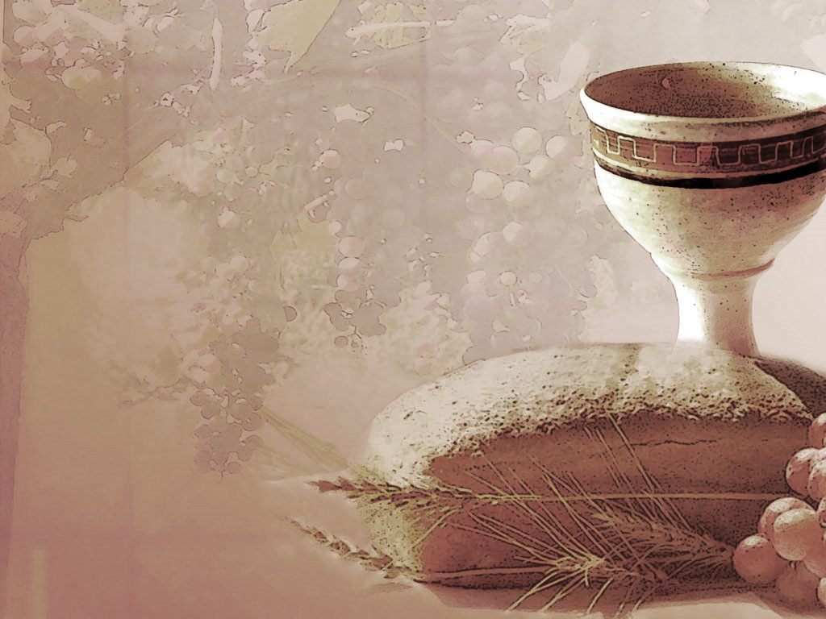
SHARING THE BREAD:
Jesus said, “I am the bread of life. Whoever comes to me will never be hungry...” (Jn. 6:35a)
Let us eat this bread in remembrance of Christ and may the spirit that is in him be in us also.
DRINKING THE CUP:
Jesus said, “I am the vine, you are the branches, apart from him, we can do nothing.”
Drink this cup in remembrance of Christ and may the spirit in which he died be our Spirit.

Slide 43
COMMUNION BLESSING:
Let us give thanks to the Lord our God.
For the joyful reign and rule of Christ’s kingdom within our lives, we praise you, O God. We thank you for Jesus’ saving death on the cross and your power which raised him from the dead. We rejoice that because He lives and lives in us, nothing past, present nor things to come shall separate us from your great love, revealed in Jesus our Lord. Amen.

Slide 44
DEPARTING IN GOD’S NAME
* HYMN: No. 302 I Danced in the Morning vv. 1, 3–5
I danced in the morning
when the world was begun,
And I danced in the moon
and the stars and the sun,
And I came down from heaven
and I danced on the earth;
At Bethlehem I had My birth.
Cont’d.

Slide 45
Dance, then, wherever you may be:
I am the Lord of the Dance, said He,
And I’ll lead you all, wherever you may be,
And I’ll lead you all in the dance said He.
Cont’d.

Slide 46
I danced on the Sabbath
and I cured the lame;
The holy people said it was a shame.
They whipped and they stripped
and they hung Me high,
And left Me there on a cross to die.
Cont’d.

Slide 47
Dance, then, wherever you may be:
I am the Lord of the Dance, said He,
And I’ll lead you all, wherever you may be,
And I’ll lead you all in the dance said He.
Cont’d.

Slide 48
I danced on a Friday when
the sky turned black;
It's hard to dance with the devil
on your back; They buried my body
and they thought I'd gone,
But I am the dance and I still go on.
Cont’d.

Slide 49
Dance, then, wherever you may be:
I am the Lord of the Dance, said He,
And I’ll lead you all, wherever you may be,
And I’ll lead you all in the dance said He.
Cont’d.

Slide 50
They cut me down and I leap up high
I am the life that will never, never die;
I’ll live in you if you’ll live in Me:
I am the Lord of the Dance said He.
Cont’d.

Slide 51
Dance, then, wherever you may be:
I am the Lord of the Dance, said He,
And I’ll lead you all, wherever you may be,
And I’ll lead you all in the dance said He.

Slide 52
* CHARGE TO THE PEOPLE & BENEDICTION

Slide 53
* CONGREGATIONAL BENEDICTION: “Song of Peace”
(sung to the tune of “Edelweiss”)
May the Lord, mighty God,
bless and keep you forever.
Grant you peace, perfect peace, courage in every endeavor.
Lift up your eyes and see God’s face, and God’s grace forever.
May the Lord, mighty God,
bless and keep you forever.

Slide 54
POSTLUDE
Our worship has ended—our Christian Witness begins!

