Slide 1
Enter in SILENCE
Wait with REVERENCE
Worship from JOY

Slide 2
PRELUDE
WELCOME & ANNOUNCEMENTS
AFFIRMATION OF MISSION STATEMENT
Our Mission Statement
As disciples of Jesus Christ, led by the Holy Spirit, we experience God’s unconditional love, and we witness to others by discovering and sharing our gifts.
MOMENT FOR MISSION: Pastor David Harvey

Slide 3
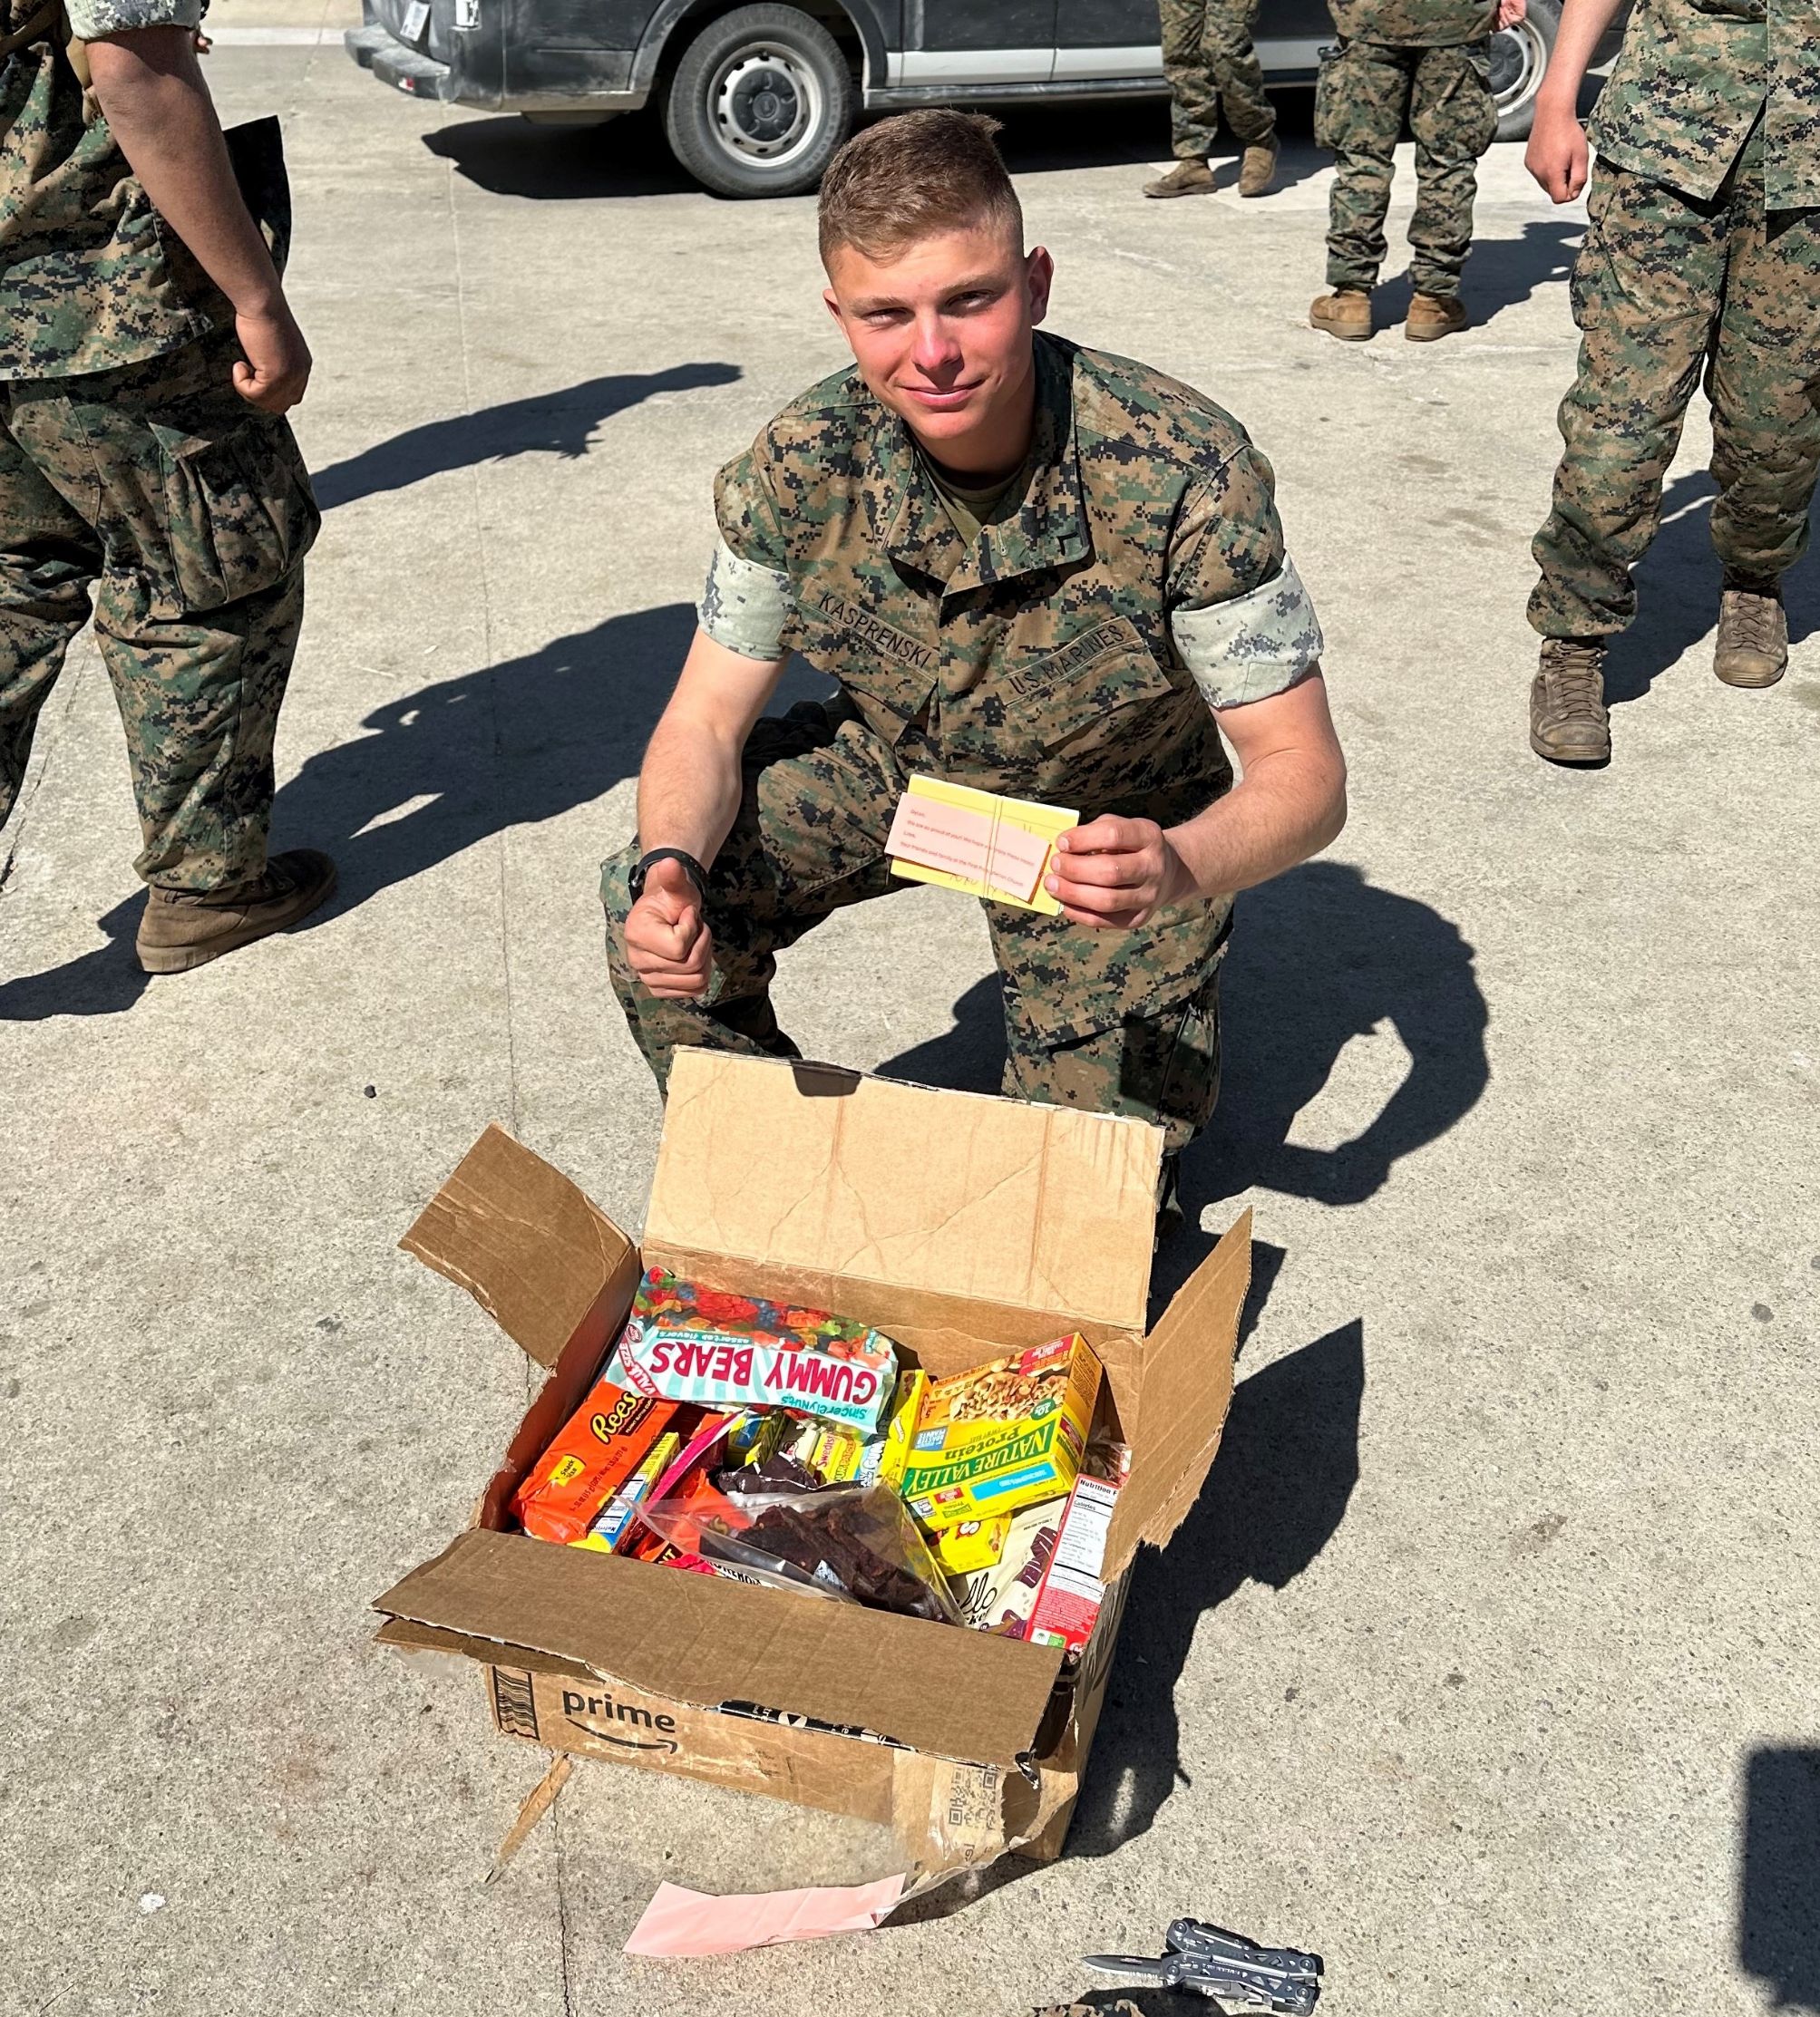
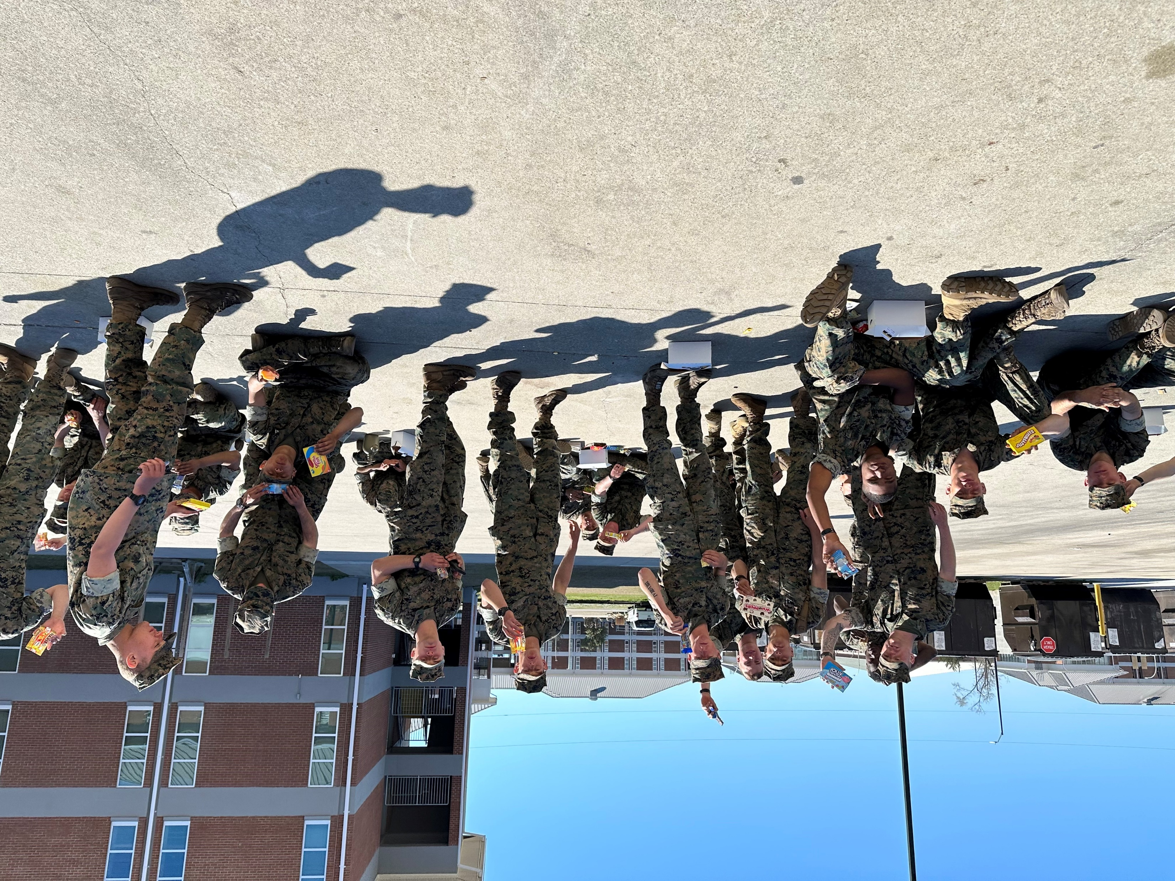
"I shared with my platoon.
We are all so grateful. THANK YOU!
Dylan"

Slide 4
CHORAL INTROIT Chancel Choir

Slide 5
* CALL TO WORSHIP:
L: Blessed is the one who comes in the name of Lord!
P: Hosanna in the highest!
L: Rejoice greatly, O daughter Zion!
P: Shout aloud, O daughter Jerusalem!
L: Lo, your king comes to you; glorious and victorious is he;
P: Humble and with humility, he rides on colt, the foal of a donkey.
L: This is the day the Lord has made.
P: Let us rejoice and be glad in it!
L: With faithfulness and joyfulness, let us worship God!

Slide 6
* HYMN OF PRAISE: No. 88 All Glory, Laud and Honor vv. 1, 3, 4
Refrain:
All glory, laud and honor
To Thee, Redeemer, King!
To whom the lips of children
Made sweet hosannas ring.
Cont’d.

Slide 7
Thou art the King of Israel,
Thou David’s royal Son,
Who in the Lord’s name comest,
The King and blessèd One.
All glory, laud and honor
To Thee, Redeemer, King!
To whom the lips of children
Made sweet hosannas ring. Cont’d.

Slide 8
To Thee, before Thy passion,
They sang their hymns of praise;
To Thee, now high exalted,
Our melody we raise.
All glory, laud and honor
To Thee, Redeemer, King!
To whom the lips of children
Made sweet hosannas ring. Cont’d.

Slide 9
Thou didst accept their praises;
Accept the prayers we bring,
Who in all good delightest,
Thou good and gracious King!
All glory, laud and honor
To Thee, Redeemer, King!
To whom the lips of children
Made sweet hosannas ring.

Slide 10
PRAYER OF CONFESSION: In silence then unison
Jesus, our Lord, we shout our hosannas to praise you, and we place our cloaks and palms on the ground before you, yet our mouths that declare our praise to you too often deny you, defy you, and doubt you. Our hands that seek to serve you become instruments that resist you, and our hearts are not humble before you. . . .

Slide 11
Lord Jesus, hear our confession that we offer to and lay before you in this moment of silence. Amen.

Slide 12
ASSURANCE OF CHRIST’S FORGIVENESS:
L: Hosanna to the Son of David! Blessed is the one who comes in the name of the Lord.
P: For Jesus came into the world not to condemn the world but so all the world may believe and receive Christ’s saving grace. In Jesus Christ, we are forgiven! Let us forgive one another!

Slide 13
* CELEBRATING CHRIST’S FORGIVENESS: Give Thanks (No. 647 GTG)
Give thanks with a grateful heart,
give thanks to the Holy One;
Give thanks, because we’re given
Jesus Christ the Son.
And now let the weak say,
“we are strong”; let the poor say,
“We are rich, because of what the Lord has
done for us!” Give thanks.

Slide 14
* EXCHANGE OF CHRIST’S PEACE:
Welcome one another with Christ’s peace.

Slide 15
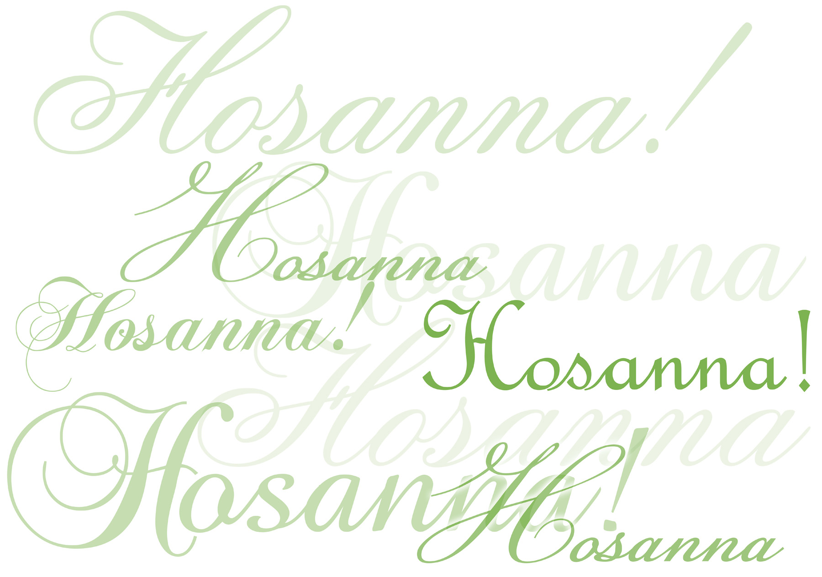
CHILDREN’S MESSAGE:

Slide 16
~ Children may go downstairs for Sunday School ~
GIVING OF OUR GIFTS & OFFERTORY:
Our God has blessed us, so let us extend God’s Blessing as we present our Tithes and Offerings.
Thank you for being faithful stewards of your church family with your prayers, your time, talent, and your financial resources.
Contributions may also be made:
Electronically on the church website at fpcb-nj.org;
By reoccurring electronic withdrawal; or by
By mailing your offering to the church: P.O. Box 385, Blairstown, NJ.

Slide 17
* DOXOLOGY: No. 592 Praise God
Praise God, from whom all blessings flow;
praise God all creatures here below;
Praise God above, ye heavenly host;
Praise Father, Son, and Holy Ghost. Amen.
* PRAYER OF DEDICATION

Slide 18
DECLARING GOD‘S WORD
GOSPEL LESSON: John 11: 1–27, 33–44
Jesus raises Lazarus from the dead.
11 Now a certain man was ill, Lazarus of Bethany, the village of Mary and her sister Martha. ² Mary was the one who anointed the Lord with perfume and wiped his feet with her hair; her brother Lazarus was ill. ³ So the sisters sent a message to Jesus, “Lord, he whom you love is ill.” ⁴ But when Jesus heard it, he said, “This illness does not . . .

Slide 19
lead to death; rather, it is for God’s glory, so that the Son of God may be glorified through it.” ⁵ Accordingly, though Jesus loved Martha and her sister and Lazarus, ⁶ after having heard that Lazarus was ill, he stayed two days longer in the place where he was.
⁷ Then after this he said to the disciples, “Let us go to Judea again.” ⁸ The disciples said to him, “Rabbi, the Jews were just now trying to stone you, and are you going there again?” ⁹ Jesus answered, . . .

Slide 20
“Are there not twelve hours of daylight? Those who walk during the day do not stumble because they see the light of this world. ¹⁰ But those who walk at night stumble because the light is not in them.” ¹¹ After saying this, he told them, “Our friend Lazarus has fallen asleep, but I am going there to awaken him.” ¹² The disciples said to him, “Lord, if he has fallen asleep, he will be all right.” ¹³ Jesus, however, had been speaking about his death, but they thought that he was referring merely . . .

Slide 21
to sleep. ¹⁴ Then Jesus told them plainly, “Lazarus is dead. ¹⁵ For your sake I am glad I was not there, so that you may believe. But let us go to him.” ¹⁶ Thomas, who was called the Twin, said to his fellow disciples, “Let us also go, that we may die with him.”
Jesus the Resurrection and the Life
¹⁷ When Jesus arrived, he found that Lazarus had already been in the tomb four days. ¹⁸ Now Bethany was near Jerusalem, some two miles away, . . .

Slide 22
¹⁹ and many of the Jews had come to Martha and Mary to console them about their brother. ²⁰ When Martha heard that Jesus was coming, she went and met him, while Mary stayed at home. ²¹ Martha said to Jesus, “Lord, if you had been here, my brother would not have died. ²² But even now I know that God will give you whatever you ask of him.” ²³ Jesus said to her, “Your brother will rise again.” ²⁴ Martha said to him, “I know that he will rise again in the resurrection on the last day.” ²⁵ Jesus said to her, . . .

Slide 23
“I am the resurrection and the life. Those who believe in me, even though they die, will live, ²⁶ and everyone who lives and believes in me will never die. Do you believe this?” ²⁷ She said to him, “Yes, Lord, I believe that you are the Messiah, the Son of God, the one coming into the world.”
³³ When Jesus saw her weeping and the Jews who came with her also weeping, he was greatly disturbed in spirit and deeply moved. ³⁴ He said, “Where have you laid him?” They said to him, . . .

Slide 24
“Lord, come and see.” ³⁵ Jesus began to weep. ³⁶ So the Jews said, “See how he loved him!” ³⁷ But some of them said, “Could not he who opened the eyes of the blind man have kept this man from dying?”
Jesus Raises Lazarus to Life
³⁸ Then Jesus, again greatly disturbed, came to the tomb. It was a cave, and a stone was lying against it. ³⁹ Jesus said, “Take away the stone.” Martha, the sister of the dead man, said to him, “Lord, already there is a stench because he has been dead . . .

Slide 25
four days.” ⁴⁰ Jesus said to her, “Did I not tell you that if you believed you would see the glory of God?” ⁴¹ So they took away the stone. And Jesus looked upward and said, “Father, I thank you for having heard me. ⁴² I knew that you always hear me, but I have said this for the sake of the crowd standing here, so that they may believe that you sent me.” ⁴³ When he had said this, he cried with a loud voice, “Lazarus, come out!” ⁴⁴ The dead man came out, his hands and feet bound with . . .

Slide 26
strips of cloth and his face wrapped in a cloth. Jesus said to them, “Unbind him, and let him go.”

Slide 27
GOSPEL LESSON: John 12: 12–19
The triumphant entry stirs the crowds and
causes the Pharisees to talk.
Jesus’s Triumphal Entry into Jerusalem
¹² The next day the great crowd that had come to the festival heard that Jesus was coming to Jerusalem. ¹³ So they took branches of palm trees and went out to meet him, shouting,
“Hosanna! Blessed is the one who comes in the name of the Lord— the King of Israel!” . . .

Slide 28
¹⁴ Jesus found a young donkey and sat on it, as it is written:
¹⁵ “Do not be afraid, daughter of Zion. Look, your king is coming, sitting on a donkey’s colt!”
¹⁶ His disciples did not understand these things at first, but when Jesus was glorified, then they remembered that these things had been written of him and had been done to him. . . .

Slide 29
¹⁷ So the crowd that had been with him when he called Lazarus out of the tomb and raised him from the dead continued to testify. ¹⁸ It was also because they heard that he had performed this sign that the crowd went to meet him. ¹⁹ The Pharisees then said to one another, “You see, you can do nothing. Look, the world has gone after him!”

Slide 30
ANTHEM with the Chancel Choir:
“Hail to the King Triumphant”
by Ruth Elaine Schram

Slide 31
MEDITATION:
with Pastor David Harvey
Jesus Encounters Humanity
Encountering Jesus Sermon Series:
Deepening Our Faith through the Lives of Those Who Encountered Jesus First

Slide 32
RESPONDING TO GOD’S WORD
* AFFIRMATION OF FAITH: Philippians 2: 4–11
Let each of you look not to your own interests, but to the interests of others. Let the same mind be in you that was in Christ Jesus, who, though he was in the form of God, did not regard equality with God as something to be exploited, but emptied himself, taking the form of a slave, . . .

Slide 33
being born in human likeness. And being found in human form, he humbled himself and became obedient to the point of death—even death on a cross.
Therefore, God also highly exalted him and gave him the name that is above every name, so that at the name of Jesus every knee should bend, in heaven and on earth and . . .

Slide 34
and under the earth, and every tongue should confess that Jesus Christ is Lord, to the glory of God the Father. Amen

Slide 35
* HYMN: No. 89 Hosanna, Loud Hosanna vv. 1 & 3
Hosanna, loud hosanna,
The little children sang;
Through pillared court and temple
The joyful anthem rang.
To Jesus, who had blessed them
Close folded to His breast,
The children sang their praises,
The simplest and the best.
Cont’d.

Slide 36
“Hosanna in the highest!”
That ancient song we sing,
For Christ is our Redeemer,
The Lord of heaven our King.
O may we ever praise Him
With heart and life and voice,
And in His blissful presence
Eternally rejoice.

Slide 37
PRAYER OF THANKSGIVING, OF THE PEOPLE, & THE LORD’S PRAYER
Our Father who art in heaven,
Hallowed be thy name.
Thy kingdom come, thy will be done;
On earth as it is in heaven.
Give us this day our daily bread;
And forgive us our debts,
As we forgive our debtors;
And lead us not into temptation,
But deliver us from evil,
For Thine is the kingdom
And the power and the glory, forever. Amen.

Slide 38
DEPARTING IN GOD’S NAME
* HYMN: No. 91 Ride On, Ride on in Majesty! vv. 1 & 4
Ride on! ride on in majesty!
Hark! all the tribes Hosanna cry;
O Savior meek, pursue Thy road
With palms and scattered garments strowed.
Cont’d.

Slide 39
Ride on! ride on, in majesty!
In lowly pomp ride on to die;
Bow Thy meek head to mortal pain,
Then take, O God, Thy power, and reign.

Slide 40
* CHARGE TO THE PEOPLE & BENEDICTION
* CHORAL BENEDICTION
POSTLUDE
Our worship has ended—our Christian Witness begins!

